Slide 1
Integrated Secure Software Engr. Approach for Functional, Collaborative, and Information Concerns
J. A. Pavlich-Mariscal, S. Berhe, A. De la Rosa Algarin, S. Demurjian
Computer Science & Engineering Department
The University of Connecticut
371 Fairfield Road, Box U-1155
Storrs, CT 06269-1155
steve@engr.uconn.edu
http://www.engr.uconn.edu/~steve
(860) 486 - 4818

Slide 2
Present an Integrated Approah
Merging and combining
  Functional Security (Jaime’s work)
  Collaborative Security (Solomon’s work)
  Information Security (Alberto’s work)
A secure software engineering approach that tackles the major concepts of an application
  Methods and Operations
  Collaboration and Adaptive Workflows
  Information and Resources used
Leveraging access control models across all three topics
  RBAC
  MAC
  DAC

Slide 3
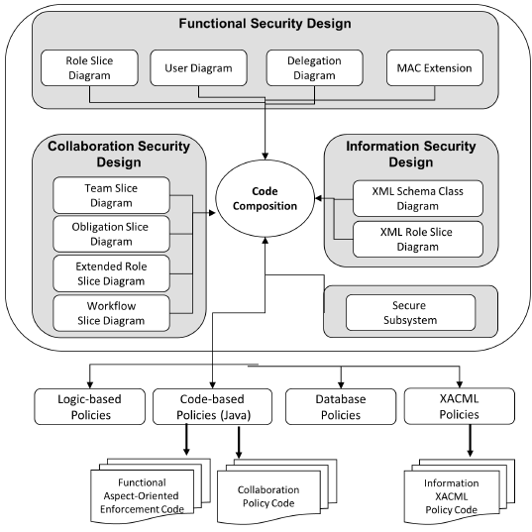
Overview of the Process

Slide 4
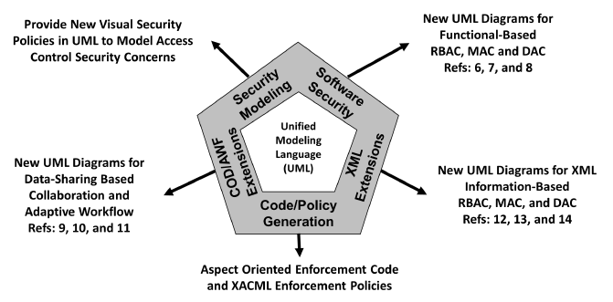
High Level View of the Process

Slide 5
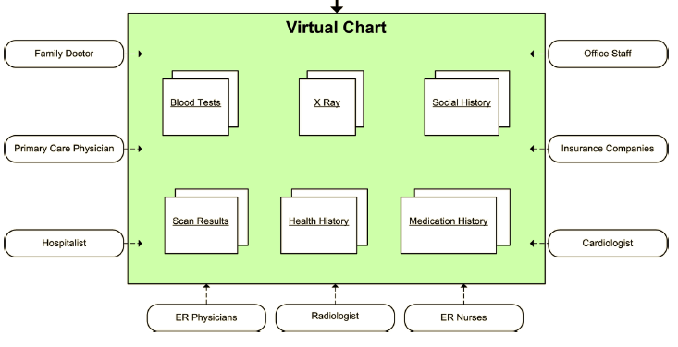
Recall Virtual Chart Example

Slide 6
VCA Use Case Diagram
6

Slide 7
Two Main Classes
7

Slide 8
Diagrams for Functional Security
Secure Subsystem
Role Slice Diagram
User Diagram
Delegation Diagram
MAC Extensions

Slide 9
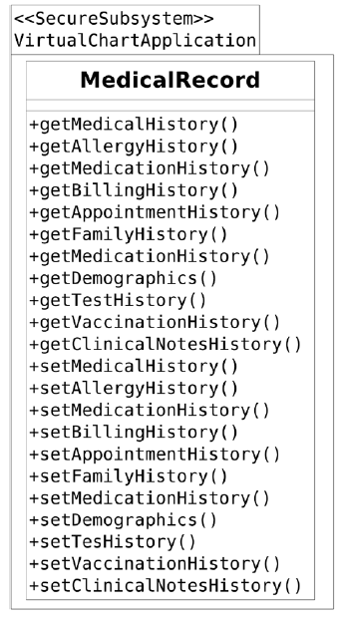
Secure Subsystem

Slide 10
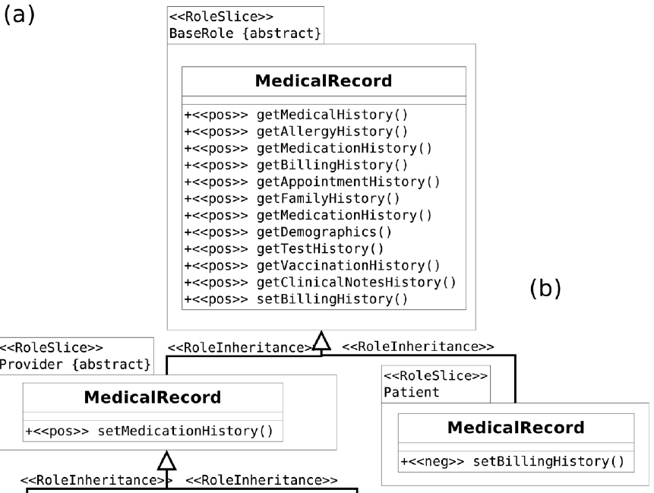
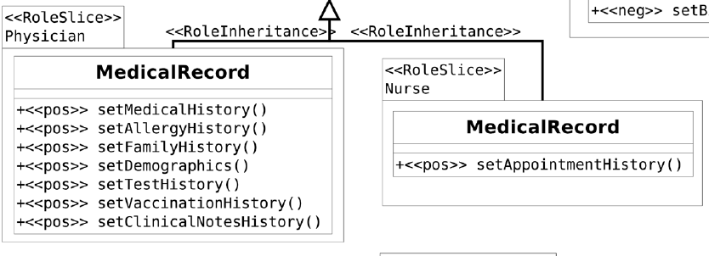
Role Slice Diagram

Slide 11
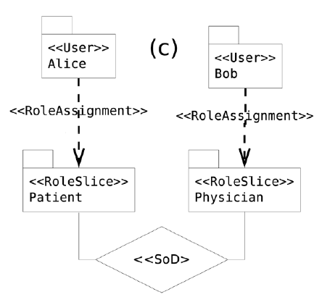
User Diagram

Slide 12
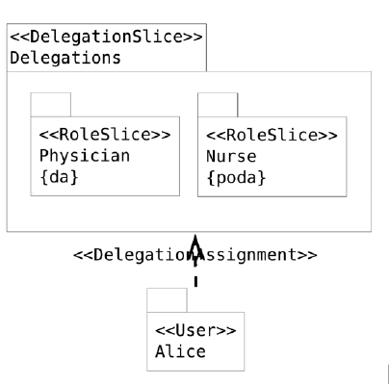
Delegation Diagram

Slide 13
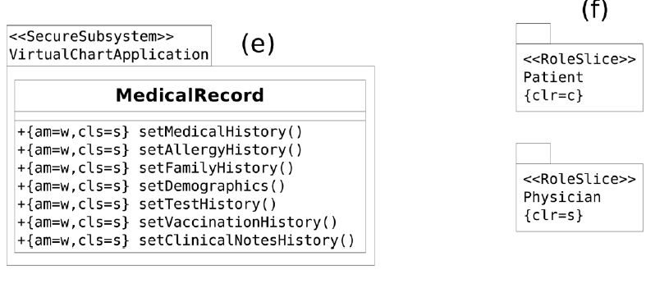
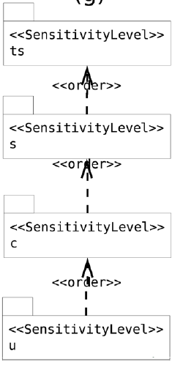
MAC Extensions

Slide 14
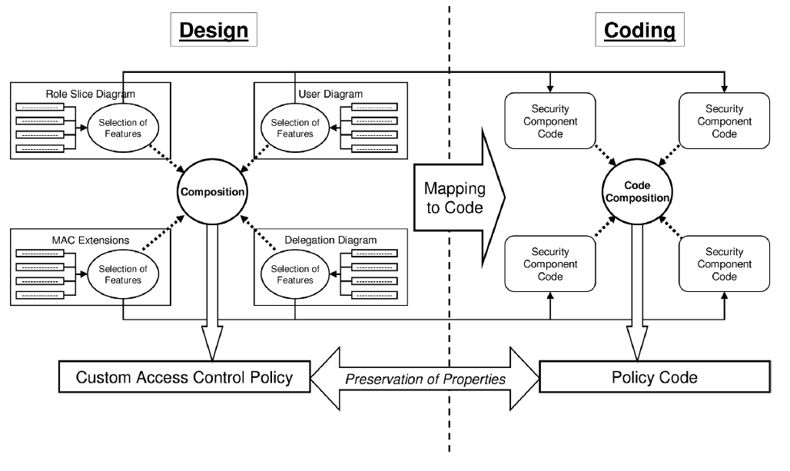
Enforcement Code Generation

Slide 15
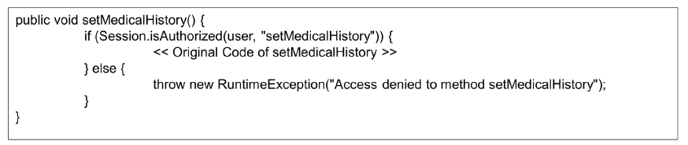
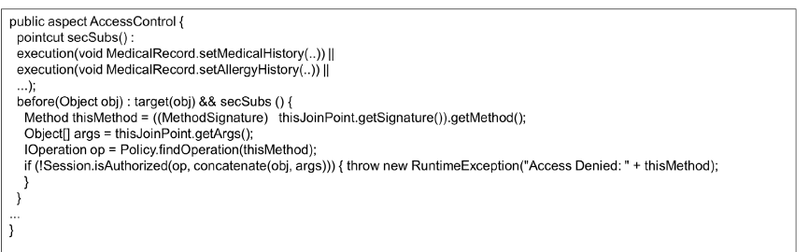
Functional Enforcement Code

Slide 16
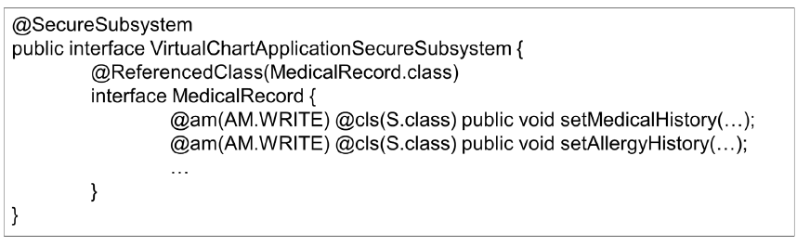
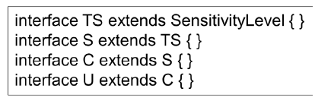
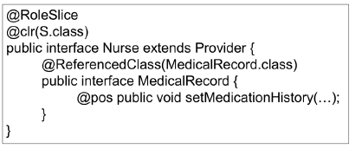
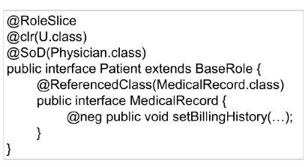
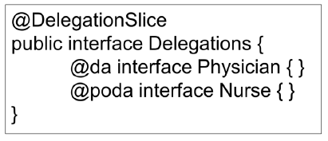
Functional Enforcement Code

Slide 17
Diagrams for Collaborative Security
Collaboration Workflow Slice Diagram
Extended Role Slice Diagram
Obligation Slice Diagram
Team Slice Diagram

Slide 18
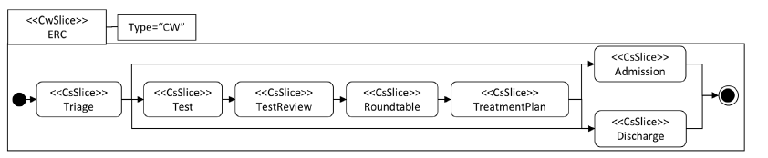
Collaboration Workflow Slice Diagram

Slide 19
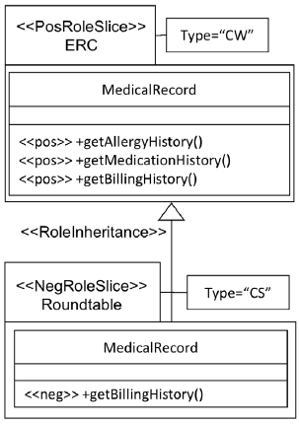
Extended Role Slice Diagram

Slide 20
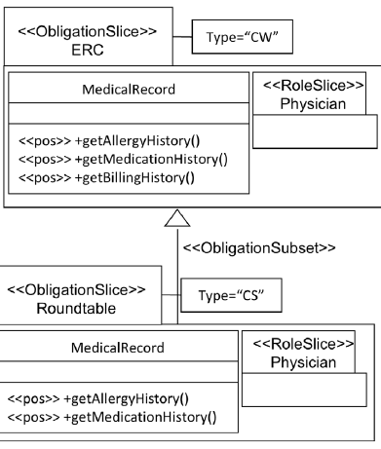
Obligation Slice Diagram

Slide 21
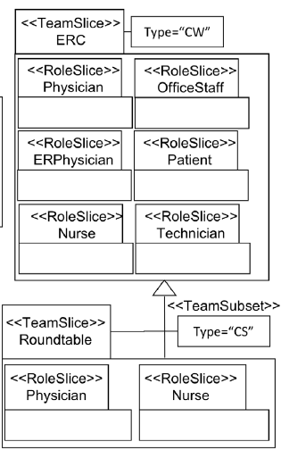
Team Slice Diagram

Slide 22
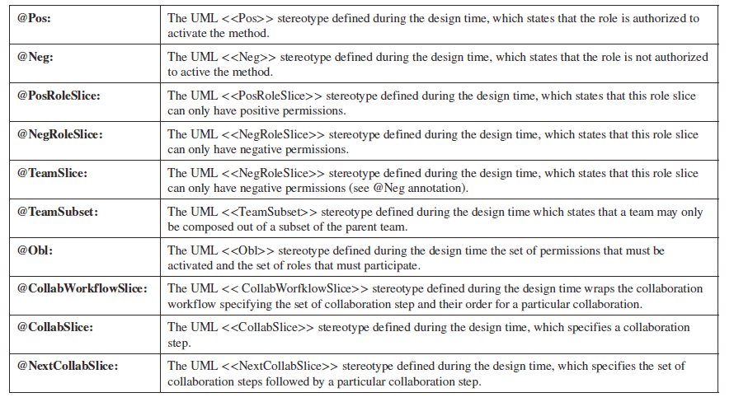
Collaborative Enforcement Generation

Slide 23
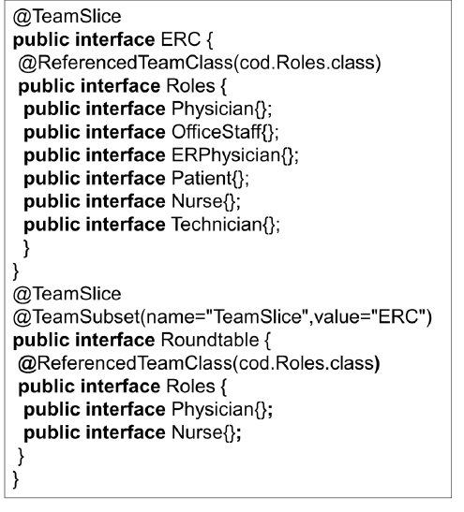
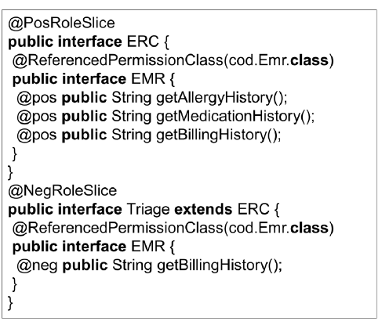
Collaborative Enforcement Code

Slide 24
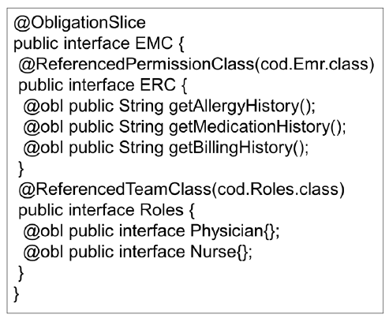
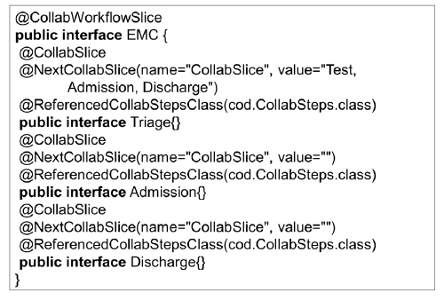
Collaborative Enforcement Code

Slide 25
Diagrams for Information Security
XML Schema Segment
XML Schema Class Diagram
XSRD Role Slice Diagram

Slide 26
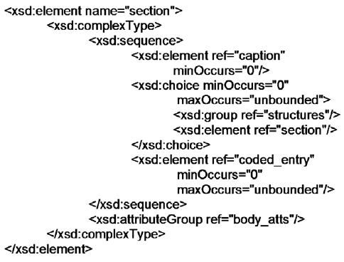
XML Schema Segment

Slide 27
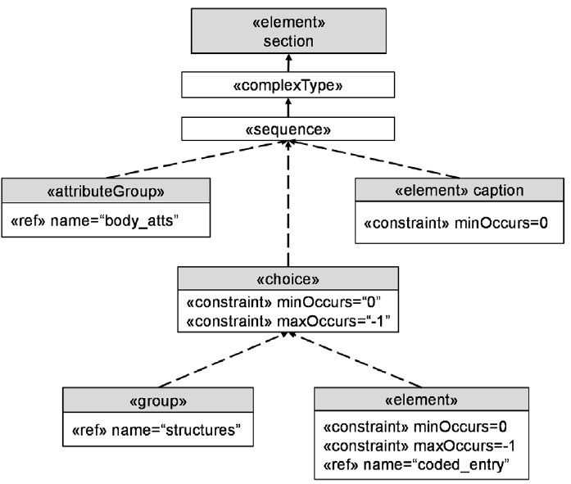
XML Schema Class Diagram

Slide 28
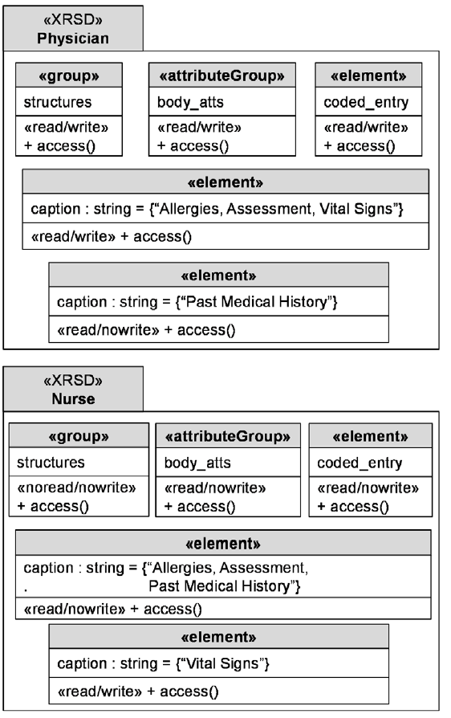
XSRD Role Slice Diagram

Slide 29
XSRD Role Slice Diagram

Slide 30
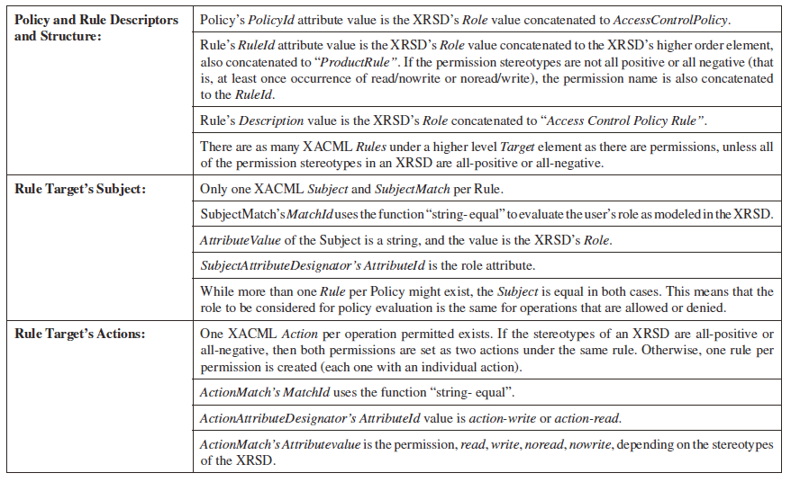
Information Enforcement Generation

Slide 31
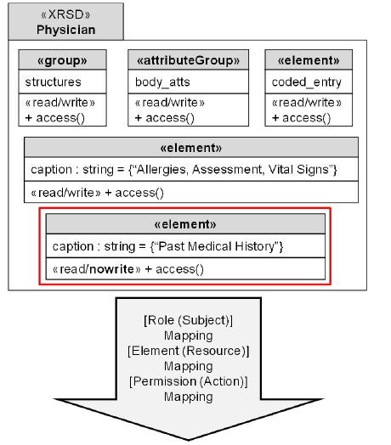
Mapping XRSD to XACML

Slide 32
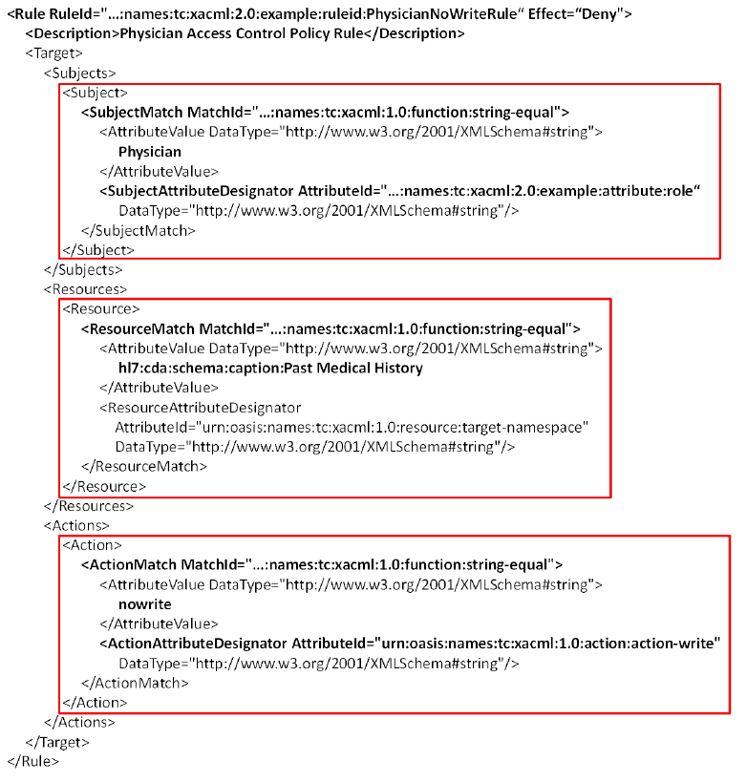
Three Segments of Code- Subject

Slide 33
Three Segments of Code - Resource

Slide 34
Three Segments of Code - Action

Slide 35
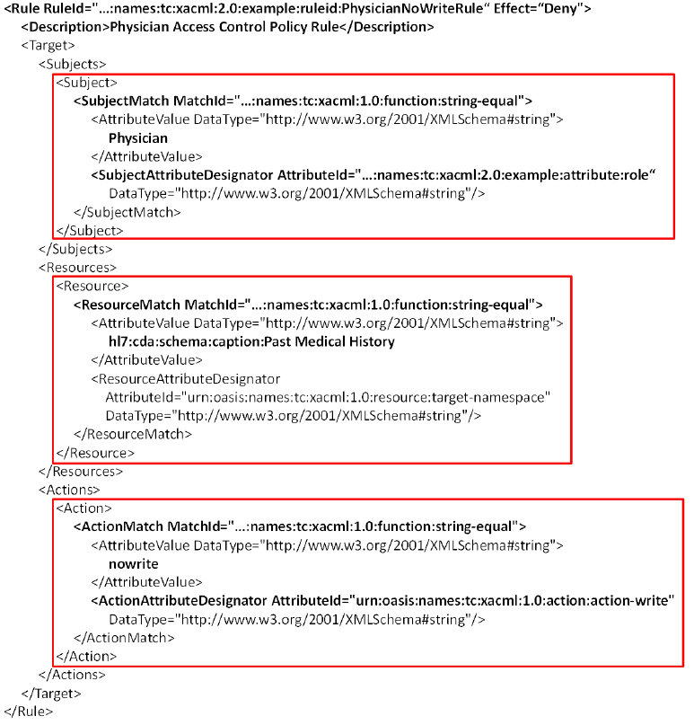
Combined Code

Slide 36
More Detailed View of Policy Generation
XML Schema Class Diagram: Artifact that holds all the characteristics of an XML schema
  Structure, Data Type, Value Constraints
Hierarchical nature of XML schemas is modeled
  xs:complexType, xs:element, xs:sequence
    UML Class with respective Stereotypes
  Child Relations (xs:element, xs:sequence, xs:simpleType)
    UML Subclass
  xs:extension
    Association between Classes
  Data-type Cardinality Requirements and Constraints; type
    «constraint»; «type» stereotypes

Slide 37
XSCD of CCR Segment
«complexType»
StructuredProductType
«extension»
CCRCodedDataObjectType
«element»
Product
«complexType»
«sequence»
«element» ProductName
«element» BrandName
«type» CodedDescriptionType
«type» CodedDescriptionType
«constraint» minOccurs=0
«element» Strength
«constraint» minOccurs=0
«constraint» maxOccurs=-1
XSCD

Slide 38
XML Role Slice Diagram
Represents Access Control Definitions
  With respect to XSCD Attributes
Fine Grained Control through
  Security Policies and Definitions to the XSCD
Permissions on XML Documents
  Read, Write, No Read, No Write
Represented in the XRSD with Stereotypes:
  «read/write»
  «read/nowrite»
  «noread/write»
  «noread/nowrite»

Slide 39
Example of XRSDs
«XRSD» Physician
«RoleDescription» «RoleRequirements»
«read/write» «element» Product
«read/write» «element» ProductName
«read/write» «element»
BrandName
«read/write» «element»
Strength
«read/write» «element»
StrengthSequencePosition
«read/write» «element»
VariableStrengthModifier
«XRSD» Nurse
«RoleDescription» «RoleRequirements»
«read/nowrite» «element» Product
«read/nowrite» «element»
ProductName
«read/nowrite» «element»
BrandName
«read/nowrite» «element»
Strength
«read/nowrite»
«element»
StrengthSequencePosition
«read/nowrite» «element»
VariableStrengthModifier

Slide 40
What is XACML?
Aims to Define a Common Language and Processing Model
  Permits a Level of Security Interoperability
XACML schema Provides Several Structures and Elements to Represent Policies
  PolicySet, Policy, Rule
PolicySets and Rules Combined by Policy/Rule Combination Algorithm
  Permit-overrides
  Deny-overrides
  First-applicable
  Only-one-applicable

Slide 41
XACML General Structure
PolicySet
Policy Combination Algorithm
Policy
Rule Combination Algorithm
Rule
Subject
Resource
Action

Slide 42
Mapping to a Security Policy (XACML)
Policies’ Language Structure and Processing Model
  PolicySet, Policy, Rule
Policy and Rule Combination Done with Normative Algorithms
  Deny-overrides, permit-overrides, first-applicable, only-one-applicable
Use Deny-overrides as Combination Algorithm for Enforcement
  If the Evaluation of One Rule Results in Deny, the Policy Evaluation is Deny
Mapping Process Divided in 3 Sub-Mappings
  Role, Element and Permission

Slide 43
Mapped Policy
Role Mapping
Permission Mapping

Slide 44
Mapped Policy
Element Mapping

Slide 45
Enforcement in a Security Architecture
The architecture has a number of components:
  Policy Enforcement Point (PEP)
    Allows a request to be made on a resource
  Policy Decision Point (PDP)
    Evaluates the request and provides a response according to the policies in place
  Policy Administration Point (PAP)
    Utilized to write and manage policies
  Policy Information Point (PIP)
    Arbitrate very fine grained security issues

Slide 46
Enforcement in a Security Architecture
XRSDs
Physician
Nurse
XACML Architecture
Policy Retrieval Point (PRP)
PEP
XACML Policy Mapping
XACML Policy – Schema 1
PAP
XACML Policy – Schema 2
PIP
PDP

Slide 47
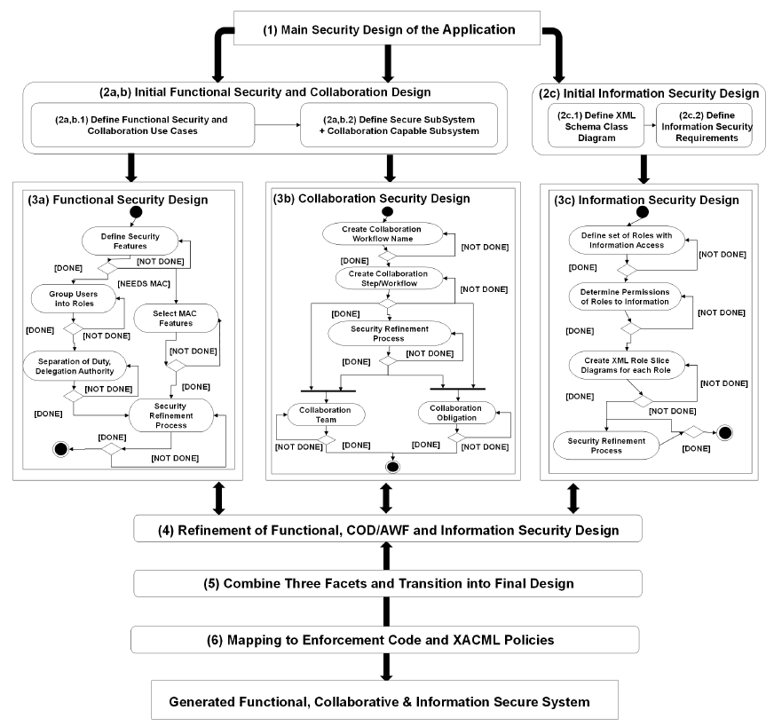
Overall Secure SWE Process

Slide 48
Overall View – Initial Design
Main Security Design of the Application
(2a,b) Initial Functional Security and Collaboration Design
(2c) Initial Information Security Design
(2a,b.1) Define Functional Security
and
Collaboration Use Cases
(2a,b.2) Define Secure
SubSystem
+
Collaboration Capable
Subsystem
(2c.1) Define XML Schema Class
Diagram
(2c.2) Define Information Security Requirements

Slide 49
Overall View – Functional Security
(3a) Functional Security Design
Define Security
Features
[DONE]
[NOT DONE]
[NEEDS MAC]
Group Users
into Roles
Select MAC
Features
[DONE]
[NOT DONE]
[NOT DONE]
Separation of Duty,
Delegation Authority
[NOT DONE]
[DONE]
Security
Refinement
Process
[DONE]
[DONE]
[NOT DONE]

Slide 50
Overall View – Collaborative Security
(3b) Collaboration Security Design
Create Collaboration
Workflow Name
[NOT DONE]
[DONE]
Create Collaboration
Step/Workflow
[NOT DONE]
[DONE]
Security Refinement
Process
[NOT DONE]
[DONE]
Collaboration
Team
Collaboration
Obligation
[NOT DONE]
[DONE]
[DONE]
[NOT DONE]

Slide 51
Overall View – Information Security
(3c) Information Security Design
Define set of Roles with
Information Access
[NOT DONE]
[DONE]
Determine Permissions
of Roles to Information
[NOT DONE]
[DONE]
Create XML Role Slice
Diagrams for each Role
[NOT DONE]
[DONE]
[NOT DONE]
Security Refinement
Process
[DONE]

Slide 52
Overall View – Refinement and Mappings
(4) Refinement of Functional, COD/AWF and Information Security Design
(5) Combine Three Facets and Transition into Final Design
(6) Mapping to Enforcement Code and XACML Policies
Generated Functional, Collaborative & Information Secure System

Slide 53
A Second Example – Crash Report System
Crash report system (CRS) big data application to collect information on accidents
Cars involved, people involved, location, specifics of actual accident, etc.)
Based on an actual crash report system in Connecticut that has data from over 20 years that has been a
  Joint effort by faculty in the Civil & Environmental Engineering and Computer Science & Engineering faculty
  Under the supervision of the State of Connecticut Department of Transportation.

Slide 54
A Second Example – Crash Report System
CRS serves as a means for researchers to collaboratively analyze the data for future crash prevention and other operational purposes.
The example presented excerpted from the Model Minimum Uniform Crash Criteria Guide (MMUCC)
  An XML standard for data to be collected on traffic crashes to be stored in CRS.
  http://mmucc.us/sites/default/files/MMUCC_4th_Ed.pdf
http://www.cti.uconn.edu/connecticut-transportation-safety-research-center/ and http://www.ctcrash.uconn.edu/

Slide 55
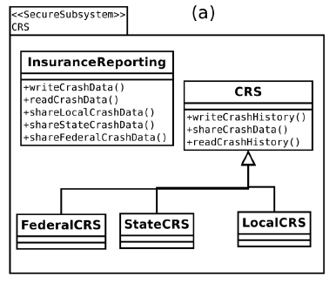
Secure Subsystem

Slide 56
CRS Roles
Passenger and Researcher
Police Office
  Local
  State
  Federal
Each Utilizes Different Portions of Secure Subsystem

Slide 57

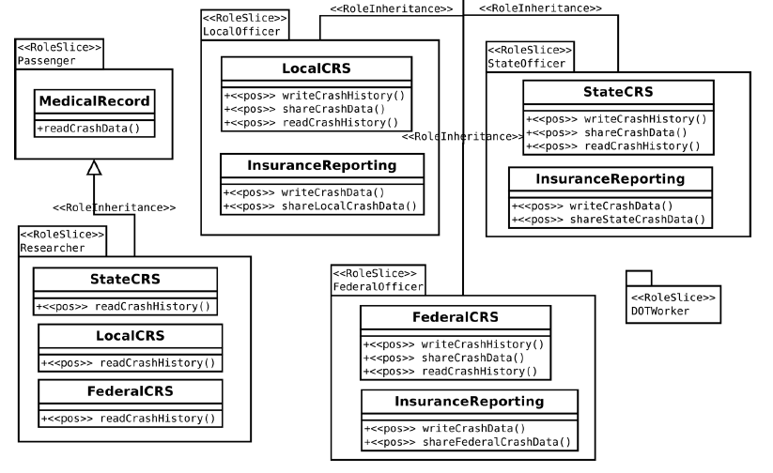
Role Slice Diagram

Slide 58
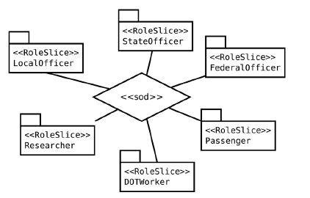
SoD Diagram

Slide 59
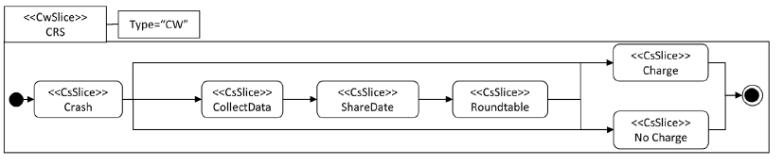
Collaboration Workflow Slice Diagram

Slide 60
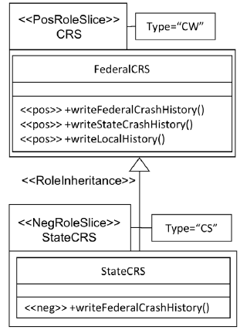
Extended Role Slice Diagram

Slide 61
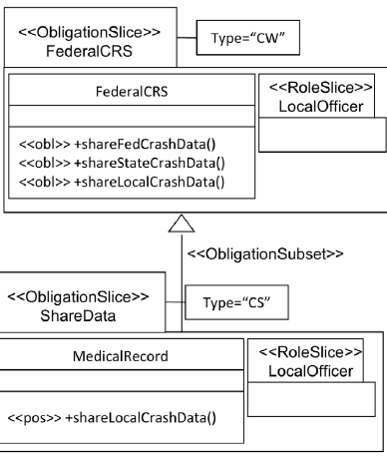
Obligation Slice Diagram

Slide 62
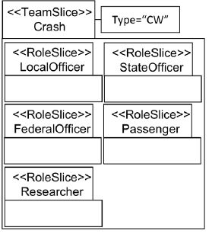
Team Slice Diagram

Slide 63
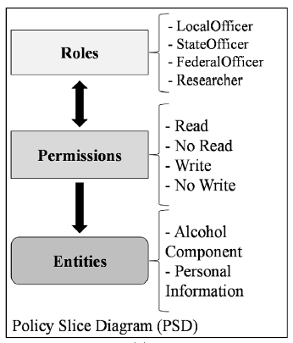
RBAC for CRS

Slide 64
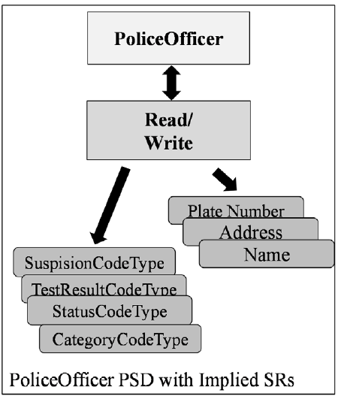
RBAC for CRS – Info Based

Slide 65
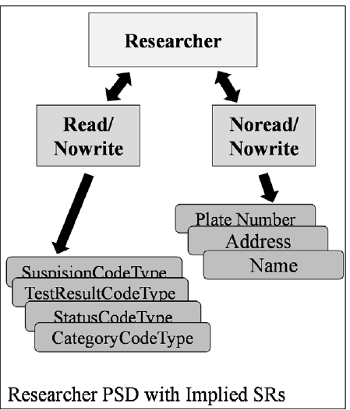
RBAC for CRS – Info Based

Slide 66
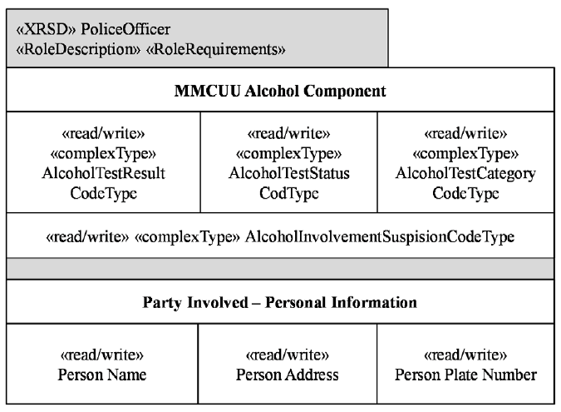
XML Role Slice Diagram – Info Based

Slide 67
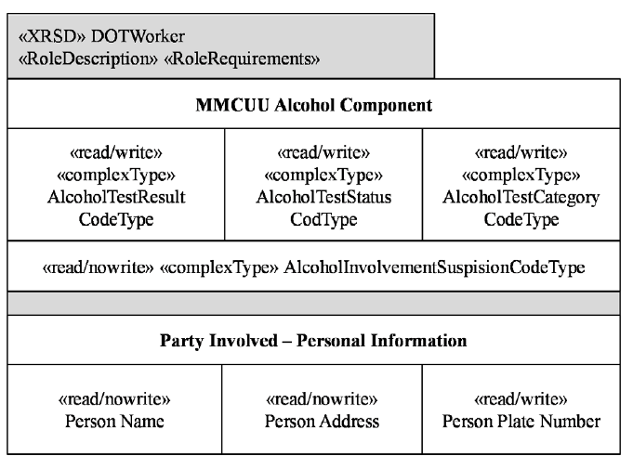
XML Role Slice Diagram

Slide 68
Concluding Remarks
Security is Part of an Overall Security Strategy
  Definition of Security Requirements
  Realization of Security at Application Level
  Integration of Security from User to OS to DB
  Rigorous Definition of Security Policy
  Dynamic Nature of Security Privileges
  Enforcement of Defined Privileges at Application and DB Levels
Overall, Security in Today’s World Integral Part of Everyday Life - Some Key Concerns
  Confidentiality of an Individuals Data
  Identity Theft
  Protecting National Infrastructure

Slide 69
Other areas of interest for info security
Modeling of other access control models
  Lattice Based Access Control (LBAC)
  Attribute Based Access Control (ABAC)
Collaboration and adaptive workflows from the perspective of information security
  Documents that are utilized by multiple roles/individuals at the same time
Hierarchically structured data with no validation agents
  Specialized XML
  JSON and JSON-LD
  RDF
  OWL

