Slide 1
A Viewpoint of Security for Digital Health Care in the United States: What’s There? What Works? What’s Needed?
Steven A. Demurjian¹, Alberto De la Rosa Algarín¹, Jinbo Bi¹, Solomon Berhe¹, Thomas Agresta², Xiaoyan Wang² and Michael Blechner²
¹Department of Computer Science and Engineering,
University of Connecticut, Storrs, CT, USA
{steve, ada, jinbo}@engr.uconn.edu, solomon.berhe@uconn.edu
²Department of Family Medicine and Pathology,
University of Connecticut Health Center, Farmington, CT, USA
agresta@nso1.uchc.edu, {xiaoywang, mblechner}@uchc.edu

Slide 2
Motivating the Topic
Consider the nearly 30yr history of healthcare security
Biskup, 1990 explored privacy and confidentiality
Medical information systems was explored
Advocated a role-based approach
Detailed the state-of-the-art in available systems
Ting, 1990 had a case study of mental health delivery
From information and semantic perspectives
Provide scenarios info usage by physicians, nurses, etc.
Promoted a role-based approach as appropriate solution
What what has stayed the same and what has changed over nearly last 30 in terms of
Tracking patient care (via paper or electronic form)
Achieving secure information exchange as a patient transitions between care settings
Biskup, J.: Protection of privacy and confidentiality in medical information systems: Problems and guidelines. North-Holland (1990)
Ting, TC: Application Information Security Semantics: A Case of Mental Health Delivery. DBSec 1989: 1-12

Slide 3
What has happened in regards to security?
In 1990, would anyone have predicted Health Insurance Portability and Accountability Act of 1996 (HIPAA) Privacy and Security Rules for protected health information?
http://www.hhs.gov/ocr/privacy/
At the time, health care delivery was based more on paper than electronic health records (EHRs)
Genetic Information Non-discrimination Act (GINA) of 2008
GINA aims to protect a patient's genetic information against discrimination in health insurance and employment.
http://www.genome.gov/24519851
Ethical, Legal and Social Implications (ELSI) research prog
ELSI was introduced to manage genomic data for personalized medicine
https://www.genome.gov/10001618/the-elsi-research-program/

Slide 4
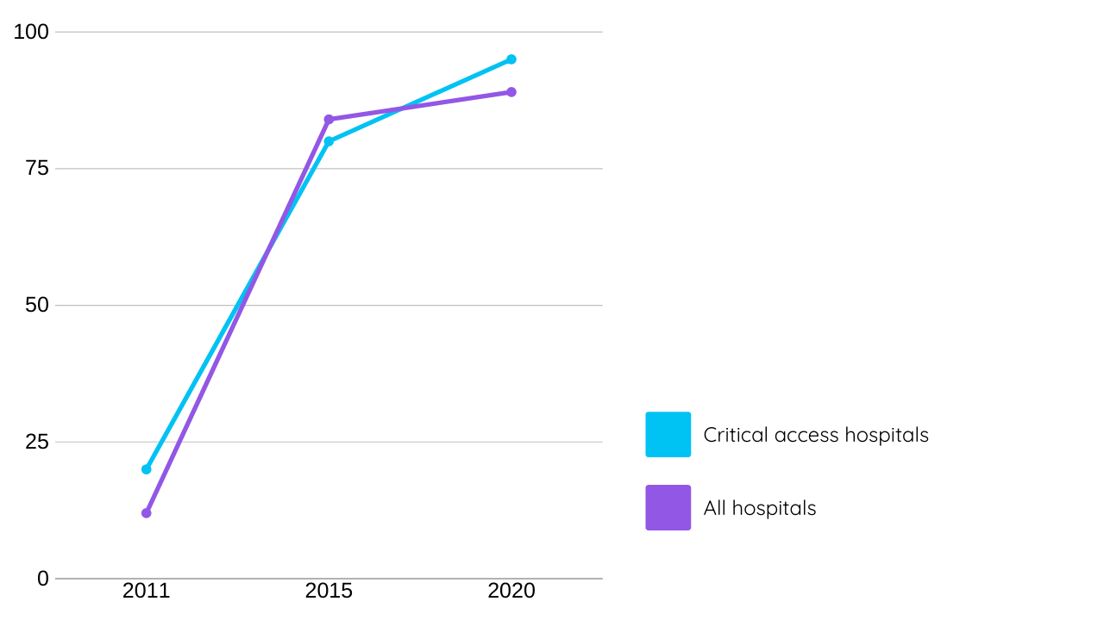
How has patient care dramatically changed?
EHRs in 2011 “just 27% of physicians used EHRs with multi-functional capabilities”
March 2017, 67% of all providers reported using an EHR, a 1% increase over September 2016
96% of non-federal acute care hospitals have possession of an EHR certified by HHS. This percentage has held through 2017.

Slide 5
How has patient care dramatically changed?
PHRs widely available to store health information
Emerging Patient Centered Medical Home where one provider coordinates care for patients with chronic diseases;
Accountable care organization (ACOs) to coordinate providers regarding Medicare patients with chronic conditions
Meaningful Use Stage 2 capability for EHRs for patients to be able to view, download, and transmit their records
Requires standardized transmission of medical information
These and other evolving initiatives will require secure data collection from multiple HIT systems.

Slide 6
The Harsh Realities
Limited capabilities of health information exchange (HIE) among all of these various data sources
Security an afterthough
Supported for individual systems for specific providers,
Overlooked when one attempts to bring together patient data from multiple electronic sources
Patient centered medical home caring for a diabetes patient with high blood pressure involves:
Family practitioner (who sees the patient regularly)
Endocrinologist (if diabetes is complex in its manifestation)
Cardiologist (diabetes patients often have heart disease)
Nutritionist (for managing diet or dealing with obesity)
4 providers have different EHRs (or none) and inability to share data (patient history, lab test results, etc) for required care

Slide 7
The Harsh Realities
Access needs to be integrated (electronic sources), secure (individual sources and across the integrated sources), and collaborative (simultaneously view/update same patient record)
Two main objectives
Enumerate prevalent issues for secure, integrated, and collaborative health care in the United States,
Provide a roadmap for secure digital health care in the not so distant future
Viewpoint is intended to answer questions such as:
What patient information is available for each source ?
How can information be standardized for u/e/exchange?
How is the local security for that source managed?
What needs to be protected from each source?
Is there a global security policy across the integrated sources?

Slide 8
Overview of the remainder of the talk
Review United States laws, standards, and emerging models of care for clinical, genomic, phenotypic info
Define a scenario from 2012 of navigating healthcare
HIT in use at some level by most providers
paper-based records exchanged via snail mail/fax
Present a proposed security framework
Propose a core set of recommendations
Organized by area that
Represents our viewpoint of what must be supported for security for digital health care
Consider impact of 4 years since initial publication

Slide 9
What are the Security needs?
Security for digital health care needs security guidelines for usage, transmission, and sharing of protected health info
Protect personally identifiable information, including names, addresses, accounts, credit card numbers, etc.
Encrypt protected health information and personally identifiable information data and its secure transmission
Extensive usage of standards for storage and exchange (Health Level Seven & FHIR)
Leveraging a wide range of health care standards (e.g., LOINC, SNOMED, UMLS)
Dealing with data interoperability issues for health information technology systems that use a wide range of data formats (e.g., XML, RDF, JSON, FHIR etc.)

Slide 10
Wide Range of Stakeholders
Security for digital health care transcends must strongly consider the usability of the information by stakeholders
EHRs (e.g., Allscripts, GE Centricity, Epic, etc.) in provider offices, clinics, and hospitals.
Personal health records
Patient portals (often part of EHRs) to electronically request appointments, prescription refill requests, etc.
Personalized medicine health portals (Genomas) for providers to view their own patients' genetic data against EHR
Ancillary systems for laboratory results (e.g. blood work), evaluating X-rays, MRIs, CT Scans, etc. to be electronically delivered to provider
A clinical research data warehouse
De-identified clinical data from medical records
Patients give permission for medical research
Support public health researchers to do population studies.

Slide 11
Support Patient and Research Initiatives
Patient Centered Medical Homes
Manage chronic conditions and optimize care by interacting stakeholders
Family practitioner, endocrinologist, cardiologist, and nutritionist
Need for the lead provider to access information in other EHRs, PHRs, etc.
Accountable Care Organizations
Brings together groups of providers, clinics, hospitals, and private insurers
Coordinated care effort for Medicare patients
Attempt to reduce or eliminate duplicate test and procedures for patients that visit multiple providers and have a chronic condition

Slide 12
Support Patient and Research Initiatives
Secondary use of clinical data
Allows providers/researchers to analyze specific diseases/yreatments across a large patient base
Uses a clinical research data warehouse,
Seek events such as adverse drug reactions, infection monitoring, or disease monitoring in a population
The flu epidemic in the United States in 2013
Meaningful use is the adoption and use of HIT within organizations
May lead to improvements in the reporting of care
Offers providers incentives to acquire/deploy technology
Personalized medicine
Targets treatment of an individual based on their unique medical profiles
Include specific types of diseases and focus on the use of a patient's genomic information

Slide 13
Facilitate Health Information Exchange
Insure correct data is available at the appropriate time in a usable fashion by a specific stakeholder.
What is shared in HIE determined by the institute that owns the data?
Data to be shared is off-loaded into another server so that there is no impact on the real-time usage of an EHR to treat patients
HIE can be used to construct a clinical research data warehouse via an electronic extract, transform, and load (ETL) process from an EHR database
HIE can be utilized to support secondary use, accountable care organizations, and meaningful use

Slide 14
Scenario of Health Information Usage
A realistic case study of one co-author navigating through a complex Healthcare process
Ten different steps over a six-month period
Involving following providers at different locations that provided care
Two different hospitals: Rockville to St Francis
Rehabilition facility
Two orthopedic surgeon offices Hartford and Mansfield
One rheumatologist office in Manchester
One internist office in South Windsor
Visiting nurse and physical therapist at home

Slide 15
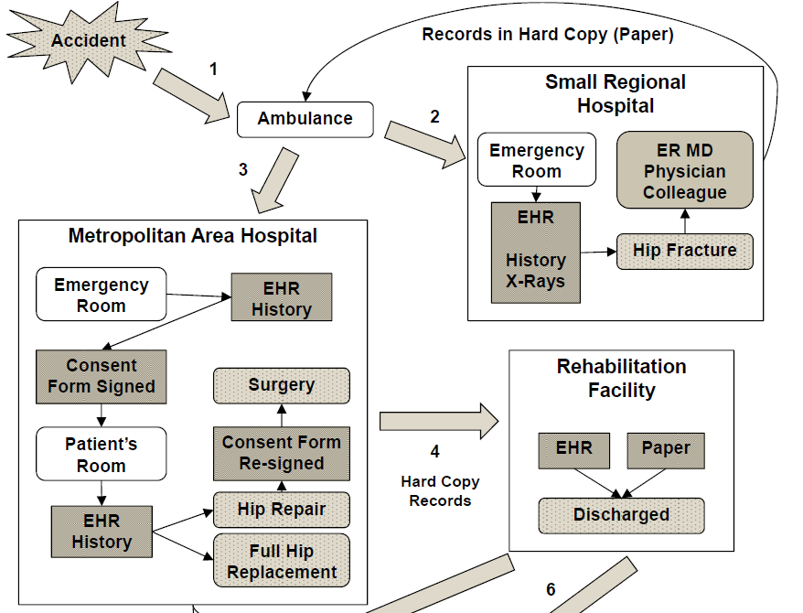
Overall Process

Slide 16
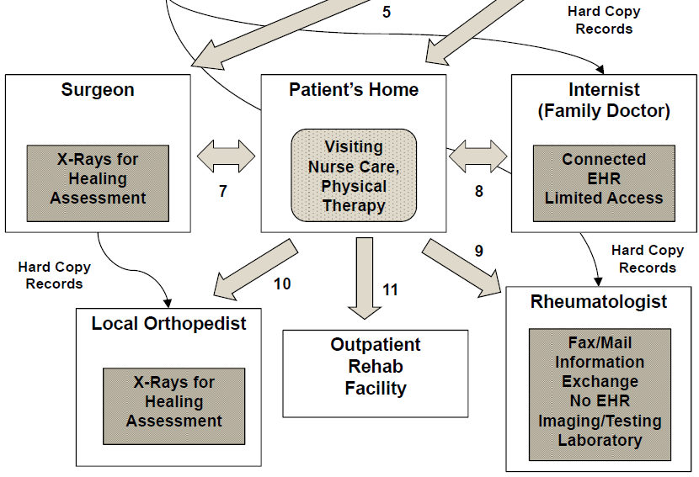
Overall Process

Slide 17
Steps 1, 2, and 3
50ish man falls while working in the yard and breaks his hip
Ambulance (Step 1) takes him to ER of regional hosp (Step2)
History is taken using an HER at the hospital,
X-rays are ordered, and a hip fracture is found.
Speaks with ER physician and physician colleague, patient decides to
Transfer by ambulance (Step 3) to a metropolitan hospital
Records sent in hard copy.
Upon arriving at ER, another patient history for new HER
Same story is told to the ER physician, orthopedic resident, etc
2AM consent form signed for a partial or full replacement
7AM the transport team takes him OR
Orthopedic surgeon can repair the hip with a plate and screws
Patient, consults with physician colleague, re-initial hardcopy consent

Slide 18
Steps 1, 2, and 3
Accident
1
Records in Hard Copy (Paper)
Ambulance
2
3
Metropolitan Area Hospital
Emergency Room
EHR
History
Small Regional
Hospital
Consent Form Signed
Emergency Room
ER MD
Physician Colleague
Surgery
EHR
History
X-Rays
Patient’s Room
Consent Form Re-signed
Hip Fracture
Hip Repair
EHR
History
Full Hip Replacement

Slide 19
Steps 4, 5, and 6
Surgery is successful, and three more days in the hospital
Patient is discharged to a rehab facility (Step 4)
Hard copy of his records
The rehab center is mostly paper-based;
Have an electronic system,
Medication list is hard copy, nurse dispenses meds
After 5 weeks, patient discharged (Step 6) to home with
Visiting Nurse Association assigned to monitor care
Provides a nurse and in home physically therapy
Patient visits the surgeon (Step 5) for X-rays to assess healing

Slide 20
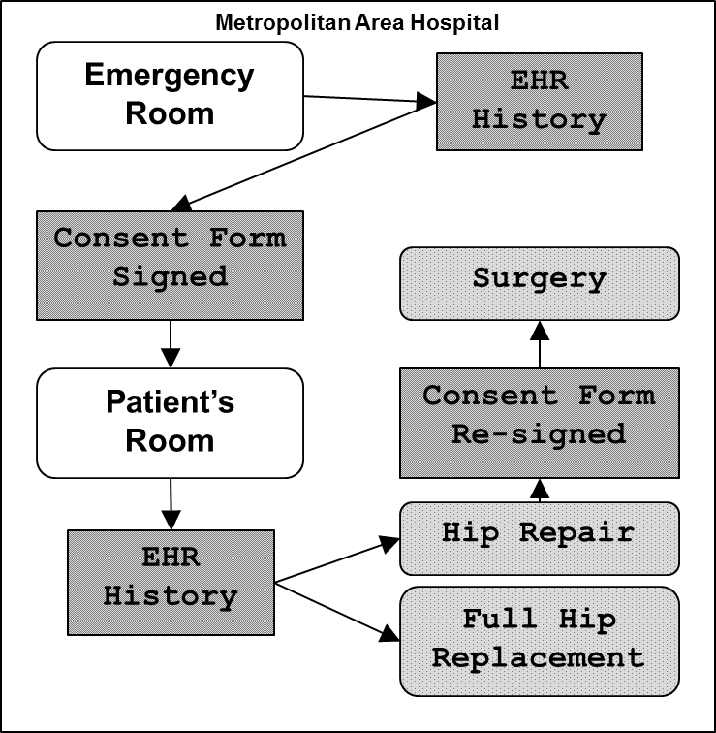
Steps 4, 5, and 6
Rehabilitation
Facility
4
EHR
Paper
Hard Copy Records
Discharged
6
5
6
Surgeon
Patient’s Home
Visiting Nurse Care,
Physical Therapy
X-Rays for Healing Assessment

Slide 21
Steps 7, 8, 9, and 10
Patient meets with his internist (Step 8) for follow up care
Internist has HER, can download tests from external lab
Hospital records faxed and scanned and put into the EHR as images
Ten weeks after the fracture,
Patient is given his release from the orthopedic surgeon (Step 7) with weight bearing
Care to be managed by a local orthopedist (Step 10)
Patient requests medical records for the local orthopedist
2 weeks later at the appointment, no records have arrived
New and old X-rays can't be compared
Due to the unusualness of a hip fracture of a 54 year old
Patient is referred to a rheumatologist (Step 9)
Hard copy of some of his medical records to appt
Blood work and a bone scan that determines call osteopenia a precursor of osteoporosis

Slide 22
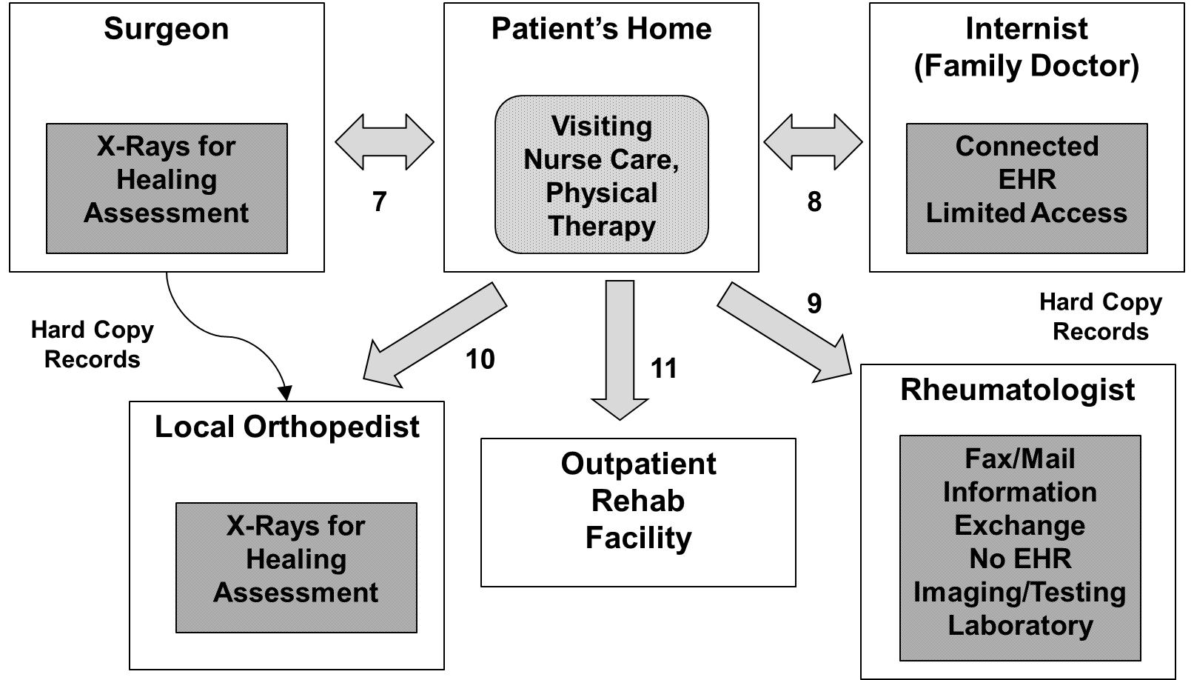
Steps 7, 8, 9, and 10

Slide 23
MS
Health Vault
C# Data
Harvard
SMART
EHR
JSON-LD
ASP.NET API
LDAM
RxTerms
XML
Schema
LOINC
XML
Schema
XML-C
XML-C
MeSH
XML DTD
REST API
LDAM
SNOMED
XML
Schema
Open mHealth
Secure
XML
JSON
Secure
XML
EPIC LUCY
Real Time
Hosp. Sys.
CCD
XML-C
Standards
LDAM
Secure
XML
UMLS
XML DTD
LDAM
EPIC LUCY
HIE Server
Global
Security
Policy and
Control
USES
USES
CCD
Secure
CCD
Share
Health
Information
Exchange
RxNorm
XML
Schema
LDAM
OpenEMR
HIE Server
Secure
XML
Share
XML
OpenEMR
Real-Time
Hosp Sys.
XML
JAVA APIs
LDAM
Secure
CDA
Secure
XML
Java APIs
LDAM
PHA
Patient App
Mobile
PatientOS
HIE Server
HL7 CDA
Secure
XML
Global Data
Analytics,
Mining and
Clinical Decision
Support
LDAM
Share
Java APIs
LDAM
Secure
CDA
Secure
CCR
Secure
XML
PHA
Provider Mobile App
PatientOS
Real-Time
Hosp Sys.
HL7 CDA
FreeMED
HIE Server
HL7 CDA
GE Centricity HIE Server
CCR
SMARTSync App
LDAM
Java APIs
LDAM
PHP APIs
LDAM
WSDL
LDAM
Share
GE Centricity
Real-Time
Hosp Sys.
XML
LDAM
FreeMED
Real-Time
Hosp Sys.
XML
Share
Java APIs
LDAM
Java APIs
LDAM
Secure PHI
PHI
Local Security
Policy/Control
XML
Converter
LDAM
Local Data Analytics,
Mining, or Decision Support

Slide 24
Proposed Architecture/Three Viewpoints
First Viewpoint: Reconciliation of security (local and global)
Insure required clinical data reaches providers involved in
Patient centered medical homes and personalized medicine
Second Viewpoint: Availability of de-identified patient data
Privacy-preserving data publishing and sharing
Support accountable care organizations, secondary use, meaningful use, and clinical decision
Third Viewpoint facilitates first two viewpoints via use of:
XML and associated standards HL7, FHIR, etc. for patient and clinical data
Ontologies augment this data with relevant tags that add meaning (SNOMED, LOINC, NDF-RT, etc.)

Slide 25
First viewpoint

Slide 26
Second viewpoint

Slide 27
Second viewpoint

Slide 28
Second viewpoint

Slide 29
Third viewpoint

Slide 30
Recommendations For Security Digital Healthcare
Meta Standard for Health Care:
Achieving HIE among the myriad variety of HIT
Dramatically hindered by a lack of agreement on one standard
Companies that are focused on vendor specific approaches and proprietary formats that limit the ability to share data.
HIT vendor community must adopt practices in their development and deployment technologies
What has arrived since paper first published in 2014?

Slide 31
What can change on this figure?

Slide 32
Recommendations For Security Digital Healthcare
Encryption:
Need encryption frameworkcapable of integrating heterogeneous local solutions
Handles new types of data unique to health care (genomic, phenotypic)
Leverage., HTTPS, SSL, etc.)
Cann each patient have their own and their own public-private key to control it?
Certificates: X.509
Extended via certificate attributes
User acquires multiple X.509 certificates one per HIT
Captures activity being authorized to utilize different systems
Can a medical provider build a series of certificates that provide a level of capability and trust to requesting access to systems which aren’t authorized?

Slide 33
Where would encryption and certificates go?

Slide 34
Recommendations For Security Digital Healthcare
Access Control:
Can role-based access control RBAC used as a cornerstone, with extensions for patient, healthcare facility, task, temporal information, and other stakeholders?
Can one extract local security policies and integrate them into a global one that is enforceable across the health care enterprise?
Can delegation of authority to facilitate access in an health information exchange setting where a provider often passes on his/her permissions (e.g., patients) to other providers?
Can secure health information exchange across a wide range of data (e.g., clinical, genomic, and phenotypic) that co-considers HIPAA, GINA, and ELSI?

Slide 35
What levels can access control be included?

Slide 36
Recommendations For Security Digital Healthcare
Cloud Computing:
Emergence of mobile computing, leveraging cloud computing
Benefit of moving towards cloud-based solutions includes the
Decreased operational cost of maintaining systems
Previously done by private practices or clinics
21% growth of the market, and estimated $5.4 billion investment by the year 2017
Computational benefits of cloud computing in health care are:
Continuous patient data monitoring, smart emergency management, always-connected mobile devices, pervasive access to patient data (new or old), etc.
Security must be attained at end-user, processing, and storage layers of an application
What are the security concerns that cloud computing can provide to health care via availability, confidentiality, data integrity, control and audit?

Slide 37
Where can cloud computing be leveraged?

Slide 38
What’s the one thing missing?

Slide 39
MS
Health Vault
C# Data
Harvard
SMART
EHR
JSON-LD
ASP.NET API
LDAM
RxTerms
XML
Schema
LOINC
XML
Schema
XML-C
XML-C
MeSH
XML DTD
REST API
LDAM
SNOMED
XML
Schema
Open mHealth
Fhir
JSON
FHIR
EPIC LUCY
Real Time
Hosp. Sys.
CCD
XML-C
Standards
LDAM
FHIR
UMLS
XML DTD
LDAM
EPIC LUCY
HIE Server
Global
Security
Policy and
Control
USES
USES
CCD
FHIR
Share
CONNIE
RxNorm
XML
Schema
LDAM
OpenEMR
HIE Server
FHIR
Share
XML
OpenEMR
Real-Time
Hosp Sys.
XML
JAVA APIs
LDAM
FHIR
FHIR
Java APIs
LDAM
PHA
Patient App
Mobile
PatientOS
HIE Server
HL7 CDA
FHIR
Global Data
Analytics,
Mining and
Clinical Decision
Support
LDAM
Share
Java APIs
LDAM
FHIR
FHIR
FHIR
PHA
Provider Mobile App
PatientOS
Real-Time
Hosp Sys.
HL7 CDA
FreeMED
HIE Server
HL7 CDA
GE Centricity HIE Server
CCR
SMARTSync App
LDAM
Java APIs
LDAM
PHP APIs
LDAM
WSDL
LDAM
Share
GE Centricity
Real-Time
Hosp Sys.
XML
LDAM
FreeMED
Real-Time
Hosp Sys.
XML
Share
Java APIs
LDAM
Java APIs
LDAM
Secure PHI
PHI
Local Security
Policy/Control
XML
Converter
LDAM
Local Data Analytics,
Mining, or Decision Support

Slide 41
What are our specific areas of Interest?
Secure Information Engineering of XML
Secure Collaboration wher Documentss utilized by multiple roles/individuals at the same time
Achieving RBAC, MAC, and DAC for Mobile Application at Different levels
Incorporating RBAC, MAC, and DAC into Cloud Computing at the service level
Utilizing a Trust Profile and Trust Negotiation Process Facilitate Dynamic HIT Interactions
Software Architectures that Facilitate Health Information Integration and Exchange
Leveraging Lattice Based Access Control for Secure Health Information Exchange under HIE

Slide 42
Secure Information Engineering of XML
Given an XML Application of Schemas/Associated Instances:
Clearances, Roles, Users, User-Role Authorizations, Delegation
Capture RBAC, MAC, and DAC
As XML Instances are Dynamically Identified to Suit a User’s Needs for an Application, can we:
Retrieve/Filter XML Instance(s) Based on Role, MAC, Delegation
XML Document Customized Based on Role, MAC, Time, Value
Deliver Filtered Instances(s) to User
Generate XACML Security Policy
Alberto De La Rosa Algarin, PhD, 2014

Slide 43
Secure Information Engineering of XML

Slide 44
Secure Collaboration
Collaboration Increasing in Health Care
Patient Centered Medical Homes for Coordinated Care
Personalized Medicine using Genomic Results
Extended NIST RBAC with Collaboration Primitives
Extended UML with New Collaboration Security Diagrams
Automatically Generated Security Policy Enforcement Code
Demonstrated complex scenarios of multiple providers collaborating in real time to care for a patient
Solomon Berhe, PhD, 2012

Slide 45
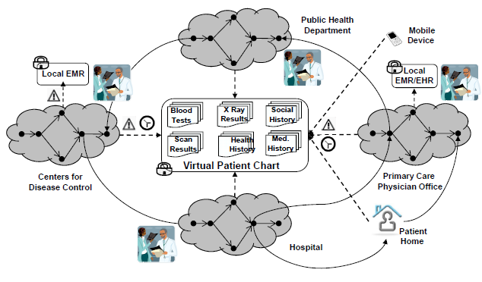
Secure Collaboration

Slide 46
A Configurable Framework for RBAC, MAC, and DAC for Mobile Application
How Do Mobile Apps Access, Share, Exchange Data?
Multiple Sources: Concussion Tracker app, Usage of FHIR
Customize UI with RBAC so that different screens and contents of different screens visible by role
Control the allowable services that can be invoked by RBAC, MAC, and DAC permissions
Intercept service calls at different locations
From the mobile app to its API
On the server side of the Data Repository
Modified the Interceptors of HAPI FHIR
Yaira Rivera Sanchez: yaira.rivera@uconn.edu
PhD August 2017

Slide 47
Framework for Secure/Interoperable Cloud Computing with RBAC, MAC, and DAC for Unified Cloud Services
Mobile Apps require access to Heterogeneous APIs
Provide a Unified and Secure Global View Via FHIR
How to reintegrate applications that need access to multiple and heterogeneous cloud service providers?
How do we provide the ability for a mobile app to easily use services regardless of where they are and how they are configured?
Can we leverage FHIR?
Can we Define global security policies?
Can we intercept every cloud service call to determine if RBAC, MAC, and DAC Permissions are met?
M. Bahain: mohammed.baihan@uconn.edu
PhD August 2018

Slide 48
Architectures for Sharing, Integration, Exchange
Hybrid Extensible Solution
What are all the different systems and how can they be interconnected?
Can we Leverage Publish-Subscribe, SOA, Grid, Cloud, Warehouse?
What role can FHIR play?
Can the resources of FHIR be Extrapolated to a Software Design Pattern Level?
Can we generalize the way to integrate EHRs, Pharmacy systems Etc?
Timo Ziminski: timoteus.ziminski@uconn.edu
Part time PhD Ongoing

Slide 49
Integrating Trust Profiles, Trust Negotiation, and Attribute Based Access Control
Credentials Build a trusted Profile of Usage
Trusted Profile Presents Strong Evidence of Historical access to Sensitive Data
Provider builds a profile over time whenever an HIT system accessed
Presents Credentials in Emergency to an HIT system that was never authorizeD
Dynamically Check and Grant Access
Work being integrated into a mobile Healthcare application
Eugene Sanzi: eugene.sanzi@uconn.edu
PhD Ongoing – Expected August 2019

Slide 50
Our Planned Architecture
OpenEMR
API
Environment Conditions
Access Control Rules
Requestor
OpenEMR Server
Trust Profile
Trust Negotiation
Policy
Controller
MyGoogle Server
Policy
MyGoogle
API
Resource Object Attributes
Release Actions

Slide 51
Our Planned Architecture
OpenEMR
HAPI FHIR
CT²
HAPI FHIR
CT²
API
OpenEMR
API
Global HAPI FHIR API
MyGoogle
API
SMH
API
MyGoogle
HAPI FHIR
SMH
HAPI FHIR

Slide 52
Our Planned Architecture
CT²
API
CT²
Mobile App
Intercepting API Calls
Local Security Policies
Server Interceptor
SMH
API
SMH Mobile App
Direct UI Modifications

Slide 53
What we've accomplished to date…
Secure Information Engineering of XML
Secure Collaboration wher Documentss utilized by multiple roles/individuals at the same time
Achieving RBAC, MAC, and DAC for Mobile Application at Different levels
Incorporating RBAC, MAC, and DAC into Cloud Computing at the service level
Utilizing a Trust Profile and Trust Negotiation Process Facilitate Dynamic HIT Interactions
Software Architectures that Facilitate Health Information Integration and Exchange
Leveraging Lattice Based Access Control for Secure Health Information Exchange under HIE
Extending FHIR with design pattern capabilities

