Slide 1
Collaborative RBAC Security
Prof. Steven A. Demurjian, Sr.
Computer Science & Engineering Department
The University of Connecticut
371 Fairfield Road, Box U-1155
Storrs, CT 06269-1155
steve@engr.uconn.edu
http://www.engr.uconn.edu/~steve
(860) 486 - 4818

Slide 2
A Framework for Secure, Obligated, Coordinated and Dynamic Collaboration that Extends NIST RBAC
Towards Emerging Requirements in Health Care.
Candidate:
Solomon Berhe
Major Advisor:
Prof. Steven A. Demurjian
Associate Advisors:
Prof. Swapna Gokhale
Prof. Sanguthevar Rajasekaran
Prof. Thomas Agresta
Notes:
2

Slide 3
Introduction & Motivation
Emergence of Wikis and Collaboration Tools
  Web Portals Provide Means for Sharing and Data/Document Creation
  Coarse Grained Security (Often All or Nothing)
  Limited Collaboration at Data/Document Level
Current Situation in Health Care (IOM 2005):
  Limited collaboration, coordination in Health Care.
Outcome (IOM 2007):
  High costs and inefficient patient treatment.
  Medical errors and increased adverse drug events.
  Redundancy of clinical data and medical actions.
IOM = Institute of Medicine
3
Notes:
2. This work is not a decision support workflow but one that outlines the boundaries of sequences of possible actions/tasks/ within which decision support can be applied.
NEXT: Recent work is trying to bring all stakeholders together…

Slide 4
Introduction & Motivation
4
New treatment models
  Patient Centered Medical Home (PCMH)
  Accountable Care Organizations (ACO)
Physician-Pharmacist Collaboration in the Management of Patients With Diabetes Resistant to Usual Care [Ramser, 2008]
Team-Based Care With a Pharmacist Linked to Better Blood Pressure Control [Barclay, 2009]
Physician and Pharmacist Collaboration to Improve Blood Pressure Control [Carter, 2009]
The objective of each study was to evaluate if a collaborative model in community-based medical offices could improve the quality of patient treatment. The outcome was positive in each study.
Notes:
4
Three recent studies that confirm the improvement of patient treatment care in a collaborative setting.
What does it mean to collaborate ? How should a collaboration look like ?

Slide 5
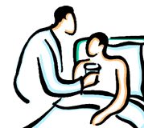
Introduction & Motivation
Physician
What does it mean
to Collaborate ?
“Take X-Ray Test…”
Blood
Tests
X Ray
Results
Scan
Results
Health History
Patient John Smith
Communication through
Access to a shared
Virtual Patient Chart
Nurse
Specialist
“Get Medication History…”
“Review X-Ray Result…”
5

Slide 6
Introduction & Motivation
6
Historical Access Control Models
  Mandatory: Classification of Data and Access to Information based on Clearance of User
  Role-Based: Emphasis on User Capability and Limiting Access
    Separation of Duty, Mutual Exclusion, Cardinality Constraints, Least Privilege, etc.
  Discretionary: Ability to Delegate Authority
Focus is on Limiting and Constraining Access and Not Promoting Interactions
Notes:
While the motivation of this work is driven by the HC domain, its results is a domain-independent framework which can be applied to other domain.

Slide 7


Dimensions of Collaboration in Health Care
Adaptable/Dynamic
Collaboration
Obligated
Collaboration
Coordinated
Collaboration
Collaboration
Requirements in
Health Care
Team-based
Collaboration
Secure
Collaboration
Timely
Collaboration
How can we define a model that integrates all requirements?
How can we leverage software engineering strategies and existing models in order to address all five requirements?
Notes:
Scalability: Test can have 100 of types of tests, there are millions of health care providers, etc…ADMINISTRATION/ADAPTATION
Scalability: A huge challenge is the question of how to deal with myriad of clinical data and stakeholders
Obligation: Collaboration happens mainly on a voluntary basis…
Coordination: Lack of coordination among health care providers (especially with other clinics) overviewed by a single PCP – REDUCE THE LEVEL OF OPTIONAL COORDINATION
Adaptation: Not all clinics offer all types of tests and medical treatment actions, etc…CUSTOMIZATION – FIXED HIGH LEVEL RULES WHICH THEN CAN BE CUSTOMIZED AT RT
Security: Privacy of patients medical data is a requirement that is always present (HIPAA, FERPA, etc…)
Team: The need of multidisciplinary team is very important…
ClinicalTrials.gov
Provides and extensive list more that 8000 clinical trials which focus on eligibility types and exclusion (discharge) inclusion (admit) criteria
- Clinical Decision Making

Slide 8
Research Contributions and Objectives
Security and Access Control Models
Secure Software Engineering
Collaboration on Duty/
Adaptive Workflow Model
Extended and New UML
Diagrams for COD/AWF
NIST RBAC Model
Role Slice Diagram
Health Care Example
COD/AWF Policy Code via
Java Meta-Programming
Google Health +
Google Wave
RBAC Enforcement
Policy Code
Enforcement
Algorithm
Proof-of-Concept
Prototype
Security Enforcement Code Generation
8

Slide 9
Research Contributions
Security and Access Control Models:
  COD/AWF to RBAC - never been done
  First access control model with COD/AWF
  COD Constraints complement RBAC SOD
Secure Software Engineering Paradigm
  Ext. Prior Work (Pavlich) on UML with RBAC
  Ext. UML Activity Diagram for Coord. Collab.
  Two new UML Diagrams for Obl. and Teams.
Security Enforcement Code Generation
  Code Templates as Initial Step in Auto Enforcement Code Generation
  Java Meta Programming and Annotations
9

Slide 10
Background: Health Care Scenario
10
Mr. Smith Arrives at ER with Whezzing, Shortness of Breath, Diabetes and Smoker
Triage Activity by ER MD and Nurse to Take History, Understand Situation, Determine Tests
Tests (XRay, EKG, Blood work, etc.) Performed
Test Results Collected
Providers (ER MD, ER Nurse, Cardiologist, Radiologist, etc.) Must Interact for Decision
Admit or Discharge
These Represent Multiple Steps by Multiple Individuals Playing Different Roles to Administer Collaborative Care in a Constrained Time Period

Slide 11
Background: UML Use Case Diagram
11

Slide 12
Background: UML Class Diagram
12

Slide 13
Background: UML Activity Diagram
13

Slide 14
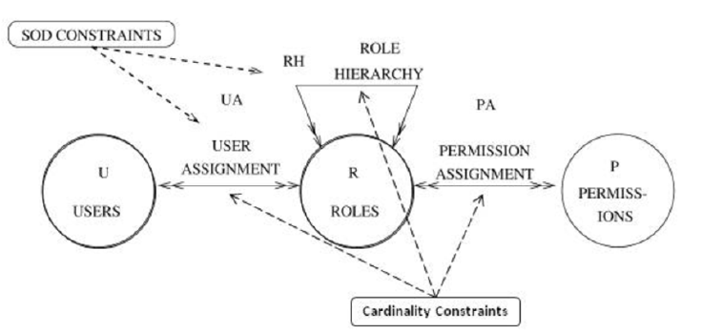
Background: NIST RBAC
Methods of UML Class Diagrams:
writeElectronicMedicalRecord, readElectronicMedicalRecord
Actors of UML Use Case Diagrams
Virtual Chart Application (VCA)
14
Separation of Duty, Mutual Exclusion, Cardinality Constraints, Least Privilege, etc.
Focus is on Limiting and Constraining

Slide 15
Background: Pavlich Role Slices in UML
15
PhD Work of Jaime Pavlich
  Separation of Concerns Emphasis for Security Design
  Introduce New UML Diagrams for RBAC, DAC, Users, and MAC Properties
  Define a Secure Subsystem – Subset of Application’s APIs that Needs to be Secure
  Focus on Role Slices that Turn on <pos> and Turn off <neg> Methods
  Generation of Aspect-Oriented Programming Enforcement Code
Leverage and Extend Pavlich’s Reserach

Slide 16
Background: Secure Subsystem
16
Secure Subsystem – Subset of Application’s APIs that Needs to be Secure – Shown Below
In Our Research on Collaboration – Want to Further Constrain What a User Can Do When in a Collaboration

Slide 17
Background: Role Slice Diagram
17
Actors from Use-Case Diagram (Roles)
Role Slices Turn on <pos> and Turn off <neg> Methods from Secure SubSystem
This Diagram will be Extended in Our work to further Constrain What can and Can’t be Done

Slide 18
Background: Role Slice Diagram
18

Slide 19
What is a Collaboration?
19
Shared Set of Actions by a Team of Individuals to Solve a Problem in a Collaborative and Coordinated Manner
A Collaboration has
  A Team of Users each with Specific Roles
  A Set of One or More Steps
  Each Step can be Constrained by Time, Participants, and their Permissions (Actions)
  Constraints Obligate Who Does What When
  Steps are Organized into a Workflow
  Entire Collaboration has Time Limit
Collaboration must Also Enforce RBAC

Slide 20
Conceptual View of Collaboration
20

Slide 21
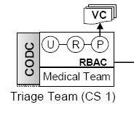
What is a Collaboration Step?
21

Slide 22
What is in the Triage Step?
WritemedicalRecord and ReadMedical Record UML Classes
Obligation Types (Required Roles and Permission Types)
Team Type (Allowed
Role members)
At least one ERNurse and
one ERPhysican must participate
and medical history must be read
ERNurse, ERPhysican, Patient
Allowed Permission Types
Relative Lifetime
30 minutes for Triage Step
getMedicalHistory, getMedicationHistory,
sendToTests, getAllergyHistory, done,
getFamilyHistory, etc.
22

Slide 23
What is in the Test Step?
WritemedicalRecord and ReadMedical Record UML Classes
Obligation Types (Required Roles and Permission Types)
Team Type (Allowed
Role members)
At least one Technician must
upload the test results
Nurse, Patient, Technician
Relative Lifetime
Allowed Permission Types
2h for Test Step
uploadTestResult, setTestResult,
done, readTestHistory, etc.
23

Slide 24
What is a Collaboration Workflow?
24
Set of Steps that Interact with One Another Over Time
Steps Below Triage a Patient, Conduct Test, Write Test Reports, Make Decision, etc.

Slide 25
What Happens at Runtime?
Patient, Physician and Nurse
John Smith (Patient), Tom Steward (Physician) ,
Kate Webber (Physician), David Adams (Nurse),
Jack Black (Nurse)
Becomes …
Obligation (Required Users and Permission Instances)
Team (Allowed
User members)
John and either Tom or Kate and
David or Jack must participate.
The participants must activate the health history of John.
Allowed Permissions Instance
JohnSmith.getMedicationHistory,
JohnSmith.sendToX-RayTest,
JohnSmith.sendToEKGTest
JohnSmith.sendToAdmit, JohnSmith.sendToDischarge etc.
Actual Lifetime
9:45am for starting 10:15am for ending
25

Slide 26
What Happens at Runtime?
Patient, Technician, Nurse
John Smith (Patient), David Adams (Nurse), Jack Black (Nurse), Mary Robinson (Technician),
Daniel Ross (Technician)
Becomes …
Obligation (Required Users and Permission Instances)
Team (Allowed
User members)
John and Mary or Daniel and
David or Jack must participate. The participants must actitvate send the results to for the EKG and X-Ray test to the test review step for review .
Allowed Permissions Instance
JohnSmith.sendToX-RayTestResult,
JohnSmith.sendToEKGTestResult,
JohnSmith.done
Actual Lifetime
After 9:45am
26

Slide 27
What Happens at Runtime?
Patient, Nurse, Physician, Office Staff
Becomes …
John Smith (Patient), David Adams (Nurse),
Jack Black (Nurse), Tom Steward (Physician) ,
Kate Webber (Physician), Linda Moore (Office Staff),
Robert Miller (Office Staff)
Obligation (Required Users and Permission Instances)
John and David or Jack, and Linda or Robert and Tom or Kate must participate. The participants must activate the permission done once a decision has been made.
Team (Allowed
User members)
Allowed Permissions Instance
JohnSmith.discharge, JohnSmith.admit,
JohnSmith.done
Actual Lifetime
After 9:45am
27

Slide 28
Full Runtime View
28
A Step at Design Time can have Multiple Instances at Runtime
See the Test and Review Test Steps
Some Steps are Not Active (Discharge instead of Admit)

Slide 29
Secure Software Engineering
29
Transition COD/AWF Model as UML
Leverage Pavlich Research
Extend Pavlich Role Slice Diagram
Extend UML Activity Diagram to Capture Collaboration as Steps and Workflow
Define Two New UML Diagrams for:
  Obligation Slice Diagram
  Team Slice Diagram

Slide 30
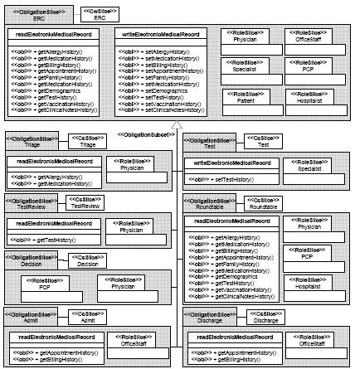
What are Four Collaboration Diagrams?
UML Collaboration Team
Slice Diagram
UML Extended Role
Slice Diagram
UML Obligation
Slice Diagram
UML Collaboration Workflow Slice Diagram
30

Slide 31
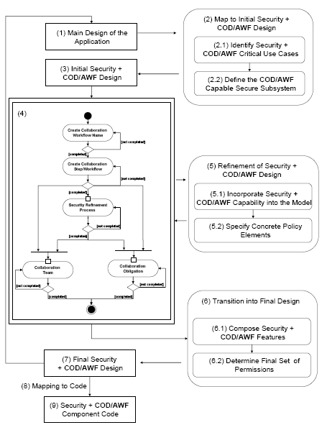
Incorporate Secure SWE Process
Software Engineering Process for creation of COD/AWF diagrams
31

Slide 32
Secure Enforcement Code Generation
32
Transition new COD/AWF Diagrams to Code
Use Java Meta Language to Encode COD/AWF Policies for
  Collaboration Teams
  Collaboration Obligations
  Collaboration Workflow
  Collaboration Security
COD/AWF Policy Authorization Algorithm using Java Meta Programming

Slide 33
Security Enforcement Code
UML Diagrams
Code Templates
UML Extended
Role Slice
Diagram
UML Workflow
Slice Diagram
Workflow Policy
Code Template
Role Policy
Code Template
UML Obligation
Slice Diagram
UML Team
Slice Diagram
Team Policy
Code Template
Obligation Policy
Code Template
33

Slide 34
Secure Enforcement Code Generation
Collaboration Workflow Code
Collaboration Security Code
@CollabWorkflowSlice
public interface EMC {
@CollabSlice
@NextCollabSlice(name="CollabSlice", value="Test, Admission, Discharge")
@ReferencedCollabStepsClass(cod.CollabSteps.class)
public interface Triage{}
@CollabSlice
@NextCollabSlice(name="CollabSlice", value="TestReview, Admission, Discharge")
@ReferencedCollabStepsClass(cod.CollabSteps.class)
public interface Test{}
@CollabSlice
@NextCollabSlice(name="CollabSlice", value="Decision, Admission, Discharge")
@ReferencedCollabStepsClass(cod.CollabSteps.class)
public interface TestReview{}
@CollabSlice
@NextCollabSlice(name="CollabSlice", value="TreatmentPaln")
@ReferencedCollabStepsClass(cod.CollabSteps.class)
public interface Discussion{}
@CollabSlice
@NextCollabSlice(name="CollabSlice", value="Admission, Discharge")
@ReferencedCollabStepsClass(cod.CollabSteps.class)
public interface TreatmentPlan{}
@CollabSlice
@NextCollabSlice(name="CollabSlice", value="")
@ReferencedCollabStepsClass(cod.CollabSteps.class)
public interface Admission{}
@CollabSlice
@NextCollabSlice(name="CollabSlice", value="")
@ReferencedCollabStepsClass(cod.CollabSteps.class)
public interface Discharge{}
}
@PosRoleSlice
public interface ERC {
@ReferencedPermissionClass(cod.Emr.class)
public interface EMR {
@pos public String getAllergyHistory();
@pos public String getMedicationHistory();
@pos public String getBillingHistory();
@pos public String getAppointmentHistory();
}
}
@NegRoleSlice
public interface Triage extends ERC {
@ReferencedPermissionClass(cod.Emr.class)
public interface EMR {
@neg public String getAppointmentHistory();
@neg public String getBillingHistory();
}
}
Collaboration Obligation Code
@ObligationSlice
public interface EMC {
@ReferencedPermissionClass(cod.Emr.class)
public interface ERC {
@obl public String getAllergyHistory();
@obl public String getMedicationHistory();
@obl public String getBillingHistory();
@obl public String getAppointmentHistory();
}
@ReferencedTeamClass(cod.Roles.class)
public interface Roles {
@obl public interface Physician{};
@obl public interface Nurse{};
}
}
Collaboration Team Code
@TeamSlice
public interface ERC {
@ReferencedTeamClass(cod.Roles.class)
public interface Roles {
public interface Physician{};
public interface OfficeStaff{};
public interface ERPhysician{};
public interface Pcp{};
public interface Patient{};
public interface Nurse{};
}
}
@TeamSlice
@TeamSubset(name="TeamSlice", value="ERC")
public interface Triage {
@ReferencedTeamClass(cod.Roles.class)
public interface Roles {
public interface Physician{};
public interface Nurse{};
public interface Patient{};
public interface Pcp{};
}
}
34

Slide 35
Remainder of this Presentation
35
Security and Access Control Models
  Collaboration on Duty/Adaptive Workflow (COD/AWF) Model
  Extends NIST RBAC with Collaboration
Secure Software Engineering
  COD/AWF via New/Revised UML Diagrams
  Secure Software Engineering Process
Security Enforcement Cod Generation
  Mapping COD/AWF Diagrams to Code
  Enforcing COD/AWF Policies at Runtime
Proof-of-Concept Prototyping Effort
  Exploit Existing Collaboration Platform

Slide 36
Define Collaboration on Duty/Adaptive Workflow (COD/AWF) Model that Extends NIST with:
  COD/AWF Lifetime Constraints
  COD/AWF Access Control Model
  COD/AWF Team Set
  COD/AWF Obligations Constraints
  COD/AWF Workflow Model
  COD/AWF Adaptive

Slide 37
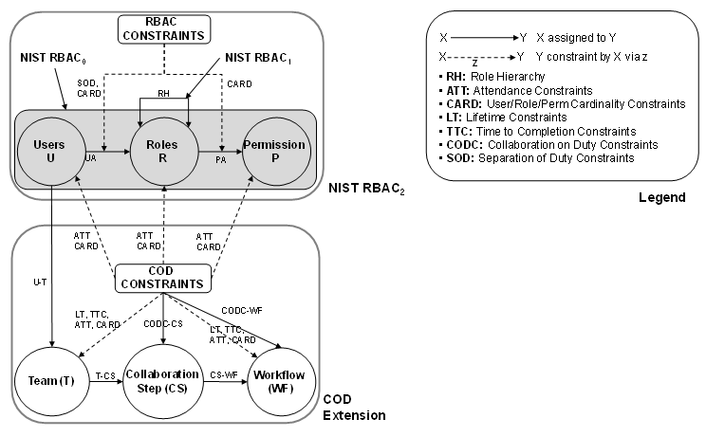
COD Model - Extending NIST RBAC₂
DT
RT
RBAC₂
RBAC₂
COD
COD

Slide 38
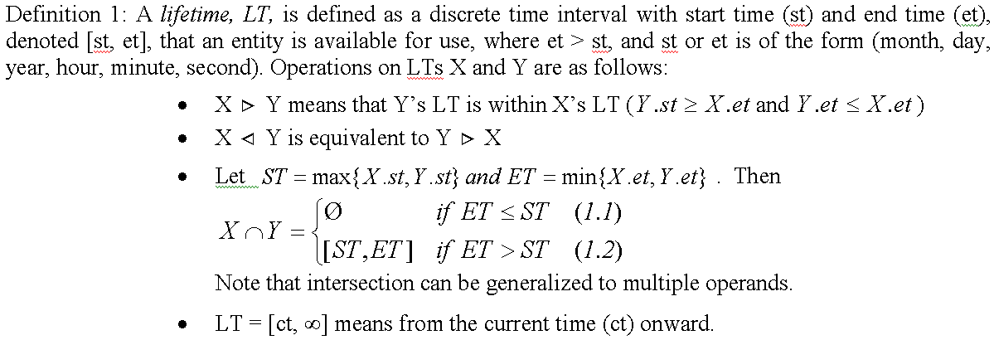
COD/AWF Lifetime Constraints
Design Time Assignment – Relative Times
Runtime – Actual Time
CS₂.LT.st = Monday 8am on August/15 2011
CS₂.LT.et = Monday 5pm on August/15 2011
CST₂
Test Type
CST₂.LT.st = Monday 8am
CST₂.LT.et = Monday 5pm
CS_{2,1}
Blood Test
In COD/AWF lifetime constraints will be applied to each collaboration step (CST, CS) and the collaboration workflow (CWT, CW) and the entire collaboration COD/AWF.
38

Slide 39
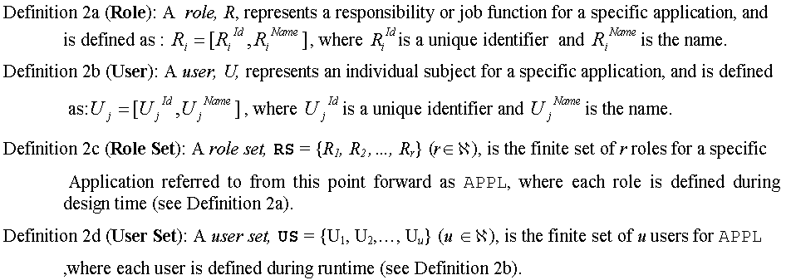
COD/AWF Access Control Model
NIST Users, Roles, and Authorizations
Design Time Roles
Runtime Users
Physician
Nurse
Pharmacist
Specialist
Hospitalist
Office Staff
Patient
Family Member
Hospitalist
Office Staff
Patient
Family Member
John Smith
Tom Steward
Kate Webber
David Adams
…
Mike Jones
Mary Robinson
Paul Williams
Daniel White
…
Linda Moore
Robert Miller
Frank Jackson
Gregory House
…

Slide 40
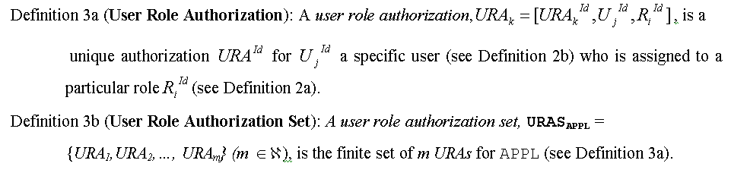
COD/AWF Access Control Model
NIST Users, Roles, and Authorizations
Design Time Roles
Runtime Users
Physician
Nurse
Pharmacist
Specialist
Hospitalist
Office Staff
Patient
Family Member
Hospitalist
Office Staff
Patient
John Smith
Tom Steward
Kate Webber
David Adams
…
Linda Moore
Robert Miller
Frank Jackson
Gregory House
…
Mike Jones
Mary Robinson
Paul Williams
Daniel White
…

Slide 41
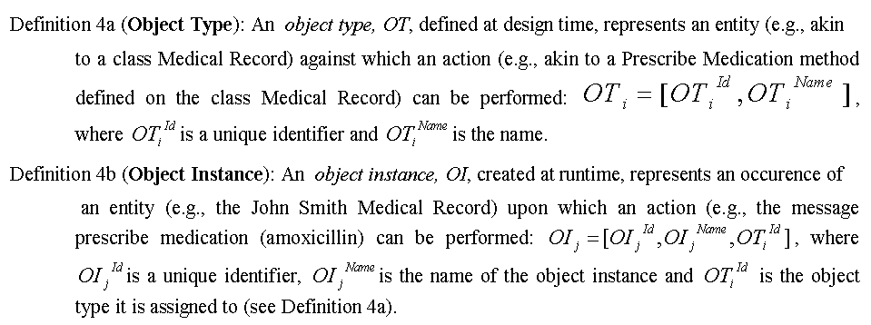
COD/AWF Access Control Model
Object Types and Instances
Design Time Object Type
Runtime Object Instances
[1, Patient]
[2, EMR]
…
[1, John Smith, Patient]
[2, Tom Steward, Patient]
[3, Kate Webber, Patient]
…
[4, EKG Test Result, EMR]
[5, Medication History, EMR]
[6, Allergy History, EMR]
…

Slide 42
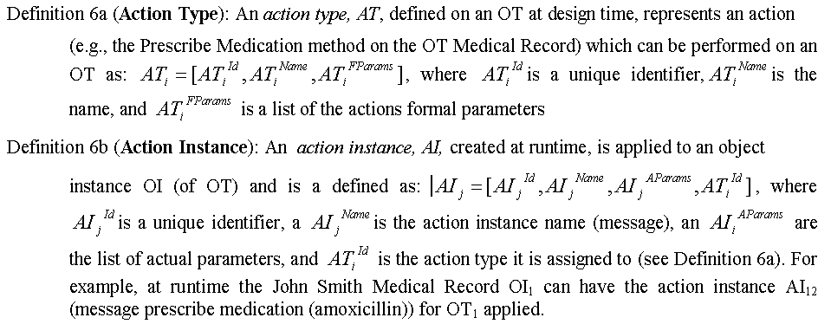
COD/AWF Access Control Model
Action Types and Instances
Design Time Action Type
Runtime Action Instances
[1, sendToTestT, patientRequired=true]
[2, readTestTResult]
…
[1, sendToBloodTest, patientRequired=true, sendToTestT,]
[2, sendToEKGTest, sendToTestT]
[3, readBloodTestResult, readTestResult]
[4, readEKGTestResult, readTestResult]
…

Slide 43
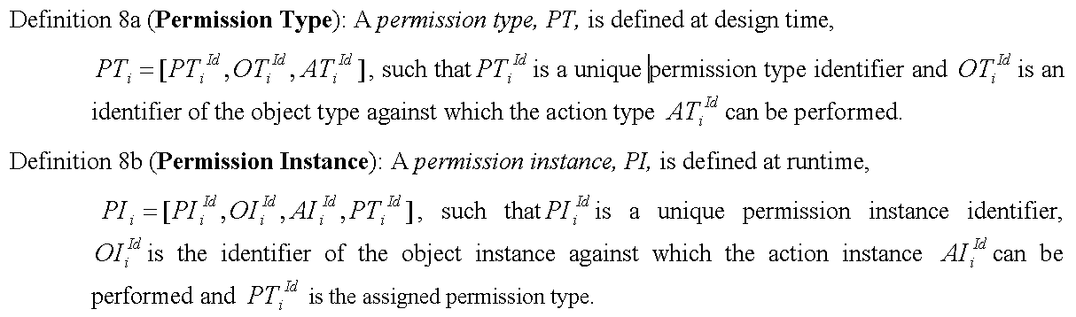
COD/AWF Access Control Model
Permission Types and Instances
Design Time Permission Types
Runtime Permission Instances
[1, Patient, {sendToTestType}]
[2, EMR, {readTestResultT, writeTestResultT}]
…
[1, John Smith, {sendToBloodTest, sendToEKGTest}, 1]
[2, Tom Steward, {sendToXRayTest, sendToLabTest}, 1]
[3, EKGTestResult, {read, write, update},2]
[4, XRayTestResult, {read, write, update},2]

Slide 44
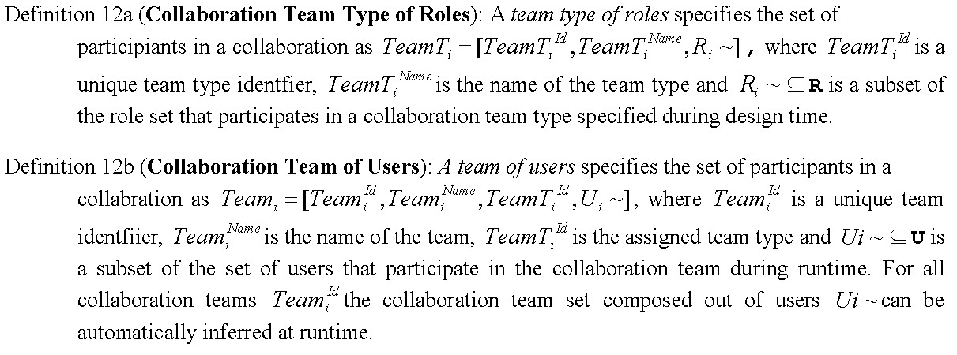
COD/AWF Team Set
Design Time Roles
Runtime Users
Physician
Nurse
Pharmacist
Specialist
Hospitalist
Office Staff
Patient
Hospitalist
Office Staff
Patient
John Smith
Tom Steward
Kate Webber
David Adams
Jack Black
Linda Moore
Robert Miller
Frank Jackson
Gregory House
Suzan Lewis
Mike Jones
Mary Robinson
Paul Williams
Daniel White
Douglass Ross

Slide 45
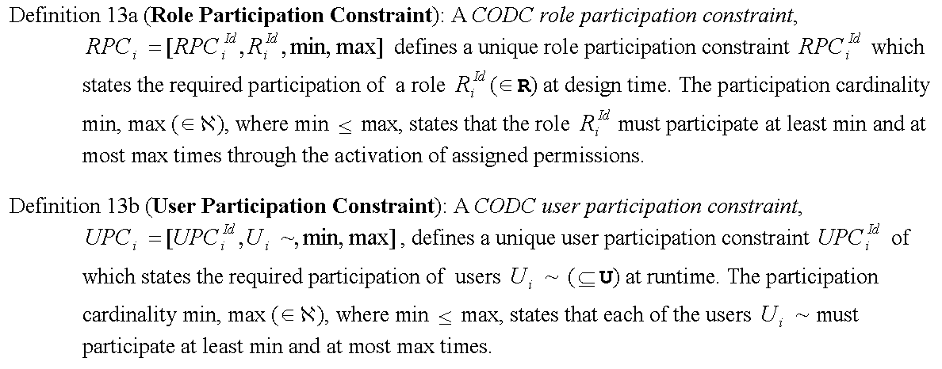
COD/AWF Obligations Constraints
Design Time Roles
Runtime Users
Physician
Nurse
Pharmacist
Specialist
Hospitalist
Office Staff
Patient
Hospitalist
Office Staff
Patient
John Smith
Tom Steward
Kate Webber
David Adams
Jack Black
Linda Moore
Robert Miller
Frank Jackson
Gregory House
Suzan Lewis
Mike Jones
Mary Robinson
Paul Williams
Daniel White
Douglass Ross

Slide 46
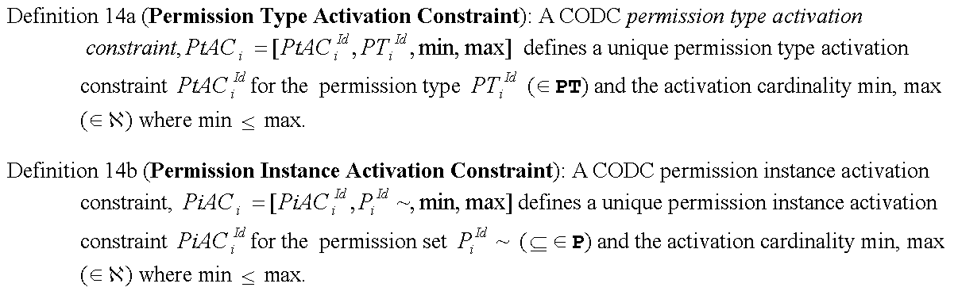
COD/AWF Obligations Constraints
Design Time Permission Types
Runtime Permission Instances
[1, Patient, {sendToTestType}]
[2, EMR, {readTestResultT, writeTestResultT}]
…
[1, John Smith, {sendToBloodTest, sendToEKGTest}, 1]
[2, Tom Steward, {sendToXRayTest, sendToLabTest}, 1]
[3, EKGTestResult, {read, write, update},2]
[4, XRayTestResult, {read, write, update},2]

Slide 47
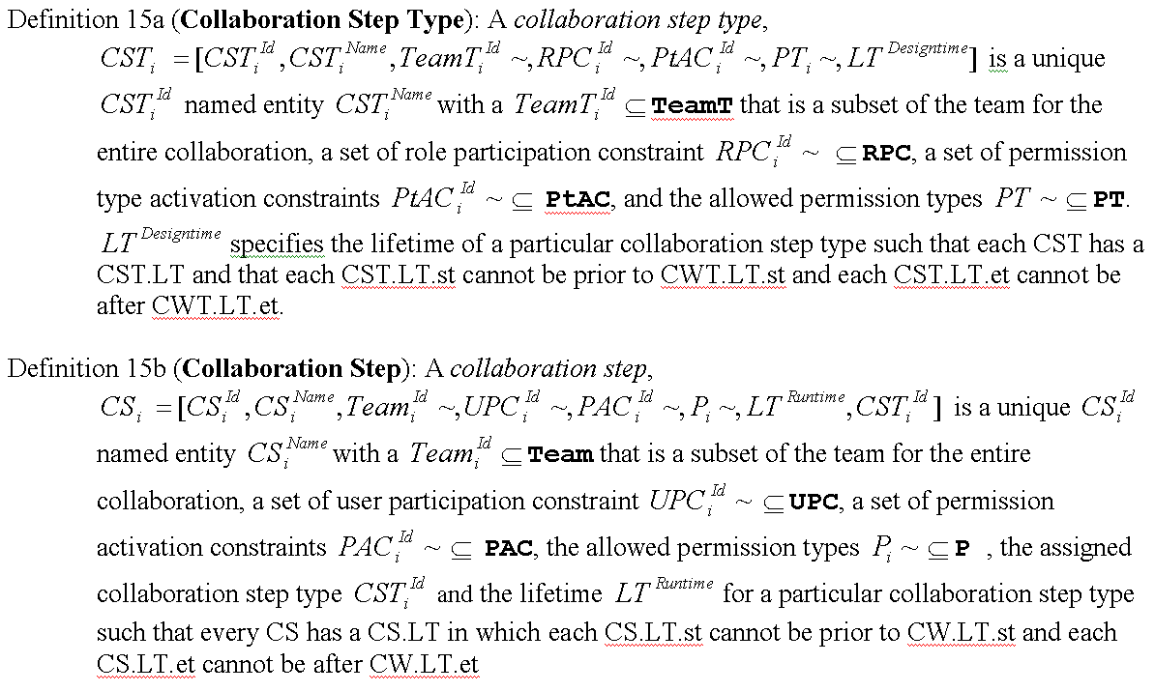
COD/AWF Collaboration Step

Slide 48
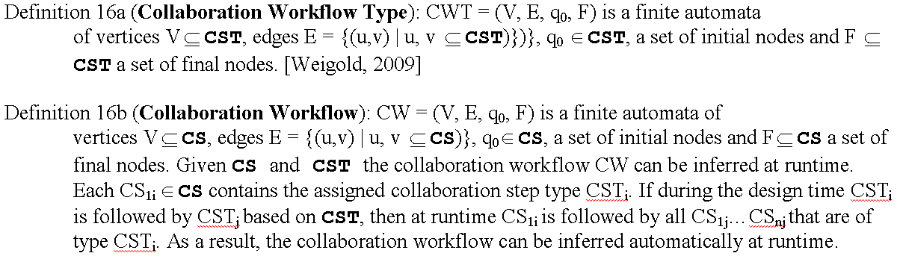
COD/AWF Workflow Model/Full Collab

Slide 49

COD/AWF ER Scenario Revisited
Design Time Assignment
admitT()
Admit
CS Type
Triage
CS Type
sendToTestT()
Test
CS Type
sendToTRT()
Test Review
CS Type
decideT()
Decision
CS Type
OfficeStaffT
Discharge
CS Type
PatientT
ProviderT
NurseT
TechnicianT
NurseT
PatientT
TechnicianT
NurseT
PatientT
SpecialistT
dischargeT()
SpecialistT
OfficeStaffT
TeamT
sendToTestT()
SpecialistT
doneT()
PermT
CODC_T
Runtime Binding and Mapping
…
Advantages:
Define global properties at DT
Define high level CW
Define COD type reqs. at DT
RT local adaptation
RT global policy enforcement
Triage
X-Ray Test
…
Blood Test
John S.: Patient (PatientT)
Bob T.:ER Provider (ProviderT)
Tim R.:ER Nurse (NurseT)
Karen M.:Radiologist(SpecialistT)
EKG Test
Mike S.:Cardiologist (SpecialistT)
Team
Mike S.
done()
sendToEKGTest()
sendToBloodTest()
Perm
CODC
49
Notes:
MAP: ACTIONS TYPES/ACTION; OBJECT TYPES/OBJECTS; CS TYPES/CS; ROLE TYPES/USER
BIND: COLLABORATION WORKFLOW, TEAMS, PERMISSIONS AND ALL
This is how current workflows work. They allow a mechanism to model all scenarios and consider each action as equal.
Lets go back and present a simple runtime clinical trial scenario (ER example).
Defining everything into a single model is very cumbersome due to its dimensions
Workflow not only depends on the tasks flows but also on the patient flow associated with it, who can only be at one location at a time!
We will provide an hierarchical approach
Medical Actions, Patient Actions
How about existing workflow solutions in health care ? GLIF/PROForm too specific
Due to the space issue all permissions/teams are not listed.
49

Slide 50
Related work Influencing COD/AWF
50
[Ni, 2008] An obligation model bridging access control policies and privacy policies.
[Berendsen, 2007] Motives and preferences of general practitioners for new collaboration models with medical specialists: a qualitative study.
[Sun, 2005] Flexible Workflow Incorporated with RBAC.
[Tolone, 2005] Access Control in Collaborative Systems.
[Park, 2001] A secure workflow system for dynamic collaboration.
Notes:
There is only one previous work [Ni, 2008] that addresses obligation models with regard to the order in which action must be performed in which order. Handled through workflow in our work. Within each CS the order is not relevant but the actions that MUST be performed and the subjects that MUST participate.
[Sun, 2005] Flexible Workflow Incorporated with RBAC.
Permissions are only assigned to activities
Only role-user binding considered
Han M, Thiery T, Song X. Managing exceptions in the medical workflow systems. Proceedings of Conference on Software Engineering; 2006 p. 741 – 750.
4. [Tolone, 2005] Access Control in Collaborative Systems. (Distributed Enforcement/generic/fine-grained/scalable/transparent/high level policy spec/dynamic/performant
5. A secure workflow system for dynamic collaboration: addresses this issue at the technology level (no model/no adaptation/etc…)

Slide 51
Secure Software Engineering
Transition COD/AWF to Set of UML Diagrams
  Leverage/Extend Work of Pavlich on:
    New RBAC Role Slice Diagram for UML
  For COD/AWL’s Realization in UML
    Extended Role Slice Diagram that Further Constraints a Role’s Access in Each Collab Step
    Extend UML Activity Diagram to Represent Entire Collaboration
  Define Two New UML Diagrams for:
    Obligation Slice Diagram
    Team Slice Diagram

Slide 52
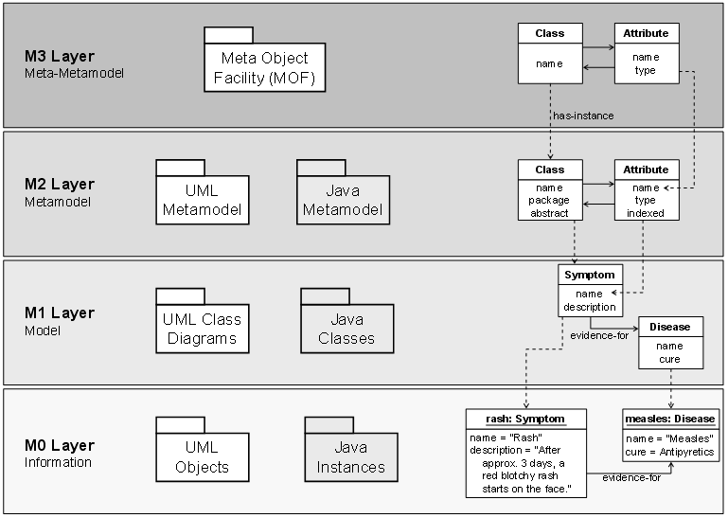
Employ MDA Approach with UML Meta Model
COD/AWF
Meta Model
COD/AWF
Model
COD/AWF
Instance
52
Notes:
Remember in OO classes, packages, variables, methods, attributes are all CLASSES WITH ATTRIBUTES AND METHODS
Usually given the COD API a developer would start implementing the model by creating classes. If we for instance create
a test class then all instances of this class (ekg, x-ray, etc.) would have the same behavior and properties and the assignment

Slide 53
COD/AWF UML Design Separation of Concerns
COD/AWF Role Slice Diagram
COD/AWF Team Slice Diagram
<<
RoleSlice
>>
CW
1
<<
RoleSlice
>>
…
<<
TeamSlice
>>
CS
<<
RoleSlice
>>
CW
1
1
CS
n
(a)
<<
RoleSlice
>>
<<
RoleSlice
>>
<<
RoleSlice
>>
<<
TeamSlice
>>
…
<<
TeamSlice
>>
R
1
R
2
R
m
CS
1
CS
n
(c)
Matching
CS/CW
COD/AWF Workflow Slice Diagram
COD/AWF Obligation Slice Diagram
<<
CsSlice
>>
…
<<
CsSlice
>>
<<
ObligationSlice
>>
CS
2
CS
n
-
3
CW
1
<<
CsSlice
>>
<<
CsSlice
…
>>
…
<<
CsSlice
>>
<<
CsSlice
>>
<<
ObligationSlice
>>
…
<<
ObligationSlice
>>
CS
1
CS
3
CS
n
-
2
CS
n
CS
1
CS
n
(b)
<<
CsSlice
>>
…
<<
CsSlice
>>
<<
CwSlice
>>
(d)
CS
4
CS
n
-
1
Let’s Review these Four Diagram in Detail
53

Slide 54
COD/AWF UML Extended Activity Diagram
Collaboration Workflow Slice
Collaboration Step Slice
54

Slide 55
COD/AWF UML Team Slice Diagram
Team Policy for the
Entire Emergency
Room Collaboration
Workflow (CW)
CS Context
Team Policy for
Each Collaboration
Step (CS)
55

Slide 56
COD/AWF UML Extended Role Slice Diagram
Only Positive
Permissions
RBAC for the
Entire Emergency
Room Collaboration
Workflow (CW)
No additional
Positive permission
allowed
RBAC for each
Collaboration
Step (CS) Further
Limit a Role’s
Permissions!
56

Slide 57
COD/AWF UML Obligation Slice Diagram
Obligation Package
Obligations for the
Entire Emergency
Room Collaboration
Workflow (CW)
Obligations for
each
Collaboration
Step (CS)
57

Slide 58
Incorporate Secure SWE Process
Software Engineering Process for creation of COD/AWF diagrams
58

Slide 59
Secure Enforcement Code Generation
59
Transition new COD/AWF Diagrams to Code
Use Java Meta Language to Encode COD/AWF Policies for
  Collaboration Teams
  Collaboration Obligations
  Collaboration Workflow
  Collaboration Security
COD/AWF Policy Authorization Algorithm using Java Meta Programming

Slide 60

Visual to Code Mapping of COD/AWF Policies
Design Time
Runtime
60

Slide 61
Workflow Slice to Workflow Code Mapping
<<
CwSlice
>>
Type=
“
CW
”
ERC
<<
CsSlice
>>
<<
CsSlice
>>
<<
CsSlice
>>
<<
CsSlice
>>
<<
CsSlice
>>
<<
CsSlice
>>
Admission
Triage
Test
TestReview
Discussion
TreatmentPlan
<<
CsSlice
>>
Discharge
Mapping
to Code
@
CollabWorkflowSlice
public interface
EMC {
@
CollabSlice
@
NextCollabSlice
(name
="
CollabSlice
", value="Test, Admission, Discharge")
@
ReferencedCollabStepsClass(cod.CollabSteps.class
public interface
Triage{}
)
@
CollabSlice
@
NextCollabSlice(name
@
="
CollabSlice
", value="
TestReview
, Admission, Discharge")
ReferencedCollabStepsClass(cod.CollabSteps.class
public interface
Test{}
)
@
CollabSlice
Collaboration Workflow
Slice for entire ERC
@
NextCollabSlice(name
@
="
CollabSlice
", value="Decision, Admission, Discharge")
ReferencedCollabStepsClass(cod.CollabSteps.class
public interface
TestReview
{}
)
@
CollabSlice
@
NextCollabSlice(name
@
="
CollabSlice
", value="
TreatmentPaln
")
ReferencedCollabStepsClass(cod.CollabSteps.class
public interface
Discussion{}
)
@
CollabSlice
@
NextCollabSlice(name
@
="
CollabSlice
", value="Admission, Discharge")
ReferencedCollabStepsClass(cod.CollabSteps.class
public interface
TreatmentPlan
)
{}
@
CollabSlice
@
NextCollabSlice(name
@
="
CollabSlice
", value="")
ReferencedCollabStepsClass(cod.CollabSteps.class
public interface
Admission{}
)
@
CollabSlice
@
NextCollabSlice(name
@
="
CollabSlice
", value="")
ReferencedCollabStepsClass(cod.CollabSteps.class
public interface
Discharge{}
)
}
61

Slide 62
Team Slice to Team Code Mapping
Team policies for
Entire Collaboration
Workflow (CW)
Team policies for
Triage Collaboration
Step (CS)
62

Slide 63
Ext. Role Slice to Ext. Role Code Mapping
Ext. Role Slice
for entire ERC
CW
Ext. Role Slice
for Triage CS
63

Slide 64
Obligation Slice to Obligation Code Mapping
Obligation Slice
for entire ERC CW
Obligation Slice
for Triage CS
64

Slide 65
COD/AWF Policy Authorization Algorithm.
COD/AWF Request Denied
_{EMR Access}
_{Request}
CS LT
Policies
Team
Policies
CS Perm
Policies
RBAC
Policies
User with a
clinical role.
Check if the collaboration
step lifetime is active.
Check if user/role is part
of the collaboration team.
Check if access is permitted
in collaboration step.
Check if user/role authorized
to activate permission.
Electronic Medical
Record (EMR).
Team Membership
Permission Set of CS
Lifetime of CS
[Pavlich-Mariscal, 2010]
65

Slide 66
Proof of Concept Prototype Effort
Google Wave the Ability to Allow Multiple Individuals to Share Information
  Entire Framework
  Utilize to Model COD/AWF and Interactions
Google Health Serves as Backend Repository
  Akin to EMR or VCA in Example
Hibernate, MySQL, and Other Technologies
Supported by MS Students
  Jing Liu, Antonio Cusano, Andal Fequirre, and James Gedonovich

Slide 67

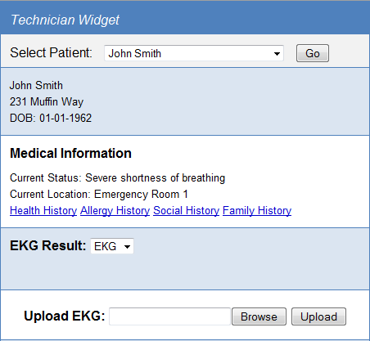
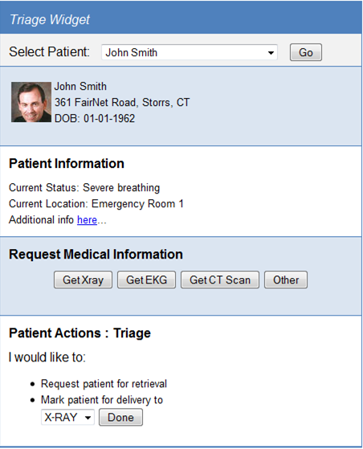
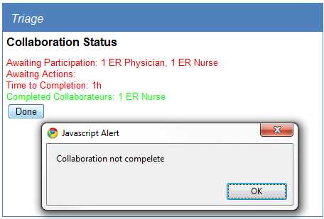
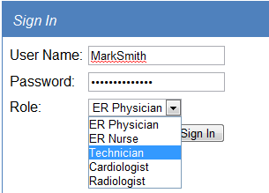
Prototyping Efforts - Google Wave and Google Health
Collaboration
Team
Collaboration
Permissions
Collaboration
Permissions
Collaboration
Permissions
Collaboration
Obligations
Joined work with Jing L., Antonio C., Andal F. and Jim G.
67
Notes:
Thanks to Antonio, Jing, Jim and Andal

Slide 68


Prototyping Efforts - Google Wave and Google Health
Virtual Chart
Application
Coordinated Collaboration
EKG
Test
EKG
Review
Admit
Triage
X-Ray
Test
X-Ray
Review
Treatment
Plan
Decision
Blood
Test
X-Ray
Review
Discharge
COD/AWF Workflow
Activate Collaboration Step
Deactivate Collaboration Step
Joined work with Jing L., Antonio C., Andal F. and Jim G.
68

Slide 69
Prototype Efforts - Architecture
Joined work with Jing L., Antonio C., Andal F. and Jim G.
69

Slide 70
Summary: Security and Access Control
70
Definition of Collaboration Workflow Model for Coordinated Collaboration
Definition of an Collaboration Obligation Model for Role/User Participation and Permission Activation
Definition of a Collaboration Team Model for Role/User Participation
Definition of Secure Collaboration Model
Definition of a Collaboration Lifetime Model

Slide 71
Summary: Secure Software Engineering
71
Extension of the Unified Modeling Language (UML) Meta Model with COD/AWF
Definition of new UML Diagram for Collaboration Workflows
Definition of new UML Diagram for Collaboration Teams
Definition of new UML Diagrams for Collaboration Obligations
Extending existing UML Role Slice Diagrams for Collaboration Security

Slide 72
Summary: Security Enforcement Code Gen
72
Utilizing Java Meta Model capabilities to encode:
  Collaboration Workflow Policies
  Collaboration Team Policies
  Collaboration Obligation Policies
  Collaboration Security
Utilizing Java Meta Programming capabilities to enforce COD/AWF policies
  Definition of a COD/AWF Authorization Algorithm

Slide 73
Research Contributions
Security and Access Control Models:
  COD/AWF to RBAC - never been done
  First access control model with COD/AWF
  COD Constraints complement RBAC SOD
Secure Software Engineering Paradigm
  Ext. Prior Work (Pavlich) on UML with RBAC
  Ext. UML Activity Diagram for Coord. Collab.
  Two new UML Diagrams for Obl. and Teams.
Security Enforcement Code Generation
  Code Templates as Initial Step in Auto Enforcement Code Generation
  Java Meta Programming and Annotations
73

Slide 74
Future Research
74
Improving Code Generation Process
  COD/AWF Requirements Evolution
  More Automated to Translate Code Templates to Working Software
Design Time Analysis
  Collaboration Constraints vs. Security Constraints
  Collaboration Constraints vs. Collaboration Resources
Runtime Analysis
  Collaboration Constraints vs. Security Constraints
  Collaboration Constraints vs. Collaboration Resources

Slide 75
Previous Research
[1] Solomon Berhe, Steven A. Demurjian, Swapna S. Gokhale, Jaime A. Pavlich-Mariscal, Rishi Saripalle: Leveraging UML for Security Engineering and Enforcement in a Collaboration on Duty and Adaptive Workflow Model That Extends NIST RBAC. DBSec 2011: 293-300
[2] Berhe, S., Demurjian, S., Saripalle, R., Agresta, T., Liu, J., Cusano, A., Fequiere, A, and Gedarovich, J., “Secure, Obligated and Coordinated Collaboration in Health Care for the Patient-Centered Medical Home,” accepted, to appear in Proceedings of AMIA 2010 Annual Symposium, November 2010.
[3] Doan, T., Demurjian, S., Michel, L., and Berhe, S. “Integrating Access Control into UML for Secure Software Modeling and Analysis”, in: International Journal of Secure Software Engineering, IGI Global, Vol. 1, No. 1, Jan.-March 2010, pp. 1-19.
[4] Berhe, S., Demurjian, S., and Agresta, T. “Emerging Trends in Health Care Delivery: Towards Collaborative Security for NIST RBAC”, in Research Directions in Data and Applications Security XXIII, E. Gudes and J. Viadya (eds.), LNCS 5645, Springer, July 2009, pp. 283-290.
[5] Demurjian, S., Ren, H., Berhe, S., Devineni, M., Vegad, S., and Polineni, K., “Chapter 24: Improving the Information Security of Collaborative Web Portals via Fine-Grained Role-Based Access Control”, in Handbook of Research on Web 2.0, 3.0 and X.0: Technologies, Business and Social Applications, S. Murugesan (ed.), a volume of the Advances in E-Business Research Series, IGI Global, Apr. 2008, pp. 430-448.
[6] Berhe, S., Demurjian, S., Ren, H., Devineni, M., Vegad, S., and Polineni, K., “Axon-An Adaptive Collaborative Web Portal” Proc. of Intl. Wksp. on Adaptation and Evolution in Web Systems Engineering (AEWSE2008), pp. 81-88, July 2008.
75
Notes:
Some of the work has been document in the four peer reviewed articles.
75

Slide 76
Related Research
[7] Rishi Saripalle, Steven Demurjian, Solomon Berhe. "Towards a Software Design Process for Ontologies.", Accepted to International Conference on Software and Intelligent Information (ICSII 2011), October 21-23, 2011, Puerto Rico, USA
[8] Demurjian, S., Saripalle, R., and Berhe, S., “An Integrated Ontology Framework for Health Information Exchange,” Proceedings of 21st International Conference on Software Engineering and Knowledge Engineering (SEKE09), pp. 575-580, July 2009.
[9] Maynard, M. Doan, T., Berhe, S., and Demurjian, S., “Ontology-Driven Architecture for an Archive Information System: A Case Study at the Roper Center,” Proc. of Intl. Workshop on 'Ontology-Driven Software Engineering, co-located with OOPSLA 2009, October 2009.
[10] M. Price, S. Demurjian, H. Sen, M. Saleem, S. Berhe "Data Verification Using Model-Driven Architecture"
Proc. of ACM/IEEE 10th International Conference on Model Driven Engineering 2007 - Nashville, TN, USA
76
Notes:
Related to UML and Ontologies
76

Slide 77
Acknowledgement
77
COD/AWF Developer Team – MS Students
  Antonio Cusano
  Andal Frequire
  Jim Gedarovich
  Jing Liu
COD/AWF Research Collaborators
  Prof. Steven A. Demurjian
  Prof. Thomas Agresta
  Prof. Swapna Gokhale
  Prof. S. Rajasekaran
  Prof. Jaime Maricial-Pavlich
  Rishi Saripalle, Ph.D. Student

