Slide 1
A Hybrid HIE Architecture (HHIEA)
Timoteus Ziminski and Prof. Steven A. Demurjian
Eugene Sanzi, Mohammed Baihan, Thomas Agresta
Computer Science & Engineering Department
The University of Connecticut
371 Fairfield Road, Box U-255
Storrs, CT 06269-2155
steve@engr.uconn.edu
http://www.engr.uconn.edu/~steve
(860) 486 - 4818
T. Ziminski, “A Study of Architectural Alternatives for
Integrating Health Care Data and Systems,”
Technische Universitat, Dortmund, Germany,
MS Thesis, June 2009, co-advised with Dr. J. Rehof.

Slide 2
HHIEA Solution - A Five Step Process
Overview software architectural alternatives for structuring an HIE system that integrates multiple HITs
Describe a detailed and realistic regional healthcare scenario with:
  A sole-provider practice, a community practice, local and regional hospitals, testing laboratories (blood, scanning, etc.), pharmacies, a university academic medical center, etc.
Examine the interplay and integration of the software architectural alternatives with the FHIR standard
Present a hybrid HIE architecture (HHIEA) with identified alternatives combined with FHIR
Map HHIEA into scenario demonstrating the realization of the architecture

Slide 3
Overview of Presentation
Health Information Technology Integration Mandates Approaches for Health Information Exchange
Need to Share Data Across Health Care Process
Consider Large-Scale Systems Integration Solution
  Federation vs. Replication vs. Centralization
Assess Architectural Solutions:
  Data Warehouse
  Service-Oriented Architectures
  Grid Computing
  Publisher-Subscriber Paradigm
Cloud Computing and FHIR
Propose A Hybrid HIE Architecture (HHIEA)

Slide 4
Motivating the Problem - Stakeholders

Slide 5
Motivating the Problem
Improve Usage and Sharing of Information Could lead to a Reduction in Medical Errors and Associated Deaths (44K to 98K per year)
Potential Savings of $77 B per Year with HIT
American Recovery and Reinvestment Act of 2009 has $19 B for HIT Funding
European Union: Comprehensive Cross-Border Interoperable EHRs by 2015
German Health Card System with 700M Euro

Slide 6
HIT Systems to Integrate
Practice management systems (PMS) for management of non-medical patient information
Electronic medical records (EMR)
Decision Support Systems (both within and external to EMRs)
Medical laboratory information systems (MLIS)
Personal health records (PHR)
Electronic Prescribing
Patient Portal (Tests, Appointments, Refills)
Billing Systems

Slide 7
Stakeholders for HIE and Virtual Chart

Slide 8
Who are the Major Stakeholders?
Patients that require short-term treatments, long-term treatments, emergency help, inpatient care, ambulatory care, home care, etc.
Providers that administer care (MDs, medical specialists, ER MDs, nurses, hospitals, long term care facilities, home health care, nurse practitioners, etc.)
Public health organizations that monitor health trends and include disease control and prevention organizations, medical associations, etc.
Researchers that explore new health treatments, medications, and medical devices
Laboratories that conduct tests and include chemistry, microbiology, radiology, blood, genome, etc.
Payers that are responsible for cost management

Slide 9
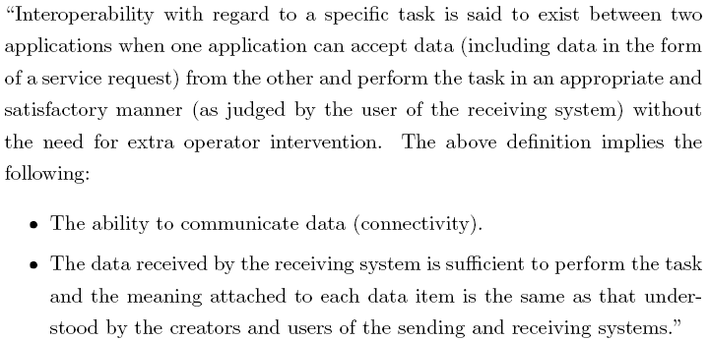
What are Interoperability Issues?
In Computing: For heterogeneous software systems, interoperability means exchanging information efficiently and without any additional effort of the user
For Medical Software Systems:

Slide 10
Syntactic Interoperability
Defined as the Ability to read and Write the Same File Formats and Communicate over Same Protocols
Available Solutions Include:
  Custom Adapter Interfaces
  XML
  Web Services
  Cloud Computing
  Standards and their Usage
    CDA and HL7
    OpenEHR (http://www.openehr.org/home.html)
    Continuity of Care Record (CCR http://www.ccrstandard.com/)

Slide 11
Semantic Interoperability
Defined as ability of systems to exchange data and interpret information while automatically allowing said information to be used across the systems without user intervention and without additional agreements between the communicating parties
Must Understand the Data to be Integrated
  In a PHR – Patient may refer to “Stroke”
  In an EMR – Provider may indicate “cerebrovascular incident”
  These need to be Reconciled Semantically
Available Technologies Include:
  SNOMED
  LOINC
  NDC

Slide 12
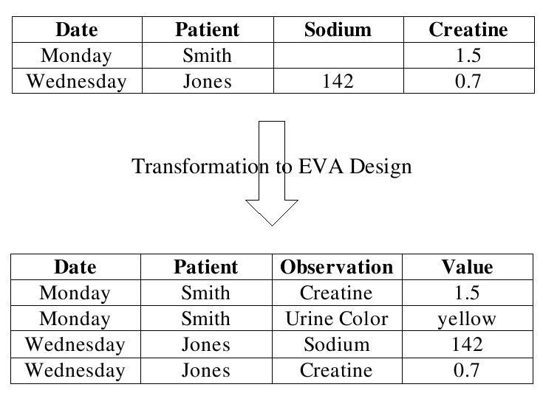
EVA Transformation

Slide 13
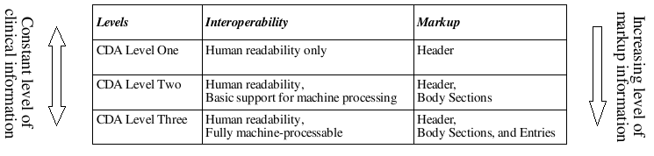
CDA vs. Semantic Interoperability

Slide 14
Relevant Security Issues
Health Insurance Portability and Accountability Act (HIPAA)
  Access to Medical Records: Physicians, clinics, hospitals, and other entities or persons collecting patient data must provide patients access to their medical records upon request within 30 days.
  Notice of Privacy Practices: Health care providers must inform patients about the way they are going to use medical information and the way in which said information is protected.
  Limits on Use of Personal Medical Records: HIPAA has strict rules in terms of sharing a patient's information. Medical records are not allowed to be forwarded to third parties, such as banks or insurance companies, if not directly concerning health care.

Slide 15
Relevant Security Issues
Health Insurance Portability and Accountability Act (HIPAA)
  Prohibition on Marketing: Sharing medical data for marketing purposes must be explicitly authorized by the patient concerned.
  Confidential Communication: Any communication containing medical information must be secured with adequate technologies.
  Complaints: Patients must be provided with the ability to le a formal complaint if any of the above regulations are violated.

Slide 16
Architectural Alternatives
Present Potential Architectural Solutions:
  Data Warehouse
  Service-Oriented Architectures
  Grid Computing
  Publisher-Subscriber Paradigm
Compare and Contrast
Objective:
  Understand their Capabilities in Support of HIE

Slide 17
Background – Nodes of Health Care Domain

Slide 18
Background – Three Logical Layers
Security Layer
  Implements Identification and Authorization
  Towards Security, Safety, and Privacy
  Secure Transmission (encryption, https)
  Access Control (RBAC, DAC, MAC)
Interoperability Layer
  Syntactic Sublayer Encapsulates Data Transformations
  Semantic Sublayer provides Ontology Level Meaning for Effective Interoperation
Administrative Layer
  Track Data Usage Towards Legal Requirements
  Monitor System and its Usage by Stakeholders

Slide 19
Security, Interop, and Admin Layers

Slide 20
Security, Interop, and Admin Layers

Slide 21
Three Architectural Styles
Overall, there are Three Major Architectural Styles Which are Considered
  Federation:
    Data Remains at Source Nodes
  Centralization:
    Data is Brought to Central Repository for Sources
  Replication
    Data is Offloaded to a Replica
These High-Level Styles Cut Across Multiple Architectural Solutions

Slide 22
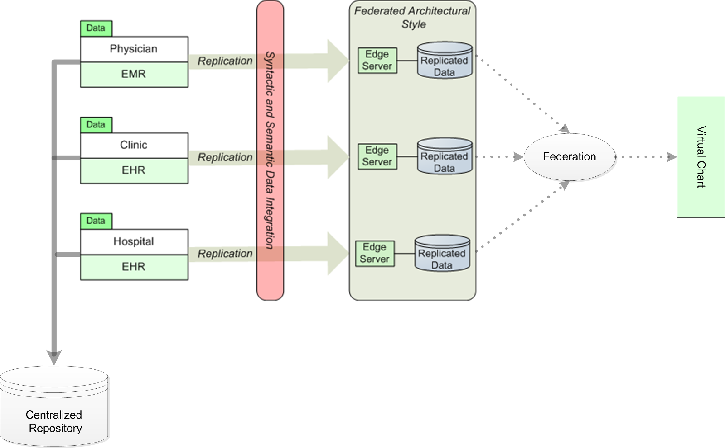
Three Architectures in Context

Slide 23
Federated Architectural Style
As Previously Illustrated for Security, Interop, and Admin Layer Figure
Data Remains at the Source Nodes and is Remotely Accessible
Global Query Issued
  Processed at Remote Nodes
  Results Combined in Final Step
Each Node Does its Own Security, Interop, and Amin.

Slide 24
Federated Architectural Style
Advantages
  Lightweight – Need a Central Node to Receive and Route Global Query and Combine Remote Results
  Sharing and Control at Remote Nodes
  Data Always Current and Up-To-Date
  Easy to Add Additional Nodes
Disadvantages
  Global Queries Can Impact Remote Performance
  One Remote Node May Turn into Bottleneck
  Remote Node Failure Means Loss of Data
  Lack of Coherent Location for Global Security Policy

Slide 25
Centralized Architectural Style
Data is Taken from Multiple Remote Locations into a Centralized Store or Repository
Remote Stakeholders (who are the Data Providers) Must Agree What to Share
Need Techniques to Link Data from Different Sources and Reconcile Conflicts
Data Repository Requires:
  Initial Creation
  Constant Updates for Accuracy of Results
No Need for Global Query
Need to Establish a Centralized Security Policy that May Supercede Remote

Slide 26
Centralized Architectural Style

Slide 27
Centralized Architectural Style
Advantages
  Performance and Query Processing More Controlled
  Availability Not Dependent on Remote Nodes
  Less Impact on Remote Node Performance
  Single Location for Syntactic and Semantic Interop
  Centralized Data and Access Control and Admin
Disadvantages
  Adds Extra Local to Maintain Currency of Data Repository (Updates from Remote Nodes)
  Repository is Incredibly Large Volume
  Potential for Bottleneck and Single Point of Failure of Centralized Node
  If Central is Hacked, Data from All Remotes Impacted

Slide 28
Replicated Architectural Style
Objective is to Move or Offload Data to be Shared into Essentially a Federated Solution
Offloading Process Limits Load on Remote Nodes
Remote Nodes Determine Frequency of Updates
Security of Remote Nodes Insured
Intent it to:
  Create Edge Servers that Interact with Remote Nodes
  Remote Nodes Push Information Through Edge Servers into Repository
  Edge Server/Repository Pairs are Federated
Suggest a “Common” Data Format for Edge Servers so that Destination Data Across Federation is Consistent (work from 2010 no FHIR!)

Slide 29
Replicated Architectural Style

Slide 30
Replicated Architectural Style
Advantages
  Remotes Control Data and Currency; are Isolated
  No Impact on Remotes for Queries
  Data Integration at Edge Server – No Impact on Remotes
Disadvantages
  If No Common Data Format for Edge Servers/Replicas than Querying Difficult
  Replicas are Not Current (perhaps 1 day old)
  Security More Complex

Slide 31
Evaluating Architectural Alternatives
Consider Four Styles
  Data Warehouse
  Service-Oriented Architectures
  Grid Computing
  Publisher-Subscriber Paradigm
For Each Style, we Detail:
  Application to HIE
  Relevant Use Cases
  Variants and Technologies
  Evaluation
We Finish with an Overall Evaluation

Slide 32
Data Warehouse Architecture
Provides Means to Collect Data from Multiple Sources that Offers Uniform View and Different Dimensions of Querying and Analysis
“Data Warehouse is a subject-oriented, integrated, time-variant, and nonvolatile collection of data in support of managements decision making process.”
  Subject-Oriented Means Targeted to Stakeholder
  Integrated Means Common Schema from Sources
  Time-Invariant means Long-Term Storage
  Nonvolatile Means Data Never Goes Away
A Nationwide Data Warehouse Could be Used for:
  Maintaining central patient EHRs, a nationwide registryfor disease control and discovery, data mining, and generating survey data for research applications

Slide 33
Data Warehouse: Application to HIE
Three Main Tasks
  Obtain Relevant Medical Data froM Sources
  Extract and Integrated into Repository
  Make Available via Query Interface
Subtasks include:
  Converting the data into a common format that is suitable for the data warehouse.
  Cleaning the data of irregularities such as data entry errors.
  Integration of the data sets to suit the data model of the data warehouse.
  Transformation of the data through summarizing and creating new attributes.

Slide 34
Data Warehouse: Architecture

Slide 36
Data Warehouse: Relevant Use Cases
Flow of Storage
  1. Perform authentication and authorization.
  2. Retrieve global patient ID from patient ID module.
  3. Store patient information with global patient ID.
Processing of Storage
  1. Create compliant medical record.
  2. Update audit records in the access logging module.
  3. Store record to repository.
Query Process
  1. Update audit records in the access logging module.
  2. Process the received query in query engine and determine related repositories.
  3. Retrieve data from repositories/assemble result set.
  4. Return result set to node.

Slide 37
Data Warehouse: Variants/Technologies
Variants:
  Real-Time or Near Real-Time Required
  Need to Obtain results in Timely Fashion to Facilitate Patient Care
  This is a Challenge for Data Warehouses Which are Often More Batch-Like for Data Analyses
Technologies:
  Off the Shelf Products Available
  IBM, Oracle, MS, SAP
  SAD Enterprise Miner, IBM DB2 Intelligent Minder, Angoss KnowledgeSEEKER
  Some Open Source Solutions: Infobright's IEE, Multifactor Dimensionality Reduction Software Package

Slide 38
Data Warehouse: Evaluation
Issues : optimization, predictable performance, administration of security and interoperability, 24/7 availability, data consistency, etc.
Three Main Factors:
  Node Performance: Is Warehouse Fast Enough?
  Data Actuality: Is Medical Data Up to Date?
  Dimensions of HIE:
    Warehouse Must Manage Communications
    Enormous Number of Source Nodes
Warehouse Well Suited for Data that: stable over time (patient data in EHRs), data aggregations for high-level decision making (such as outcome analysis), data mining, and for an emergency summary application (such as tracking a pandemic event).

Slide 39
Service-Oriented Architecture
Loosely coupled APIs that are Black Boxes and Available as Interfaces (e.g., Web Services)
SOA is Architectural Pattern with
  Loose Coupling (Independent Components)
  Published Services with Each Service Akin toa Method
  Hide the Implementation Details
  Well Defined Service Definition (Signature)
  Services Use/Used By Other Services
Long History:
  DCOM, CORBA (1980s)
  Java, Jini (1990s)
  Web Services (2000s)

Slide 40
Service-Oriented : Architecture

Slide 41
Service-Oriented : Application to HIE
Assume Number of Components that Represent:
  Medical Service Registry (MSR)
  Patient ID Component (PIC): Master Patient Index
  Medical Record Locator (MRL)
  These Services Interact with One Another to Deliver Patient Data to Service Requestor (Client)
Implementation Perspective:
  PIC is Index, MRL Holds References to Medical records (contained in EMRs and Elsewhere)
  MSR is for Administration Across Multiple Nodes (Each with Own Services)
  No Central Administration – Interoperability is “Behind the Scenes”

Slide 42
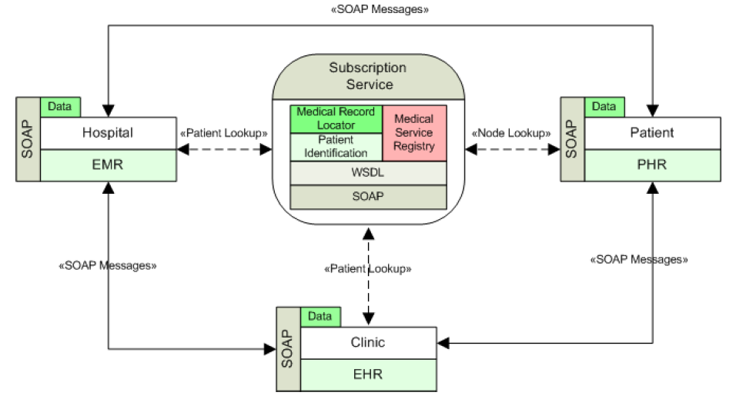
Service-Oriented : Application to HIE
SOAP would be replaced with FHIR

Slide 43
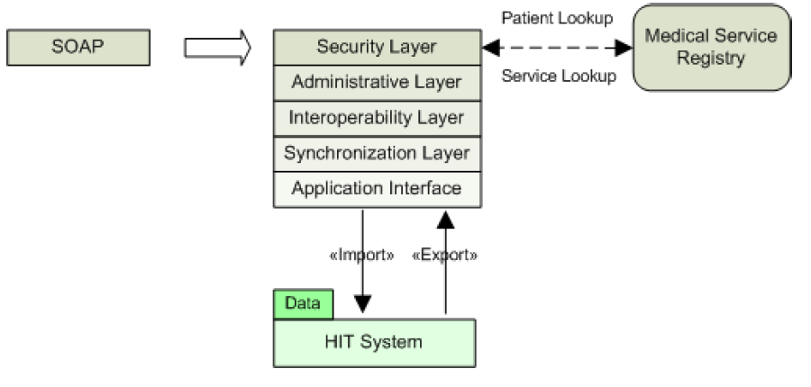
Service-Oriented : Application to HIE

Slide 44
Service-Oriented : Relevant Use Cases
Identify Relevant Data:
  1. Access Main Component - Authentication and authorization.
  2. Retrieve the global patient identifier for the respective patient from the PIC.
  3. Store a reference to new patient information, e.g., node location and said identifier, in the MRL.
Retrieval of Medical Data:
  1. Access Main Component - Authentication and authorization.
  2. Retrieve the global patient identifier for the respective patient from the PIC.
  3. Retrieve, from the MRL, references to patient information related to said patient identifier.

Slide 45
Service-Oriented : Relevant Use Cases
Retrieval of Medical Data:
  4. Access the referenced nodes (authentication and authorization).
  5. Retrieve sets of patient information from all available nodes.
  6. Assemble the retrieved patient information to a global result record.
Store Medical Data (more Complex):
  1. Store the condition in a local record.
  2. Store Lipitor as new medication in the said record.
  3. Access the main component.
  4. Retrieve global patient identifier for the respective patient from the PIC.

Slide 46
Service-Oriented : Relevant Use Cases
Store Medical Data (more Complex):
  5. Store a reference to the new patient information in the MRL.
  6. Access the remote node “emergency medication and allergy list."
  7. Store information about the new medication (Lipitor) into the remote node.
  8. Access the remote node health insurance
  9. Trigger the billing for the patient billing on the remote node.
  10. Access patient's PHR system.
  11. Store a medication reminder into the remote system.

Slide 47
Service-Oriented : Variants/Technologies
Variants: Commercial Enterprise Service Bus for SOA
  Sun Microsystems OpenESB
  IBM WebSphere Enterprise Service Bus
  Microsoft BizTalk Server, Oracle ESB
  Apache Software Foundation Synapse ESB
Technologies:
  http and https, XML
  SOAP, Simple Object Access Protocol
  WSDL, Web Services Description Language
  UDDI, Universal Description, Discovery and Integration
Models: Model Driven Architecture, UML and its Object Constraint Language, Web Services Business Process Execution Language (WSBPEL)

Slide 48
Service-Oriented : Evaluation
Weaknesses:
  Interoperability Difficult Since Remote Nodes (and Services) are All Independent
  Process of Identifying/Using Services Difficult
  Uneven Load Impacts Performance
  Each Service Must Handle Interop, Security, etc.
Strengths:
  Uniform Treatment of HIT Resources through a Front-End of Services
  Easily Attached to Legacy Systems
  Uniformity in Access
  Supports Scalability
From SOA to the Cloud?

Slide 49
Grid Architecture
Distributed Computing environment where High Demand Resources are Shared and Accessible
Like SOA, Grid has Service-Based front End
Grid Typically Brings to Bear Computing Power in terms of CPU Cycles, Memory, Secondary Storage
  Support Large Scale Applications
  Computational Intensive
Grid Solutions Typically Used for Large-Scale Resource Intensive Applications such as:
  Medical Image Processing/Analysis
  Pharmaceutical Research
  Modeling and Visualization
  Bio and Genome Informatics

Slide 50
Grid : Application to HIE
Employ a Central Node Registry that Provides
  Node Lookup (Find Where the Information is, meta-data, and grid Applications)
  Authentication and Verification (Is Requestor Allowed to Perform the Task)
Communication Leverages Web-Based Solutions (SOAP, WSDL)
Grid Layers Encapsulate:
  security and encryption, network connectivity, and grid service proposal/localization
  node identification, access control, and audit tasks in cooperation with the central node registry

Slide 51
Grid : Architecture

Slide 52
Grid : Architecture

Slide 53
Grid : Relevant Use Cases
Grid Analysis for MRI Image:
  1. Access the main node registry (authentication and authorization).
  2. Request and retrieve a list of nodes supporting the MRI analysis application from the node registry.
  3. Contact the needed number of eligible nodes (authentication and authorization can be implemented with the help of the node registry).
  4. Negotiate resource usage with the contacted nodes.
  5. Utilize adequate imaging algorithms for dividing the MRI analysis into subtasks and dispatch them to the contacted nodes.
  6. Retrieve results from the remotely computing nodes and assemble them, with adequate imaging algorithms, into analysis result.

Slide 54
Grid : Variants/Technologies
Variants:
  Computational Grids: Image, Genomic, Virtual Cell, etc.
  Data Grids: Repositories and Statistical Analyses
  Collaborative Grids: Adding in Ability of Users Interacting on Shared Problems
Technologies:
  SOAP, WSDL, UDDI, HTTP and XML
  Globus Toolkit
  IBM's Grid Medical Archive
  Sun's Open Cloud Initiative
From SOA to Grid to Cloud? Are these Really Same?

Slide 55
Grid : Evaluation
Pros and Cons Mirror Previous SOA Slide
Difficult to Distinguish Differences
Main Issue:
  SOA Typically Targeted to Software Applications that are Not Computationally Intensive
  Grid Applications Provide Access to Computational Resources which may be:
    Supercomputer
    Distributed Computer
    CPU Cycles from Idle PC Networks (at Night)
  For Grid, who and how Computing Occurs Invisible to End User
  This Would be Problematic for HIE – Bring together Different Data sources where Grid Federates Different Computational Entities

Slide 56
Publisher/Subscriber Architecture
Senders (publishers) interact with Receivers (subscribers) in a Push/Pull Context:
  Publisher: sends out messages containing relevant data.
  Subscriber: subscribes to one or several feeds, which cover message classes.
  Broker: Optional – mediates between publishers and subscribers)
For HIE, a publisher/subscriber architecture used for:
  Exchange of medical data between the nodes of the domain
  Health status and advisory alerts such as epidemics
  Feedback mechanisms such as drug reaction reporting or recalls

Slide 57
Publisher/Subscriber : Application to HIE
Patient Identification Implements Master Patient Index
Node Admin and Access Logging to Track Access and Usage of Meta-Data/Data in Detail (auditing)
Message Feed Admin - What are Data Feeds?
Subscription Admin – Who Gets Data?
Publish Service
  Ability to Post Information for Subscribers
  Syntax and Semantic
Subscription Service
  Ability to Request Certain Data Feeds
  Frequency of When/Where Feeds Delivered

Slide 58
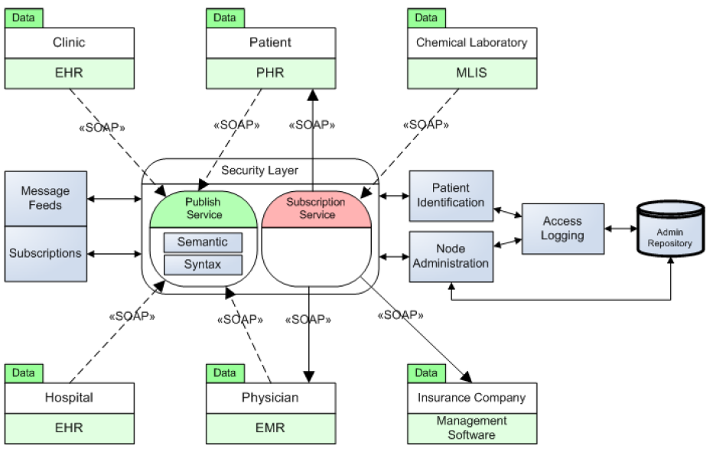
Publisher/Subscriber : Architecture

Slide 59
Publisher/Subscriber : Relevant Use Cases
Subscription:
  1. Access the central subscription service (A&A).
  2. Retrieve a list of available message feeds.
  3. Subscribe to the message feed(s).
Publication:
  1. Access the central subscription service (A&A).
  2. Publish message containing the alert to the ESB.
  3. Determine who receives message notification.
  4. Notify subscribers of the new message.
Message Reception
  1. Receive Message Notification from Feed.
  2. Access the central subscription service (A&A).
  3. Retrieve message from the subscription service.
  4. Process Message Accordingly

Slide 60
Publisher/Subscriber : Variants/Technologies
Variants:
  Implementation of P/S/Broker can Differ Based on
    Who is Allowed to Do What
    How/When Information Pushed/Pulled
  Need to Understand the Ability to Define Feeds (from HIT Products) and Make them Available
Technologies:
  SOAP, WSDL, UDDI, HTTP and XML
  Implementations Include:
    Apache ActiveMQ
    Oracle Tuxedo
    OpenDDS

Slide 61
Publisher/Subscriber : Evaluation
Advantages
  Implements a Federated Approach
  Leaves Responsibility to Providers to Determine What and When to Publish
  Decentralized Security and Administration
Disadvantages
  No Centralized Means to Control Feeds and Access to Feeds
  What Happens When Feeds Come from Multiple Sources?
  Who Combines Feeds?
How Might this Related to SmartPlatform?

Slide 62
Ten Criteria for Four Alternatives
Comparison of Architectural Styles in Context of:
  Usability, Performance, Security, Privacy
  Extensibility and Customization
Virtual Chart Support
  Storage vs. Retrieval
Cost Efficiency
  Central Infrastructure vs. Connected Node
Bottleneck Handling
  Nodes vs. Central Infrastructure
Data Security
Privacy
Auditing and Logging
  HIPAA, FERPA
  Others in EU
Scalability
  Expand/Extend
Open Source Solutions
Open Standards
  Use of ODBC, XML, Hibernate, …
Customization

Slide 63
Qualitative Comparison Measures
Six Measures to Evaluate Four Architectural Styles for Each of the 10 Criteria:
  Possible: May Support Criterion
  Supported: Limited Degree of Support
  Strong: Significant Degree of Support
  Very Strong: Very Significant Degree of Support
  Emerging: Potential for Handling Criterion
  Blank: Cannot Determine at this Time

Slide 64
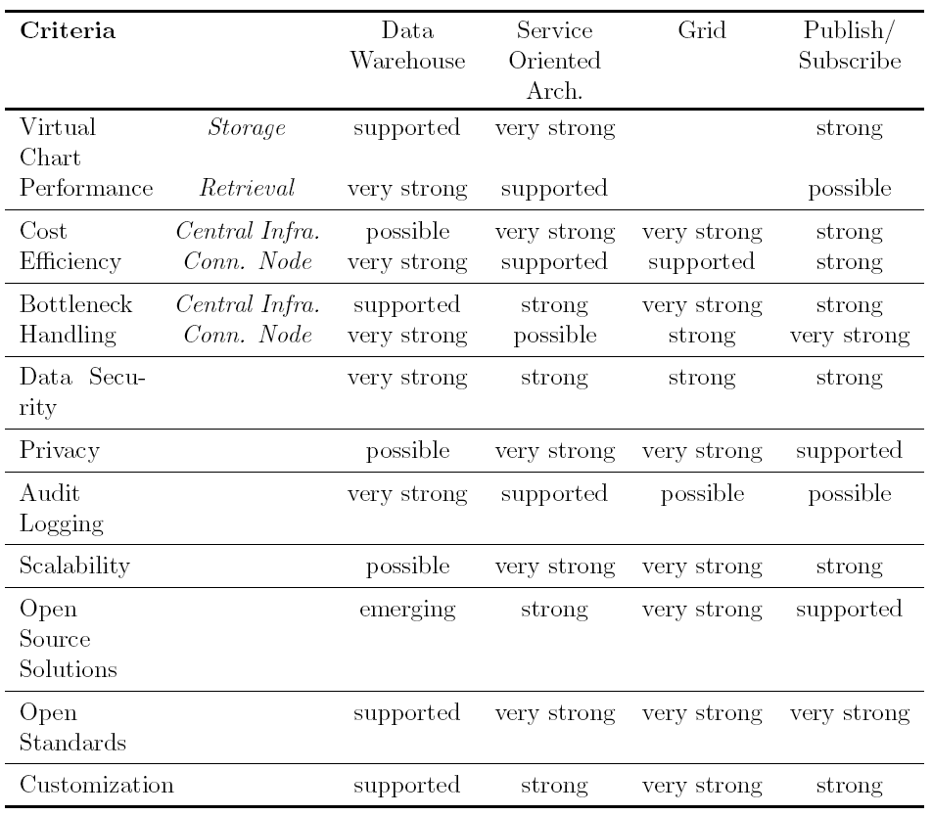
Comparing Architectural Styles

Slide 65
Summary of Measures per Style

Slide 66
Cloud Computing and FHIR
Recall Architectural Styles from PhD of . M. Baihan
Let’s review slide 7 to 43 of
  https://sdcse.engr.uconn.edu/cse5810/mohammedcloudsecurity.pptx

Slide 67
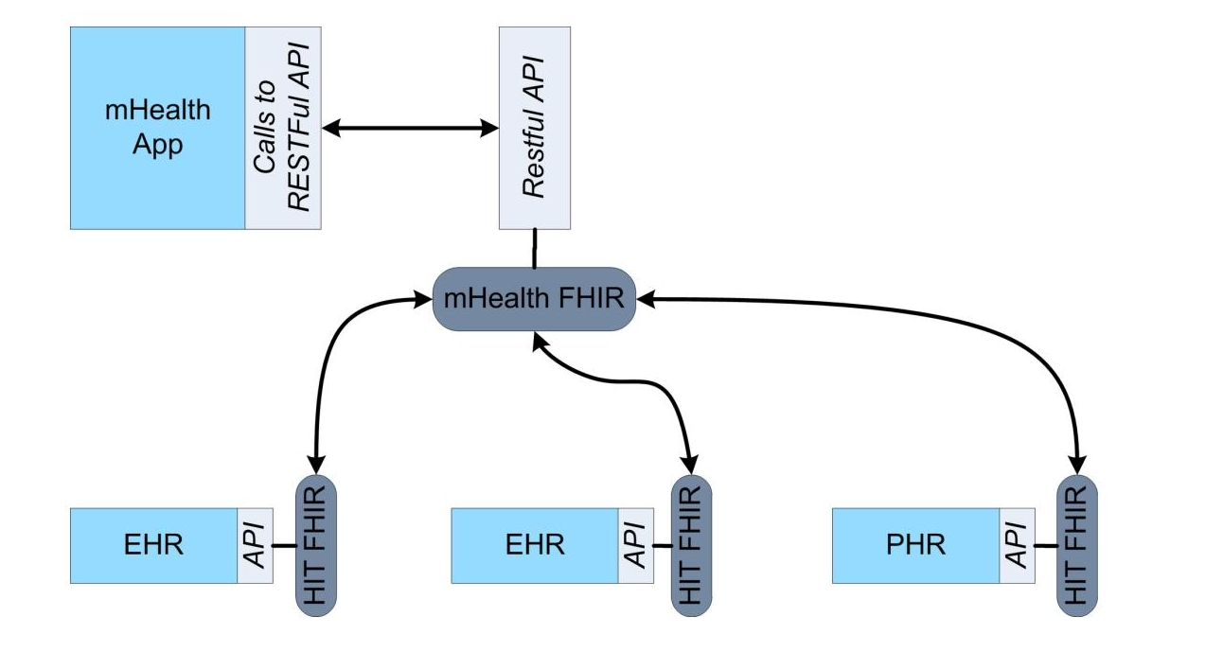
Basic architecture
      a FHIR server that works directly with the App repository and FHIR servers for OpenEMR, OpenMRS, and PHR

Slide 68
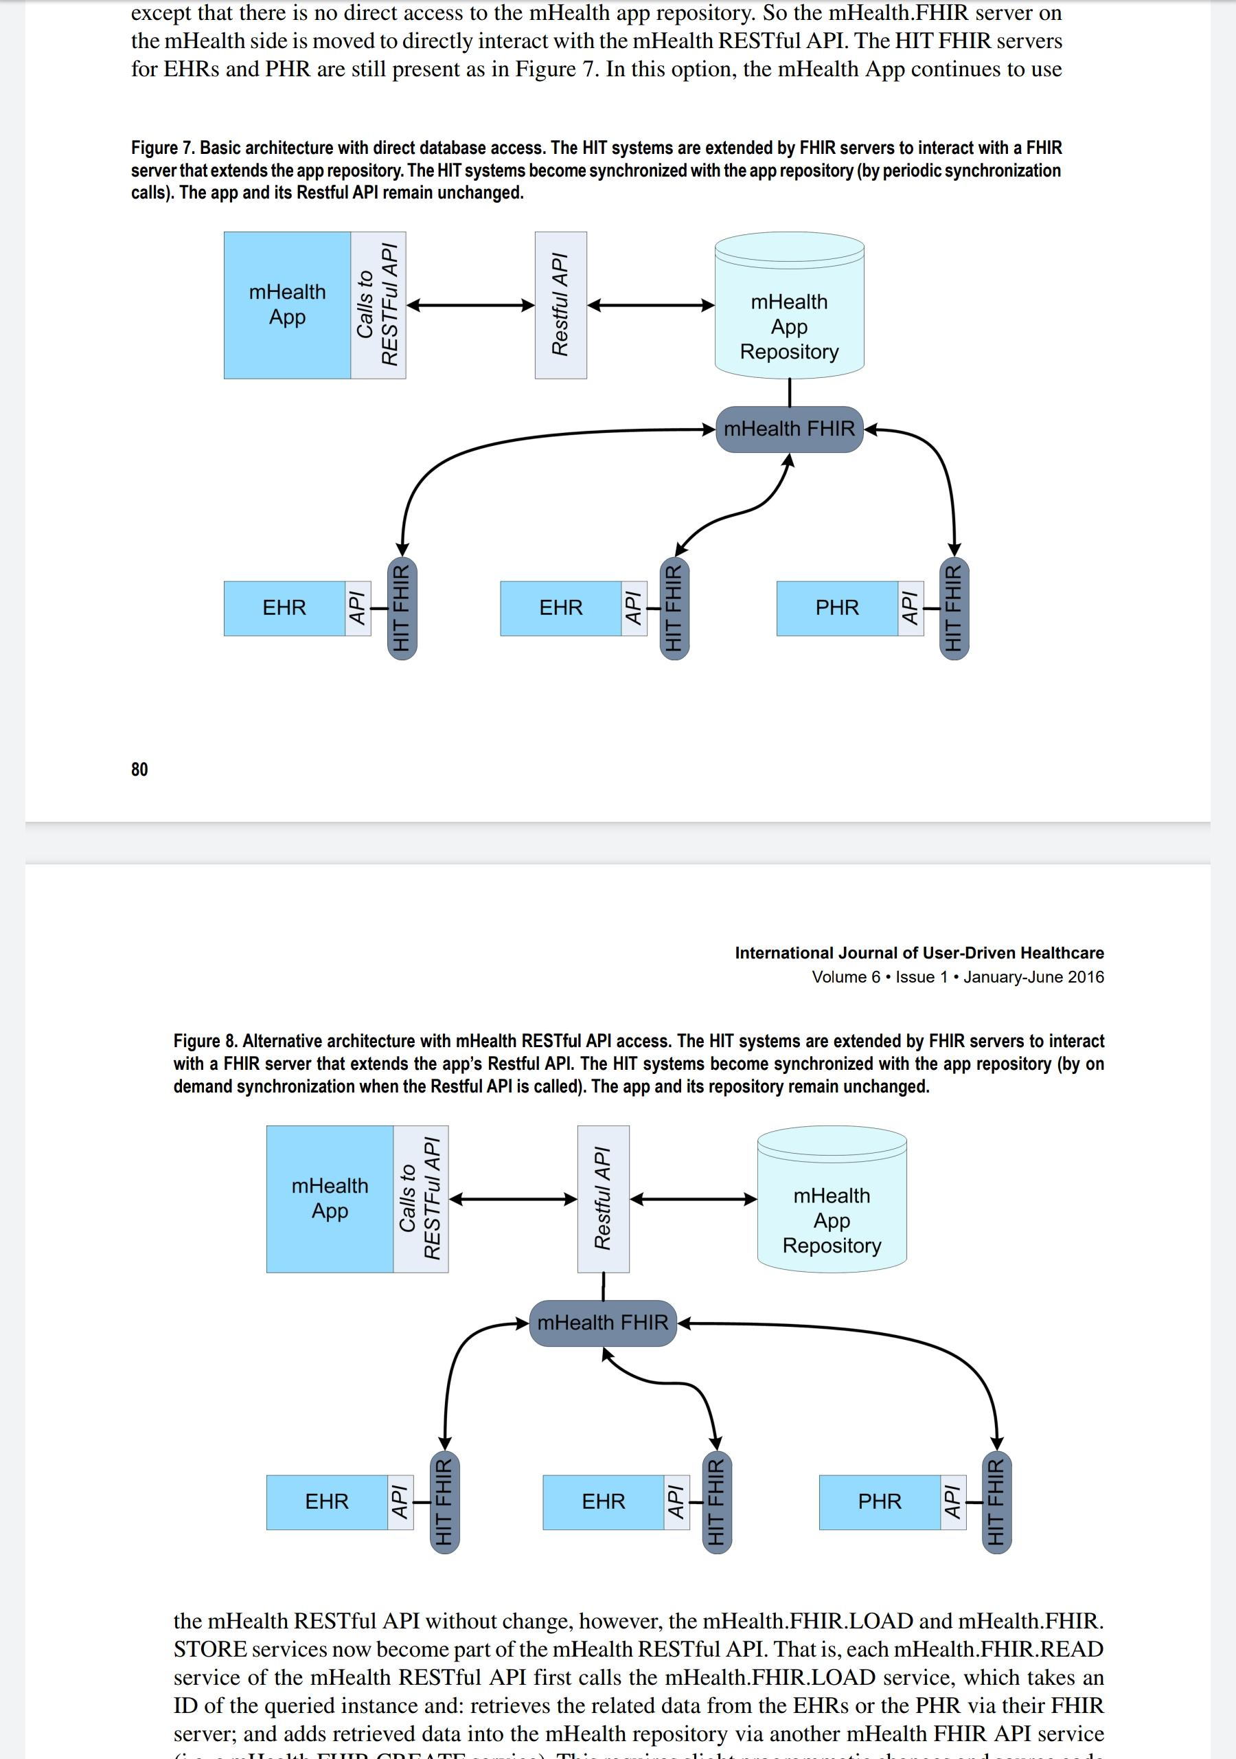
Alternative architecture
      a FHIR server that works directly with the App RESTful API and FHIR servers for OpenEMR, OpenMRS, and PHR

Slide 69
Alternative architecture
      a FHIR server that works directly with the App RESTful API and FHIR servers for OpenEMR, OpenMRS, and PHR

Slide 70
A Proposed Hybrid HIE Architecture
Across Four Styles, seek “Best” of Each to Leverage into a Combined Proposed Hybrid
Explore Different IT Systems and Understand Links
Four Styles Clearly Demonstrate that Not Single Ideal Solution Given Pros and Cons of Each
Key Issues to Consider:
  Proposed Hybrid Minimizes Shortcomings of Individual System
  Takes Full Advantage of Benefits

Slide 71
Background: Regional HIE Scenario
Employ a Supplier Consumer Model (see next slide)
Data Suppliers hold data relevant for the HIE in their operative HIT systems
  Goal: Efficiently make this data available outside system boundaries without impacting the functionalities of the operative systems
Data Consumers utilize data available via HIE for analysis, aggregations, merging, processing, etc.
Notes:
  Suppliers can Consume Data (from other Suppliers) at that Same Time
  Consumers Can Supply Data Relevant for Other Suppliers Purposes

Slide 72
A Regional HIE Scenario

Slide 73
Who are the Data Suppliers?
Community Practice (CP): A medical practice operated by several physicians (e.g., a general practitioner, a pediatrician, an internist, and a radiologist) and their staff.
Local Hospital (LH): via EMR
University Health Center (UHC):
Personal Health Record
Insurance Industry
Others?

Slide 74
Who are the Data Consumers?
Local Pharmacies
State Agencies
Insurance Companies
Pharmaceutical Research
University Research
Virtual Chart

Slide 75
Proposed Hybrid Architecture
Leverages Supplier/Consumer Model
Combines Concepts of four Alternative Architectuers
Organized Around Five Logical Groups of Functionality:
  Data Layer: Suppliers and Consumers
  ID Management: Users and their Privileges
  HIE Management: Tracking Records and their Locations Across Entire Environment
  Security: Audit Trails, Patient Consent, and Authentication
  Health Service Bus: Responsible for the Exchange of Messages Between Nodes

Slide 76
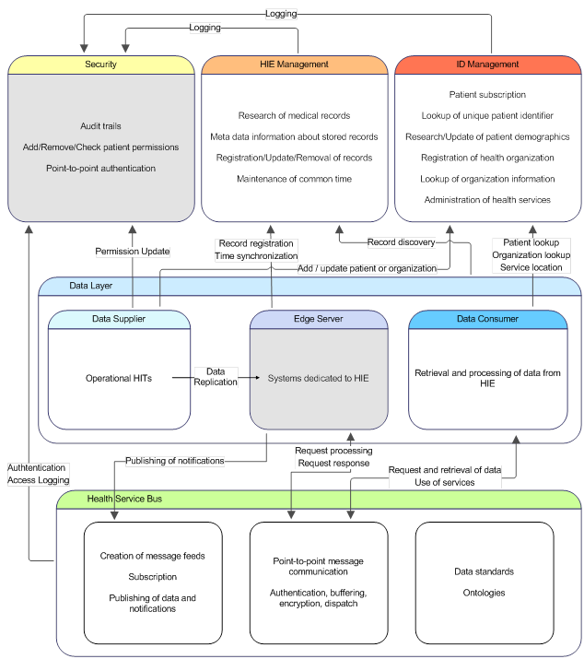
Overview of Hybrid Architecture

Slide 77
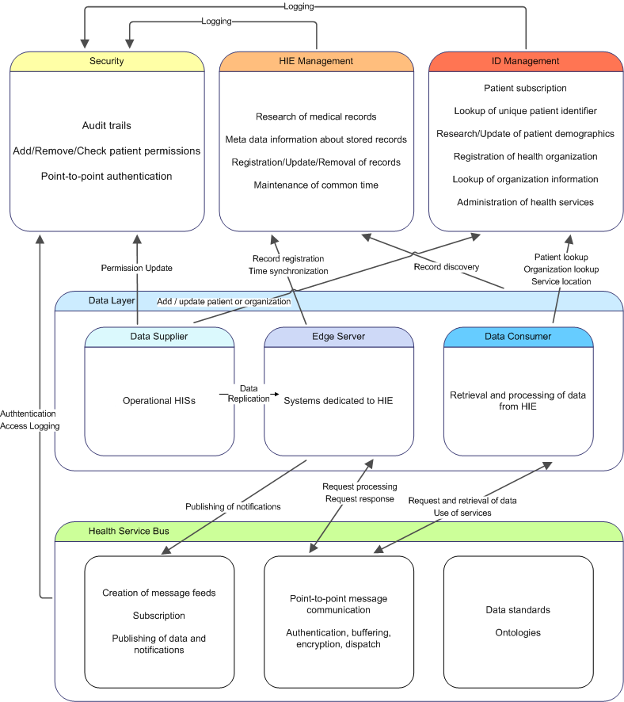
Overview of Hybrid Architecture

Slide 78
Overview of Hybrid Architecture

Slide 79
The Data Layer
Data layer
  location where information that has been extracted from each HIT source
  utilized with a replicated storage style with edge servers in order to acquire information from the HIT sources
Data suppliers provide services that are needed to create the initial replica and incrementally update from the HIT source(s)
Data consumers are for stakeholders to access the aggregated information that spans these multiple HIT source(s) that are now replicas in the data layer

Slide 80
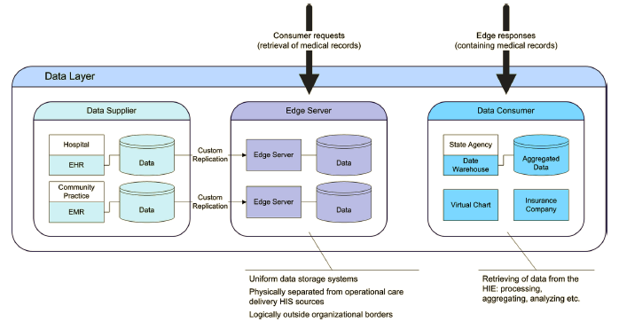
The Data Layer - Original

Slide 81
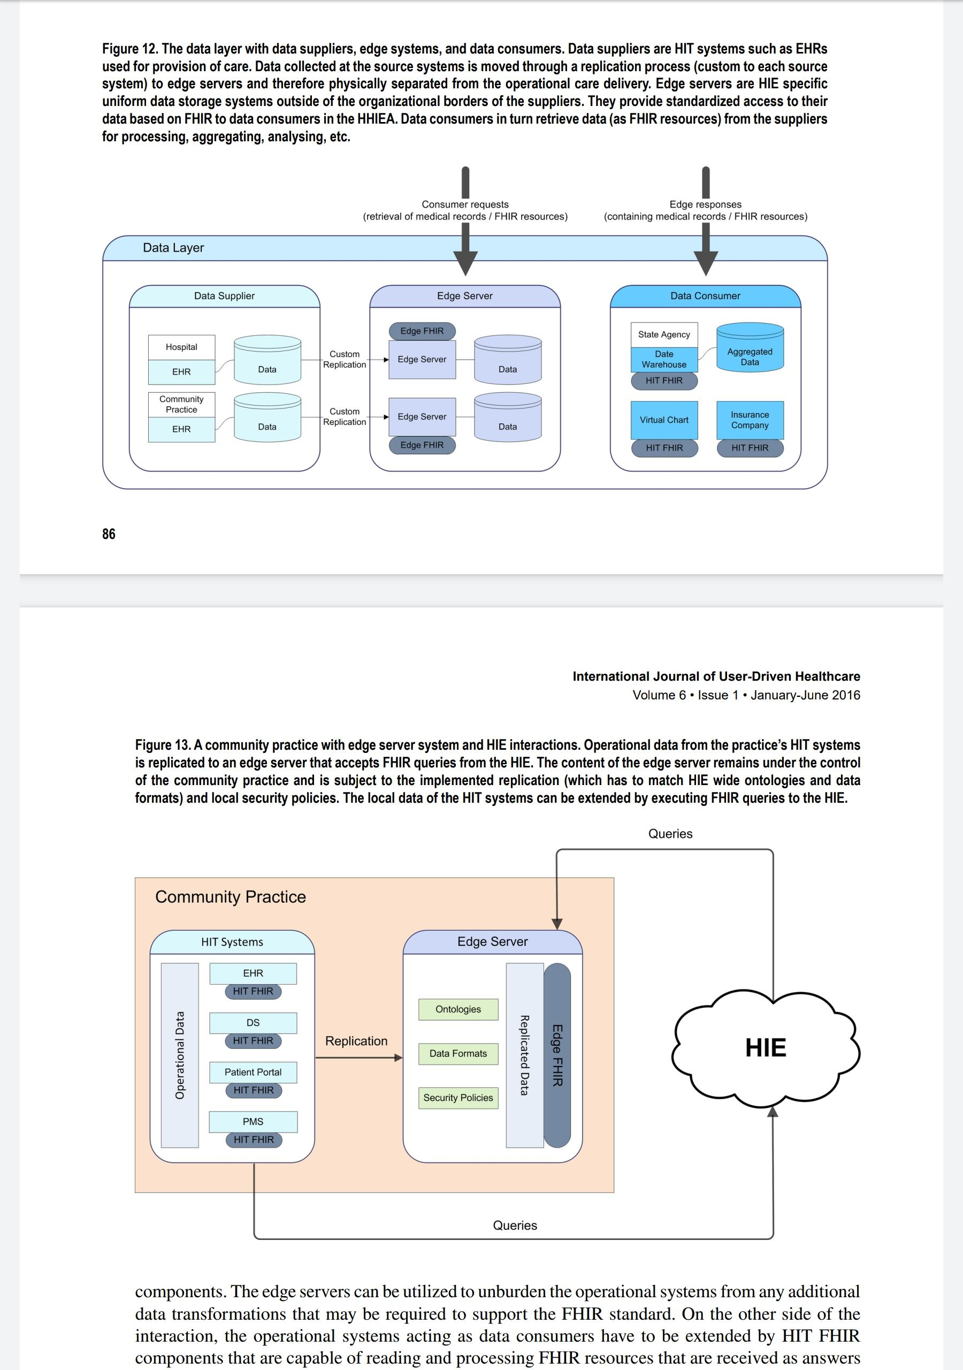
The Data Layer – With FHIR

Slide 82
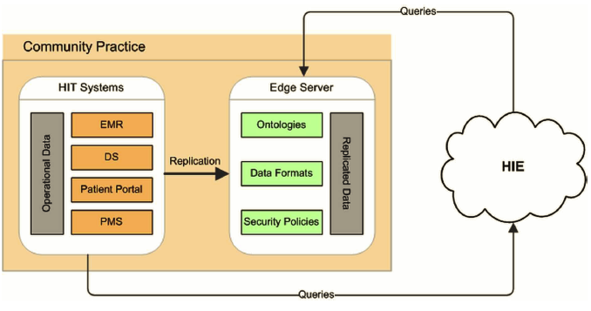
Comm Practice with Edge Server/HIE

Slide 83
Comm Practice w/Edge Server/HIE + FHIR

Slide 84
ID management
ID management provides the means for HHIEA to maintain cross-organizational identification of HIE participants.
For the identification of patients, a master patient index (MPI) is implemented
  Register a unique ID for every patient participating in the HIE
  Store with a set of demographic information
MPI must support two types of queries:
  Queries parameterized with a valid global patient ID that returns demographics
  Queries parameterized with a set of demographic information can be retrieved for further use

Slide 85
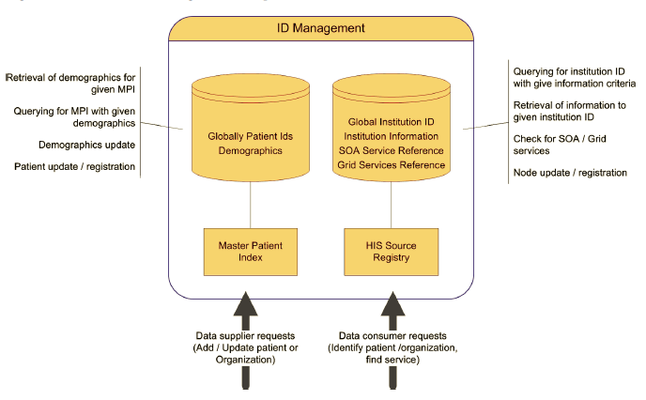
Hybrid Architecture: Identity Management

Slide 86
HIE Management
The HIE management consists of two components:
  a medical record registry that is capable of mapping the MPI to all of the multiple replicas that may contain data for a patient
  a global clock for time-stamps to eliminate inconsistencies in data

Slide 87
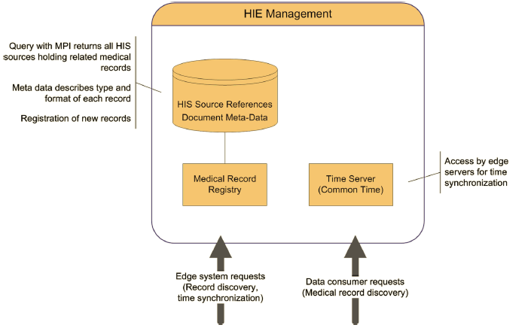
Hybrid Architecture: HIE Management

Slide 88
Security
security group contains:
  An authentication component
  An access authorization component
  An audit authority component

Slide 89
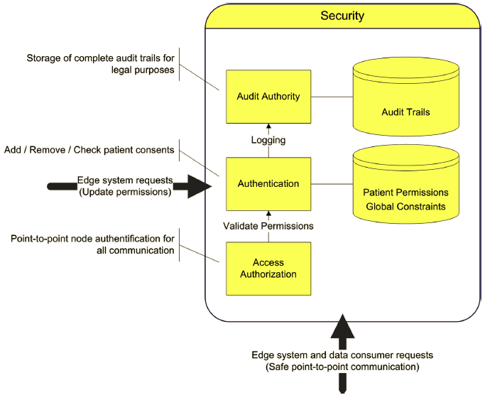
Hybrid Architecture: Security Management

Slide 90
Health Service bus
Health Service Bus contains components for communication of data suppliers and data consumers
Secure Messaging Bus enables message-based, asynchronous, point-to-point communication between the participating HIT source
Service bus receives and buffers messages, clears security and logging issues with the components of the security component, and dispatches the messages
Secure messaging infrastructure can be based on
  Web services as interfaces for HIT source replicas
  SOAP (Simple Object Access Protocol) as basic message format
  Enterprise Service Bus (ESB) solution for business SOA as the connecting element

Slide 91
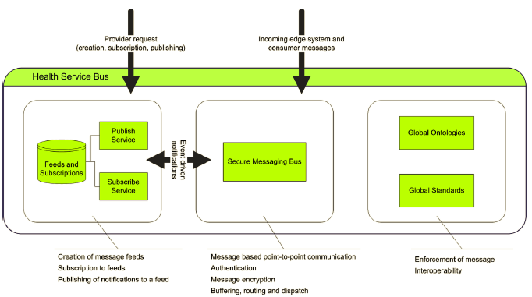
Hybrid Architecture: Health Service Bus

Slide 92
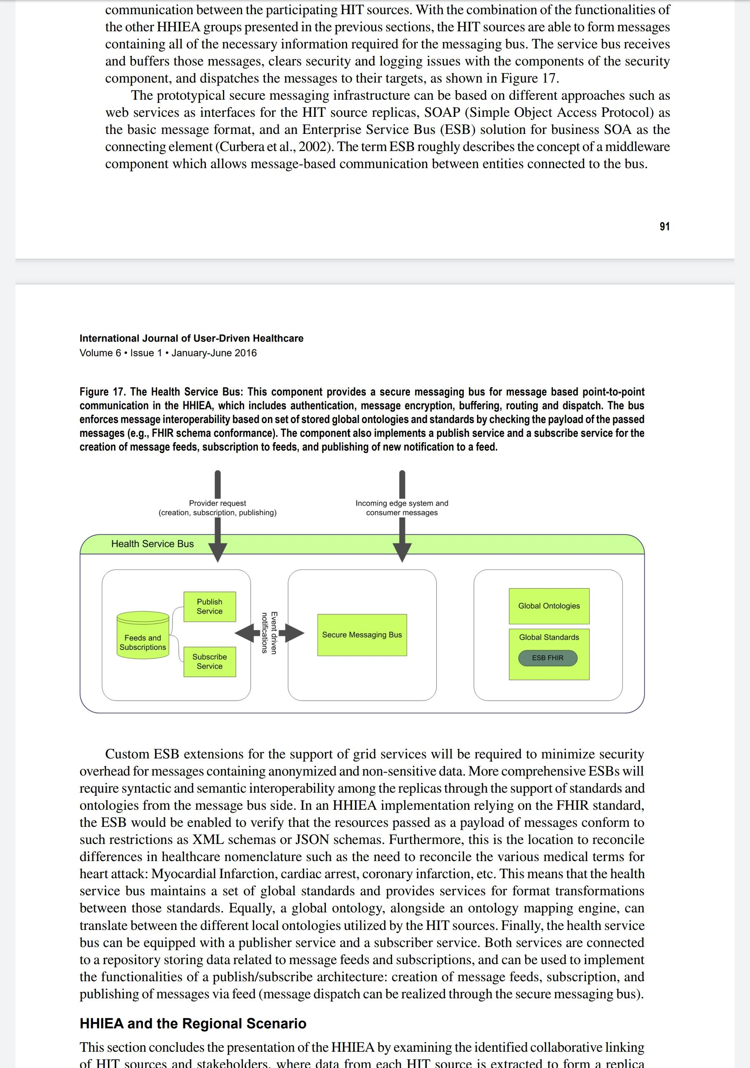
Hybrid Architecture Health Service Bus+FHIR

Slide 93
Hybrid Architecture: Detailed View

Slide 94
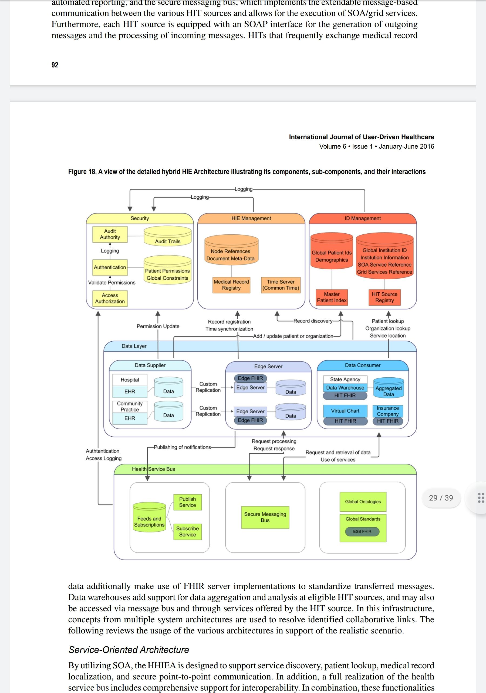
Hybrid Architecture: Detailed View + FHIR

Slide 95
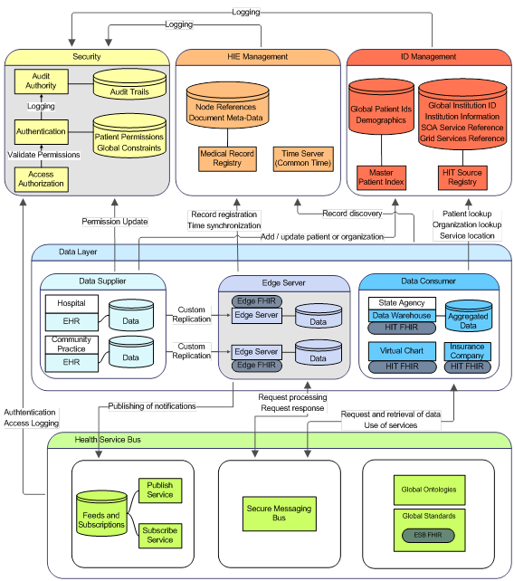
Hybrid Architecture: Detailed View

Slide 96
Hybrid Architecture: Detailed View FHIR

Slide 97
Hybrid Architecture: Detailed View

Slide 98
Summary of Hybrid Architecture
Shared data in the data layer is replicated to edge servers
  Communicates outside of local system boundaries
  Accepts Messages in SOAP from consumers
Secure Communication via Secure Messaging Bus
  Authenticates Communication Partners, Audit trails, and Compliance with Patient Permissions
Patient Consent Provided via Authorization Component from a Data Supplier
Edge Servers do Point-to-Point and Publish (broadcast) Communication
Find through MPI and Associated Service
Consumer Contact Registry

Slide 99
SOA within HHIEA
With SOA, HHIEA Can support service discovery, patient lookup, medical record localization, and secure point-to-point communication
Supports retrieving all of available medical records related to a certain patient and foror a virtual chart
Resolves links
  Community Practice – Virtual Chart, Local Hospital – Virtual Chart, PHR – Virtual Chart
  Community Practice – Local Pharmacy, Local Pharmacy University Health Center
  Local Pharmacy – Local Hospital, Insurance Company – Community Practice
  Insurance Company – Local Hospital

Slide 100
Publisher/Subscriber within HHIEA
Health service bus is equipped with a publish/subscribe
Infrastructure for the administration of message feeds, and the means to dispatch messages containing arbitrary data
Resolves Event Driven Tasks
  Community Practice – State Agency, Local Hospital – State Agency
  University Health Center – State Agency, Pharmaceutical Research Center – Local Hospital
  Pharmaceutical Research Center – Community Practice
  University Health Center - Pharmaceutical Research Center

Slide 101
Cloud Computing within HHIEA
HHIEA contains multiple components that are suitable to benefit from the cloud computing abstraction
Edge server infrastructure can run on a cloud infrastructure with an adequate deployment model
benefit from
  Elasticity (i.e., on-the-fly relocation of resources to replicas that experience increased system load)
  Low up-front cost (i.e., decrease of initial implementation barriers).
Further targets for the cloud model are the installed data warehouses as well as any of the dedicated HITs (e.g., EHRs, PHRs, PMSs, etc. that are integrated).

Slide 102
Grid within HHIEA
HHIEA provides all of the means for
  Execution of grid applications:
  Grid service discovery
  Grid service descriptions
  Secure virtual domain with point-to-point messaginG
Resolves links related to applications requiring large amounts of computational or data storage resources
  Local Hospital – University Supercomputer Center
  University Health Center – University Supercomputer Center

Slide 103
Data Warehouse within HHIEA
Proposed infrastructure effectively supports reporting, and transfer of arbitrary healthcare data
Warehouses can be installed at HIT sources such as Stage Agency and Pharmaceutical Research Center.
Creation of warehouse can occur through
  Incremental event-driven reporting
  Publish/subscribe
  Mass extraction of data from data suppliers (HIT sources) of the HIE via an adequate service
Access of data warehouses can be either limited to governing HIT source or available to the whole HIE via service

Slide 104
FHIR within HHIEA
FHIR’s focus on modern API design and ease of implementation makes
Excellent choice for usage at relevant locations in the HHIEA that need to exchange healthcare records
Candidates for HHIEA
  Community Practice – Virtual Chart, Local Hospital – Virtual Chart, and PHR – Virtual Chart
  Links for gathering and aggregating medical records & event driven reporting of medical cases
Examples are State Agency and the Pharmaceutical Research Center.
Implementations can serve FHIR resources in XML or JSON format either as payload messages of the SOA infrastructure and/or provide immediate access over adequate RESTful APIs.

Slide 105
Hybrid Architecture: Applied to Real Setting

Slide 106
Hybrid Architecture: with FHIR

Slide 107
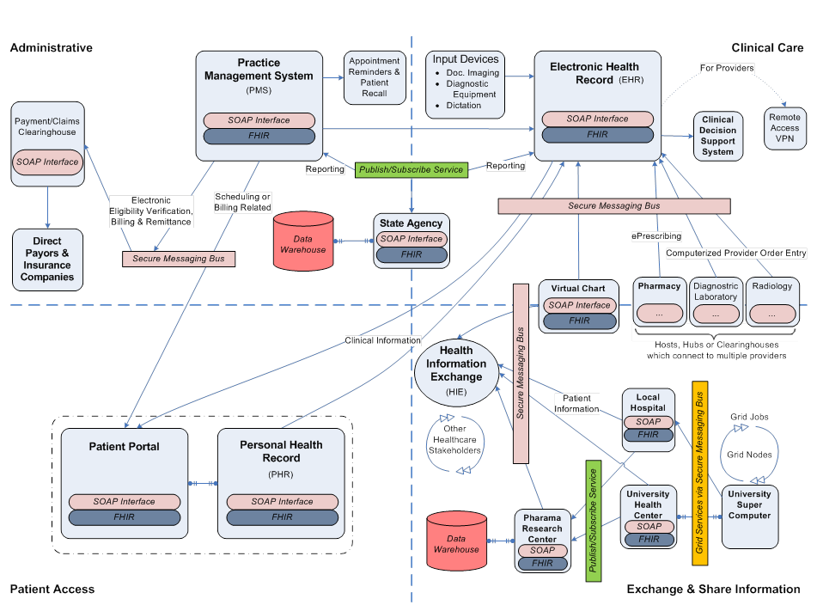
Hybrid Architecture: Applied to Real Setting

Slide 108
Hybrid Architecture: Applied to Real Setting

Slide 109
Hybrid Architecture: Applied to Real Setting

Slide 110
Hybrid Architecture: Applied to Real Setting

Slide 111
Emerging Trends
Modularization of healthcare applications
  Smart and open mhealth
Integration of genomic testing and EHRs Requires
  Safety and privacy preserving access to the data
  Preparation of the data by establishing common formats and extraction procedures
EHRs have to be redesigned to
  Match genomics enabled workflows
  Support preemptive ordering of tests based on a patient’s health history and health markers
  process genetic test results of frequently large and highly complex data sets
Leverage/extend FHIR to support first two trends
  SMART on FHIR Genomics adds genomic capabilities to FHIR with the intent to integrate genomic and clinical data.

Slide 112
Concluding Remarks
Presented a Detailed Study of Architectures and their Potential Utilization for Connecting HIT Products for HIE
Reviewed General Styles (Centralized, Replicated, Federated)
Examined/Compared Architectural Styles in Detail
  Data Warehouses and SOA
  Grid Computing and Publish/Subscriber
Proposed Hybrid Architecture
  Combined Features Across Styles to Leverage Each of their Strengths and Limit Weaknesses
  Demonstrated High-Level Architecture
  Illustrated Applicability at System (HIT) Level

