Slide 1
Announcements
Upcoming PPT Due Date and Requirements
Utilize the project template which I’ll email
Two options for 11 presentations -4 days instead of five
25 minute presentations –use regular class time
30 minute presentations –one presentation go to 3:30
Either case we start exactly at 2:00 p.m.
Extra two days for due date to April 13 11:59 p.m.
Implementation status reports by groups
March 10 April 5 April 28
April 5
Identify who did want
Provide update on your development

Slide 2
Implementation Group Assignments
Name | Group | FHIR
Ahmad,Bilal | A | GF
Weiner,Samson | A | GF
Deng,Jieren | B | GF
Zhang,Chenyu | B | GF
Furuness,Justin | C | GF
Gorbenko,Christina | C | GF
Kocian,Justin | D | GF
Roberts,Graham | E | GF
Shalaby,Noha | F | EF
Ul Haque,Ehsan | G | SF
Zappulla,Frank | H | CF

Slide 3
Updated Remaining Semester Schedule
March 29, 2022 | March 31, 2022
XML Security Framework | Access Control for Mobile Apps
April 5, 2022 | April 7, 2022
Team Implementation Project Updates | Access Control for Cloud Computng
April 12, 2022 | April 14, 2022
Adaptive Trust Negotiation | Research Presentation
April 19, 2022 | April 21, 2022
Research Presentation | Research Presentation
April 26, 2022 | April 28, 2022
Research Presentation | Implementation Project Presentation

Slide 4
Due dates (subject to change)
Research Project (due end of semester)
Short presentation Due April 13, 11:59 p.m.
Presentations starting April 14 in class
I take detailed comments on each presentation that I send to the student Essentially free grading advice Use them to modify and submit your final presentation Send out on April 22nd to all students
Final paper and Long presentation Due April 29, 11:59 p.m.
Implementation status reports
March 10th April 5th April 28th
Final implementation report & build instructions Due April 29, 11:59 p.m.

Slide 5
Research project requirements reminder
Research project proposal: at most one page (single-spaced 12 point, 1 inch margins, Arial or Times New Roman)
A 15 page paper (single-spaced 12 point, 1 inch margins, Arial) excluding references and figures on the topic with an extensive reference list.
Web links for your references.
A 1 hour minute lecture (45+ PowerPoint slides using class template).
Shortened version of lecture for a 20 minutes presentation to class

Slide 6
Grading for research PPT and report
PowerPoint presentation--100 point total
45 required slides
Essentially two points per slide for 90/100
Other 10 points for formatting and structure
Presentation not assigned points
Research report -- 100 point total
90 for the report 10 points for the references
Make sure you use sections and subsections with an introduction and conclusion
Number figures sequentially & cite them in the text
At least one page of references with links

Slide 7
Guest Lectures March 24th
March 1: Smart on FHIR
John DeStefano, PharmD
March 8: Emerging Standards and Health IT Development
Ryan Bramble, COO, CRISP Shared Services (infrastructure provider to Connie HIE)
March 24: TBD
Kensaku Kawamoto, MD, PhD, MHS, FACMI, FAMIA and Nitu Kashyap, MD

Slide 8
Research topics so far
Security and Privacy Considerations on Patient Portals and Patient Facing HIE Accesses
Bioinformatics and Cloud Computing
Bioinformatics and Artificial Intelligence
Mobile Computing and Patient Health and Information
Classifying, Sharing & Exchanging Healthcare Data
Biomedical Informatics in Pain Research and Management
Clinical decision support
Privacy-preserving Federated Survival Analysis
Honest broker for gathering deidentified patient data
Gait-based Continuous Authentication Using Machine learninglearning

Slide 9
Focusing implementation project
Focus on
Amazon AWS and Google FHIR
Three electronic health records
SMART on FHIR.
Amazon has two people, Google has one, epic has one, and SMART on FHIR has one person.

Slide 10
Focusing implementation project
AWS and Google FHIR
Learn how to install and access FHIR
Put together a simple driver program that can get information
Demonstrate that you know how to pull information out using either programmatic or https calls
Three electronic health records
Good instructions and tutorials
sign up and get access
Demonstrate how to effectively use those to pull information display even if it’s just a driver program

Slide 11
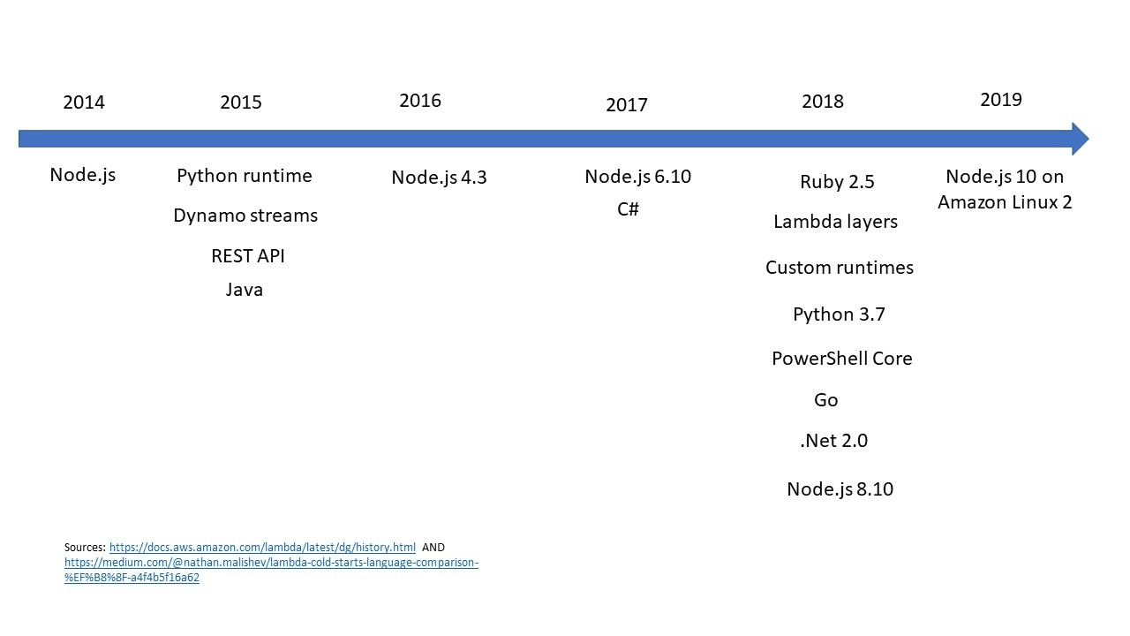
Programming languages for AWS

Slide 12
Programming languages for Google health
The following curl and Windows PowerShell samples work with R4 FHIR stores.
The Go, Java, Node.js, and Python samples work with STU3 FHIR stores.
Curl is object-oriented programing software that is used to transfer data through a vast array of Internet Protocols for a given URL.
command-line utility that permits the transfer of files within the URL syntax.
Curl is basically a client-side program which boasts commands that are designed in a way that they work to check connectivity to the URLs and facilitate data transfer.
Curl’s creator, Daniel Stenberg, defined it as a library that permits you to connect and interact with different servers with a number of protocols.
https://rapidapi.com/blog/api-glossary/curl/

Slide 13
Programming languages for Azure

Slide 14
Sample FHIR Code
Let’s look at some Google Health code
https://cloud.google.com/healthcare-api/docs/how-tos/fhir-resources#healthcare-create-encounter-python
Hapi FHIR return one instance or all instances
You can do these calls directly in any browser
http://hapi.fhir.org/baseR4/Patient/1722652/_history/1?_pretty=true
http://hapi.fhir.org/baseR4/Patient
http://hapi.fhir.org/baseR4/Condition?_pretty=true
http://hapi.fhir.org/baseR4/Condition/1165001/_history/1?_pretty=true
Training in oFHIR – strongly suggest
https://fhir-drills.github.io

Slide 15
Individual/Team Design/Development Project
Objectives
Desire of Patients to Control Access to Own Health Data
Pervasiveness & Ubiquity of Mobile Devices
Explosion of Fitness/Health Devices, Apps, Data Collection
Explore larger scale Health Information Technology Systems and their Interaction
Standards, Frameworks, & Systems
Support Interoperability via XML and Other Standards
Individual/Team Structure
To be Developed over Course of the Semester

Slide 16
Course Projects
Research Project (due end of semester)
Choose a Computer Science or Biomedical Engineering Topic
Explore the Topic related to BMI
Individual/Team Project (due throughout semester)
Explore Health Information Technology Systems
Explore Open Source and Other Solutions
Focus on Information Exchange and Interactions
Leverage HAPI FHIR with Synthea test data
Deployable within a Docker container
Available & extendable code for extracting information

Slide 17
Research Project
Deliverables
15 page paper
40-45 slide powerpoint
Multiple Samples on Web page
Presentation at end of semester subset of slide deck 30 minutes plus 5 minutes of questions
One fixed deadline for all presentations for fairness
Potential Topics:
Any computer science and engineering area that can be applied to biomedical informatics
Any biomedical engineering area that can be applied to biomedical informatics
Encourage you to do topic related to your research
https://sdcse.engr.uconn.edu/Cse5810/ResProj.pdf

Slide 18
Research Project - Other Topics
Computer Science issues and solutions for supporting a Master patient index/Unified Health ID with respect to HIT systems, Interoperability, patient access to own data, etc.
http://www.statnews.com/2016/01/28/patient-mixups-universal-identification/
http://www.statnews.com/2016/01/28/experts-argue-unique-patient-identifier/
Try a Google Search: unique (or national) patient identifier
Exploring Computer Science Issues in Privacy from a patient perspective. This can be done from many different computing perspectives ranging from theory to practice in security.
http://www.ncbi.nlm.nih.gov/pubmed/20696276
http://www.ncbi.nlm.nih.gov/pubmed/23228807
http://www.ncbi.nlm.nih.gov/pubmed/23184192
http://www.ncbi.nlm.nih.gov/pubmed/?term=patient+privacy

Slide 19
Research Project - Other Topics
Honest Brokers for Secure De-identification of Patient Records
http://www.ncbi.nlm.nih.gov/pmc/articles/PMC3002130/
https://peerj.com/articles/1506.pdf
http://www.ncbi.nlm.nih.gov/pubmed/?term=Honest+Broker
Classifying, Sharing, and Exchanging health care data
http://article.sapub.org/10.5923.j.database.20120101.01.html
http://www.databreachtoday.com/blogs/importance-data-classification-p-1153
http://www.ncbi.nlm.nih.gov/books/NBK54296/
Biomedical Informatics and HPC – there is enough work for this to involve two individuals.
http://hpc.sagepub.com/content/early/2009/06/16/1094342009106192.short
http://www.hindawi.com/journals/bmri/2013/185679/abs/
http://www.ncbi.nlm.nih.gov/pmc/articles/PMC3808097/
Try a Google Search: biomedical informatics and HPC

Slide 20
Research Project - Other Topics
Remote health monitoring that explores the use of sensor networks for patient monitoring, mobile apps, wearables, medical devices, etc. – within a medical facility, elderly housing, etc. and to explore the usage of computer science as applied to healthcare to monitory health.
http://www.ncbi.nlm.nih.gov/pubmed/26788055
http://www.ncbi.nlm.nih.gov/pubmed/26737852
http://www.ncbi.nlm.nih.gov/pubmed/26736485
http://www.ncbi.nlm.nih.gov/pubmed/?term=remote+patient+monitoring
Biomedical Informatics and Cloud Computing – there is enough work for this to involve two individuals.
http://www.j-biomed-inform.com/article/S1532-0464(09)00115-4/abstract
http://bmcmedinformdecismak.biomedcentral.com/articles/10.1186/s12911-015-0145-7
http://www.ncbi.nlm.nih.gov/pubmed/26146645
Try a Google Search: biomedical informatics and cloud computing

Slide 21
Individual/Team Design/Development Project
Objectives
Desire of Patients to Control Access to Own Health Data
Pervasiveness & Ubiquity of Mobile Devices
Explosion of Fitness/Health Devices, Apps, Data Collection
Explore larger scale Health Information Technology Systems and their Interaction
Standards, Frameworks, & Systems
Support Interoperability via XML and Other Standards
Individual/Team Structure
To be Developed over Course of the Semester
https://sdcse.engr.uconn.edu/Cse5810/project.docx

Slide 22
Challenges: The Big Picture
https://conniect.org/

Slide 23
Available Software/Server Testbed
Established a downloadable test bed that includes:
HAPI FHIR Docker: A open source FHIR reference implementation. http://hapifhir.io
Loaded with sample data from synthea https://synthea.mitre.org/
Organized as a deployable docker container with installation instructions

Slide 24
Relevant Links
HAPI FHIR https://hapifhir.io/
Azure FHIR https://github.com/microsoft/fhir-server
Crucible https://projectcrucible.org/
Pyrohealth https://pyrohealth.net/
Google https://cloud.google.com/healthcare
Epic FHIR https://fhir.epic.com/ (33% EHR market)
Cerner FHIR https://fhir.cerner.com/
https://developer.apple.com/documentation/healthkit
Other relevant links: http://hl7.org/fhir/ https://www.hl7.org/fhir/resourcelist.html
Inferno is a rich and rigorous testing suite for HL7® Fast Healthcare Interoperability Resources (FHIR) to help developers implement the FHIR standard consistently. https://inferno.healthit.gov/
HAPI FHIR clone has been developed by one of my CSE undergrads that includes the loading of a feed of data from synthea to set up a server that has realistic simulated data. Based on: https://github.com/hapifhir/hapi-fhir-jpaserver-starter and there will be a version made available as a zip file that is installable as a docker container

Slide 25
Leverage Hapi FHIR Docker Testbed
13 students in the class (as of January 20)
Can we explore the interoperability of all those different platforms in the big picture?
We have sample data in our Hapi FHIR Docker Testbed
Each of those different platforms has their own sample data
Is it possible to gather data from all those platforms to make it available at summary level?
Well this involved potential mobile applications?
Are there any students in the class with mobile application development expertise?

Slide 26
Leverage and Extend Testbed
Design an ER Diagram for Health/Fitness/Medical/Chronic Disease data collected by patients.
Applications in Android (using Google Fit) or iOS (using Apple Healthkit).
Linking up Bluetooth devices (Fitness, Scales, Glucometers, BP, etc.) to a mobile app, the database on health/fitness/medical/chronic data being defined
Ability to feed from Bluetooth devices into an EMR via REST APIs, FHIR, SMART, etc.
Server/REST Infrastructure to allow data from multiple sources (different data repositories) to be staged back and forth to a mobile app and interaction with EMRs.

Slide 27
Collaboration with
Dr. Thomas Agresta, MD, MBI
Professor and Director of Medical Informatics Family Medicine
Director of Clinical Informatics Center for Quantitative Medicine
Informatics Leader, Connecticut Institute for Primary Care Innovation (CIPCI)
Will be proposing potential projects integrated with our Testbed

Slide 28
Project Possibilities
Expanding our existing HAPI FHIR with Additional Resources by mimicing /reusing current cide
Developing/Leveraging a FHIR for OpenMRS
Developing/Leveraging a FHIR for MS HealthVault in particular
Exploring SMART on FHIR
Linking Apple HealthKit to FHIR Using HAPI FHIR and openEMR
Linking Google Health to FHIR Using HAPI FHIR and openEMR

Slide 29
Project Possibilities
A Mobile iOS app that would allow the user to enter chronic disease tracking information via HealthKit and store the information via FHIR using Patient/Observation into OpenEMR or OpenMRS.
A Mobile Andorid app that would allow the user to enter chronic disease tracking information (see pages 6 and 7 of via Google fit and store the information via FHIR using Patient/Observation into OpenEMR or OpenMRS.
A Mobile app (iOS or Android) that would allow a patient to supply information for the Medicare Annual Wellness Visit Questionnaire

