Slide 1
Open Platforms for Innovation
https://www.google.com/url?sa=t&source=web&rct=j&url=http://smarthealthit.org/wp-content/uploads/McCallie-SMART-VendorAPI-26Jun20172.pptx&ved=2ahUKEwiZyuT7tKXeAhUIRa0KHVkdBikQFjAAegQIAhAB&usg=AOvVaw3W_80_DKvNABMdqWlFzSZc
SMART ITdotHealth – Harvard, June 2017
David McCallie Jr, MD, FACMI
SVP Medical Informatics, Cerner Corporation

Slide 2






EHRs will become more like “platforms”
Platforms have transformed other industries
EHR-as-Platform: EHR responsible for:
  User and patient management
  Core workflows (orders, etc.)
  Legal medical record (data persistence)
  Regulatory requirements
Platform extensions to:
  Address functional gaps
  Increase user choice
  Encourage innovations
“Substitutable Medical Applications and Reusable Technology”
“Fast Health Interoperability Resources”

Slide 3
Emerging standards make “apps” a reality
FHIR = “Fast Health Interoperability Resources”
A standard for accessing health care data (“Resources”)
ReSTful API design leverages Internet standards (HTTP, etc.)
Created by Health Level 7 International (HL7)
Emerging support by most major HIT providers (e.g., Argonaut Project)
Meets EHR Certification for MU3
SMART = “Substitutable Medical Applications and Reusable Technology”
A SMART App is a Web App
  HTML5 + JavaScript
  Typically embedded in EHR
EHR Data Access is via FHIR
OAuth2 for security and context passing
Also supports smart-phone and patient-controlled apps

Slide 4
The “API Era” – how did we get here?
JASON Report (Apr 2014)
“EHRs should expose ‘public’ APIs”
EHR Certification Rule (2015)
Requires API for access to MU data elements (FHIR to be required in future)
JASON Task Force (Oct 2014)
Provide standards-based API for “core data services & core data profiles”
Argonaut Project (Dec 2014)
Coalition to agree on API “core data services and profiles”
Surprisingly rapid emergence of standards-based APIs for Health IT
Will it continue for 21CC?

Slide 5


Slide 6
Cerner Open Developer Experience: http://code.cerner.com

Slide 7
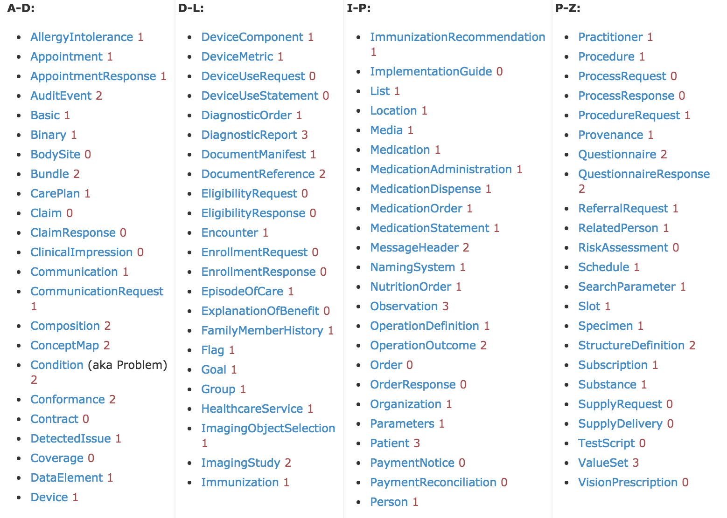
Resource Availability (June 2017)
22 Current Resources
10+ Planned
DSTU 2 for 2017
Rollout to all clients
Then STU3 (TBD)
Writeable:
  Condition
  Doc Ref (xhtml)
  Med Statement
  Allergy Intolerance
  (Observation)
  (Schedule)
Notes:
Visually…
All resources with the exception of DocumentReference allow read access.
DocumentReference, MedicationStatement, AllergyIntolerance and Condition allow write access.

Slide 8










Ignite Developer Program (>1000 apps in sandbox)
Clients
code
Cerner Teams
Sandbox Community
70
Engaged Biz. Develop.
Engaged with Business Development Team
25
Qualified Prospects
Company has proven that they qualify for the program
In Contracting
Contract is with App Company and pending agreement/signatures
7
15
In Program
Fully executed agreement

Slide 9
Licensing & Fees – multiple categories
 | Provider Facing | Patient Facing | Patient MU3
Commercial Developers | All 22 resources Certification required Revenue sharing | All 22 resources Certification required Revenue sharing | Only 11 MU CCDS NO Certification Any app can connect
Client Developed (internal use) | All 22 resources No Certification No Revenue sharing | All 22 resources No Certification No Revenue sharing | All 22 resources No Certification Any App can connect
Open Source | Someone has to host Someone has to manage ??? | Someone has to host Someone has to manage ??? | Only 11 MU CCDS NO Certification Any app can connect
IP entanglement is minimized due to use of standard APIs:
  App developers retain all rights and ownership of their own IP
  Limited license granted to Cerner for testing, etc.
  NDA is required only for developers who wish to become members and undergo certification

Slide 10
21CC: “All electronic data” = HIPAA “Designated Record Set”?
Individuals have a right to access a broad array of health information about themselves maintained by or for covered entities, including:
  medical records;
  billing and payment records;
  insurance information;
  clinical laboratory test results;
  medical images, such as X-rays;
  wellness and disease management program files;
  clinical case notes

Slide 11
Increasing Role of Consumer Mediated Exchange
HIPAA Right of Access -> paper copy, for a fee
Blue Button -> download text
MU2 - “View Download and Transmit” -> structured data for free
MU3 - Consumer-facing API -> “connect apps of their choice”
Aggregator Apps
  One portal at a time
  Like “Mint for Healthcare”?
Aggregation Services
  One stop shopping for all your portals / all your data
  Like a credit check?
Will this become “Consumer Directed Exchange?”
  Does “right of access” allow for open-ended delegation?
  Risks of bypassing HIPAA protections?

Slide 12

EHR as Open Platform – The Emerging Picture
FHIR Data
Subscriptions
FHIR
Exports
Analytics
DB
SMART / FHIR / CDSH
Services
EHR Platform
SMART
Apps
SMART
Components
FHIR-based
Mobile Apps
CDS Hooks Alerts
EHR WORKFLOW

