Slide 1
SMART on FHIR
for managed authorised access to medical records
https://www.slideshare.net/mobile/BrettEsler/2016-sep-smart-on-fhir-75760729?qid=63626df8-0434-4c76-a3ca-37a02d94155a&v=&b=&from_search=5

Slide 2
SMART
Substitutable Medical Apps Reusable Technologies
Started as a US research project
Boston Children’s Hospital Computational Health Informatics Program and the Harvard Medical School Department for Biomedical Informatics
Open Standards
Aligning with FHIR® standards development
Funded by US Office of the National Coordinator
US Argonaut Project:12+ funding vendors; 70+ others

Slide 3
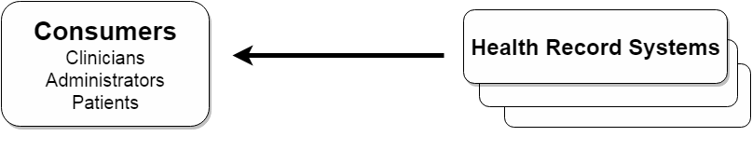
What is SMART about?
Consumers want to use info in varied ways
Health record systems are many and varied

Slide 4
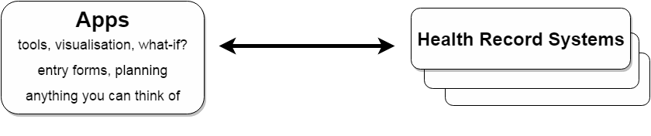
SMART Apps
plug-and-play; substitutable
Need some things:
  clinical data: format and terminology
  authentication/authorisation: policy, decisions
  appropriate access: mobile, web, integrated

Slide 5
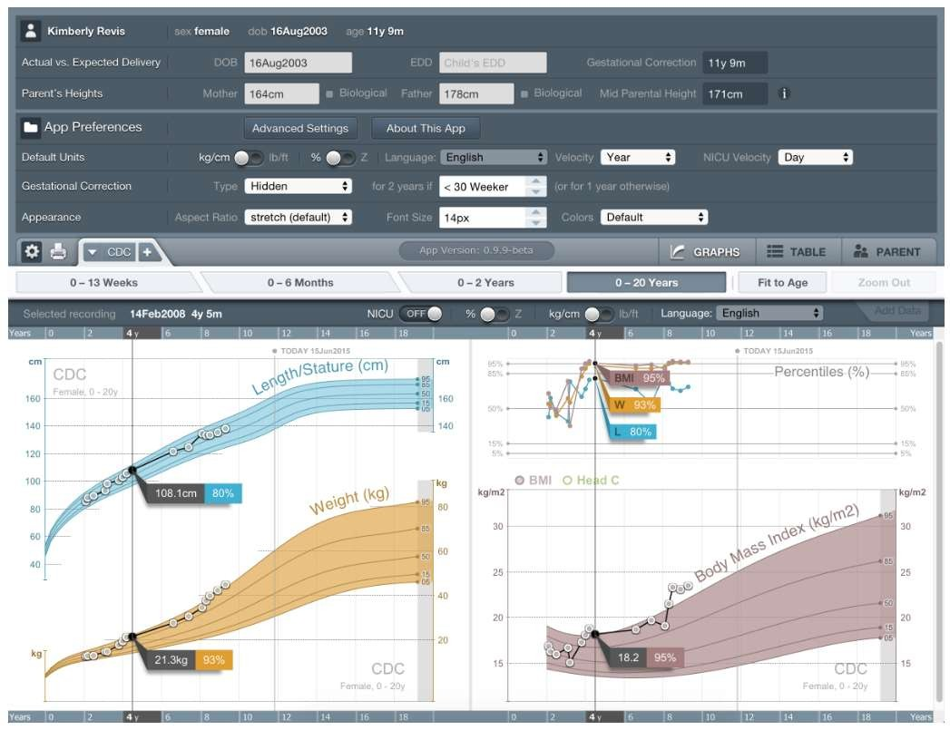

Slide 6
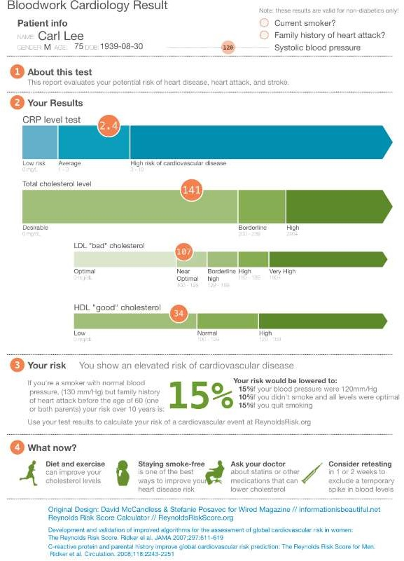

Slide 7
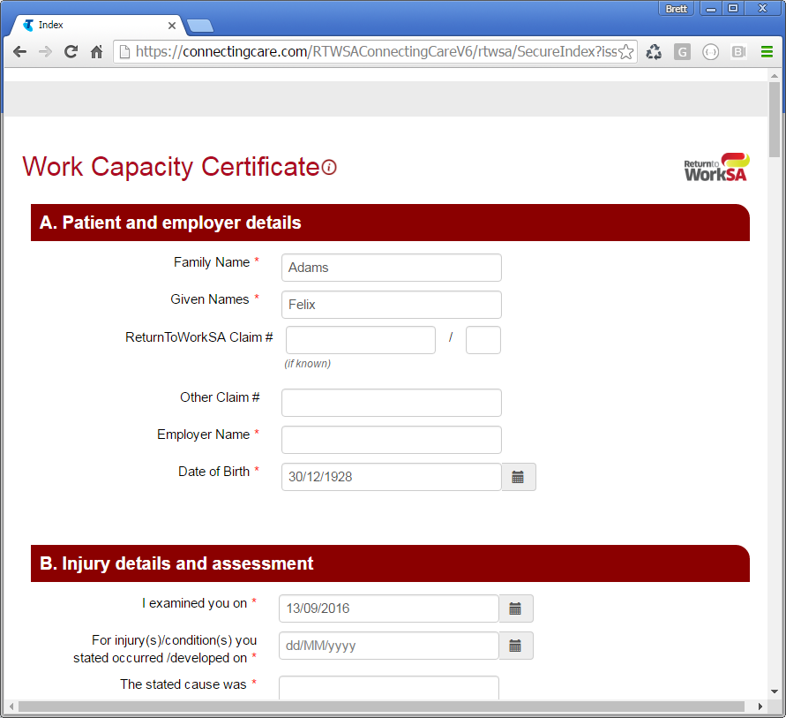
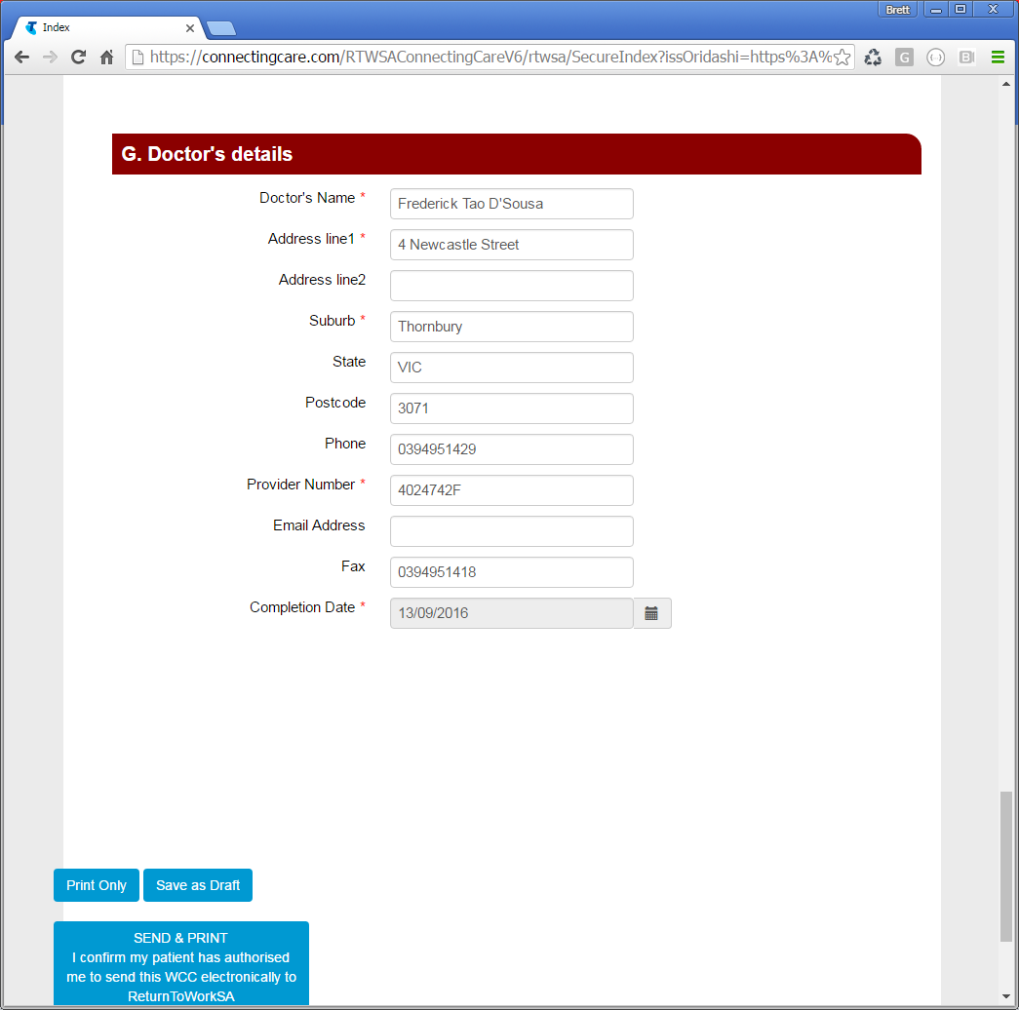

Slide 8


Clinical Data
Common API to Health Record Systems
FHIR® as common format, search
Terminology and vocabulary
Profiles – Argonaut, HL7 Australia
Apps need data and can create data

Slide 9
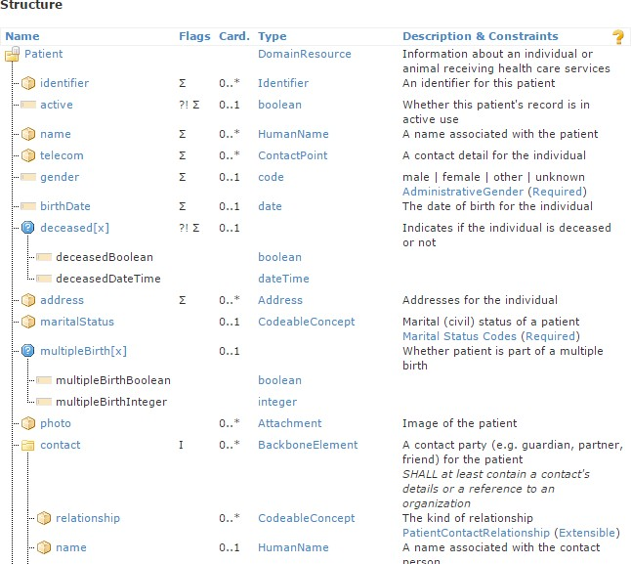
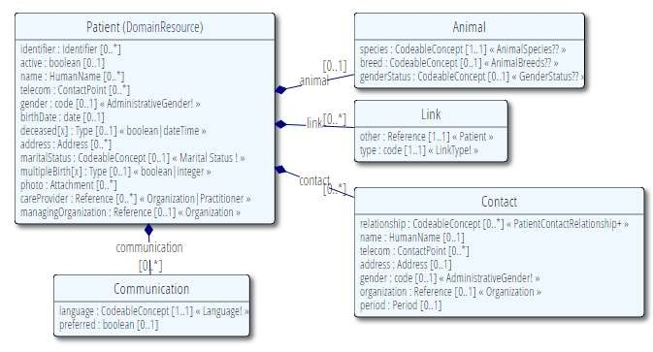

Slide 10
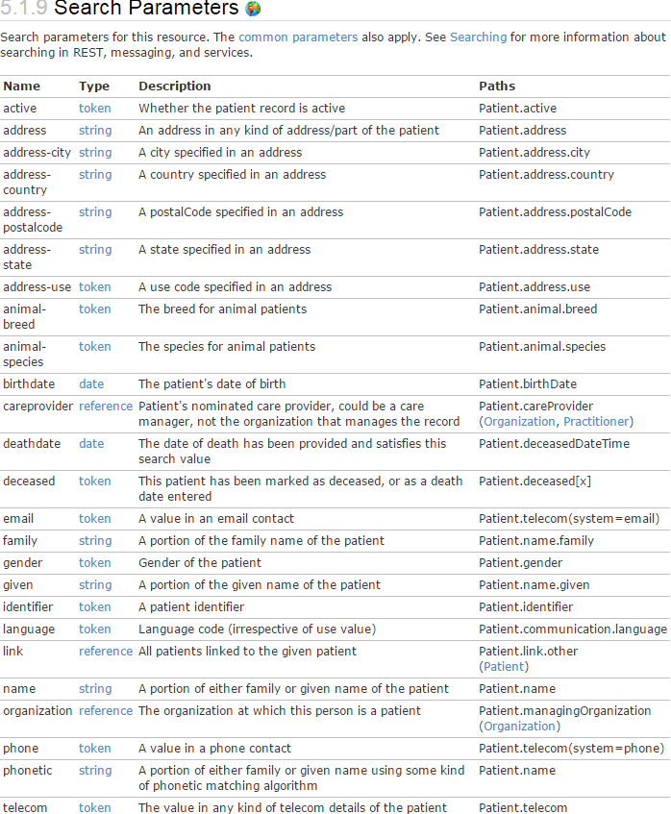

Slide 11
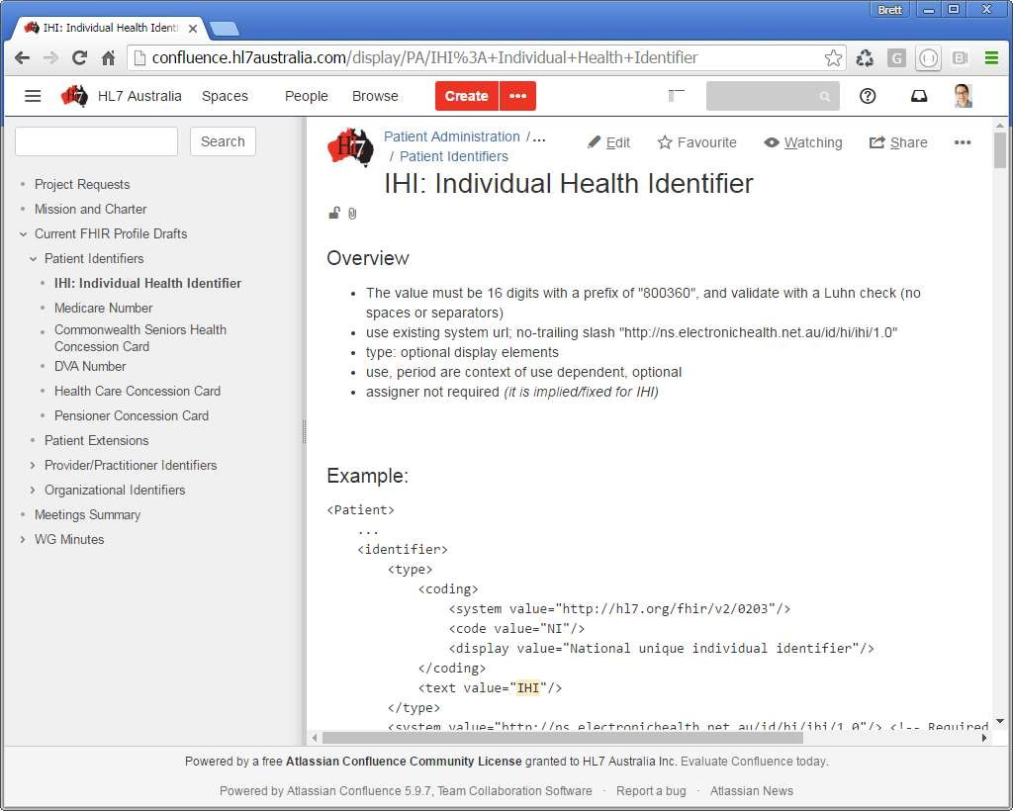

Slide 12
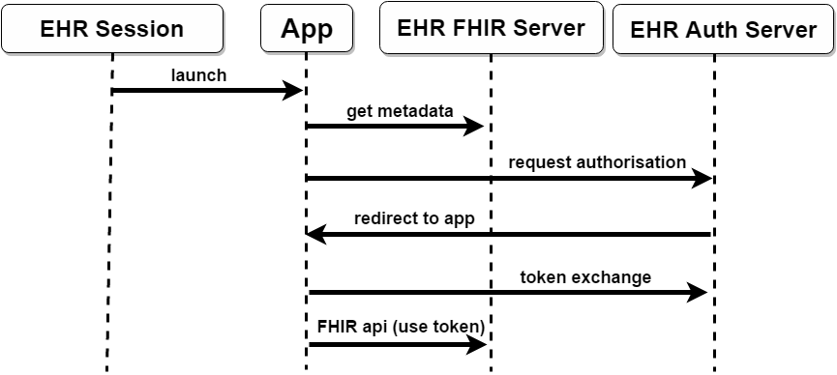
Authentication/Authorisation
Establish security context (OAuth2)
Launch an application (supply FHIR server endpoint)
Locate the EHR Auth Server (Conformance)
Obtain security token for FHIR server access

Slide 14
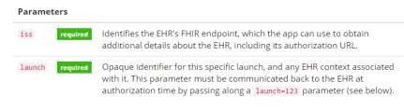
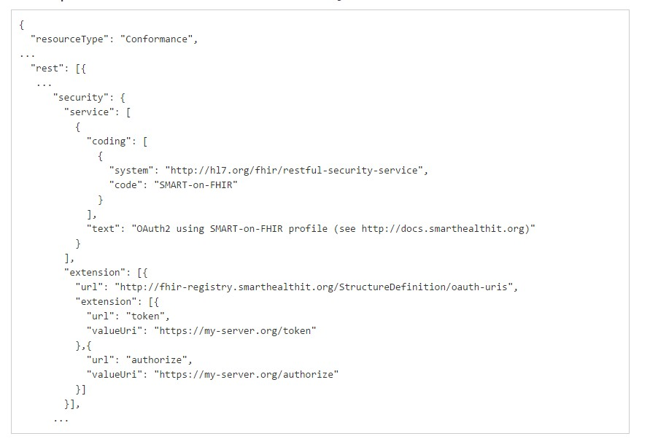
Launch and Metadata
URL launched app (iss locates FHIR server)
FHIR Server Metadata resource (locates Auth server)

Slide 16
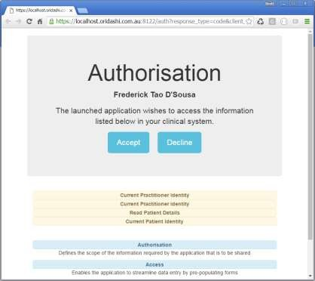
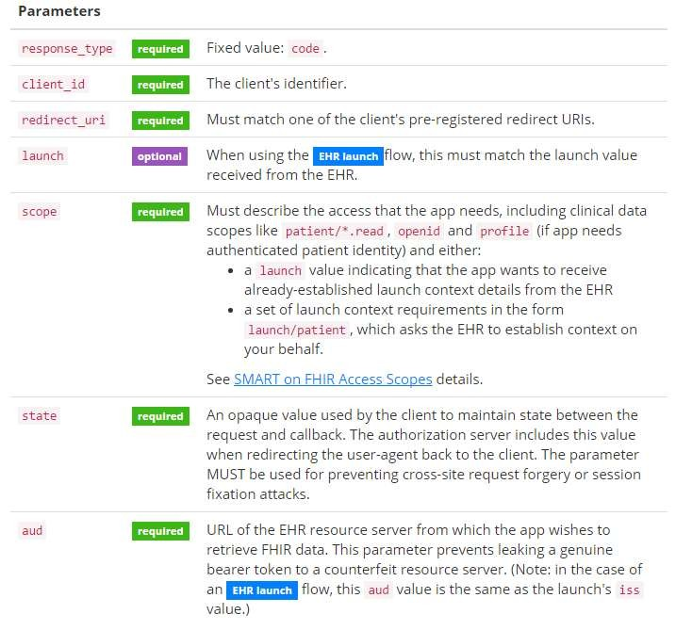
Request Authorisation
Check user is authenticated
Request authorised scope of use

Slide 18
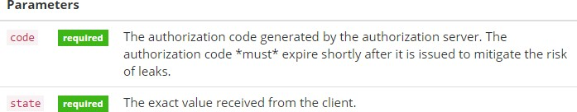
Redirect to App
Auth server redirects to App URL location
URL is registered as a well known application
Supplied code parameter to obtain token

Slide 20
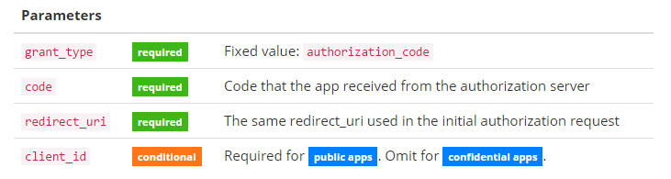
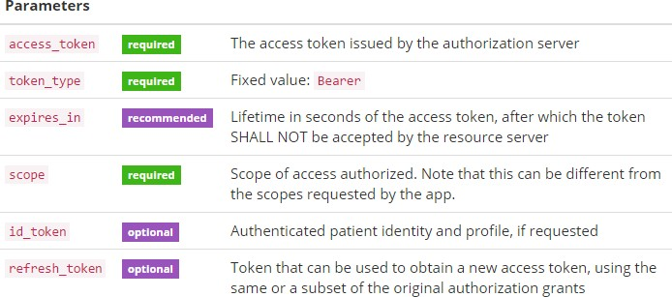
Token Exchange
POST to Auth server to obtain a security token
JSON Response: access token, granted scope, patient/user context

Slide 21
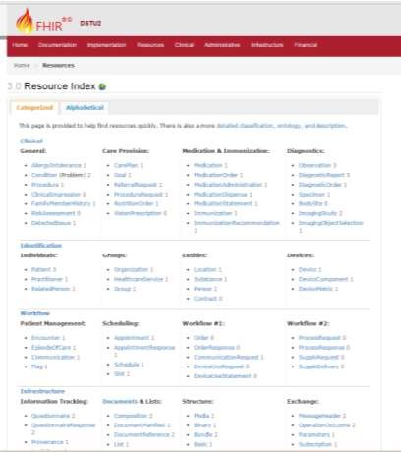
FHIR API Access
GET https://ehr/fhir/Patient/123
Authorization: Bearer i8hweunweunweofiwweoijewiwe

Slide 22
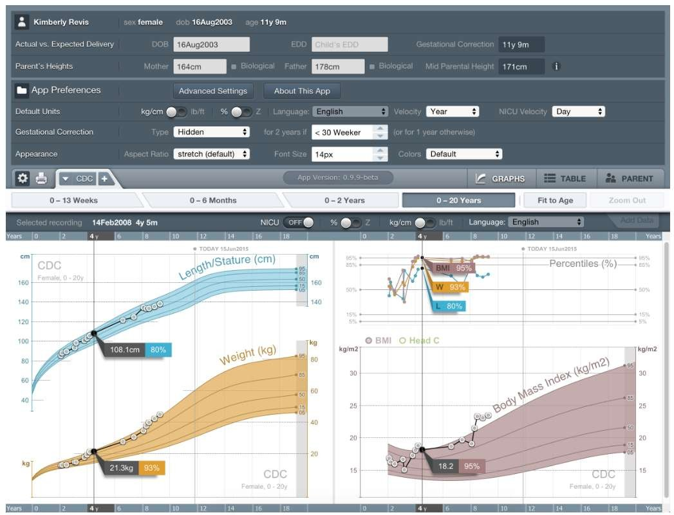
GET Patient (Name, DOB, Gender)
GET Observation (LOINC Height, Weight, BMI)

Slide 23
SMART on FHIR
for managed authorised access to medical records
http://docs.smarthealthit.org/
https://gallery.smarthealthit.org/
http://hl7.org/implement/standards/fhir/ http://confluence.hl7australia.com/

