Slide 1
Experience with the deployment of biomedical applications on the grid
Vincent Breton
LPC, CNRS-IN2P3
Credit for the slides: M. Hofmann, N. Jacq, V. Kasam, J. Montagnat

Slide 2
Who am I ?
Vincent Breton, research associate at CNRS
  Email: breton@clermont.in2p3.fr
  Phone: + 33 6 86 32 57 51
In 2001, I created a research group in my laboratory on grid-enabled biomedical applications
  Web site: http://clrpcsv.in2p3.fr
The PCSV team has been continuously attempting to deploy scientifically relevant applications on grid infrastructures
  FP5: DataGrid
  FP6: EGEE, Embrace, BioinfoGRID, Share
This talk is given from a user perspective

Slide 3
Introduction
A few principles
Grids for life sciences and healthcare: the vision
EGEE biomedical applications
  Focus on medical data manager
First large scale deployments: the WISDOM data challenges on malaria and avian flu
Perspectives
Conclusion

Slide 4
A few principles
Basic principles we used to achieve scientific production on grids
  Principle n°1: the bottom-up approach
  Principle n°2: the grid risk
  Principle n°3: the natural choice
  Principle n°4: the minimum effort
These principles are not relevant to people who are doing research on grids

Slide 5
Principle n°1: the bottom-up approach
There are two complementary approaches to doing science with grids
  Top-down (à la MyGRID): start from end users and integrate grid services as appropriate
  Bottom-up (our approach): start from the services made available by the grid infrastructures
Our philosophy: identify and deploy the science that can be done with the services available
  It requires to understand both the needs of the user communities and the services available on the grids
Consequence: don’t ever wait for the next generation middleware
  It will not hold on premises !

Slide 6
Principle n°2: the grid risk
Most scientific applications today do not require grids
  Most data crunching applications require only cluster computing
  Most data applications do not require grids
By gridifying them, new perspectives are open
  Exemple: virtual screening
Remember the pioneers building planes
  First planes were by no mean efficient vehicles for traveling
  It took years and a war to offer a transport service using planes
Look at your grid application as a prototype for the future
  Grid operating systems are going to evolve in the coming years
Consequence: be ready to face skepticism

Slide 7
Principle n°3: the natural choice
To achieve scientific production, we needed help
  Developing our own middleware or building our own grid infrastructure was very expensive and out of reach
  Learning how to use a middleware was already expensive
  Being alone would have been a very heavy burdeon
Looking at principle n°1, we had to make compromises
  User support and accessibility at the price of reduced functionalities provided by EGEE middleware services
Consequence: look around you and make sure to choose the technology for which you will get the strongest support

Slide 8
Principle n°4: minimum effort
keep in mind there are two steps
  Application development requires services
  Application deployment requires an infrastructure offering the services used to develop application
At development stage, it is tempting to use services not yet available on the infrastructure
  Very important additional cost to maintain additional services
To achieve scientific production, it is import to stick to the middleware released
  As a consequence, put as much pressure as possible to get the services you need in the middleware release
Consequence: think carefully in terms of the middleware and the infrastructure you will need

Slide 9


the Vision
Computing Grid
For data crunching applications
An environment, created through the sharing of resources,
in which heterogeneous and dispersed data :
  molecular data (ex. genomics, proteomics)
  cellular data (ex. pathways)
  tissue data (ex. cancer types, wound healing)
  personal data (ex. EHR)
  population ( ex. epidemiology)
as well as applications, can be accessed by all users as an tailored information
providing system according to their authorisation and without loss of information.
Data Grid
Distributed and optimized storage of large amounts of accessible data
Knowledge Grid
Intelligent use of Data Grid for knowledge creation and tools provisions to all users

Slide 10
Biomedical applications are running today on grids world wide!
Computing Grid
For data crunching applications
Computing grid applications are being deployed successfully
A few successful data grids (BIRN, BRIDGES, Medical Data Manager)
No knowledge grid yet deployed
Knowledge Grid
Intelligent use of Data Grid for knowledge creation and tools provisions to all users
Data Grid
Distributed and optimized storage of large amounts of accessible data
Notes:
Ontology is the sweet spot for HL7 (Health Level Seven, the US based Standards Development Organization that does ascyncronous messaging currently). The issue is HL7 does not yet realize (or is just beginning to recognize) that they should/could be the right organization to take on the ontology efforts.
Do you think I should highlight some of the UCSD/SDSC Grid service offerings and Optiputer? I did not go into specifics, but it might be a nice complement your talking points.

Slide 11
Biomed Achievements (I)
Goal: demonstrate grid potential for real-scale biomedical applications.
Start of EGEE in Apr 04: several app. prototypes developed, not yet deployed.
First year achievements
  Organization of work
    Creation of the “Biomed” Virtual Organization
    Deployment of associated services (guinea pig VO)
      Definition of application test cases
      Use of them to test new or updated EGEE components
    Creation of the “Biomed Task Force”
      Biomedical user support: GGUS, Data Challenge, tutorials, …
      Collaboration with middleware and infrastructure activities
  Application deployment
    Successful deployment of applications in the field of bioinformatics and medical imaging
    ~70k jobs from Biomed users reported at EGEE’s first review

Slide 12
Biomed Achievements (II)
Development of secured data management and complex data flows on the grid
  Medical Data Management group has demonstrated complete chain for processing medical images on the grid using these services
First CPU-intensive grid deployments for bioinformatics in the world
  In silico drug discovery against malaria and bird flu
  Very large impact in the grid community
  Biologically-relevant results being processed
Sustained growth of the “Biomed” VO
  New apps. interested in joining the VO: 11 in DNA4.4 inventory
  3 sub-areas: bioinformatics, medical imaging, drug discovery
  ~80 users
  1000 jobs / day on average

Slide 13
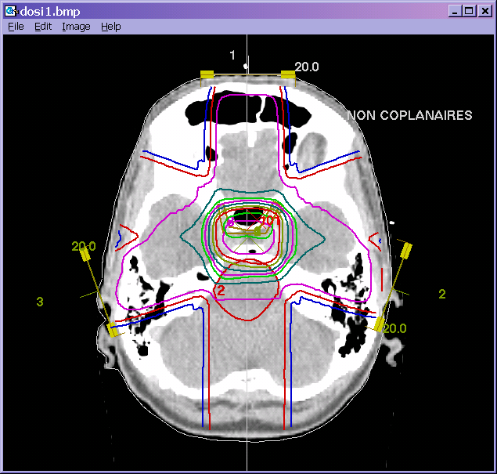
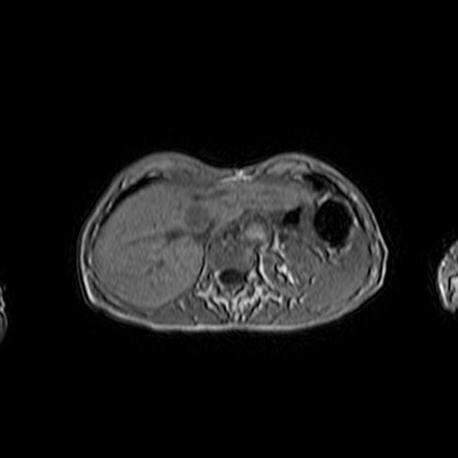
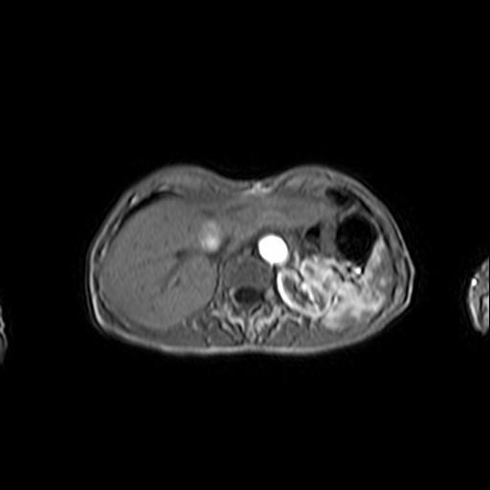
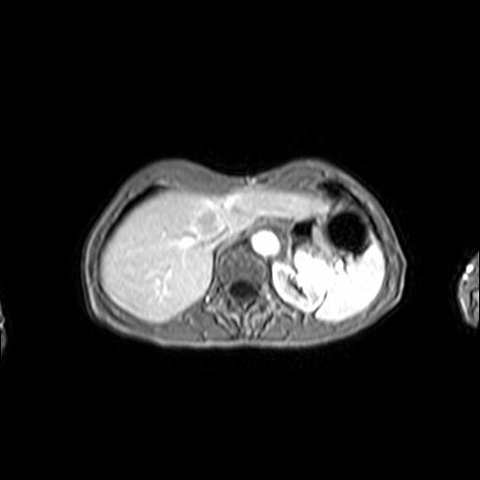
Medical image processing
GATE: Radiotherapy planning
  CNRS-IN2P3
  Monte Carlo simulation
  Parallel execution on
  different seeds
Pharmacokinetics: contrast agent diffusion study
  UPV
  Medical images
  registration
  Distribution of
  registration pairs

Slide 14
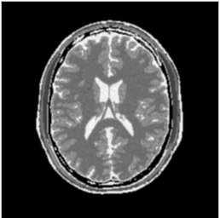
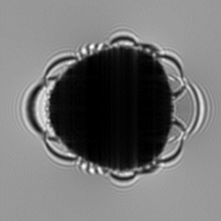
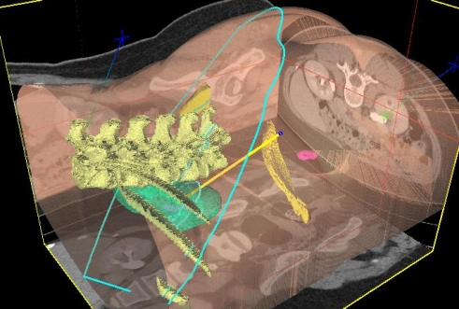
Medical image processing
SiMRI3D MRI simulation
  CNRS-CREATIS
  Magnetic Resonance physics
  simulation (Bloch’s equation)
  Parallel processing (MPI)
gPTM3D: Radiological images segmentation tool
  CNRS-LRI, CNRS-LAL
  Deformable-contour based
  segmentation
  Interactivity through
  agent-based scheduling

Slide 15
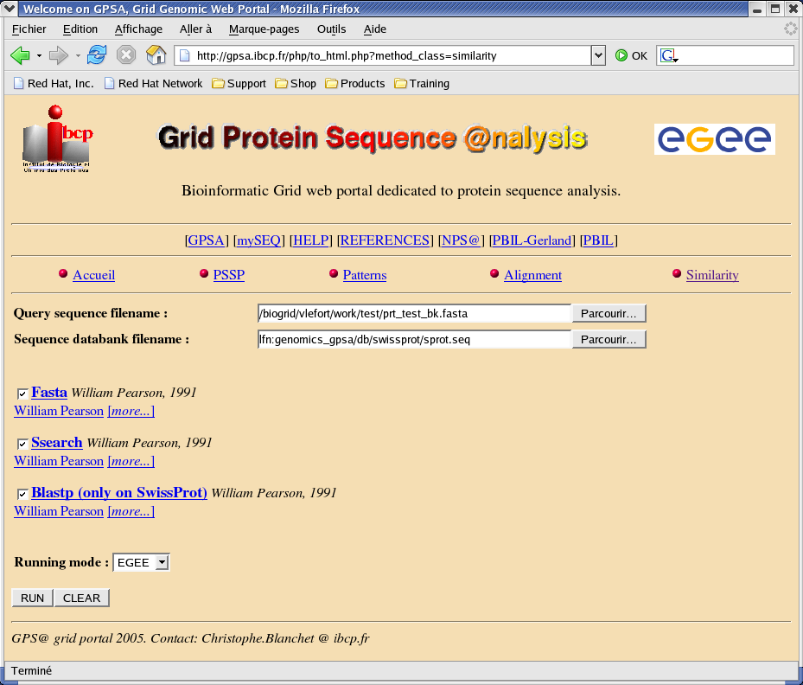
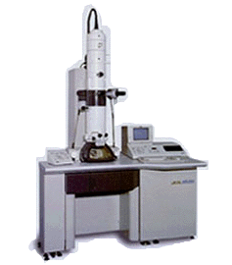
Bioinformatics
GPS@: bioinformatics portal
  CNRS-IBCP
  http://gpsa.ibcp.fr/ web portal
  Existing (but overloaded NPSA portal)
  Tens of bioinformatics legacy code
  Thousands of potential users
Electron-microscopic image reconstruction
  CNB-CSIC
  Image filtering and noise reduction
  3D structure analysis

Slide 16
Potential vs current impact of EGEE applications on scientific community
Application | dev | user | Potentially impacted community | Most limiting factors
GATE | 8 | 12 | 400 | Overhead on jobs execution time Middleware stability Storage space
CDSS | 9 | 9 | 30 (mental diseases) + 50 (soft tissue tumours) in a short term. | For production: overhead for short jobs. For training the classifiers: computing time (around 1 week)
gPTM3D | 0.5 | 1 | Tens (clinical researchers) | Jobs submission response time (in particular queuing delay) Lack of firewall-proof connectivity solution
SiMRI3D | 10 | 10 | Several hundreds from the MR physics, medical and image processing communities | Correct handling of MPI jobs (too many errors today). Lack of scheduling time estimation.
Bronze Std | 2 | 4 | Tens to hundreds once a proper interface has been set up. | Capacity to handle lot (hundreds) of jobs concurrently in an efficient manner. Currently the speed-up achieved is far from the expected bound. This is still under investigation but probably related to the bottlenecks of centralized RBs / UIs.
Pharmcok. | 9 | 10 | Hundreds when the tool will prove stable and accurate enough. | Sufficient computing power dedicated to the application. In production it should represent 3 CPU years per year.
GPS@ | 3 | 10 | Difficult to estimate as the portal is opened anonymously to the biological community (probably several thousands) | Efficient handling of short jobs. Anonymous users authorization. Automatic replication.
Xmipp_ML | 5 | 10-15 | Will be proposed to a NoE: hundreds. | CPU intensive Reliable MPI support High data throughput (data replication)
SPLATCHE | 4 | 5 | Limited to a community of specialists in a short term | Sufficient CPUs availability (> 70) to compete with local cluster Multi-data jobs submission capability
WISDOM | 8 | 9 | 20 in a short term (2006). In the order of 100 later. | Reliability of services, especially WMS Security of data Number of CPUs
GROCK | 4 | Tens | Thousands | Difficulty to reliably detect 'hung' processes in the working nodes.
Reference: EGEE deliverable DNA4.1

Slide 17
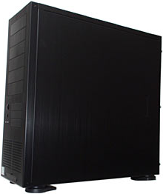
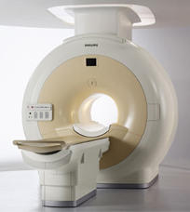
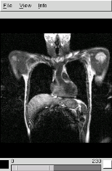
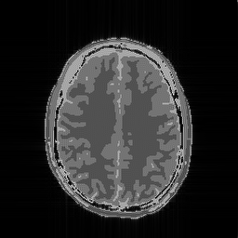
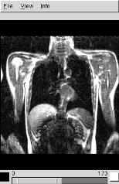
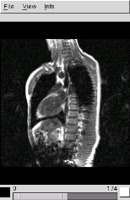
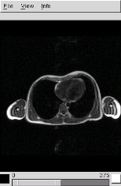
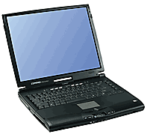
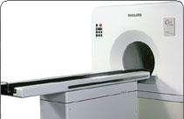
Medical Data Manager
Objectives
  Expose a standard grid interface (SRM) for medical image servers (DICOM)
  Use native DICOM storage format
  Fulfill medical applications security requirements
  Do not interfere with clinical practice
DICOM
Interface
SRM
Worker Nodes
DICOM server
DICOM clients
User Interfaces

Slide 18
High-level Grid Services Req’d
Legal constraints demand that patient data be treated in accordance with strict confidentiality requirements.
Data are naturally distributed (and controlled) by a large number of distributed sites, typically hospitals.
Medical images and associated patient metadata may have different access rights.
Grid technology must integrate well with existing hospital infrastructures
  Significant investment in existing equipment
  Little expertise for deploying and maintaining grid services

Slide 19
Interfacing sensitive medical data
Privacy
  Fireman provides file level ACLs
  gLiteIO provides transparent access control
  AMGA provides metadata secured communication and ACLs
  SRM-DICOM provides on-the-fly data anonimization
    It is based on the dCache implementation (SRM v1.1)
Data protection
  Hydra provides encryption/ decryption transparently
gLite 1.5 service
Fireman
File
Catalog
gLite 1.5 service
gLiteIO
server
NA4/ARDA service
AMGA Metadata
NA4 service
SRM-DICOM
Interface
gLite 1.5 service
Hydra
Key store

Slide 20



Bronze Standard Application
Medical image registration algorithms assessment
  Registration needed in many clinical procedures
  Real clinical impact
Interfaced to the medical data manager
  To retrieve suitable input images
Compute intensive
  Medical image registration algorithms: minutes to hours of computations on PCs
Data intensive
  Hundreds to thousands of image pairs
Workflow-based
  Using MOTEUR service-based workflow manager
  Developed in the French ACI “Masse de données” AGIR project

Slide 21

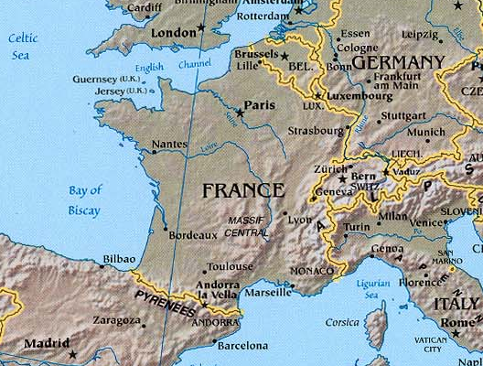



Demonstration at last EGEE review
3 SRM-DICOM servers with gliteIO servers (NA4 sites)
AMGA (NA4 site), Fireman, Hydra (JRA1 site)
Fireman
File
Catalog
Short Deadline
queue
Orsay
Hydra Key store
3.0
CERN
Lyon
AMGA Metadata
Nice

Slide 22
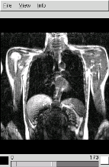
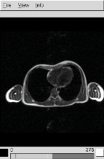
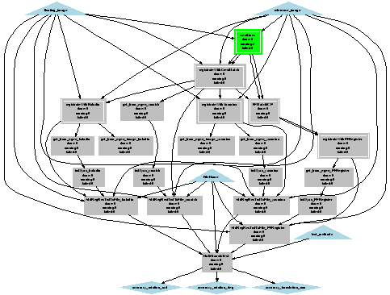
Moteur workflow
Service status:
Not started
(waiting
inputs)
Service status:
Running
Processed: 2
Errors: 0
Service status:
Pending
Service status:
Running
Processed: 5
Errors: 0
Service status:
Completed
Processed: 8

Slide 23

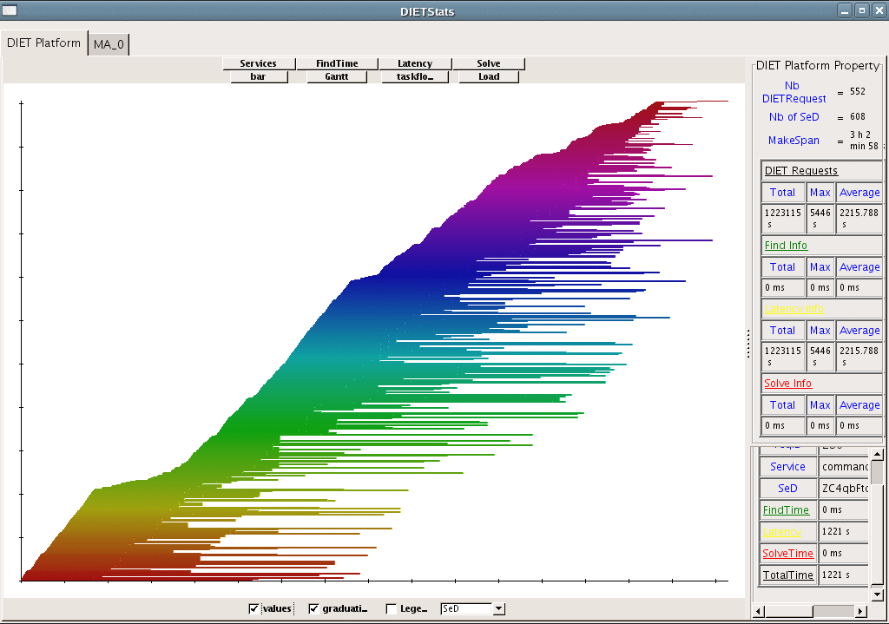
Post-mortem trace
Parallel
processes
orchestrated
by MOTEUR
Processes
0 100 200 300 400 500 600
Execution time
0 1h 2h 3h

Slide 24
Perspectives for Medical Data Manager
Medical Data Manager is the first grid service allowing secure manipulation of medical data and images
Concern: key middleware components of Medical Data Manager not included in gLite 3.0
Bronze standard application is producing scientific results
  Algorithm assessment

Slide 25
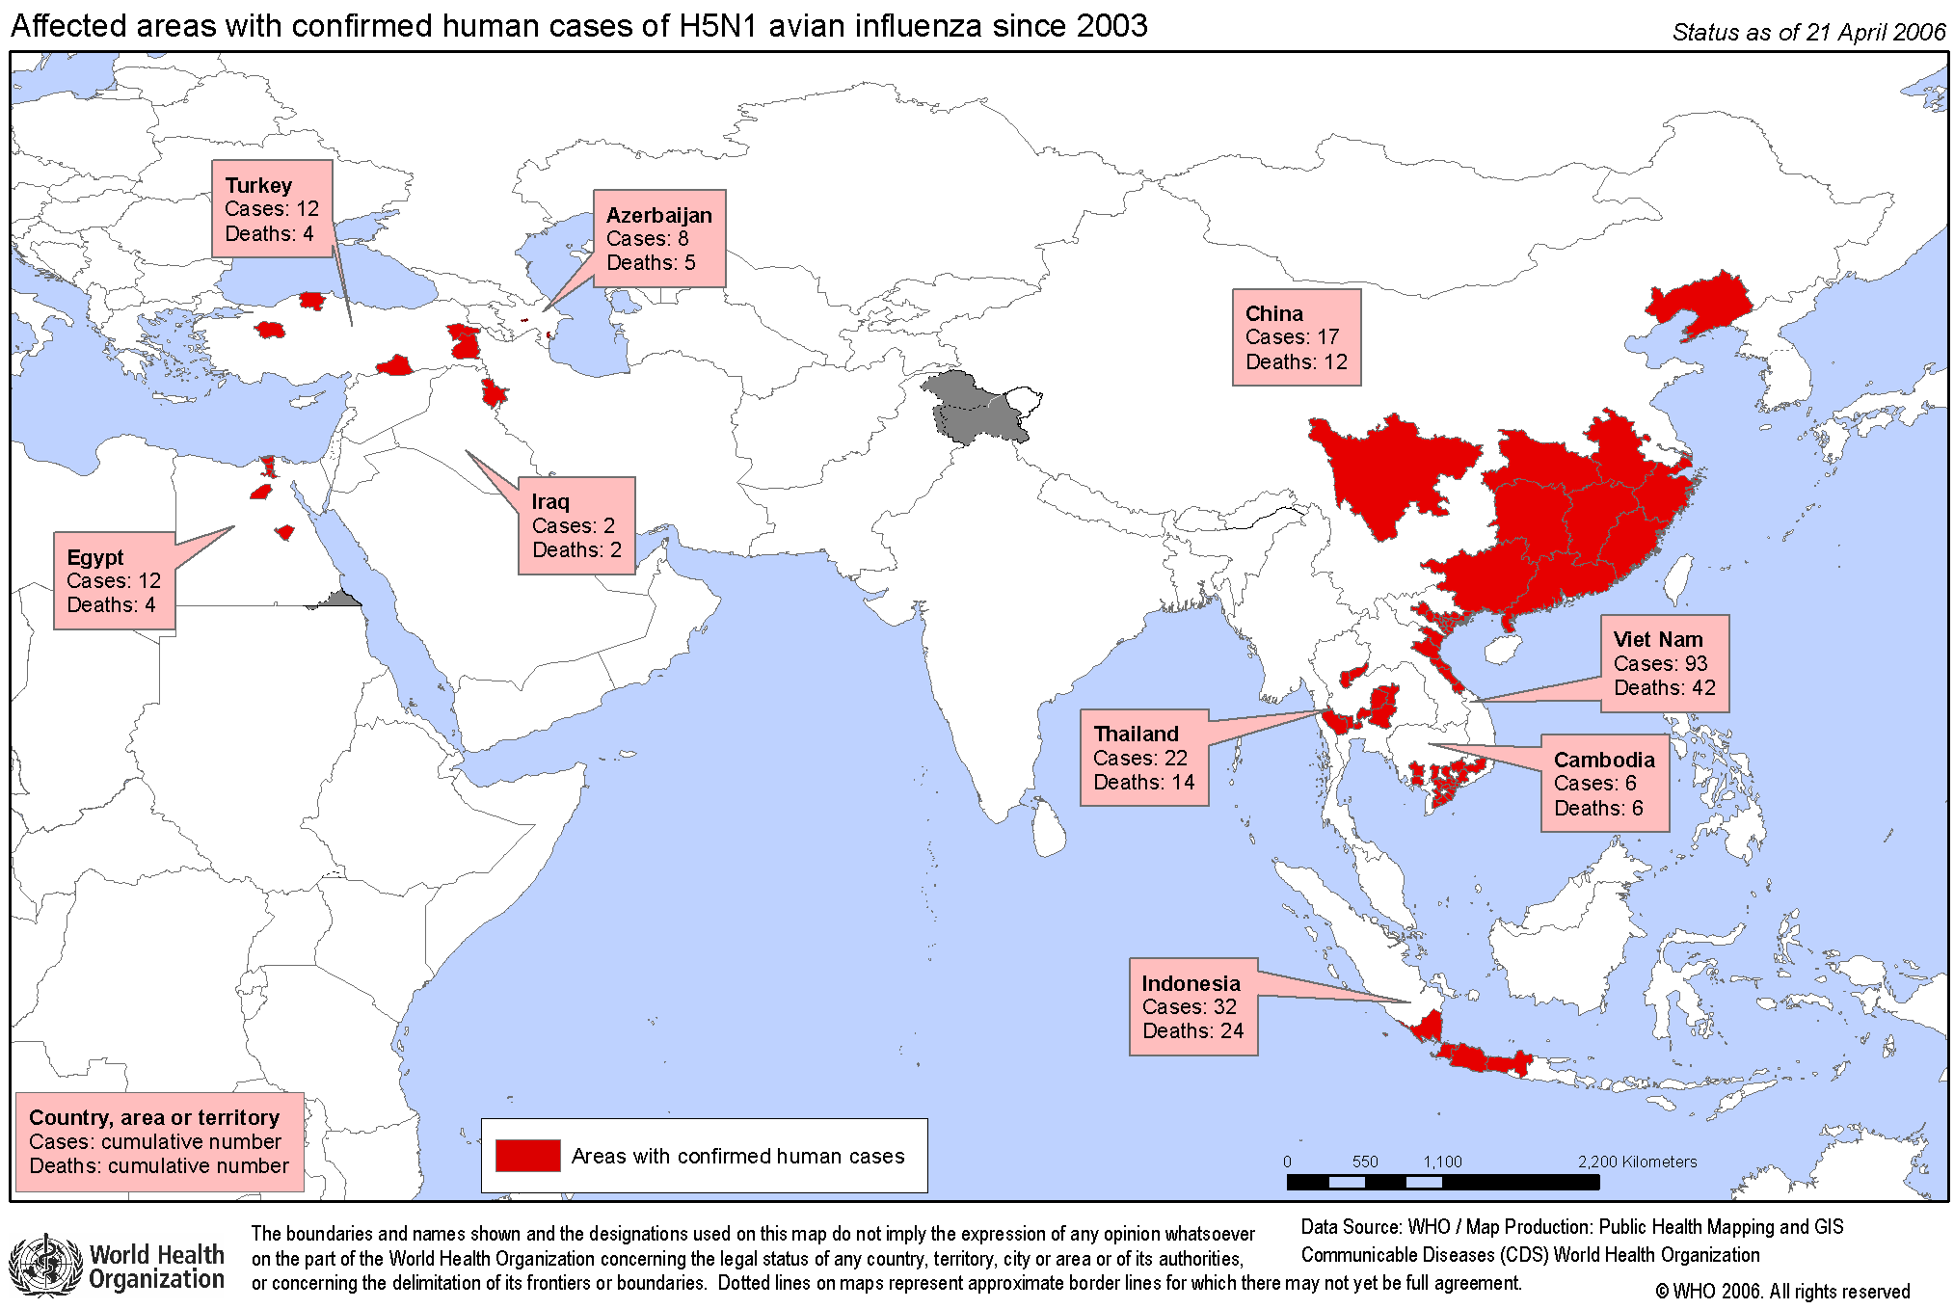
Addressing neglected and emerging diseases
Neglected and emerging diseases are major public health concerns in the beginning of the 21st century
  Neglected diseases keep suffering lack of R&D
  Emerging diseases are a growing threat to world public health
Both emerging and neglected diseases require:
Early detection
  Emergence, resistance
Epidemiological watch
  Emergence, resistance
Prevention
Search for new drugs
Search for vaccines
Avian influenza:
human casualties

Slide 26
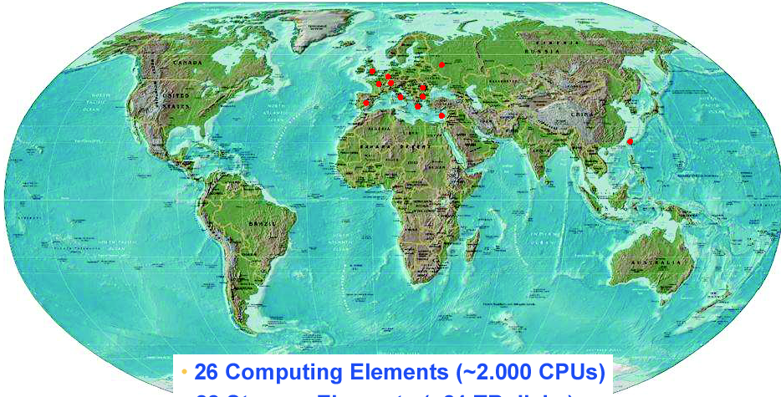
The grid added value for international collaboration on emerging and neglected diseases
Grids offer unprecedented opportunities for sharing information and resources world-wide
Grids are unique tools for :
Collecting and sharing information (Epidemiology, Genomics)
Networking experts
Mobilizing resources routinely or in emergency (vaccine & drug discovery)

Slide 27
In silico drug discovery against neglected and emerging diseases
Grids open new perspectives to in silico drug discovery
  Reduced cost for R&D against neglected diseases
  Accelerating factor for R&D against emerging diseases
EGEE plays a pioneering role in exploring grid impact
  Data challenge against malaria in the summer 2005
  Data challenge against bird flu in April-May 2006
H.C. Lee talk will
describe the work
done on Avian flu

Slide 28

Burden of Diseases in Developing World

Slide 29
Where grids can help addressing neglected diseases
Contribute to the development and deployment of new drugs and vaccines
  Improve collection of epidemiological data for research (modeling, molecular biology)
  Improve the deployment of clinical trials on plagued areas
  Speed-up drug discovery process (in silico virtual screening)
Improve disease monitoring
  Monitor the impact of policies and programs
  Monitor drug delivery and vector control
  Improve epidemics warning and monitoring system
Improve the ability of developing countries to undertake health innovation
  Strengthen the integration of life science research laboratories in the world community
  Provide access to resources
  Provide access to bioinformatics services

Slide 30
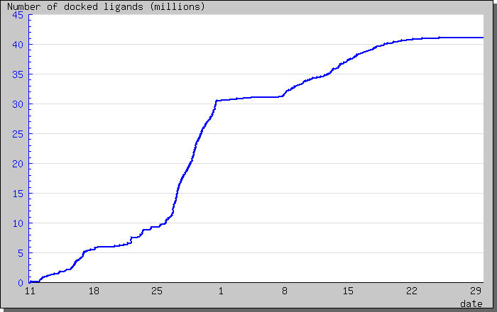
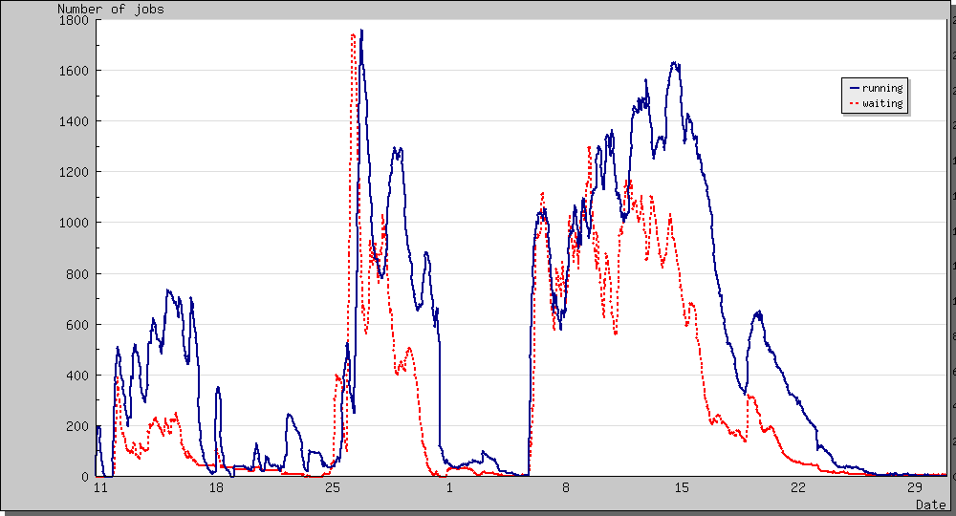
First initiative: World-wide In Silico Docking On Malaria (WISDOM)
Initial partners: Fraunhofer Institute, CNRS – IN2P3
Significant biological parameters
  two different molecular docking applications (Autodock and FlexX)
  about one million virtual ligands selected
  target proteins from the parasite responsible for malaria
Significant numbers
  Total of about 46 million ligands docked in 6 weeks
  1TB of data produced
  Up 1000 computers in 15 countries used simultaneously corresponding to about 80 CPU years
  Average crunching factor ~600
Number of running and waiting jobs vs time
Number of running and waiting jobs vs time

Slide 31
Deployment on EGEE infrastructure, wisdom.eu-egee.fr
Countries with nodes contributing to the data challenge WISDOM
country
sites
country
sites
country
sites
Bulgaria
3
Greece
3
Romania
1
Croatia
1
Israel
1
Russia
2
Cyprus
1
Italy
13
Spain
7
France
9
Netherlands
2
Taiwan
1
Germany
1
Poland
1
UK
10
Total amount of CPU provided by EGEE federation: 80 years

Slide 32
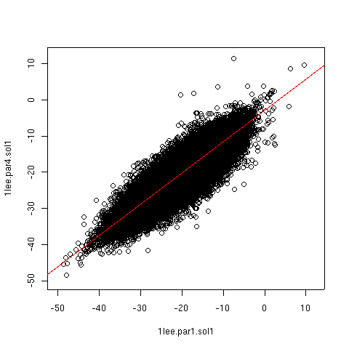
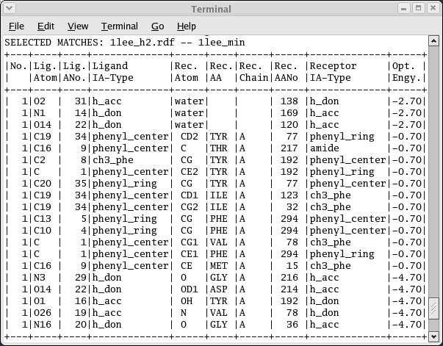
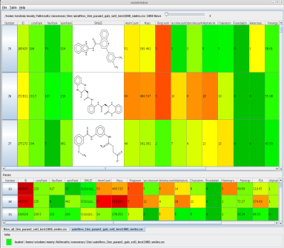
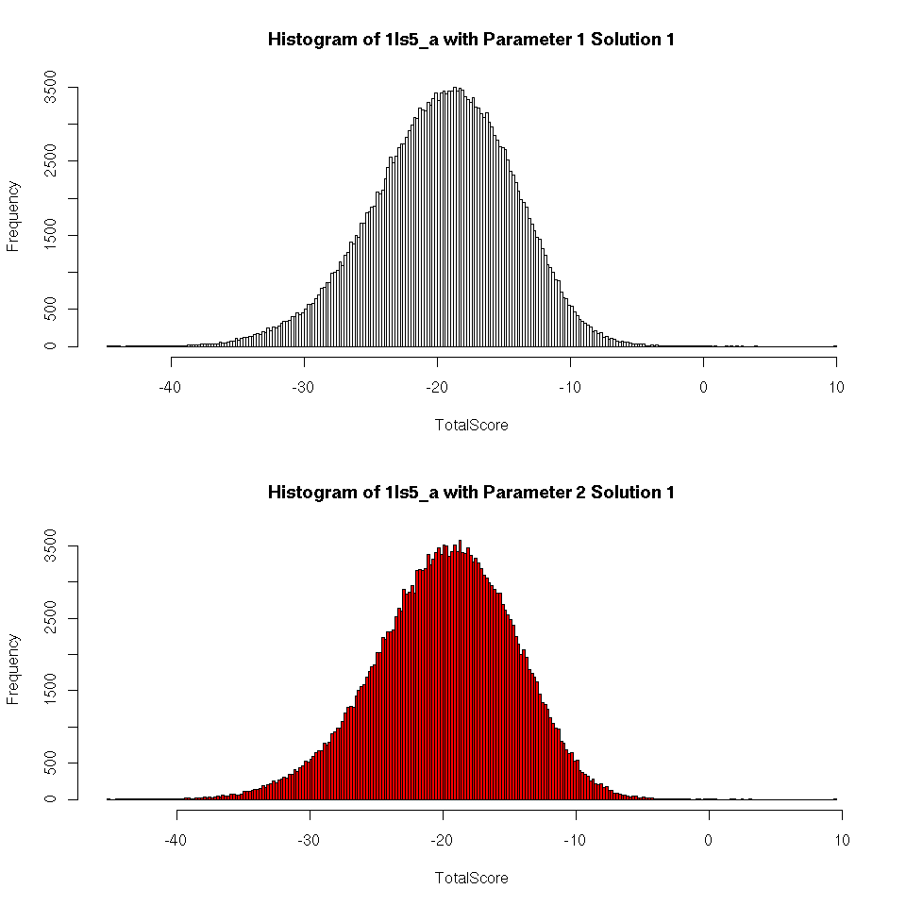
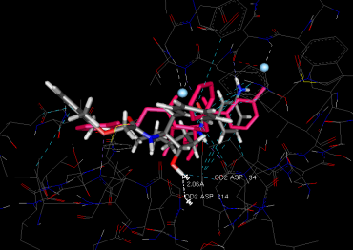
Strategies in result analysis
Results based on Scoring
Results based on match information
Results based on consensus scoring
Results based on different parameter settings
Results based on knowledge on binding site
Credit: V. Kasam
Fraunhofer Institute

Slide 33
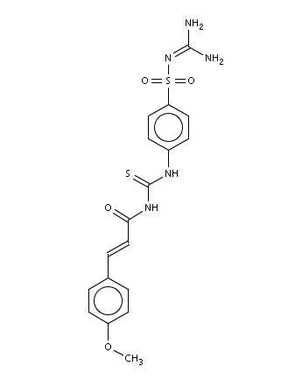
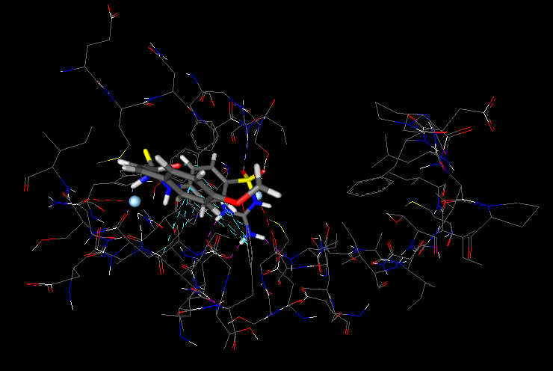
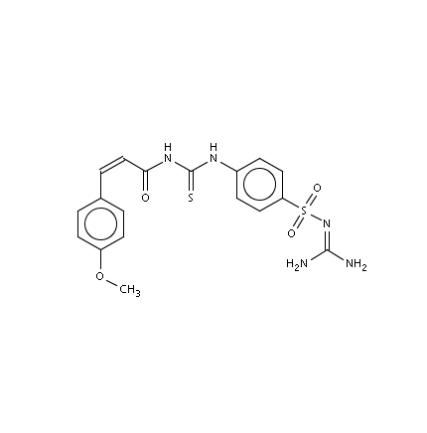
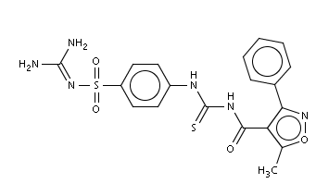
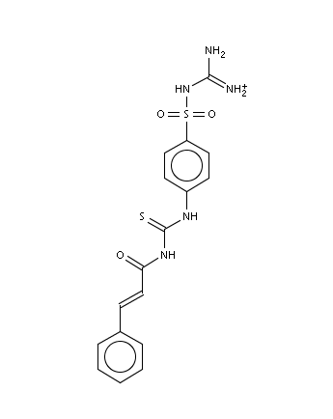
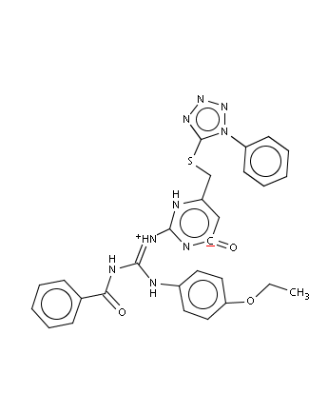
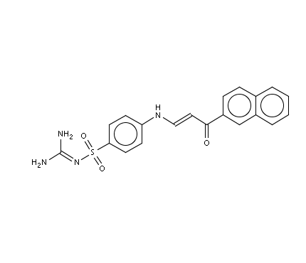
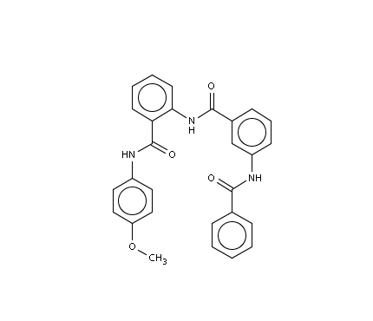
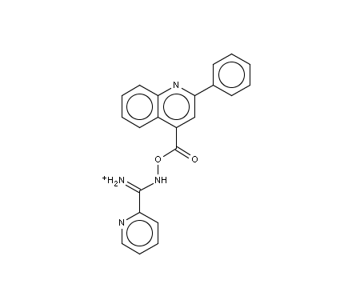
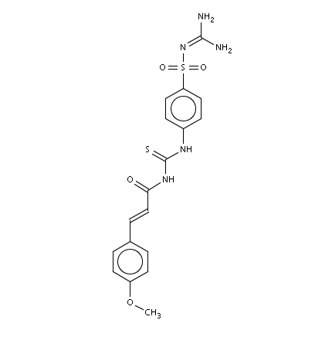
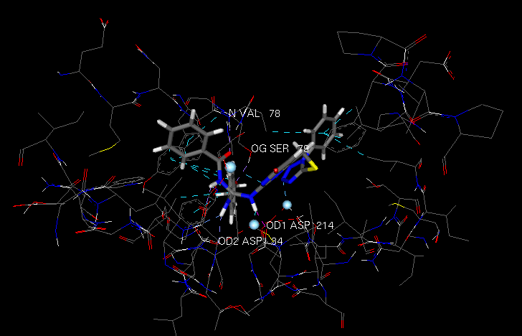
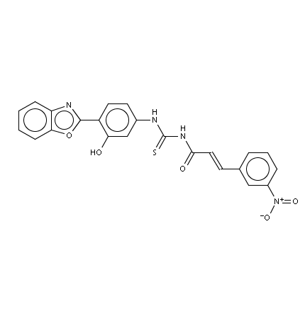
Top 10 compounds by scoring
1. WISDOM-490500
2. WISDOM-491901
3. WISDOM-490515
Top scoring but poor binding mode
4. WISDOM-490514
5. WISDOM-462271
6. WISDOM-235118
7. WISDOM-278345
8. WISDOM-360604
9. WISDOM-490502
Known inhibitors: thiourea and urea compounds
Potentially new inhibitors: guanidino compounds
10. WISDOM-495979
Top scoring, good binding mode, interactions to key residues

Slide 34
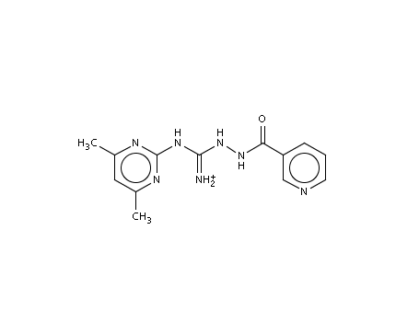
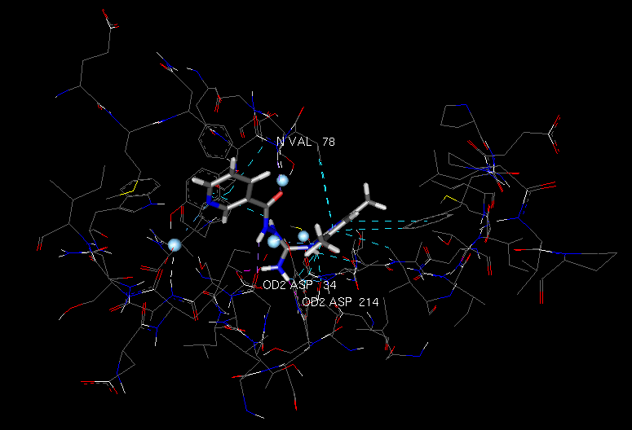
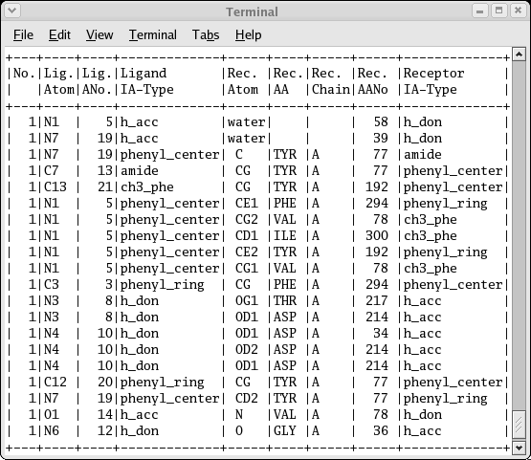
Compounds for Molecular Dynamics: Guanidino compounds
Note: Satisfied all criteria, good binding mode, interactions to key residues, good score, appropriate descriptors.

Slide 35
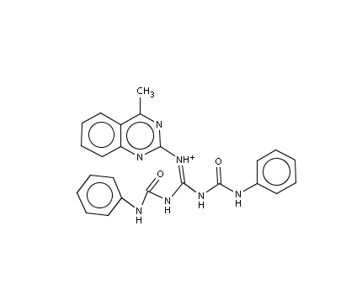
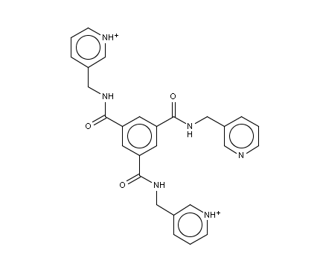
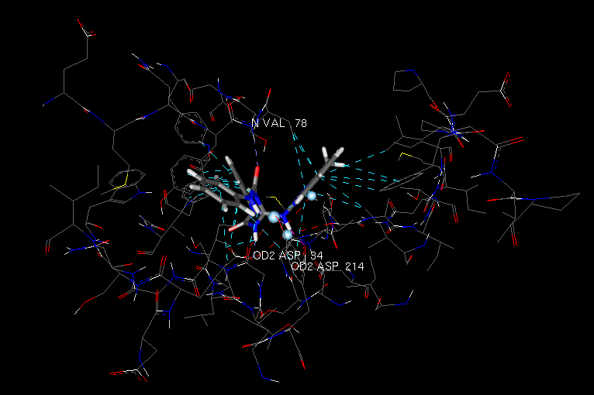





Compounds from consensus scoring
Good binding mode and consensus score
FlexX: 48
Autodock: 33
FlexX: 30
Autodock: 24
FlexX: 77
Autodock: 130
FlexX: 30
Autodock: 97
FlexX: 60
Autodock:160
FlexX: 98
Autodock: 110
Good score but bad binding mode

Slide 36

First initiative on in silico drug discovery against emerging diseases
Spring 2006: drug design against H5N1 neuraminidase involved in virus propagation
  impact of selected point mutations on the efficiency of existing drugs
  identification of new potential drugs acting on mutated N1
H5
N1
Partners: LPC, Fraunhofer SCAI, Academia Sinica of Taiwan, ITB, Unimo University, CMBA, CERN-ARDA, HealthGrid
Grid infrastructures: EGEE, Auvergrid, TWGrid
European projects: EGEE-II, Embrace, BioinfoGrid, Share, Simdat

Slide 37
An unprecedented deployment on grid infrastructures
Up to 2000 computers mobilized in April 2006 to provide more than one century of CPU cycles
Less than 3 months between the first contacts and the achievement of all the required virtual screening
RESULTS ALREADY ACHIVED
Number of docked compounds | 2,5 million
Duration of the experience | 6 weeks
Estimated duration on 1 PC | 105 years
Number of computers | 2000
Number of countries giving computers | 17
Volume of data produced | 600 GB
Distribution of jobs on EGEE federations and Auvergrid

Slide 38
From virtual docking to virtual screening
Grid service customers
WISDOM
Check
point
Check
point
Check
point
Chemist/biologist teams
Biology teams
Selected hits
hits
target
Grid infrastructure
MD service
Docking services
Annotation services
Grid service providers
Chimioinformatics teams
Bioinformatics teams

Slide 39
The next steps
Docking step still requires a lot of manual intervention
  Goal: reduce as much as possible the time needed for experts to analyze the results
  Task: improve output data collection and post-docking analysis
  Contribution from CNR-ITB, within the framework of EGEE-II
The next step after docking is Molecular Dynamics
  Goal: grid-enable the reranking of the best hits
  Task: deploy Molecular Dynamics computations on grid infrastructures
  Contribution from CNRS-IN2P3, within the framework of BioinfoGRID
Beyond virtual screening, the long term vision: building a grid for malaria
  To provide services to research labs working on malaria
  To collect and analyze epidemiological data

Slide 40
A grid for malaria
LPC Clermont-Ferrand:
Biomedical grid
SCAI Fraunhofer:
Knowledge extraction
Chemoinformatics
Embrace
EGEE
BioinfoGRID
Auvergrid
Healthgrid:
Grid, communication
Univ. Los Andes:
Biological targets, malaria biology
Univ Modena:
Molecular Dynamics
ITB CNR:
Bioinformatics,
Molecular modelling
Academica Sinica:
Grid user interface
EELA
Univ. Pretoria:
Bioinformatics, malaria biology
Use the grid technology to foster research and development
on malaria and other neglected diseases
Contacts also established with WHO, Microsoft, TATRC, Argonne, SDSC, SERONO, NOVARTIS, Sanofi-Aventis, Hospitals in subsaharian Africa,

Slide 41
WISDOM-II
WISDOM-II is the second large scale docking deployment against neglected diseases
Biological goals
  Validation of virtual vs in vitro screening
  Virtual docking on new malaria targets
    New targets from Univ. Pretoria, Univ. Los Andes, CEA Grenoble, Univ. Modena
  New compound libraries
    Thai library of compounds
  Possible extension to other neglected diseases
    Contacts with Univ. Glasgow
Grid goals:
  Improve the user interface, the job submission system and the post-processing (BioinfoGRID, EGEE, Embrace)
  Test the infrastructure at a larger scale (100 -> 500 CPU years)
  Test the deployment on several infrastructures: Auvergrid, EGEE, EELA

Slide 42


Perspectives on bird flu
Summer 2006: analysis of virtual screening on bird flu
  Collaboration CNR-ITB, ASGC Taïwan, CNRS
Contacts already established for new targets (University of Los Andes, South America)

Slide 43
WISDOM timeline
WISDOM | MD reranking |  |  |  | In vitro testing |  |  |  | Further processing
WISDOM II | Preparation |  |  |  | Deployment |  | Analysis |  |  |  |  |  | MD reranking
Avian Flu | Analysis |  |  |  |  |  | MD reranking |  |  |  |  |  | Further processing
Avian Flu II |  |  |  |  |  |  | Preparation |  |  |  | Deployment |  | Analysis
Month | 6 06 | 7 06 | 8 06 | 9 06 | 10 06 | 11 06 | 12 06 | 1 07 | 2 07 | 3 07 | 4 07 | 5 07 | 6 07 | 7 07 | 8 07 | 9 07 | 10 07 | 11 07 | 12 07
We are
HERE

Slide 44
Conclusion
Applying 4 principles, we achieved large scale deployment of life science applications
  Principle n°1: the bottom-up approach
  Principle n°2: the grid risk
  Principle n°3: the natural choice
  Principle n°4: the minimum effort
Example of EGEE biomedical applications
  Most of these applications are compute intensive
  Emergence of data grid applications
Exciting perspectives to develop in silico drug discovery
  Collaboration of partners and EC projects
  WISDOM-II, further step towards a malaria grid

