Slide 1
FHIR for Developers
Updated for FHIR DSTU!
Ewout Kramer
January 17, 2014
http://www.slideshare.net/ewoutkramer/hl7-fhir-for-developers

Slide 2
Introduction
Notes:
Time start-10:00 (10 minutes)

Slide 3

Who am I?
Name: Ewout Kramer
Company: Furore, Amsterdam
Background:
  FHIR core team, RIMBAA
  Software developer & healthcare architect
Contact:
  e.kramer@furore.com
  www.thefhirplace.com

Slide 4
Introduce ourselves
About your organization…
HL7 (v2/v3) background?
How did you hear about FHIR?
Platform of choice (.NET, Java, Ruby, …)?
Familiar with HTTP, Xml, JSON, REST?
Persistence technologies used?

Slide 5
Contents of this tutorial
Deconstructing FHIR
FHIR RESTful service interface
Beyond REST
Searching
FHIR on the Wire
Distribution for developers
Building a FHIR server

Slide 6
What perspective?
v3
App
v2
FHIR
PHR
FHIR
Broker
Comm.
Interface
FHIR
DB
Notes:
You’re a message broker routing and translating between v2, v3 and FHIR
Your app interfaces with a PHR using FHIR natively
Your application can communicate using FHIR, but your software uses a proprietary RDBMS
Use FHIR as the common language for a Vendor Neutral Archive
…Or a combination….
You might see data as a nested structure of XML, a series of tables with keys, class-diagrams….

Slide 7
Deconstructing FHIR
Looking at FHIR data modeling concepts from a software engineering perspective
Notes:
Time: 10:00-40:00 (30 minutes)

Slide 8


Resources (review!)
“Resources” are:
  Small logically discrete units of exchange
  Defined behaviour and meaning
  Known identity / location
  Smallest unit of transaction
  “of interest” to healthcare
  V2: Sort of like Segments
  V3: Sort of like CMETs

Slide 9
Composition versus reference
FHIR makes composition and references explicit:
  References are in between Resources. No context conduction across references – safe retrieval as individual resources.
  Composition is within a Resource: Components have no meaning outside resource, no identity, no separate access path except through resource
Notes:
No context conduction: if a Condition resource references a particular Patient as it's subject, and it links to a Procedure resource as it's cause, there is no automatic rule or implication that the procedure has the same patient as it's subject.

Slide 10
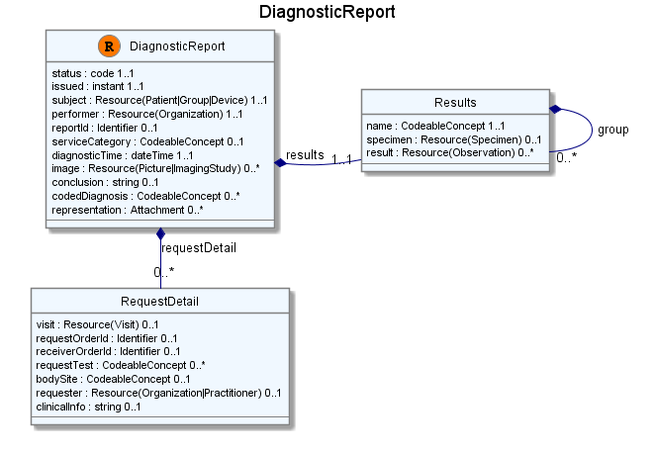
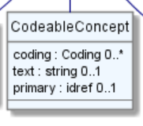
Composition of a Resource
Resource Root
Resource Component
Simple & Complex elements (may be repeating)
Notes:
® Diagnostic Report – the Resource root
RequestDetail & Results are components within Diagnostic Report
Use of non-primitive “datatypes” / “value types”

Slide 11
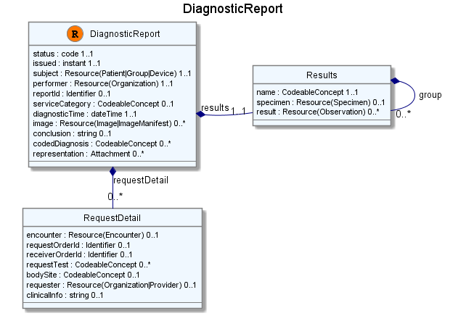
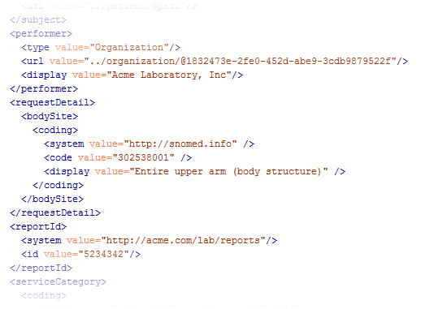
Containment

Slide 12

Resource Reference
“Refers to…”
  Note: No referential integrity – references are just URL’s
Notes:
References between resources are not by “business key”, it is *not* the patient id, it’s a REST URI!

Slide 13
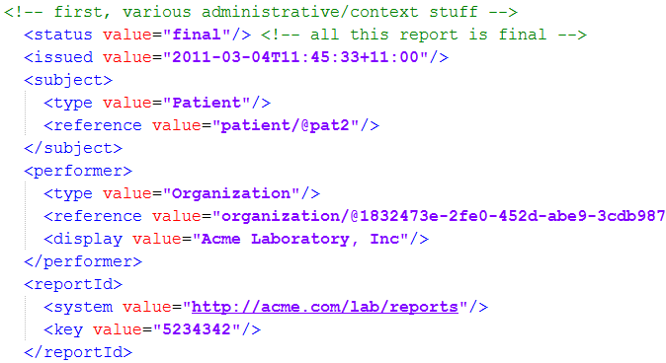
Resource Reference

Slide 14
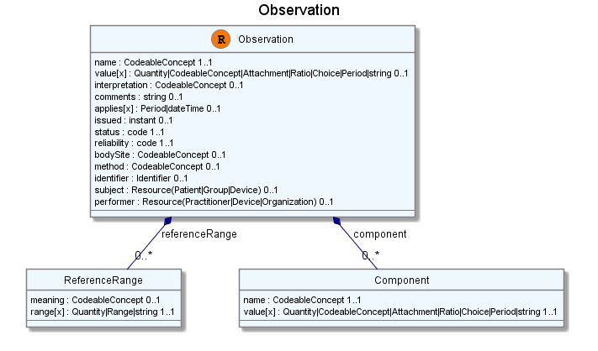
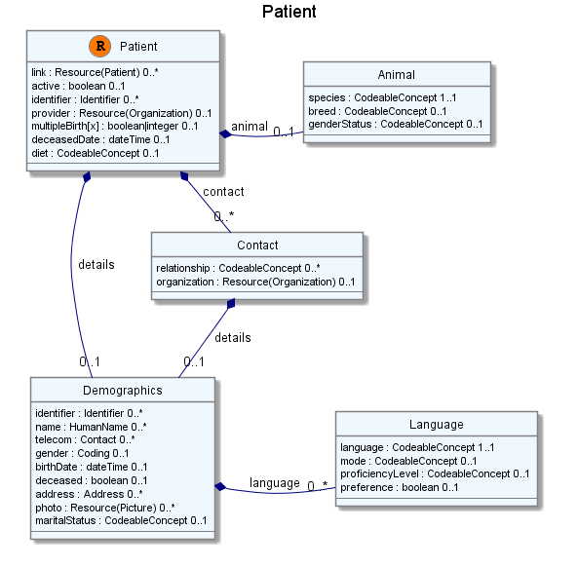
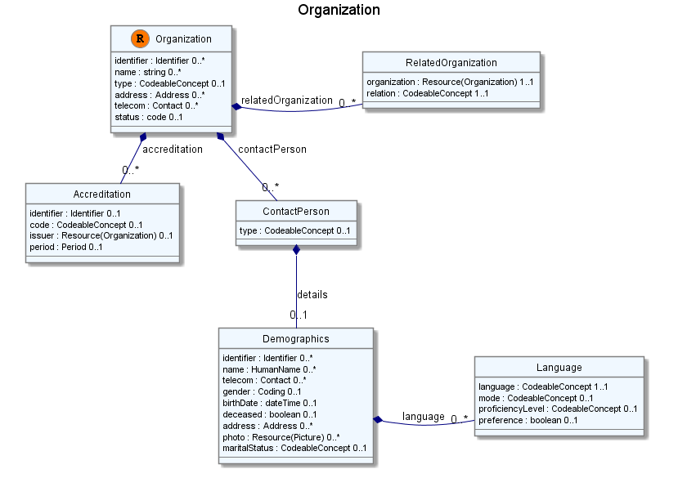
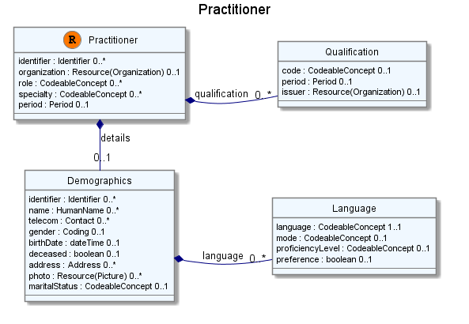
Network
subject
performer
organization

Slide 15

Resource Aggregate
“How do we know where an object
made up of other objects begins
and ends?”
“In any system with persistent storage
of data, there must be a scope for a
transaction that changes data and a way of maintaining the consistency of the data”
Notes:
Very important concept, comparable with the “Aggregate” notion of Domain Driven Design, for which many useful implementation strategies have been documented on the internet.

Slide 16
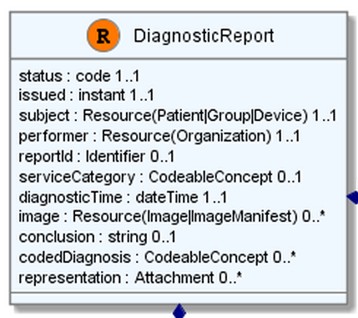
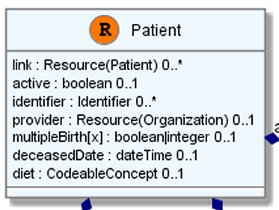
“Business” identifiers
Notes:
Resource Id’s (=URLs) are infrastructural id’s, they differ from “business” identifier.
Many Resources also have business identifiers, they are explicitly modeled, like Patient.identifier (even more than one identifier possible!)
Business identifiers are completely separate from technical resource id’s

Slide 17
A Resource’s identity
In fact: an URL
  http://server.org/fhir/Patient/1
resource type
endpoint
identifier
Note: This URL resolves to the current version of a resource
Notes:
This is not only the URL you use to retrieve the resource, it’s also its id.
All URL’s in FHIR are case-sensitive (and so is the id)
It is *metadata*, you won’t find this in the Resource’s definition

Slide 18
Resource metadata
Patient
MRN 22234
“Ewout Kramer”
30-11-1972
Amsterdam
REST Identities
http://fhir.hl7.org/Patient/23E455A3B
http://fhir.hl7.org/Patient/23E455A3B/_history/4
Last updated
2013-12-23T23:33:01+01:00
http://hl7.org/fhir/tag
http://example.org/fhir/Status#Test
http://hl7.org/fhir/tag/profile
http://hl7.org/fhir/Profile/us-core

Slide 19
The FHIR Elements
Composite
Datatypes
(HumanName,
Quantity, Period,
Address, Identifier )
Constrained Types
(Quantity: Distance, Count, Duration, Money)
use
Primitives
(integer, boolean,
string, instant)
Derived Primitives
(oid, uuid,
code, id)
Notes:
Only the Resources are user-definable, other types are “built-in”
Derived primitives are patterns -> validation consists of regexp matching
Constrained types are defined using invariants (OCL, Xpath, prose) -> validation using schematron, code
Narrative and Extension are both ONLY used in Resources
Resources can use both (derived) primitives and composite datatypes in its definitions
Infrastructural types need special handling, not general-purpose types

Slide 20
Start at the bottom: Primitives
boolean | xs:boolean | Values can be either true or false
integer | xs:int | A signed 32-bit integer
decimal | xs:decimal | A rational number. A true decimal, with inbuilt precision (e.g. Java BigDecimal)
base64Binary | xs:base64Binary | A stream of bytes, base64 encoded
instant | xs:dateTime | An instant in time - known at least to the second and always includes a timezone.
string | xs:string | A sequence of Unicode characters.
uri | xs:anyURI | A Uniform Resource Identifier Reference.
date | union of xs:date, xs:gYearMonth, xs:gYear | A date, or partial date as used in human communication. No time zone.
dateTime | union of xs:dateTime, xs:date, xs:gYearMonth, xs:gYear | A date, date-time or partial date as used in human communication. If hours and minutes are specified, a time zone must be populated.
Notes:
The lexical rendering for these primitives in Xml is the same as in JSON (maybe this should go in the serialization section)
Expressing the allowed values in terms of XSD primitives brings in more variability then we would like. E.g. “0” and “1” are valid for xs:boolean. “+000004”, “4”, “+4” are all valid decimals.

Slide 21
Derived primitives
Using the ISO date/time with timezone
  “1951”, “1951-06” and “1951-06-04”
  “1951-06-04T10:57:34.0321+01”
  “1951-06-04T10:57:34.0321Z”
Notes:
TODO: Search on timestamps (lower, upper bound), converting to zulu, user-timezone, sorting of times etc.
* Old-school types built on classis logic and math from the Greek, we have new stuff too…types based on urls!

Slide 22
Derived primitives
Based on uri(!): OID and UUID
  urn:oid:1.2.3.4.5
  urn:uuid:a5afddf4-e880-459b-876e-e4591b0acc11
Based on string:
  code (string of characters, may contain single spaces) - “4548-4”, “active”, “not known”
  id ([a-z0-9\-\.]{1,36})
Notes:
TODO: Search on timestamps (lower, upper bound), converting to zulu, user-timezone, sorting of times etc.
* Old-school types built on classis logic and math from the Greek, we have new stuff too…types based on urls!

Slide 23
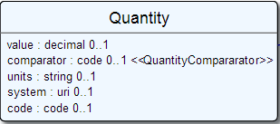
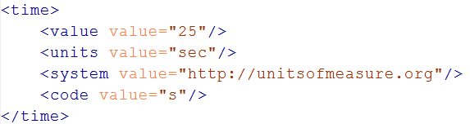
Level up:
Composite Datatypes
Notes:
The content of a primitive is not rendered in XML as a text node but as an attribute
Notice how the “system” of a code is now a uri, so unlike in v3 an OID is now ALSO a uri (urn:oid:1.2.3.4.5)

Slide 24
Datatypes
Let’s take a look at the “Data Types” section of the FHIR specification at
http://www.hl7.org/implement/standards/fhir/datatypes.htm
Notes:
Datatypes use both primitives and other datatypes.
Some datatypes use attributes with cardinality > 1
CodeableConcept.primary is actually refers to a coding in CodeableConcept.coding, so is not a code itself.
Quantity has constrained variations Distance, Count, Duration, Money. They introduce constraints on useable units, but do not add attributes, so not shown here.
Note that HumanId.assigner refers to a Resource

Slide 25
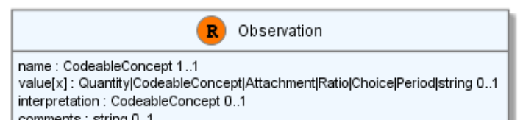
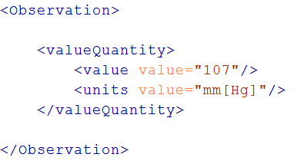
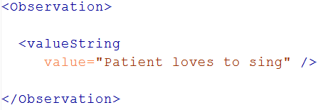
“Choice” properties
Notes:
* value[x] means: An element with a name that starts with “value”. The [x] is replaced by the (capitalized) name of the actual datatype

Slide 26
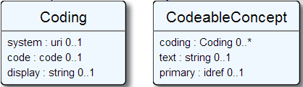

Coded types
Codes are defined in code systems
Notes:
Examples is from http://www.hl7.org/implement/standards/fhir/observation.htm
Bindings can be Incomplete (HL7 defines some codes for it, but you can add your own), Fixed (HL7 defines the only codes that are allowed) and Example (no specific codes defined, but some are given to give you an idea of what goes in the element)

Slide 27
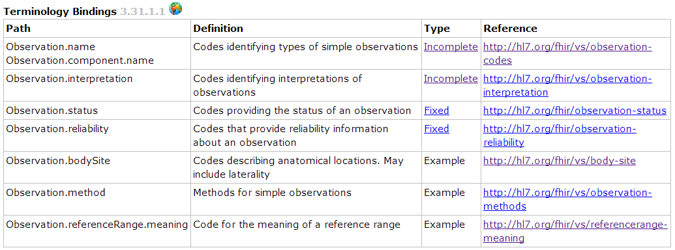
Coded types
When used in a Resource, the modelers include Bindings
Bindings specify which codes can be used
Notes:
Examples is from http://www.hl7.org/implement/standards/fhir/observation.htm
Bindings can be Incomplete (HL7 defines some codes for it, but you can add your own), Fixed (HL7 defines the only codes that are allowed) and Example (no specific codes defined, but some are given to give you an idea of what goes in the element)

Slide 28
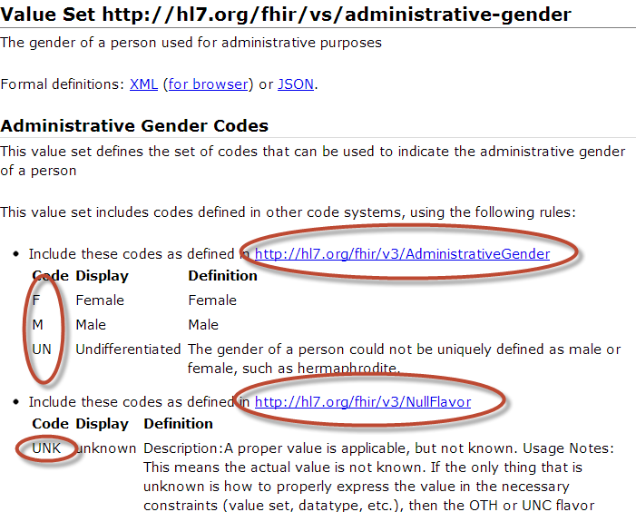
Notes:
Bindings use ValueSets to define what codes are allowed.
Patient.administrativeGender has a binding using the valueset “http://hl7.org/fhir/vs/administrative-gender”
This valueset includes codes from two code systems http://hl7.org/fhir/v3/AdministrativeGender and http://hl7.org/fhir/v3/NullFlavor
So yes, FHIR reused code systems from v3 (and v2), and has some defined specifically for FHIR.

Slide 29
Goto Some interesting valuesets to look at them

Slide 30
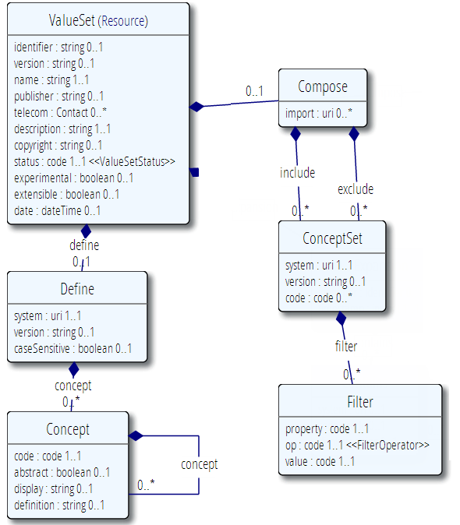
Publication meta-data
Concepts from 1 or more existing systems
Additional concepts

Slide 31
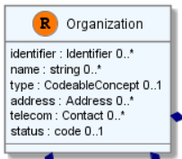
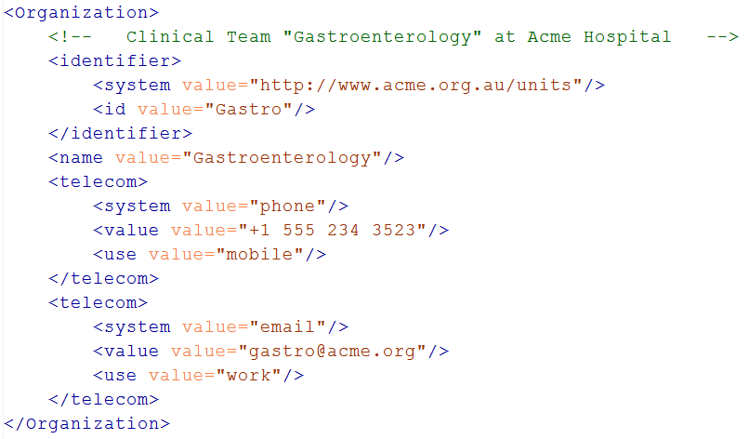
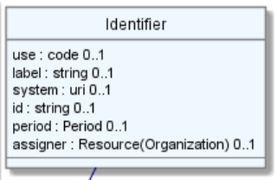
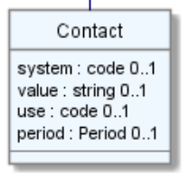
Level up: resources
Notes:
The element “identifier” is of type Identifier
The element “telecom” repeats, there is no notion of a “list” in Xml.
Empty elements are left out

Slide 32
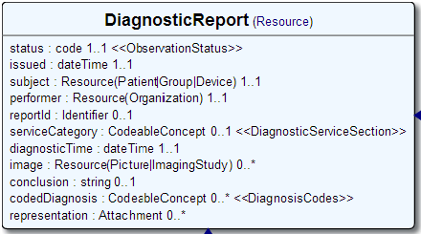

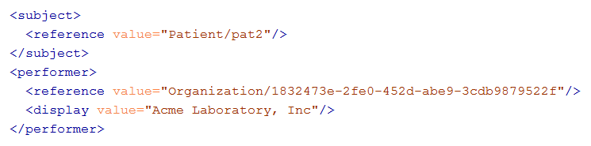
References
Notes:
There are references that can reference more than one type of resource! In this example: Resource(Patient | Group | Device)
The reference has a “type” element to indicate the kind of Resource that is referenced
References may be: Relative (on the same server), absolute URL (somewhere external) and internal (not treated here)

Slide 33
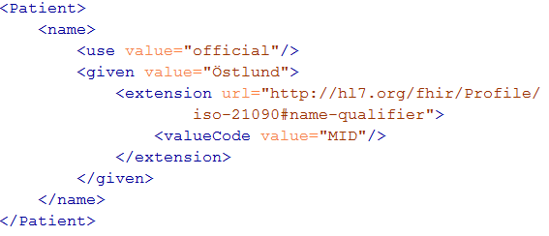
Extending a name
Key = location of formal definition
Value = value according to definition

Slide 34
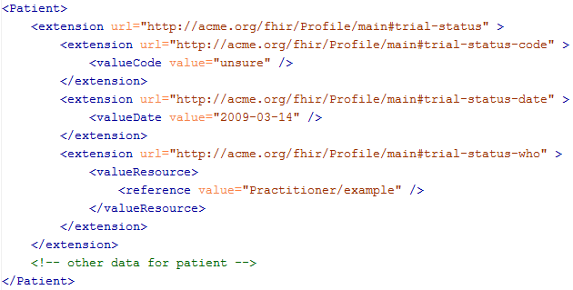
Complex extensions

Slide 35
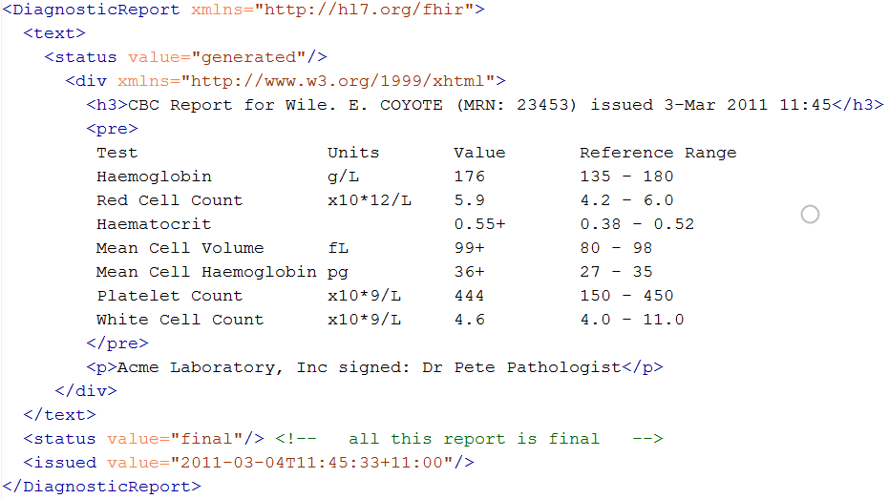
Narrative
Notes:
* “Every resource SHALL include a human readable narrative”

Slide 36
The FHIR datamodel (simplified!)
Composite
Datatypes
(HumanName,
Quantity, Period,
Address, Identifier )
Constrained Types
(Quantity: Distance, Count, Duration, Money)
Resources
Narrative
Elements
use
Extensions
use
Extensions
Primitives
(integer, boolean,
string, instant)
use
Derived Primitives
(oid, uuid,
code, id)
Notes:
Only the Resources are user-definable, other types are “built-in”
Derived primitives are patterns -> validation consists of regexp matching
Constrained types are defined using invariants (OCL, Xpath, prose) -> validation using schematron, code
Narrative and Extension are both ONLY used in Resources
Resources can use both (derived) primitives and composite datatypes in its definitions
Infrastructural types need special handling, not general-purpose types

Slide 37
Resources in code
How resources are made into classes in the supplied reference implementations
Notes:
Time: 40:00-50:00 (10 minutes)

Slide 38
Reference implementations
Contents
  Model – classes generated from the spec
  Parsers – Parsers generated from the spec
  Serializers – Serializers generated from the spec
  FhirClient
  Validation (currently Java only)
Java – Everything on the downloads page
.NET – NuGet “FHIR”, or GitHub “fhir-net-api”

Slide 39
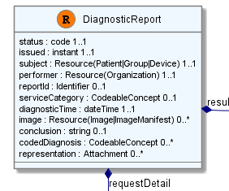
Object Model
[FhirResource("DiagnosticReport")]
public partial class DiagnosticReport : Resource
{
public Code<ObservationStatus> Status {…}
public Instant Issued {…}
public ResourceReference Subject {…}
public ResourceReference Performer {…}
public Identifier ReportId {… }
public
List<DiagnosticReportRequestDetailComponent> RequestDetail { …}

Slide 40
Parsing/Serializing using C#
ErrorList errors = new ErrorList();
// Create a file-based reader for Xml
XmlReader xr = XmlReader.Create(
new StreamReader(@"publish\observation-example.xml"));
// Parse the Observation from the stream
var obs = (Observation)FhirParser.ParseResource(xr, errors);
// Modify some fields of the observation
obs.Status = ObservationStatus.Amended;
obs.Value = new Quantity() { Value = 40, Units = "g" };
// Serialize the in-memory observation to Json
var jsonText = FhirSerializer.SerializeResourceToJson(obs);

Slide 41
REST service interface
How FHIR uses RESTful principles to communicate Resources
Notes:
Time: 0:50:00-1:30:00 (40 minutes)

Slide 42
Paradigms
FHIR supports 4 interoperability paradigms
REST
Documents
Messages
Services
Notes:
* Content is the same

Slide 43
REST?
“REpresentational State Transfer”
Represent your data as “resources”
Make “Resources” URI addressable
Use HTTP to do CRUD operations
Resources may be exchanged using different representations

Slide 44
Just a quick GET
GET /fhir/Patient/1 HTTP/1.1
HTTP/1.1 200 OK
Content-Type: application/xml+fhir;charset=utf-8
Content-Length: 787
Content-Location:
http://fhir.furore.com/fhir/Patient/1/_history/1
Last-Modified: Tue, 29 May 2012 23:45:32 GMT
HTTP Verb + path
UTF-8 encoded
<?xml version="1.0" encoding="UTF-8"?>
<Patient xmlns="http://hl7.org/fhir"><identifier><label>SSN</label><identifier><system>
http://hl7.org/fhir/sid/usssn</system><id>444222222</id></identifier></identifier><name><use>official</use><family>Everywoman</family><given>Eve</given></name><telecom><system>phone</system><value>555-555 2003</value><use>work</use></telecom><gender><system>http://hl7.org/fhir/sid/v2-0001</system>
<code>F</code></gender><birthDate>1973-05-31</birthDate><address><use>home</use><line>2222 Home Street</line></address><text><status>generated</status><div xmlns="http://www.w3.org/1999/xhtml">Everywoman, Eve. SSN:444222222</div></text></Patient>
See the BOM?
Notes:
You can retrieve any person using a GET on the person’s id, which is just an url on the server: /fhir/person/@<id>
We have our own MIME-type: “text/xml+fhir”
Note that FHIR always uses UTF-8. Since this is not the default for HTTP, the server explicitly mentions this
But should mean the xml encoding mentions “utf-8” and that the payload is really encoded in utf-8
There can be a Byte Order Mark, but hopefully your framework handles all that ;-)
The response returns a Content-Location header with a version-specific location….see next slide

Slide 45
A Resource’s REST identity
In fact: an URL
  http://server.org/fhir/Patient/1
resource type
endpoint
identifier
Note: This URL resolves to the current version of a resource
Notes:
This is not only the URL you use to retrieve the resource, it’s also its id.
All URL’s in FHIR are case-sensitive (and so is the id)

Slide 46
One more look at the header
GET /fhir/Patient/1 HTTP/1.1
HTTP/1.1 200 OK
Content-Type: application/xml+fhir;charset=utf-8
Content-Length: 787
Content-Location: http://fhir.furore.com/fhir/Patient/1/_history/12
Last-Modified: Tue, 29 May 2012 23:45:32 GMT
Notes:
You can retrieve any person using a GET on the person’s id, which is just an url on the server: /fhir/person/@<id>
We have our own MIME-type: “text/xml+fhir”
Note that FHIR always uses UTF-8. Since this is not the default for HTTP, the server explicitly mentions this
But should mean the xml encoding mentions “utf-8” and that the payload is really encoded in utf-8
There can be a Byte Order Mark, but hopefully your framework handles all that ;-)
The response returns a Content-Location header with a version-specific location….see next slide

Slide 47
For a specific version…
We have the version-specific URL
  http://server.org/fhir/ (continued)
  Patient/1/_history/4
base path
resource type
identifier
version id
Notes:
Both the Resource id URL and the version-specific URL are used on many places of the REST spec and resource content (References!). They are always used consistently in this form.

Slide 48
Support for versions
33, v12 – 2012-12-04
/server.org/fhir/Patient/33/_history/12
33, v13 – 2012-12-05
/server.org/fhir/Patient/33/_history/13
33, v14 – 2012-12-08
/server.org/fhir/Patient/33/_history/14
33, v15 – 2012-12-09
/server.org/fhir/Patient/33/_history/15
/server.org/fhir/Patient/33
Notes:
* Note that you have two ways (at one moment) to reach version 15

Slide 49
REST “representations”
GET /fhir/Patient/1?_format=json HTTP/1.1
HTTP/1.1 200 OK
Content-Type: application/json+fhir;charset=utf-8
Content-Length: 787
GET /fhir/Patient/1 HTTP/1.1
Accept: application/json+fhir
HTTP/1.1 200 OK
Content-Type: application/json+fhir;charset=utf-8
Content-Length: 787
Notes:
You can retrieve any person using a GET on the person’s id, which is just an url on the server: /fhir/person/@<id>
We have our own MIME-type: “text/xml+fhir”
Note that FHIR always uses UTF-8. Since this is not the default for HTTP, the server explicitly mentions this
But should mean the xml encoding mentions “utf-8” and that the payload is really encoded in utf-8
There can be a Byte Order Mark, but hopefully your framework handles all that ;-)
The response returns a Content-Location header with a version-specific location….see next slide

Slide 50
Question
DO I REALLY HAVE TO IMPLEMENT VERSIONS?
DO I REALLY NEED TO SUPPORT THAT PRE-HISTORIC XML STUFF?
NO, You are not required to keep history, and may return 410 (Gone) on a “vread” for any request for an older version than the current one!

Slide 51
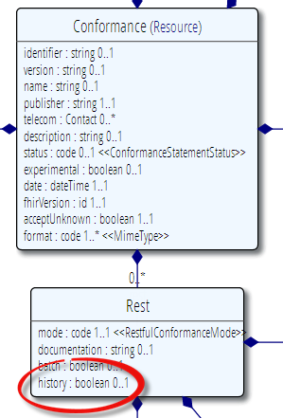
Remember conformance?
Which FHIR version?
Which Resources?
What search operations?
What formats?
Is this a test server?
Who can I contact?
What’s the name of the software?
DO YOU SUPPORT HISTORY?
DO YOU SUPPORT XML/JSON?
http://www.hl7.org/fhir/conformance.htm

Slide 52
Tag metadata
GET /fhir/Patient/1 HTTP/1.1
HTTP/1.1 200 OK
Content-Location: http://sever.om/fhir/Patient/1/_history/12
Last-Modified: Tue, 29 May 2012 23:45:32 GMT
Category: http://example.org/fhir/Status#Test;
scheme=" http://hl7.org/fhir/tag"; label="Our test tag"
http://hl7.org/fhir/tag | A general tag
http://hl7.org/fhir/tag/profile | A profile tag - a claim that the Resource conforms to the profile identified in the term
http://hl7.org/fhir/tag/security | A security label
Notes:
You can retrieve any person using a GET on the person’s id, which is just an url on the server: /fhir/person/@<id>
We have our own MIME-type: “text/xml+fhir”
Note that FHIR always uses UTF-8. Since this is not the default for HTTP, the server explicitly mentions this
But should mean the xml encoding mentions “utf-8” and that the payload is really encoded in utf-8
There can be a Byte Order Mark, but hopefully your framework handles all that ;-)
The response returns a Content-Location header with a version-specific location….see next slide

Slide 53
Mapping (meta)data to HTTP
Resource data
Resource id
Resource version
Last update date
Tags
http body
Url
Content-Location header
Last-Modified header
Category header

Slide 54
REST in the spec
Let’s look at these operations in the specification….

Slide 55
Mapping to verbs
create 2.1.10
The create interaction creates a new resource in a server assigned location. The create interaction is performed by an HTTP POST operation as shown:
POST [service-url]/[resourcetype] (?_format=mimeType)
read 2.1.6
The read interaction accesses the current contents of a resource. The interaction is performed by an HTTP GET operation as shown:
GET [service-url]/[resourcetype]/{id} (?_format=mimeType)
update 2.1.8
The update interaction creates a new current version for an existing resource or creates a new resource if no resource already exists for the given id. The update interaction is performed by an HTTP PUT operation as shown:
PUT [service-url]/[resourcetype]/{id} (?_format=mimeType)
delete 2.1.9
The delete interaction removes an existing resource. The interaction is performed by an HTTP DELETE operation as shown:
DELETE [service-url]/[resourcetype]/{id}

Slide 56
To create a resource
You POST the contents to an url which indicates the resource type:
  E.g. http://server.org/fhir/patient
Supply body’s format in Content-Type header
Server returns 201 (Created).
Returns only the newly assigned version id URL in the Location header.

Slide 57
To update a resource
Use PUT on the resource’s URL, with the new contents in the body
Tell server the body’s format (xml/json) in the Content-Type header
Server returns 200 and the URL to new version in the Content-Location header.

Slide 58
Using PUT to create
Server might/might not allow you to PUT to an id that does not yet exist.
If it does: Resource gets created at that location ➔ client determines resource’s id!
If it does not: server returns 405 (Method not allowed)
Notes:
- Whether server allows this depends on the level of trust between server and client: e.g. in-house scenario versus nation-wide network.

Slide 59
Version-aware updates
Server requires client to send Content-Location header with a version-specific URL
Server uses this to check whether you are updating the latest version.
Server will then return 409 (Conflict) if it has been updated by someone else in the meantime
Notes:
Behaviour depends on server configuration (and made public in a conformance statement).

Slide 60
What’s a ‘deleted’ Resource?
Trying read operations will return in a 410 (Gone) result in stead of 404 (Not Found)
The resource will not be returned by the search operation.
You can “undelete” by doing an update with fresh content
Just a “marker” in a resource’s history
Notes:
* the deletion operation should be understood as deleting the record of the resource, with nothing about the state of the real-world corresponding resource implied.

Slide 61
Version history - deletions
33, v12 – 2012-12-04
/server.org/fhir/Patient/33/_history/12
33, v13 – 2012-12-05
/server.org/fhir/Patient/33/_history/13
33, v14 – 2012-12-08
/server.org/fhir/Patient/33/_history/14
33, v15 – 2012-12-09
/server.org/fhir/Patient/33/_history/15
33, v16 – 2012-12-10
DELETION
/server.org/fhir/Patient/33/_history/16
/server.org/fhir/Patient/33
Notes:
* Now, if you query for /server.org/fhir/patient/@33, you get a 410

Slide 62
Version history - revival
33, v13 – 2012-12-05
/server.org/fhir/Patient/33/_history/13
33, v14 – 2012-12-08
/server.org/fhir/Patient/33/_history/14
33, v15 – 2012-12-09
/server.org/fhir/Patient/33/_history/15
33, v16 – 2012-12-10
/server.org/fhir/Patient/33/_history/16
33, v17 – 2012-12-11
/server.org/fhir/Patient/33/_history/17
/server.org/fhir/Patient/33
Notes:
* The resource returns back to life!

Slide 63
The Binary Endpoint
http://someserver/fhir/Binary/
Accepts any kind of content
Stores the content as is, along with the content type provided by the HTTP headers.
Acts just like the normal Resource endpoints (but there is no search)

Slide 64
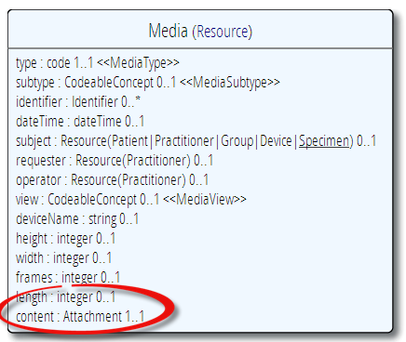
Useful for Attachments
/Binary/23344

Slide 65
Using FHIR Client in C#
var client = new FhirClient(
new Uri("http://fhir.com/svc/fhir"));
var patEntry = client.Read<Patient>("1");
var pat = patEntry.Resource;
var restId = patEntry.Id;
var tags = patEntry.Tags;
pat.Name.Add(HumanName.ForFamily("Kramer")
.WithGiven("Ewout"));
client.Update<Patient>(patEntry);

Slide 66
BUNDLES
How FHIR uses Atom to communicate sets of resources
Notes:
Time: 0:50:00-1:30:00 (40 minutes)

Slide 67
Communicating lists
We need to communicate lists of Resources
  Search result
  History
  Documents or messages
  Multiple-resource inserts (“batches”)
So, we need an industry-standard to represent lists, and a place to put our metadata

Slide 68
Bundles
Atom RFC 4287 + Tombstones RFC 6721
Poll-based protocol for keeping up-to-date with newsfeeds (RSS and Atom)
You can “subscribe” to a FHIR feed and get updates
Notes:
- In our previous section on REST we saw how we mapped this metadata to HTTP headers, but in a query result, we need to find a way to map this to a list, Atom

Slide 69
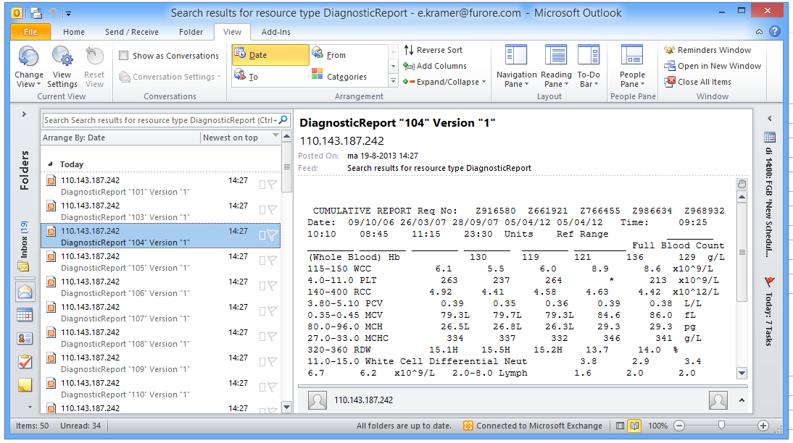
New reports in the mail

Slide 70
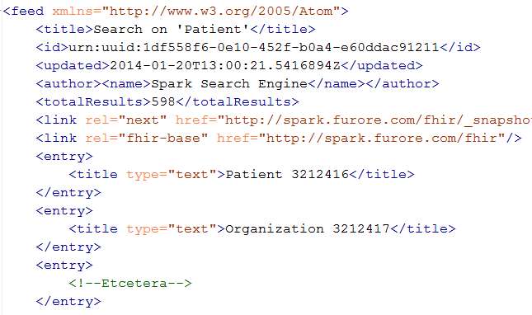
An example Bundle
Notes:
Note that the id of the resource is kept outside the resource itself
Atom has many other meta-data items (not shown), which we will discuss later.

Slide 71
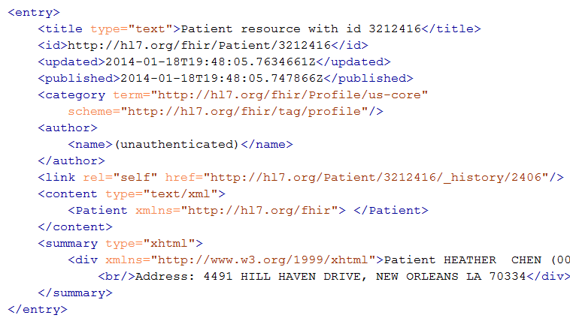
Resource Entry
Resource id
Last modified
Tags
Version-specific id
Resource content
Human-readable form,
just like Resource.text
Notes:
See how the resource meta-data is mapped to equivalent Atom members
Author is required by atom, so you’ll have to keep track who authored the resource, which might well be the user that POSTed it to your RESTful endpoint
Summary is optional, but it is easy to fill it with the Resource’s <text> (human readable narrative), so Feed readers have a way to display the contents of a resource. Yes, this means the summary is present twice in the entry.
All elements you see here are Atom spec, not FHIR

Slide 72
Example: Keeping in sync
History of all resources on server
  http://server.org/fhir/_history
History of all patient resources on server
  http://server.org/fhir/Patient/_history
History of specific patient on server
  http://server.org/fhir/Patient/1/_history
A history of all changes: updates and deletions, ordered by newest first
Limit with _since and _count

Slide 73
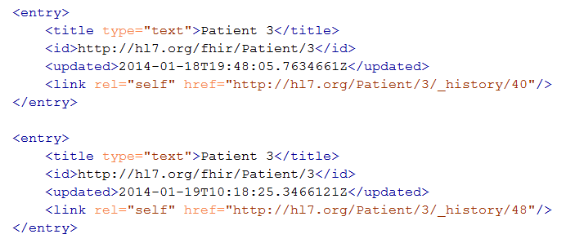
Multiple versions of entries
Same
id!
Notes:
Multiple versions are supported explicitly by Atom by having mutliple entries with the same id, but a different ‘updated’ date
Notice how the ‘self’ links do differ, these are different versions after all.

Slide 74
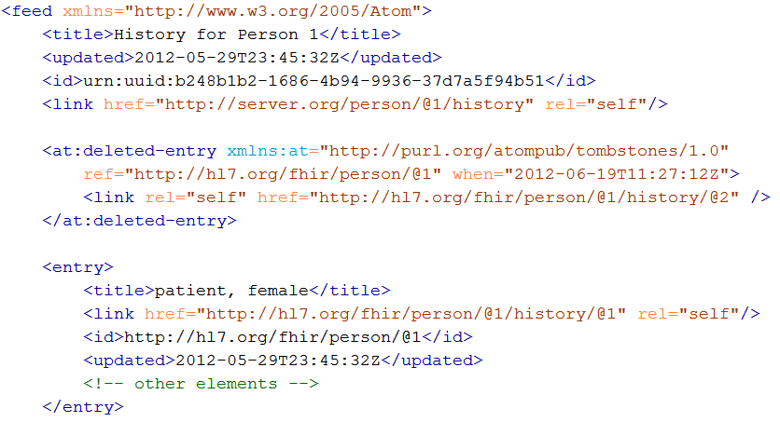
Atom Tombstones - Deletions
Notes:
Brand-new RFC, probably not much support in frameworks (yet).
Note the additional namespace
Updated Timestamp is still present, but is now called “when”.

Slide 75
Atom in JSON
There’s not yet a way to render Atom in JSON, though there are initiatives, all ugly.
So, we had to (sorry) roll our own….
…very straightforward, single-purpose
Atom JSON solution
(Note: MIME type is still application/json!)

Slide 76
Json Atom - Example
{
"title": "Search result",
"updated": "2012-09-20T12:04:45Z",
"id": "urn:uuid:50ea3e5e-b6a7-4f55-956c-caef491bbc08",
"link": [ { "rel": "self", "href": "http://server.org/fhir/Patient?format=json" } ],
"entry": [
{ "title": "Resource of type Patient, with id = 1 and version = 1",
"link": [ { "rel": "self", "href": "http://fhir.furore.com/fhir/Patient/1/_history/1" } ],
"id": "http://fhir.furore.com/fhir/Patient/1",
"updated": "2012-05-29T23:45:32Z",
"published": "2012-09-20T12:04:47Z",
"author": [ { "name": "Grahame Grieve / HL7 publishing committee" } ],
"content":
{ "Patient": { } }
}
]
}
Notes:
Just take a quick glimpse, it’s a pretty trivial translation of the Xml form to JSON, removing all needs for namespaces and attributes, and turning repeating elements into JSON arrays.

Slide 77
Bundles
For both Java and C#, reference has custom-built Atom parser
For .NET, you could use the framework’s SyndicationFeed
  A bit more low-level
  No support for deleted-entries (even parse problems)
  Incompatible with WinRT (Win8 mobile apps)
Notes:
* You might wonder: Since bundles are Atom, why not use standard Atom parsers?

Slide 78
Bundles in C#
Abstraction on top of Atom parser
Bundle = feed, BundleEntry = entry.
Bundle result = new Bundle() { Title = "Demo bundle" };
result.Entries.Add(new ResourceEntry<Patient>()
{ LastUpdated=DateTimeOffset.Now, Content = new Patient() });
result.Entries.Add(new DeletedEntry()
{ Id = new Uri("http://..."), When = DateTime.Now });
var bundleXml = FhirSerializer.SerializeBundleToXml(result);

Slide 79
Bundles in Java
AtomFeed feed = new AtomFeed();
feed.setTitle("Demo bundle");
AtomEntry pat = new AtomEntry();
pat.setUpdated(Calendar.getInstance());
pat.setResource(new Patient());
feed.getEntryList().add(pat);
AtomEntry del = new AtomEntry();
del.setUpdated(Calendar.getInstance());
del.setDeleted(true); del.setId("http://nu.nl/fhir");
feed.getEntryList().add(del);
ByteArrayOutputStream bos = new ByteArrayOutputStream();
AtomComposer comp = new AtomComposer();
comp.compose(bos, feed, true);
String xml = bos.toString("UTF8");

Slide 80
SEARCH FUNCTIONALITY
And finally, the last REST operation (for now):
Notes:
Time: 1:30:00-1:50:00 (20 minutes)

Slide 81
Getting “all” patients
http://server.org/fhir/Patient
Always returns a paged feed
Use _count to indicate number of results per page
Special case of the “real” search operation:
http://server.org/fhir/Patient/search?name=eve

Slide 82
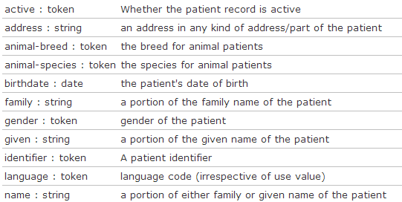
Search (patient)
Each resource has a set of “standard” search operations, so not every element can be searched!:
Our last search used this one

Slide 83
Combining parameters
Specifying multiple parameters finds resources matching all params ➔ “AND”
Parameters may list multiple values ➔ “OR”
http://server.org/fhir
/Patient/search?
  birthdate=1972-11-30
  &language=NL,FR

Slide 84
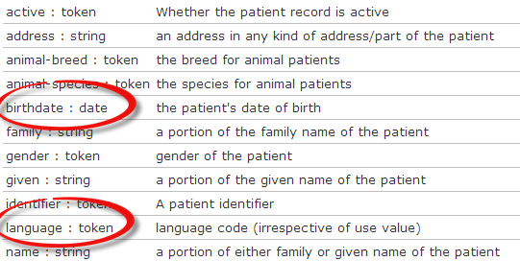
Search (patient)
Each search parameter has a ‘type’
Parameter
Type

Slide 85
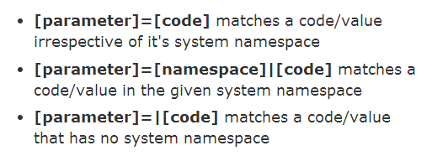
Token

Slide 86
Ok I get it…or not?
http://server.org/fhir/Patient/Search 406 hits
http://server.org/fhir/search?gender=M 234 hits
http://server.org/fhir/search?gender=F 167 hits
Total: 234 + 167 = 401
http://server.org/fhir/Patient/Search 406 hits
http://server.org/fhir/search?gender=M 234 hits
http://server.org/fhir/search?gender=F 167 hits
http://server.org/fhir/search?gender:missing=true 5 hits
Total: 234 + 167 + 5 = 406

Slide 87
Chained searches
Patient has a search for “name”.
Observation has a search for “subject” (the id of the Patient, Group or Device)
How do I find Observations for a patient, searching using his name?

Slide 88
2 queries in 1
You (as a client) don’t need to do separate operations, just one:
http://server.com/fhir/observation/search?
subject.name=jim
But note: this still only works on the predefined search parameters. You cannot just use any property of the resource.

Slide 89
More optimalizations
Say we do:
  http://fhir.com/fhir/Observation?date=2014-01-20
  We get back: a Bundle with 0..* “Observations”
Now, usually, wouldn’t we want the Patient information too? => Need to do “N” queries for the Observation’s “subject”
Quicker:
  ?_include=Observation.subject
    Returns both Observations + Patients

Slide 90
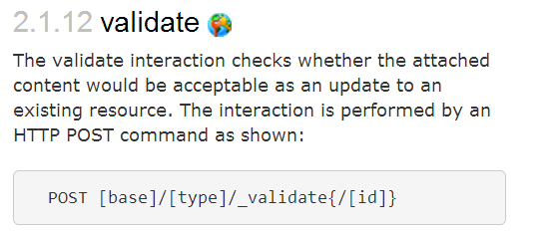
Validation

Slide 91
Tagging a Resource
Patient
MRN 22234
“Ewout Kramer”
30-11-1972
Amsterdam
http://hl7.org/fhir/tag/security
http://hl7.org/fhir/v3/ActCode#TABOO
http://hl7.org/fhir/tag
http://example.org/fhir/Status#Test
http://hl7.org/fhir/tag/profile
http://hl7.org/fhir/Profile/us-core
“a claim that the Resource conforms to the profile identified in the term”

Slide 92
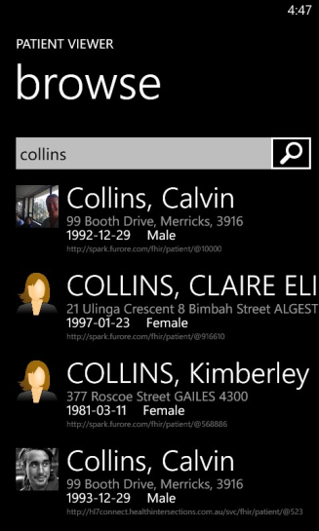

(Distributed) validation
App’s server
Store &
Validate
Country validation server
Validate
Profile X
Profile Y
Profile Y
Validate
Notes:
A server might defer validation to another server (because it doesn’t know the profile)
A server may fetch the “unknown” profile and validate it itself
There may be several servers sharing the work

Slide 93
Validation
When receiving an XML resource
  1. Validate using schema
  2. Run schematrons
When receiving JSON
  1. Parse the JSON
  2. Serialize to XML
  3. Validate using schema
  4. Run schematrons
There’s a validation pack for Java

Slide 94
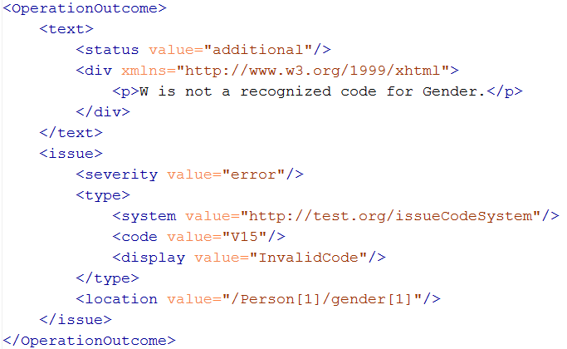
Operation Outcome
When something goes wrong….return the OperationOutcome Resource!

Slide 95
Beyond REST
How FHIR supports messages and documents
Notes:
Time: 1:50:00-2:00:00 (10 minutes)

Slide 96
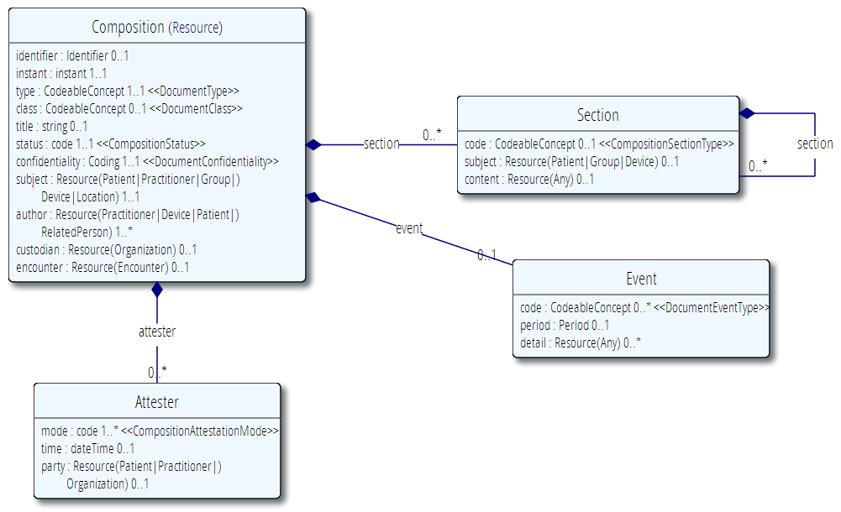
The Document resource

Slide 97
Documents – are bundles
<feed>
<entry>
<Composition />
</entry>
<entry>
<Observation />
</entry>
<entry>
<Device />
</entry>
<entry>
<Prescription />
</entry>
<entry>
<Patient />
</entry>
</feed>
Composition Resource
Section
Metadata
Attester
Section
Observation Resource
Device Resource
Prescription Resource
Patient Resource
Notes:
A Document, no matter how nested, is flattened to a list of entries, the Document’s header being the first.
The document header (and any other the other resources) refer to each other using normal references to reflect the document’s nesting.
Of course, there may be a digital signature (on the whole Bundle) to attest to the content of the document.

Slide 98
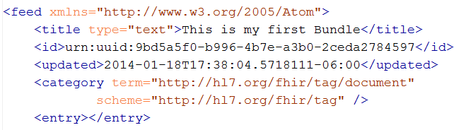
Tag as “Document”
This Bundle is a Document

Slide 99
Communicating documents
You can also “drop” your document using FHIR on
  http://server.org/fhir/Mailbox
No storage or disassembly is implied, your just posting a document in its entirety.
Servers can implement specific functionality as required between trading partners when receiving such a document.
Notes:
* But ofcourse, some server could have functions to disassemble documents on reception. Since the contents of documents are resources, each of the contained resources (including the Document header) can be stored using the normal REST interface. But they are no longer the document anymore!

Slide 100
Communicating documents
You can store your document using
  http://server.org/fhir/Document
Storage, NO disassembly is implied, document (and signature) stays intact
Search is supported (you search on it’s Message header – Composition)
NEW!
Notes:
* But ofcourse, some server could have functions to disassemble documents on reception. Since the contents of documents are resources, each of the contained resources (including the Document header) can be stored using the normal REST interface. But they are no longer the document anymore!

Slide 101
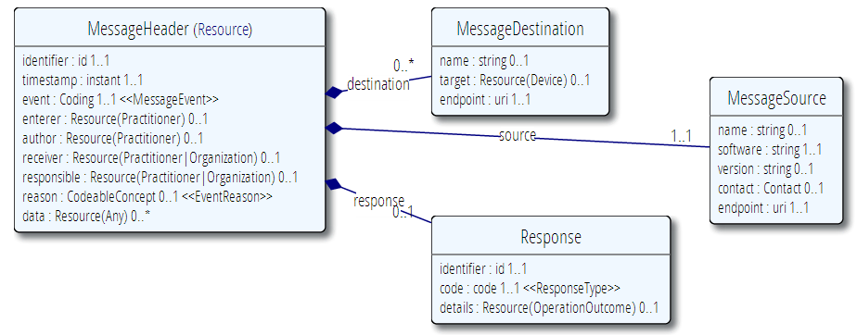
MessageHeader Resource

Slide 102
Messages – are bundles
<feed>
<entry>
<MessageHeader />
</entry>
<entry>
<Observation />
</entry>
<entry>
<Patient />
</entry>
<entry>
<Device />
</entry>
</feed>
Message Resource
source
destination
event
Observation Resource
Device Resource
Patient Resource
Notes:
A Message is similar, refers (amongst others) to its author, and contains information about the source, destination and the event that triggered it.
A message contains 1 “data” resource, which is the root of the payload of the message. This is just a normal resource, which in its turn can refer to other related resources.

Slide 103
Tag as “Document”
This Bundle is a Document

Slide 104
Sending messages
Again, REST not necessary, but…
There is an explicit REST endpoint:
  http://server.org/fhir/Mailbox
No storage implied. Might be a router, converted to v2, etc. etc.
The server can process them based on the event code and return the response as another message (again a bundle).
Notes:
* It’s the same drop-off point as for documents!

Slide 105
INSIDE THE FHIR DISTRIBUTION
Notes:
Time: 2:25:00-2:35:00 (10 minutes)

Slide 106
Browsing the site
REST API
Data Types
XML & JSON
Codes / Terminologies
Resource List
Stack Overflow
Public Test servers

Slide 107
The FHIR distribution
Under Implementation-Support-Downloads:
  The XSD schema’s / schematrons
  The Java / C# / Delphi zips (model, serializers, parsers, etc, both code & binary)
  All xml + json examples
  Full spec for offline reading (always have your FHIR with you)
  Note! .NET implementation has moved to GitHub, distribution by NuGet (.NET) and Maven (Java)

Slide 108
In the FHIR SVN
All you need to build FHIR (/build)
All presentations (/presentations)
Source of the publication process (/buils/tools, we use Eclipse + Java 1.6)
Archived older versions of FHIR (/archive)
You can download only the /build
Then run publish.bat & wait

Slide 109
The FHIR SVN
The “build” SVN tree, the “full” SVN tree
  http://gforge.hl7.org/svn/fhir
  User ‘anonymous’, blank password
Note: you have to run the publisher to be able to build the C# and Delphi source. Without that…they won’t compile!

Slide 110
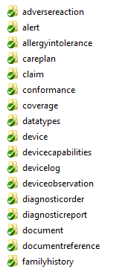
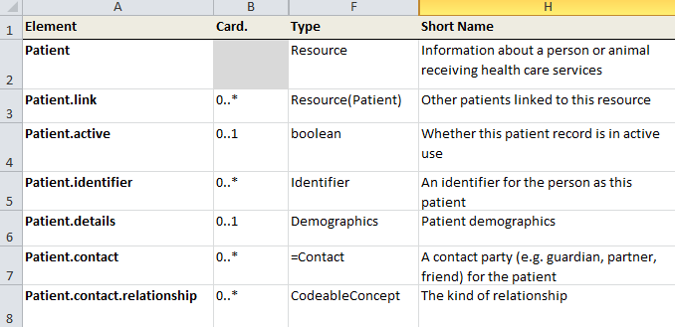
“Source” of FHIR

Slide 111
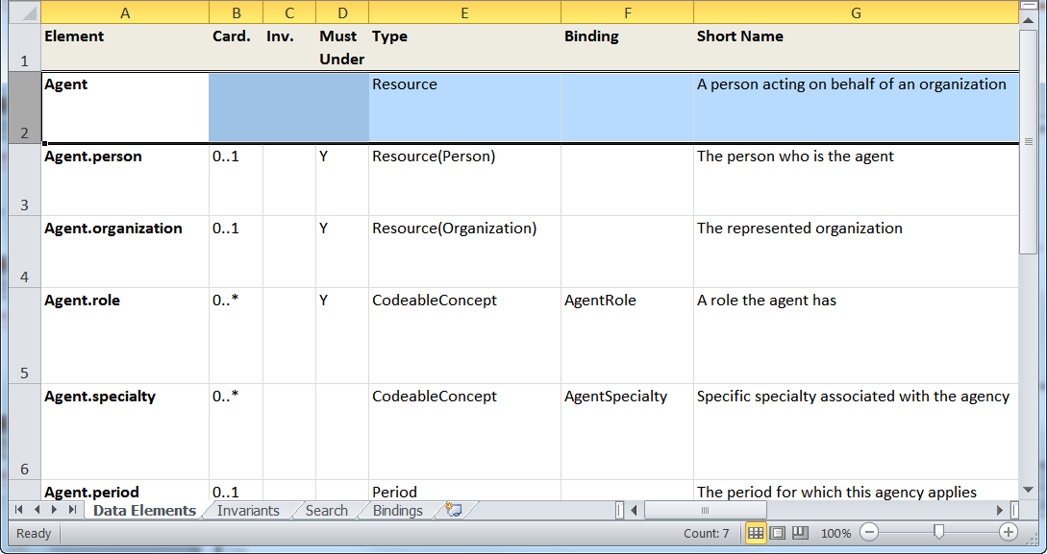
“Source” of FHIR

Slide 112


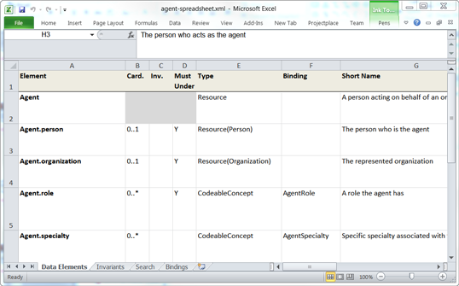


Publication process
.INI
Publication tool
(org.hl7.fhir.tools.jar)
Website
Examples
Resource
UML
Java, C#,
Delphi
Validation
Schema’s
DictXml
Resource profiles
eCoreDefinitions.xml

Slide 113
Generator writers!
There’s a file called eCoreDefinitions.xml that the C# generator runs of. It has all details from the definitions
There are Profiles for each resource, basically describing the “unconstrained” resources

Slide 114
Building a fhir server
FHIR in practice
Notes:
Time: 2:35:00-2:55:00 (20 minutes)

Slide 115
Some possible uses
v3
App
v2
FHIR
PHR
FHIR
Broker
Comm.
Interface
FHIR
DB
Notes:
You’re a message broker routing and translating between v2, v3 and FHIR
Your app interfaces with a PHR using FHIR natively
Your application can communicate using FHIR, but your software uses a proprietary RDBMS
Use FHIR as the common language for a Vendor Neutral Archive
…Or a combination….
You might see data as a nested structure of XML, a series of tables with keys, class-diagrams….

Slide 116
Repository model
HIS
LIMS
PACS
SystemX
Gateway
FHIR
FHIR
FHIR
FHIR
FHIR
Vendor Neutral Repository

Slide 117
Overview of a server
HTTP / REST interface
Encoding/decoding, param validation, syntax validation
Implement service operations as described in spec
Fhir Service
Indexer / Search
Storage

Slide 118
From wire to store
REST interface
JSON/XML
JSON/XML
JSON/XML
FHIR Parser
FHIR Parser
FHIR Parser
Fhir Service
POCO/POJO
POCO/POJO
POCO/POJO
O-R Map
Serialize
Serialize
Storage
NoSql
(Xml/Json)
DBMS
DBMS
Notes:
First scenario is most common for existing databases: you have to map the FHIR structure (as POCO’s) onto your (existing) databases tables. Lot’s of mappings to support our nesting, cardinalities, datatypes
Second scenario uses the parsers to create POCO’s then use a NoSql driver’s serialization possibilities to store the structure-as-is in NoSql
Third scenario uses POCO’s and DBMS, but instead of mapping FHIR to tables, stores the data as-is into blob storage in a DBMS

Slide 119
Briefest intro to JSON
JSON (“JavaScript Object Notation”): it’s JavaScript, not markup!
    {
    “Country" : {
    “name" : “the Netherlands",
    “population" : 16696000,
    “popDensity” : 447.9
    }
    }
var report = eval(“({…})”);
alert(report.LabReport.status);
Very easy parsing for JavaScript clients. But actually, use JSON.parse() instead ;-)

Slide 120
Xml and JSON are different
Xml
JSON
<XXX xmlns=“urn:foo”>
<B a=“c” />
<C>One</C>
<C>Two</C>
<D>One</D>
<div>Not <b>so</b>
easy</div>
</XXX>
{ “B”: { “a” : “c” },
“C”: [ “One”, “Two” ],
“D” : “One”,
“div” : {
“text-before”:“Not ”,
b:“so”,
“tekst-after”:“easy”}
}
How to retain namespaces?
How do you identify attributes?
Bridge difference in datatypes?
Distinguish single elements from lists with one element?
Mixed content?
Notes:
We tried to find a way to automatically convert between the two so you could round-trip…
But discovered you’d need additional metadata to do that, or vendor-specific solutions
Decided not to introduce these: result was weird Xml or weird Json
Reference platform contains tools to interconvert (these use model definition metadata)

Slide 121

Xml and Json in FHIR
code.coding is 0..*

Slide 122

Xml and Json in FHIR

Slide 123
Handling both
You need “meta” knowledge of the definition to distinguish lists / attributes
The Java/C# API’s can easily interconvert
Digital Signatures (in json?) are a problem when converting → store the original
JAXB / XmlSerializer / DataContract would need extensive customization / additional @annotation / [attributes]. Contact us!

Slide 124
Document-oriented store
A document-oriented store can store Resources as a “whole” document.
E.g. MongoDb stores documents in JSON:
post = { author: “mike”,
text: “my blog post...”,
tags: [“mongodb”,“intro”] };
db.posts.save( post );
db.posts.find( { author: “mike” } );
db.posts.find().sort({date: -1}).limit(10);

Slide 125


Slide 126


No (sql) transactions

Slide 127
Batch: needs transactions
Transaction
The transaction interaction submits a set of resources to be updated, created or deleted on the server. This interaction allows multiple resources to be updated/created in a single transaction. The interaction is performed by an HTTP POST command as shown:
POST [service-url] (?_format=mimeType)
The content of the post submission is a resource bundle.

Slide 128
Storing resources
FHIR POCO Model
Mongo
Patient
Atom Entry
(stored json)
Resource
Binary
Observation
Amazon S3
Metadata
Binary
Original
(json or xml)
Notes:
You might have to keep the original (as you received it on the service interface), for attestation/digital signatures
Store the binaries in another location (e.g. Amazon S3, filesystem) and just keep the URL here.

Slide 129
RDBMS: BLOB + Index
Id | ResourceId | VersionId | LastUpdate | Contents
1 | 1 | 1 | 2012-12-19 | <Patient …>
2 | 1 | 2 | 2012-12-20 | <Patient …>
3 | 2 | 1 | 2012-12-20 | <Observation …>
Id | Param | Value | System
2 | Patient.Name | “Ewout”
2 | Patient.DoB | “1972-11-30”
3 | Obs.Code | “234332” | SNOMED
Separate tables for current and history?
Type | VersionIdHigh
Patient | 2
Lab | 3
Need to index only latest version!

Slide 130
Both implementations use a separately maintained index for search?
Yes, here’s why…

Slide 131

Predictable search
Each resource has a fixed set of search parameters:
Searched element
Parameter
Type

Slide 132
Types of parameters
integer | Search parameter must be a simple whole number.
string | Search parameter is a simple string, like a name part. Search is case-insensitive and accent-insensitive. May match just the start of a string.
date | Search for an exact match on a date (parameters look like 1956-05-27T12:34:12+04:00 or shorter)
token | Search parameter on a coded element or identifier. May be used to search through the text, displayname, code and code/codesystem (for codes) and label, system and key (for identifier).
reference | A pair of resource type and resource id, separated by "/". Matches when the resource reference resolves to a resource of the given type and id.
Note: you need to escape the query-string!!

Slide 133
Partial/combined match
The search parameter description shows that the match certainly isn’t always exact, and can even combine the contents of several elements:
Name / Type | Description
address : string | an address in any kind of address/part of the patient
family : string | a portion of the family name of the patient
given : string | a portion of the given name of the patient
name : string | a portion of either family or given name of the patient
phonetic : string | a portion of either family or given name using some kind of phonetic matching algorithm
telecom : string | the value in any kind of telecom details of the patient

Slide 134

Prepare your data!
patient/search?
name=johan&
name=grafin&
telecom=5552004
“Groom” – prepare for searching

Slide 135
The end is near…
Notes:
Time: 10:00-35:00 (25 minutes)

Slide 136
Balloting plans
First Draft Standard for Trial Use ballot (DSTU) complete
  Yesterday HL7 decided FHIR is now published as a DSTU
  Will provide a semi-stable platform for implementers while still allowing non-backward-compatible change for Normative version if implementation experience dictates
  Additional DSTU versions roughly annually to make fixes, introduce new resources
Normative is around 3 years out
  We want *lots* of implementation experience before committing to backward compatibility

Slide 137

Next Steps for you
Read the spec: http://hl7.org/fhir
Try implementing it
Come to a (European?) Connectathon!
fhir@lists.hl7.org
#FHIR
Implementor’s Skype Channel
EU RIMBAA meetings (november)
StackOverflow: hl7 fhir tag

Slide 138
QUESTIONS?
Notes:
Time: 10:00-35:00 (25 minutes)

