Slide 1
Chapter 4
Lexical and Syntax Analysis

Slide 2
Chapter 4 Topics
Introduction
Lexical Analysis
The Parsing Problem
Recursive-Descent Parsing
Bottom-Up Parsing

Slide 3
Introduction
Language implementation systems must analyze source code, regardless of the specific implementation approach
Nearly all syntax analysis is based on a formal description of the syntax of the source language (BNF)

Slide 4
Syntax Analysis
The syntax analysis portion of a language processor nearly always consists of two parts:
  A low-level part called a lexical analyzer (mathematically, a finite automaton based on a regular grammar)
  A high-level part called a syntax analyzer, or parser (mathematically, a push-down automaton based on a context-free grammar, or BNF)

Slide 5
Advantages of Using BNF to Describe Syntax
Provides a clear and concise syntax description
The parser can be based directly on the BNF
Parsers based on BNF are easy to maintain

Slide 6
Reasons to Separate Lexical and Syntax Analysis
Simplicity - less complex approaches can be used for lexical analysis; separating them simplifies the parser
Efficiency - separation allows optimization of the lexical analyzer
Portability - parts of the lexical analyzer may not be portable, but the parser always is portable

Slide 7
Lexical Analysis
A lexical analyzer is a pattern matcher for character strings
A lexical analyzer is a “front-end” for the parser
Identifies substrings of the source program that belong together - lexemes
  Lexemes match a character pattern, which is associated with a lexical category called a token
  sum is a lexeme; its token may be IDENT

Slide 8
Lexical Analysis (continued)
The lexical analyzer is usually a function that is called by the parser when it needs the next token
Three approaches to building a lexical analyzer:
  Write a formal description of the tokens and use a software tool that constructs a table-driven lexical analyzer from such a description
  Design a state diagram that describes the tokens and write a program that implements the state diagram
  Design a state diagram that describes the tokens and hand-construct a table-driven implementation of the state diagram

Slide 9
State Diagram Design
  A naïve state diagram would have a transition from every state on every character in the source language - such a diagram would be very large!

Slide 10
Lexical Analysis (continued)
In many cases, transitions can be combined to simplify the state diagram
  When recognizing an identifier, all uppercase and lowercase letters are equivalent
    Use a character class that includes all letters
  When recognizing an integer literal, all digits are equivalent - use a digit class

Slide 11
Lexical Analysis (continued)
Reserved words and identifiers can be recognized together (rather than having a part of the diagram for each reserved word)
  Use a table lookup to determine whether a possible identifier is in fact a reserved word

Slide 12
Lexical Analysis (continued)
Convenient utility subprograms:
  getChar - gets the next character of input, puts it in nextChar, determines its class and puts the class in charClass
  addChar - puts the character from nextChar into the place the lexeme is being accumulated, lexeme
  lookup - determines whether the string in lexeme is a reserved word (returns a code)

Slide 13
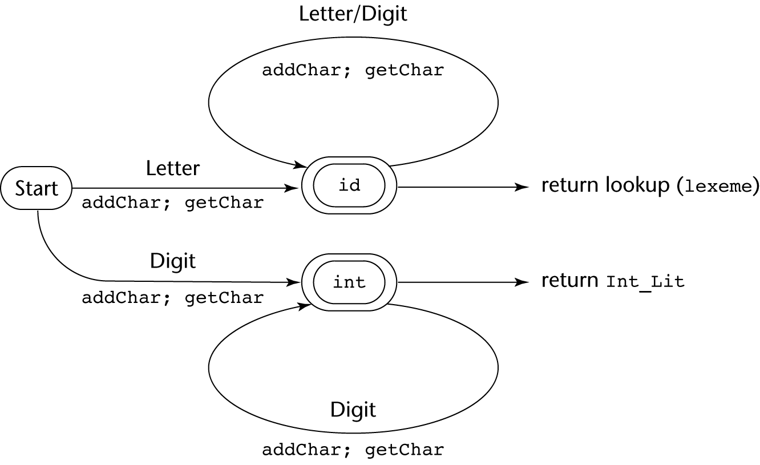
State Diagram

Slide 14
Lexical Analyzer
Implementation:
→ SHOW front.c (pp. 172-177)
- Following is the output of the lexical analyzer of
front.c when used on (sum + 47) / total
Next token is: 25 Next lexeme is (
Next token is: 11 Next lexeme is sum
Next token is: 21 Next lexeme is +
Next token is: 10 Next lexeme is 47
Next token is: 26 Next lexeme is )
Next token is: 24 Next lexeme is /
Next token is: 11 Next lexeme is total
Next token is: -1 Next lexeme is EOF

Slide 15
The Parsing Problem
Goals of the parser, given an input program:
  Find all syntax errors; for each, produce an appropriate diagnostic message and recover quickly
  Produce the parse tree, or at least a trace of the parse tree, for the program

Slide 17
The Parsing Problem (continued)
Two categories of parsers
  Top down - produce the parse tree, beginning at the root
    Order is that of a leftmost derivation
    Traces or builds the parse tree in preorder
  Bottom up - produce the parse tree, beginning at the leaves
    Order is that of the reverse of a rightmost derivation
Useful parsers look only one token ahead in the input

Slide 18
The Parsing Problem (continued)
Top-down Parsers
  Given a sentential form, xAα , the parser must choose the correct A-rule to get the next sentential form in the leftmost derivation, using only the first token produced by A
The most common top-down parsing algorithms:
  Recursive descent - a coded implementation
  LL parsers - table driven implementation

Slide 19
The Parsing Problem (continued)
Bottom-up parsers
  Given a right sentential form, α, determine what substring of α is the right-hand side of the rule in the grammar that must be reduced to produce the previous sentential form in the right derivation
  The most common bottom-up parsing algorithms are in the LR family

Slide 20
The Parsing Problem (continued)
The Complexity of Parsing
  Parsers that work for any unambiguous grammar are complex and inefficient ( O(n³), where n is the length of the input )
  Compilers use parsers that only work for a subset of all unambiguous grammars, but do it in linear time ( O(n), where n is the length of the input )

Slide 21
Recursive-Descent Parsing
There is a subprogram for each nonterminal in the grammar, which can parse sentences that can be generated by that nonterminal
EBNF is ideally suited for being the basis for a recursive-descent parser, because EBNF minimizes the number of nonterminals

Slide 22
Recursive-Descent Parsing (continued)
A grammar for simple expressions:
<expr> → <term> {(+ | -) <term>}
<term> → <factor> {(* | /) <factor>}
<factor> → id | int_constant | ( <expr> )

Slide 23
Recursive-Descent Parsing (continued)
Assume we have a lexical analyzer named lex, which puts the next token code in nextToken
The coding process when there is only one RHS:
  For each terminal symbol in the RHS, compare it with the next input token; if they match, continue, else there is an error
  For each nonterminal symbol in the RHS, call its associated parsing subprogram

Slide 24
Recursive-Descent Parsing (continued)
/* Function expr
Parses strings in the language
generated by the rule:
<expr> → <term> {(+ | -) <term>}
*/
void expr() {
/* Parse the first term */
term();
/* As long as the next token is + or -, call
lex to get the next token and parse the
next term */
while (nextToken == ADD_OP ||
nextToken == SUB_OP){
lex();
term();
}
}

Slide 25
Recursive-Descent Parsing (continued)
This particular routine does not detect errors
Convention: Every parsing routine leaves the next token in nextToken

Slide 26
Recursive-Descent Parsing (continued)
A nonterminal that has more than one RHS requires an initial process to determine which RHS it is to parse
  The correct RHS is chosen on the basis of the next token of input (the lookahead)
  The next token is compared with the first token that can be generated by each RHS until a match is found
  If no match is found, it is a syntax error

Slide 27
Recursive-Descent Parsing (continued)
/* term
Parses strings in the language generated by the rule:
<term> -> <factor> {(* | /) <factor>)
*/
void term() {
/* Parse the first factor */
factor();
/* As long as the next token is * or /,
next token and parse the next factor */
while (nextToken == MULT_OP || nextToken == DIV_OP) {
lex();
factor();
}
} /* End of function term */

Slide 28
Recursive-Descent Parsing (continued)
/* Function factor
Parses strings in the language
generated by the rule:
<factor> -> id | (<expr>) */
void factor() {
/* Determine which RHS */
if (nextToken) == ID_CODE || nextToken == INT_CODE)
/* For the RHS id, just call lex */
lex();
/* If the RHS is (<expr>) – call lex to pass over the left parenthesis,
call expr, and check for the right parenthesis */
else if (nextToken == LP_CODE) {
lex();
expr();
if (nextToken == RP_CODE)
lex();
else
error();
} /* End of else if (nextToken == ... */
else error(); /* Neither RHS matches */
}

Slide 29
Recursive-Descent Parsing (continued)
- Trace of the lexical and syntax analyzers on (sum + 47) / total
Next token is: 25 Next lexeme is ( Next token is: 11 Next lexeme is total
Enter <expr> Enter <factor>
Enter <term> Next token is: -1 Next lexeme is EOF
Enter <factor> Exit <factor>
Next token is: 11 Next lexeme is sum Exit <term>
Enter <expr> Exit <expr>
Enter <term>
Enter <factor>
Next token is: 21 Next lexeme is +
Exit <factor>
Exit <term>
Next token is: 10 Next lexeme is 47
Enter <term>
Enter <factor>
Next token is: 26 Next lexeme is )
Exit <factor>
Exit <term>
Exit <expr>
Next token is: 24 Next lexeme is /
Exit <factor>

Slide 30
Recursive-Descent Parsing (continued)
The LL Grammar Class
  The Left Recursion Problem
    If a grammar has left recursion, either direct or indirect, it cannot be the basis for a top-down parser
      A grammar can be modified to remove direct left recursion as follows:
      For each nonterminal, A,
      Group the A-rules as A → Aα₁ | … | Aα_{m} | β₁ | β₂ | … | β_{n}
      where none of the β‘s begins with A
      2. Replace the original A-rules with
      A → β₁A’ | β₂A’ | … | β_{n}A’
      A’ → α₁A’ | α₂A’ | … | α_{m}A’ | ε

Slide 31
Recursive-Descent Parsing (continued)
The other characteristic of grammars that disallows top-down parsing is the lack of pairwise disjointness
  The inability to determine the correct RHS on the basis of one token of lookahead
  Def: FIRST(α) = {a | α =>* aβ }
(If α =>* ε, ε is in FIRST(α))

Slide 32
Recursive-Descent Parsing (continued)
Pairwise Disjointness Test:
  For each nonterminal, A, in the grammar that has more than one RHS, for each pair of rules, A → α_{i} and A → α_{j}, it must be true that
FIRST(α_{i}) ⋂ FIRST(α_{j}) = φ
Example:
A → a | bB | cAb
A → a | aB

Slide 33
Recursive-Descent Parsing (continued)
Left factoring can resolve the problem
Replace
<variable> → identifier | identifier [<expression>]
with
<variable> → identifier <new>
<new> → ε | [<expression>]
or
<variable> → identifier [[<expression>]]
(the outer brackets are metasymbols of EBNF)

Slide 34
Bottom-up Parsing
The parsing problem is finding the correct RHS in a right-sentential form to reduce to get the previous right-sentential form in the derivation

Slide 35
Bottom-up Parsing (continued)
Intuition about handles:
  Def: β is the handle of the right sentential form
γ = αβw if and only if S =>*_{rm} αAw =>_{rm} αβw
  Def: β is a phrase of the right sentential form
γ if and only if S =>* γ = α₁Aα₂ =>+ α₁βα₂
  Def: β is a simple phrase of the right sentential form γ if and only if S =>* γ = α₁Aα₂ => α₁βα₂

Slide 36
Bottom-up Parsing (continued)
Intuition about handles (continued):
  The handle of a right sentential form is its leftmost simple phrase
  Given a parse tree, it is now easy to find the handle
  Parsing can be thought of as handle pruning

Slide 37
Bottom-up Parsing (continued)
Shift-Reduce Algorithms
  Reduce is the action of replacing the handle on the top of the parse stack with its corresponding LHS
  Shift is the action of moving the next token to the top of the parse stack

Slide 38
Bottom-up Parsing (continued)
Advantages of LR parsers:
  They will work for nearly all grammars that describe programming languages.
  They work on a larger class of grammars than other bottom-up algorithms, but are as efficient as any other bottom-up parser.
  They can detect syntax errors as soon as it is possible.
  The LR class of grammars is a superset of the class parsable by LL parsers.

Slide 39
Bottom-up Parsing (continued)
LR parsers must be constructed with a tool
Knuth’s insight: A bottom-up parser could use the entire history of the parse, up to the current point, to make parsing decisions
  There are only a finite and relatively small number of different parse situations that could have occurred, so the history could be stored in a parser state, on the parse stack

Slide 40
Bottom-up Parsing (continued)
An LR configuration stores the state of an LR parser
(S₀X₁S₁X₂S₂…X_{m}S_{m}, a_{i}a_{i+1}…a_{n}$)

Slide 41
Bottom-up Parsing (continued)
LR parsers are table driven, where the table has two components, an ACTION table and a GOTO table
  The ACTION table specifies the action of the parser, given the parser state and the next token
    Rows are state names; columns are terminals
  The GOTO table specifies which state to put on top of the parse stack after a reduction action is done
    Rows are state names; columns are nonterminals

Slide 42
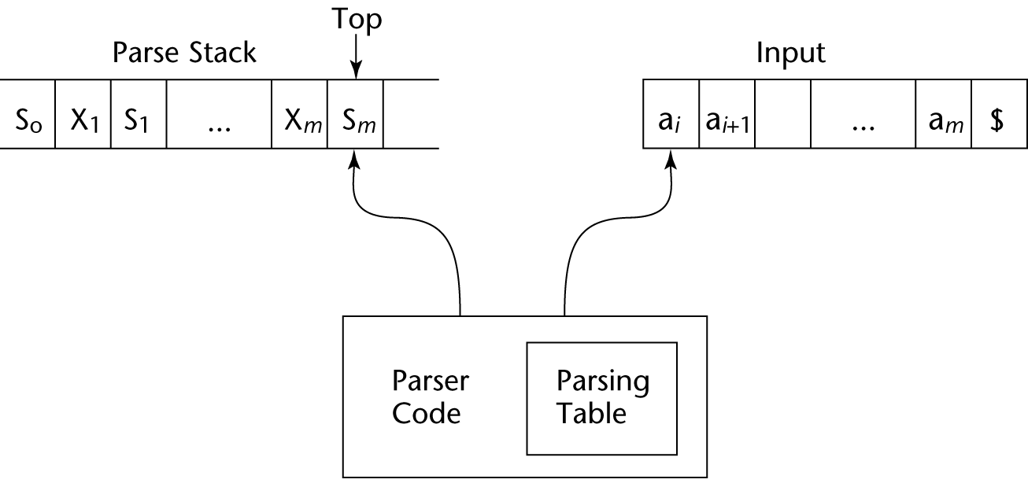
Structure of An LR Parser

Slide 43
Bottom-up Parsing (continued)
Initial configuration: (S₀, a₁…a_{n}$)
Parser actions:
  For a Shift, the next symbol of input is pushed onto the stack, along with the state symbol that is part of the Shift specification in the Action table
  For a Reduce, remove the handle from the stack, along with its state symbols. Push the LHS of the rule. Push the state symbol from the GOTO table, using the state symbol just below the new LHS in the stack and the LHS of the new rule as the row and column into the GOTO table

Slide 44
Bottom-up Parsing (continued)
Parser actions (continued):
  For an Accept, the parse is complete and no errors were found.
  For an Error, the parser calls an error-handling routine.

Slide 45
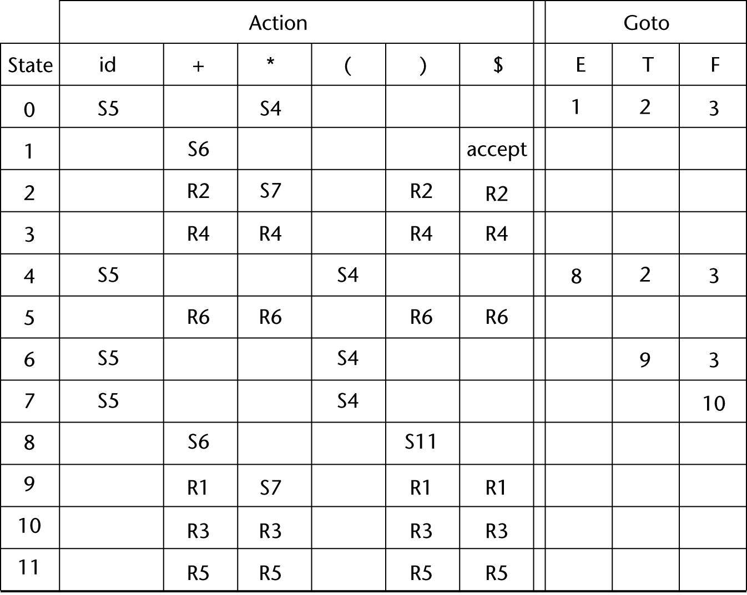
LR Parsing Table

Slide 46
Bottom-up Parsing (continued)
A parser table can be generated from a given grammar with a tool, e.g., yacc or bison

Slide 47
Parsing
From: Chapter 3 of Compilers: Principles, Techniques and Tools, Aho, et al., Addison-Wesley
Prof. Steven A. Demurjian
Computer Science & Engineering Department
The University of Connecticut
371 Fairfield Way, Unit 2155
Storrs, CT 06269-3155
steve@engr.uconn.edu
http://www.engr.uconn.edu/~steve
(860) 486 - 4818

Slide 48
Basic Intuition
Use a sliding window over input to Lookahead
Benefit
  Reveal the input
    Slowly
    A little bit at a time
      1 token at a time
      Maybe 2 at a time ?
    But systematically
      Left to Right
What kind of derivation can use tokens in this way?
The Input

Slide 49
Overall Top-Down Algorithm
Data structures
  A stack Holds the symbols to treat
  A lookahead window to choose a prediction
Algorithm
  Startup
    Initialize stack to start symbol (a non-terminal)
    Initialize lookahead window at start of token stream
  Recursive Process
    Find out if front of window and top of stack match
    If match
      Consume the symbols
    No match
      Pop / Select / Push

Slide 50
How Could Algorithm Work?
Grammar: E → TE’
E’ → +TE’ | ∈
T → id
Input : id + id $
Derivation:
E ⇒ TE’ ⇒ idE’ ⇒ id +TE’ ⇒ id +idE’ ⇒ id +id’
Processing Stack: Contains the Derivation plus $
E
$
T
E’
$
id
E’
$
E’
$
+
T
E’
$
T
E’
$
id
E’
$
E’
$
$

Slide 51
The Lookahead Window
How large ?
  Very good question.
The art of counting
  1,2, a lot.
Conclusion
  Usually, 1 token is plenty
  Occasionally, 2 tokens may be needed
  Beyond 2 is wild
In theory
  Any finite constant will do 1,2,3....,k

Slide 52
Lookahead Size and Languages
With k tokens of lookahead
  Some languages can be parsed (this way)
  Some languages cannot be parsed
What about k+1 tokens ?
  More languages can be parsed....
  So the set of languages recognized with k is a subset of the set of languages recognized with k+1!
  We have a hierarchy!
Still...
  In practice LL(1) should be enough.

Slide 53
LL(1) Grammars for Top-Down Parsing
L : Scan input from Left to Right
L : Construct a Leftmost Derivation
1 : Use “1” input symbol as lookahead in conjunction with stack to decide on the parsing action
LL(1) grammars have no multiply-defined entries in the parsing table.
Properties of LL(1) grammars:
  Grammar can’t be ambiguous or left recursive
  Grammar is LL(1) ⇔when A →α⏐β
  1. α & β do not derive strings starting with the same terminal a
  2. Either α or β can derive ∈, but not both.
Note: It may not be possible for a grammar to be manipulated into an LL(1) grammar

Slide 54
Top-Down Parsing
Identify a leftmost derivation for an input string
Why ?
  By always replacing the leftmost non-terminal symbol via a production rule, we are guaranteed of developing a parse tree in a left-to-right fashion consistent with scanning the input.
  A ⇒ aBc ⇒ adDc ⇒ adec
  (scan a, scan d, scan e, scan c - accept!)
Recursive-descent parsing concepts
Predictive parsing
  Recursive / Brute force technique
  non-recursive / table driven
Error recovery
Implementation

Slide 55
Recursive Descent Parsing Concepts
General category of Parsing Top-Down
Choose production rule based on input symbol
May require backtracking to correct a wrong choice.
Example: S → c A d
A → ab | a
input: cad
S
cad
S
cad
c
A
d
c
A
d
a
b
Problem: backtrack
S
S
S
cad
cad
cad
c
d
c
A
d
A
c
A
d
a
b
a
a

Slide 56
Predictive Parsing : Recursive
To eliminate backtracking, grammar must have:
  no left recursion
  apply left factoring
  remove ∈-moves
If so, we can utilize current input symbol in conjunction with non-terminals to be expanded to uniquely determine the next action
Utilize transition diagrams (TDs):
  For each non-terminal of the grammar:
    Create an initial and final state
    If A→ X₁X₂…X_{n} is a production, add path with edges X₁, X₂, … , X_{n}
TDs can be algorithmized into Program

Slide 57
Transition Diagrams (TDs)
Unlike lexical equivalents, each edge represents a token
Transition implies: if token, choose edge, call proc
Recall earlier grammar and its associated TDs
E → TE’ E’ → + TE’ | ∈
T → FT’ T’ → * FT’ | ∈
F → ( E ) | id
T
E’
E:
0
1
2
How are transition diagrams used ?
Are ∈-moves a problem ?
Can we simplify transition diagrams ?
Why is simplification critical ?
+
T
E’
E’:
3
4
5
6
∈
F
T’
T:
7
8
9
*
F
T’
T’:
10
11
12
13
∈
(
E
)
F:
14
15
16
17
id

Slide 58
Motivating Table-Driven Parsing
1. Left to right scan input
2. Find leftmost derivation
Grammar: E → TE’
E’ → +TE’ | ∈
T → id
Terminator
Input : id + id $
Derivation:
E ⇒ TE’ ⇒ idE’ ⇒ id +TE’ ⇒ id +idE’ ⇒ id +id’
Processing Stack: Contains the Derivation plus $
E
$
T
E’
$
id
E’
$
E’
$
+
T
E’
$
T
E’
$
id
E’
$
E’
$
$

Slide 59
Non-Recursive / Table Driven
a
+
b
$
Input
(String + terminator)
Stack
X
Predictive Parsing Program
Output
NT + T symbols of CFG
Y
Z
What actions parser should take based on stack / input
Parsing Table M[A,a]
Empty stack symbol
$
General parser behavior: X : top of stack a : current input
1. When X=a = $ halt, accept, success
2. When X=a ≠ $ , POP X off stack, advance input, go to 1.
3. When X is a non-terminal, examine M[X,a]
  if it is an error → call recovery routine
  if M[X,a] = {X → UVW}, POP X, PUSH W,V,U in reverse order
  DO NOT expend any input

Slide 60
Algorithm for Non-Recursive Parsing
Set ip to point to the first symbol of w$;
repeat
let X be the top stack symbol and a the symbol pointed to by ip;
if X is terminal or $ then
if X=a then
pop X from the stack and advance ip
else error()
else /* X is a non-terminal */
if M[X,a] = X→Y₁Y₂…Y_{k} then begin
pop X from stack;
push Y_{k}, Y_{k-1}, … , Y₁ onto stack, with Y₁ on top
output the production X→Y₁Y₂…Y_{k}
end
else error()
until X=$ /* stack is empty */
Input pointer
May also execute other code based on the production used

Slide 61
Example
E → TE’ E’ → + TE’ | ∈
Our well-worn example !
T → FT’ T’ → * FT’ | ∈
F → ( E ) | id
Table M
INPUT SYMBOL
Non-terminal
id
+
*
(
)
$
E
E→TE’
E→TE’
E’
E’→+TE’
E’→∈
E’→∈
T
T→FT’
T→FT’
T’
T’→∈
T’→*FT’
T’→∈
T’→∈
F
F→id
F→(E)

Slide 62
Trace of Example
STACK
INPUT
OUTPUT
$E
$E’T
$E’T’F
$E’T’id
$E’T’
$E’
$E’T+
$E’T
$E’T’F
$E’T’id
$E’T’
$E’T’F*
$E’T’F
$E’T’id
$E’T’
$E’
$
id + id * id$
id + id * id$
id + id * id$
id + id * id$
+ id * id$
+ id * id$
+ id * id$
id * id$
id * id$
id * id$
* id$
* id$
id$
id$
$
$
$
E→ TE’
T→ FT’
F → id
T’ → ∈
E’ → +TE’
T→ FT’
F → id
T’ → *FT’
F → id
T’ → ∈
E’ → ∈
Expend Input

Slide 63
Leftmost Derivation for the Example
The leftmost derivation for the example is as follows:
E ⇒ TE’ ⇒ FT’E’ ⇒ id T’E’ ⇒ id E’ ⇒ id + TE’ ⇒ id + FT’E’
⇒ id + id T’E’ ⇒ id + id * FT’E’ ⇒ id + id * id T’E’
⇒ id + id * id E’ ⇒ id + id * id

Slide 64
Bottom-Up Parsing
Basic Intuition and Motvation
Recall that
  LL(k) works
    TOP-DOWN
    With a LEFTMOST Derivation
    Predicts the right production to select based on lookahead
Our new motto
  LR(k) works
    BOTTOM-UP
    With a RIGHTMOST Derivation in REVERSE
    Commits to the production choice after seeing the whole body (right hand side of rule), working in “reverse”

Slide 65
Bottom-Up Parsing
Inverse or Complement of Top-Down Parsing
Top Down Parsing Utilizes “Start Symbol” and Attempts to Derive the Input String using Productions
Bottom-Up Parsing Makes Modifications to the Input String which Allows it to Reduce to Start Symbol
For Example, Consider Grammar & Derivations:
S → a A B e
A → Abc | b
B → d
What Does Each Derivation Represent?
  Top-Down ---- Leftmost Derivation
  Bottom-Up ---- Rightmost Derivation in Reverse!
abbcde ⇒
aAbcde ⇒
aAde ⇒
aABe ⇒
S ⇒
S ⇒ aABe
⇒ aAbcBe
⇒ abbcBe
⇒ abbcde

Slide 66
Bottom-Up Parsing
Top-Down Derivation Bottom-Up in Reverse
S ⇒ aABe
⇒ aAbcBe
⇒ abbcBe
⇒ abbcde
S → a A B e
A → Abc
A → b
B → d
abbcde ⇒
aAbcde ⇒
aAde ⇒
aABe ⇒
S ⇒
A → b
A → Abc
B → d
S → a A B e

Slide 67
Type of Derviation
Grammar:
S → a A B e
A → Abc | b
B → d
Key Issues:
  How do we Determine which Substring to “Reduce”?
  How do we Know which Production Rule to Use?
  What is the General Processing for BUP?
  How are Conflicts Resolved?
  What Types of BUP are Considered?
TDP: S ⇒ aABe ⇒ aAbcBe ⇒ abbcBe ⇒ abbcde
BUP: S ⇒ aABe ⇒ aAde⇒ aAbcde ⇒ abbcde

Slide 68
Illustrating BUP
Grammar:
S → a A B e
A → Abc | b
B → d
Rules are Processed in Reverse
  A → b
  A → Abc
  B → d
  S → a A B e
BUP: S ⇒ aABe ⇒ aAde⇒ aAbcde ⇒ abbcde
Steps 4. 3. 2. 1

Slide 69

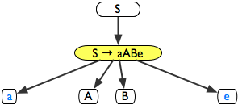
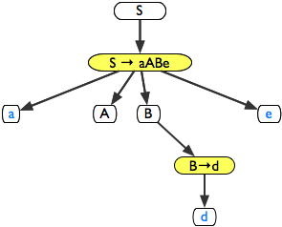
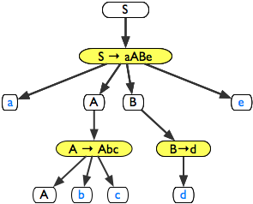
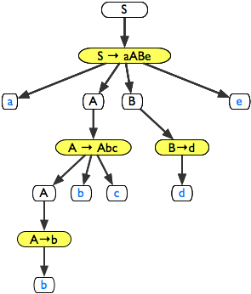
Identify Right Hand Side of Rule
Consider again...
  S ⇒ aABe ⇒ aAde ⇒ aAbcde ⇒ abbcde
S → aABe
A → Abc | b
B → d

Slide 70
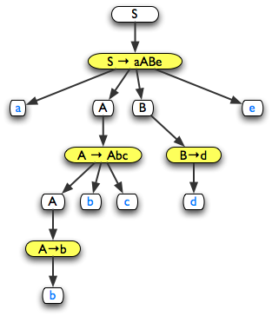
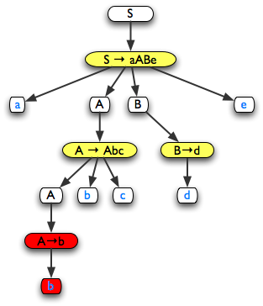
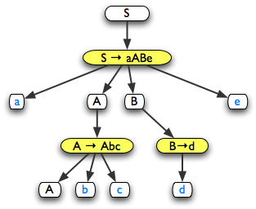
Identify Right Hand Side of Rule
What bottom-up really means...
abbcde
aAbcde

Slide 71
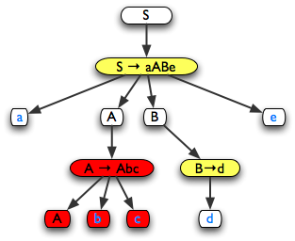
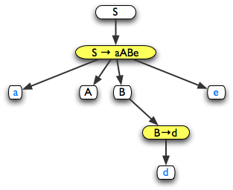
Identify Right Hand Side of Rule
aAbcde
aAde

Slide 72
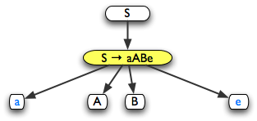
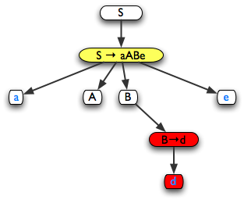
Identify Right Hand Side of Rule
aAde
aABe

Slide 73
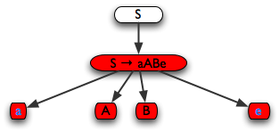
Identify Right Hand Side of Rule
aABe
S

Slide 74
Bottom-Up Parsing …
Recognized body (RHS of rule ) of last production applied in rightmost derivation
Replace the symbol sequence (RHS of rule) of that body by the LHS of the Production Rule Based on “Current” Input
Repeats
At the end
  Either
    We are left with the start symbol ⇒ Success!
  Or
    We get “stuck” somewhere ⇒ Syntax error!
Key Issue: If there are Multiple Handles for the “Same” Sentential Form, then the Grammar G is Ambiguous

Slide 75
General Processing of BUP
Basic mechanisms
  “Shift”
  “Reduce”
Basic data-structure
  A stack of grammar symbols (Terminals and Non-Terminals)
Basic idea
  Shift input symbols on the stack until ... the entire handle (RHS of rule) of the last rightmost reduction
  When the body of the last RM reduction is on Stack, Reduce it by replacing the body by the right-hand-side of the Production Rule
  When only start symbol is left
    We are done.

Slide 76
Grammar rules
Number each rule
1 S → aABe
2 A → Abc
3 A → b
4 B→ d

Slide 77
Example
1 S → aABe
2 A → Abc
3 A → b
4 B→ d
$ | abbcde$ | Shift a
$a | bbcde$ | Shift b
$ab | bcde$ | Reduce 3
$aA | bcde$ | Shift
$aAb | cde$ | Shift
$aAbc | de$ | Reduce
$aA | de$ | Shift
$aAd | e$ | Reduce
$aAB | e$ | Shift
$aABe | $ | Reduce
$S | $ | Accept
Rule to Reduce with (LHS of rule 3)
Handle (RHS of rule)

Slide 78
Example
$ | abbcde$ | Shift a
$a | bbcde$ | Shift b
$ab | bcde$ | Reduce 3
$aA | bcde$ | Shift b
$aAb | cde$ | Shift c
$aAbc | de$ | Reduce 2
$aA | de$ | Shift
$aAd | e$ | Reduce
$aAB | e$ | Shift
$aABe | $ | Reduce
$S | $ | Accept
Handle
Rule 2 to Reduce

Slide 79
Example
$ | abbcde$ | Shift a
$a | bbcde$ | Shift b
$ab | bcde$ | Reduce 3
$aA | bcde$ | Shift b
$aAb | cde$ | Shift c
$aAbc | de$ | Reduce 2
$aA | de$ | Shift d
$aAd | e$ | Reduce
$aAB | e$ | Shift
$aABe | $ | Reduce
$S | $ | Accept
Handle
Rule 4 to
Reduce

Slide 80
Example
$ | abbcde$ | Shift a
$a | bbcde$ | Shift b
$ab | bcde$ | Reduce 3
$aA | bcde$ | Shift b
$aAb | cde$ | Shift c
$aAbc | de$ | Reduce 2
$aA | de$ | Shift d
$aAd | e$ | Reduce 4
$aAB | e$ | Shift e
$aABe | $ | Reduce
$S | $ | Accept

Slide 81
Example
$ | abbcde$ | Shift a
$a | bbcde$ | Shift b
$ab | bcde$ | Reduce 3
$aA | bcde$ | Shift b
$aAb | cde$ | Shift c
$aAbc | de$ | Reduce 2
$aA | de$ | Shift d
$aAd | e$ | Reduce 4
$aAB | e$ | Shift e
$aABe | $ | Reduce 1
$S | $ | Accept
1 S → aABe
2 A → Abc
3 A → b
4 B→ d

Slide 82
Key Observation
At any point in time
  Content of the stack is a prefix of a right-sentencial form
  This prefix is called a viable prefix
Check again!
  Below = all the right-sentencial form of a rightmost derivation
  S ⇒ aABe
  ⇒ aAde
  ⇒ aAbcde
  ⇒ abbcde
$
$a
$ab
$aA
$aAb
$aAbc
$aA
$aAd
$aAB
$aABe
$S

Slide 83
What is General Processing for BUP?
Utilize a Stack Implementation:
  Contains Symbols, Non-Terminals, and Input
  Input is Examined w.r.t. Stack/Current State
General Operation: Options to Process Stack Include:
  Shift Symbols from Input onto Stack
  When Handle β on Top of Stack
    Reduce by using Rule: A → β
    Pop all Symbols of Handle β (RHS of rule)
    Push Non-Terminal A (LHS of rule) onto Stack
  When Configuration ($S, $) of Stack, ACCEPT
  Error Occurs when Handle Can’t be Found or S is on Stack with Non-Empty Input

Slide 84
Consider the Example Below

Slide 85
What are Possible Grammar Conflicts?
Shift-Reduce (S/R) Conflict:
  Content of Stack and Reading Current Input
  More than One Option of What to do Next
stmt → if expr then stmt
| if expr then stmt else stmt
| other
Consider Stack as below with input of token else
$ …. if expr then stmt
  Do we Reduce “if expr then stmt” to stmt
    This assumes that there is an earlier if to match the upcoming else
  Do we Shift “else” onto Stack?
    This means that the else matches to the most recent if
  Both can fail based on input yet to be seen

Slide 86
What are Possible Grammar Conflicts?
Reduce-Reduce (R/R) Conflict:
stmt → id ( parameter_list )
parameter_list → parameter_list, parameter
parameter → id
expr → id ( expression_list )
| id
expression_list → expression_list, expr
| expr
Consider Stack as below with input of token
$ …. id (id, … , id) ….
  Do we Reduce to stmt?
  Do we Reduce to expr?

Slide 87
Bottom-Up Parsing Techniques
LR(k) Parsers
  Left to Right Input Scanning (L)
  Construct a Rightmost Derivation in Reverse (R)
  Use k Lookahead Symbols for Decisions
Advantages
  Well Suited to Almost All PLs
  Most General Approach/Efficiently Implemented
  Detects Syntax Errors Very Quickly
Disadvantages
  Difficult to Build by Hand
  Tools to Assist Parser Construction (Yacc, Bison)

Slide 88
Components of an LR Parser
Table
Generator
Grammar
Parsing Table
Driver
Routines
Parsing
Table
Output
Parse Tree
Input Tokens
Common to all LR Parsers
Differs Based on
Grammar/Lookaheads

Slide 89
Three Classes of LR Parsers
Simple LR (SLR) or LR(0)
  Easiest but Limited in Grammar Applicability
  Grammar Leads to S/R and R/R Conflicts
Canonical LR(k) k lookaheads
  Powerful but Expensive
  LR(k) – Usually LR(1)
Lookahead LR (LALR) – In Between Two
Two Fold Focus:
  Parser Table Construction – Item and Item Sets
  Examination of LR Parsing Algorithm

Slide 90
LR Parser Structure
s_{m}
X_{m}
s_{m-1}
X_{m-1}
…
X₁
s₀
a₁ ... a_{i} a_{i+1} ... a_{n}$
INPUT
(s₀ X₁ s₁ X₂ ... X_{m-1} s_{m-1} X_{m} s_{m} , a_{i} a_{i+1} ... a_{n} $)
O
U
T
P
U
T
state
Grammar symbol
(Terminal or
non-terminal)
LR
Parsing Program
action goto
action[s_{m} , a_{i} ] is Parsing Table with Four Options
1. Shift S onto Stack 2. Reduce by Rule
3. Accept ($,$) 4. Report an Error
goto[s_{m} , a_{i} ] determines next state for action
Question: What does following Represent? Right sentential form
X₁ X₂ ... X_{m-1} X_{m} a_{i} a_{i+1} ... a_{n}

Slide 91
What is the Parsing Table?
Combination of State, Action, and Goto
  Shift s5 means shift input symbol and state 5
  Reduce r2 means reduce using rule 2
  goto state/NT indicates the next state for reduction

Slide 92
Actions Against Configuration
Configuration: (s₀ X₁ s₁ X₂ ... X_{m-1} s_{m-1} X_{m} s_{m} , a_{i} a_{i+1} ... a_{n} $)
action[s_{m} , a_{i} ] =
  Shift s in Parsing Table – Move a_{i}s_{m+1} to Stack
  (s₀ X₁ s₁ X₂ ... X_{m-1} s_{m-1} X_{m} s_{m} a_{i} s_{m+1} , a_{i+1} ... a_{n} $)
  Reduce A → β means
    Remove 2×| β| symbols from stack and Push A along with state s = goto[s_{m-1} , A] onto stack
    Uses Prior State after popping to determine goto
  Accept – Parsing Complete
  Error – Call recovery Routine

Slide 93
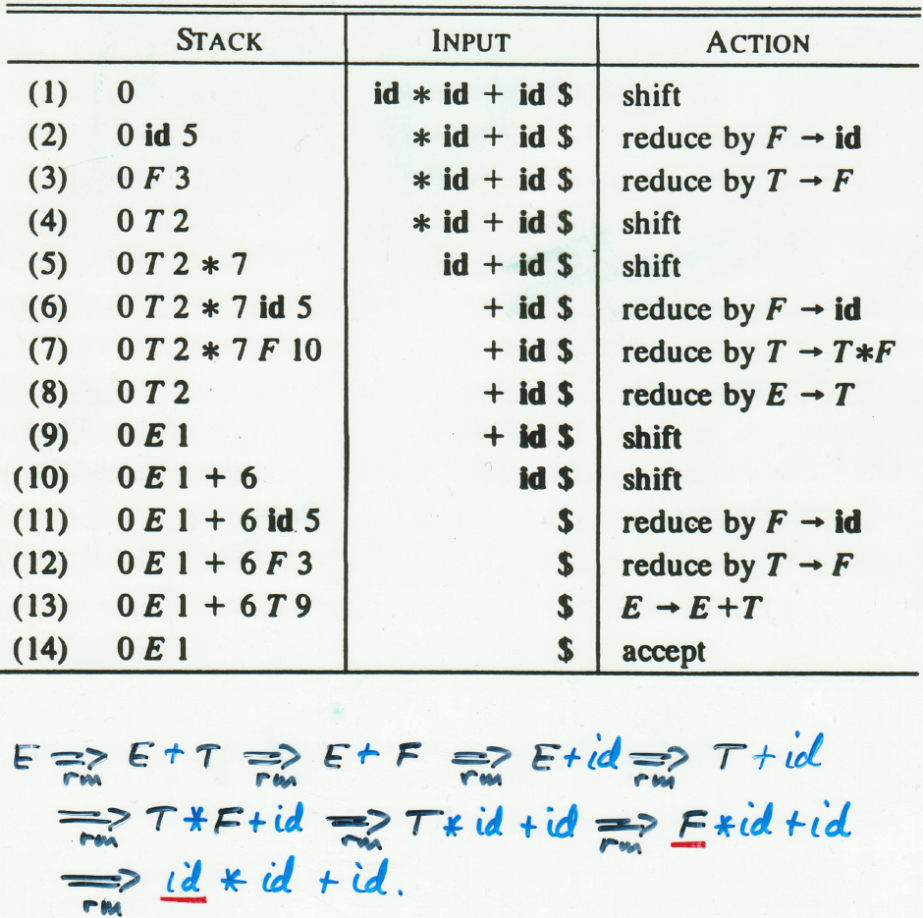
How Does BUP Work?
Stack Input Action

Slide 94
Another Detailed Example

Slide 95
Another Detailed Example

Slide 96
Another Detailed Example

Slide 97
Parser Generators
The entire process we describe can be automated
  Computation of the machine states
  Computation of the lookaheads
  Computation of the action and goto tables
  Optimization of the LALR tables.
Therefore...
  Tools exist to do this for you!

Slide 98
Parser Generators II
In the C/C++ world
  Most famous parser generator
    YACC LALR(1)
  Most used parser generator
    BISON LALR(1)
  Table-driven leftmost
    PCCTS LL(k)
In the Java world
  Several alternatives
    CUP (a BISON/YACC lookalike) LALR(1)
    JACK LALR(1)

Slide 99
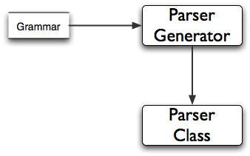
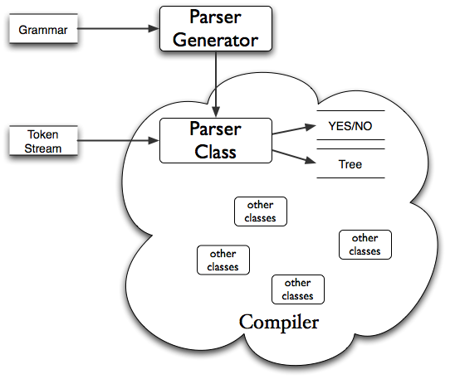
Big Picture

Slide 100
Summary
Syntax analysis is a common part of language implementation
A lexical analyzer is a pattern matcher that isolates small-scale parts of a program
  Detects syntax errors
  Produces a parse tree
A recursive-descent parser is an LL parser
  EBNF
Parsing problem for bottom-up parsers: find the substring of current sentential form
The LR family of shift-reduce parsers is the most common bottom-up parsing approach

