Slide 1
Chapter 10
Implementing Subprograms

Slide 2
Augment Sebesta Material
Programming Languages-Cheng (Fall 2004)
  http://www.cse.msu.edu/~cse452/Fall2004/Lectures/09-subprograms.ppt

Slide 3
Chapter 10 Topics
The General Semantics of Calls and Returns
Implementing “Simple” Subprograms
Implementing Subprograms with Stack-Dynamic Local Variables
Nested Subprograms
Blocks
Implementing Dynamic Scoping

Slide 4
The General Semantics of Calls and Returns
The subprogram call and return operations of a language are together called its subprogram linkage
General semantics of calls to a subprogram
  Parameter passing methods
  Stack-dynamic allocation of local variables
  Save the execution status of calling program
  Transfer of control and arrange for the return
  If subprogram nesting is supported, access to nonlocal variables must be arranged

Slide 5
The General Semantics of Calls and Returns
General semantics of subprogram returns:
  In mode and inout mode parameters must have their values returned
  Deallocation of stack-dynamic locals
  Restore the execution status
  Return control to the caller

Slide 6
Implementing “Simple” Subprograms
Call Semantics:
- Save the execution status of the caller
- Pass the parameters
- Pass the return address to the called
- Transfer control to the called

Slide 7
Implementing “Simple” Subprograms (continued)
Return Semantics:
  If pass-by-value-result or out mode parameters are used, move the current values of those parameters to their corresponding actual parameters
  If it is a function, move the functional value to a place the caller can get it
  Restore the execution status of the caller
  Transfer control back to the caller
Required storage:
  Status information, parameters, return address, return value for functions, temporaries

Slide 8
Implementing “Simple” Subprograms (continued)
Two separate parts: the actual code and the non-code part (local variables and data that can change)
The format, or layout, of the non-code part of an executing subprogram is called an activation record
An activation record instance is a concrete example of an activation record (the collection of data for a particular subprogram activation)

Slide 9
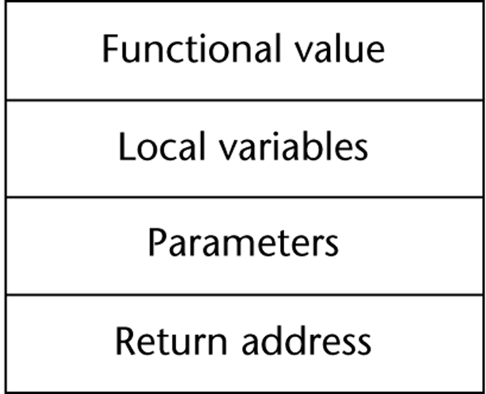
Simple Subprograms
Required Storage:
  Status information of the caller
  Parameters
  return address
  functional value (if it is a function)
Subprogram consists of 2 parts:
  Subprogram code
  Subprogram data
    The format, or layout, of the noncode part of an executing subprogram is called an activation record
    An activation record instance (ARI) is a concrete example of an activation record (the collection of data for a particular subprogram activation)

Slide 10
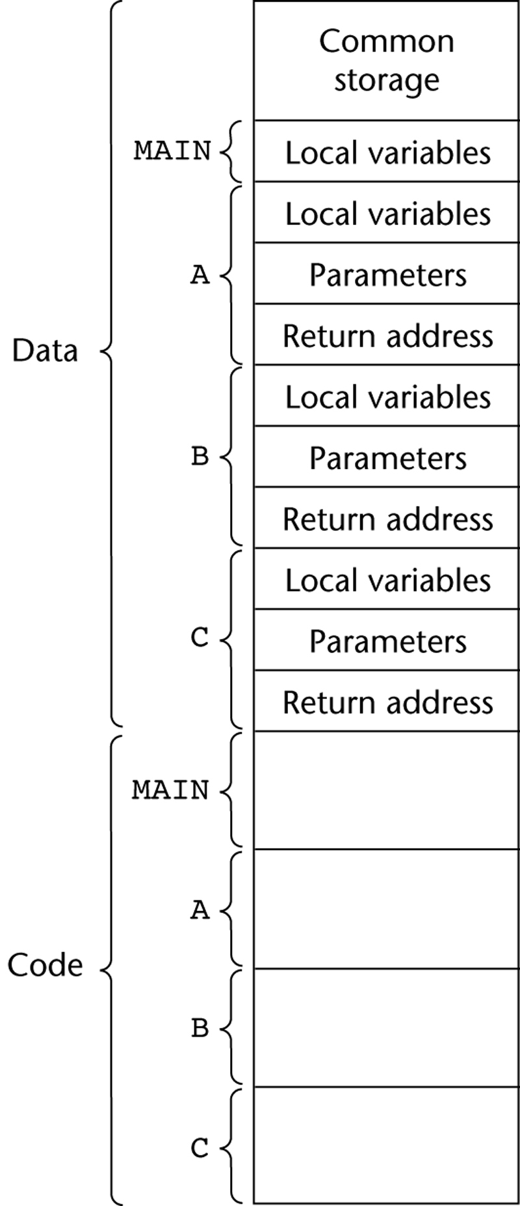
Code and Activation Records of a Program with “Simple” Subprograms

Slide 11
Implementing Subprograms with Stack-Dynamic Local Variables
More complex activation record
  The compiler must generate code to cause implicit allocation and deallocation of local variables
  Recursion must be supported (adds the possibility of multiple simultaneous activations of a subprogram)

Slide 12
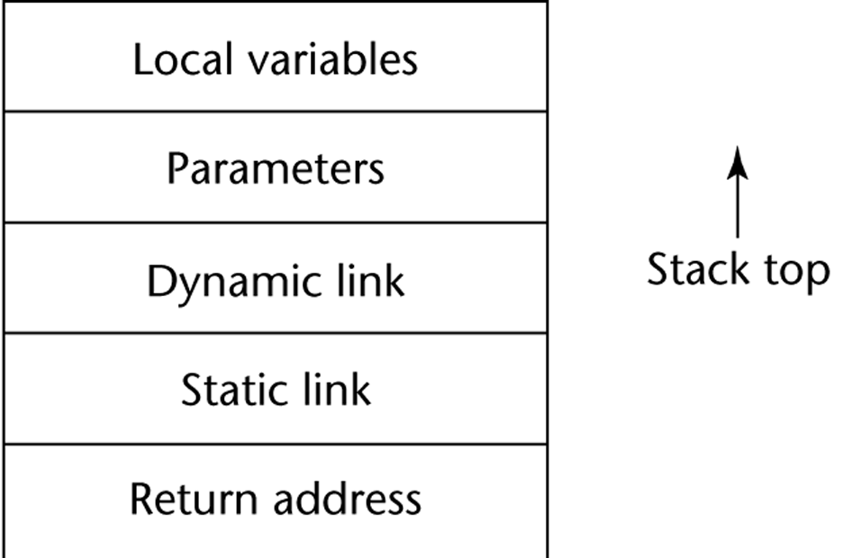
Typical Activation Record for a Language with Stack-Dynamic Local Variables

Slide 13
Implementing Subprograms with Stack-Dynamic Local Variables: Activation Record
The activation record format is static, but its size may be dynamic
The dynamic link points to the top of an instance of the activation record of the caller
An activation record instance is dynamically created when a subprogram is called
Activation record instances reside on the run-time stack
The Environment Pointer (EP) must be maintained by the run-time system. It always points at the base of the activation record instance of the currently executing program unit

Slide 14
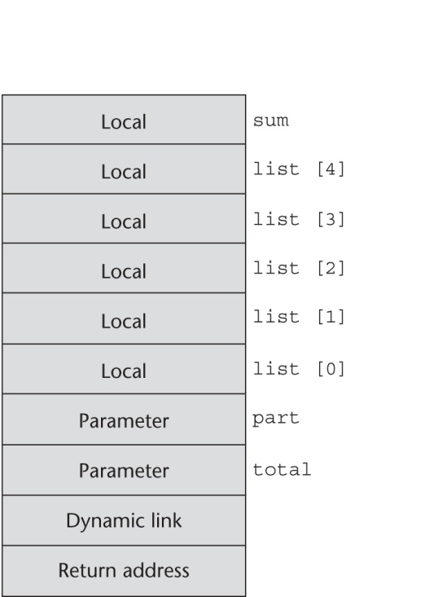
An Example: C Function
void sub(float total, int part)
{
int list[5];
float sum;
…
}

Slide 15
Revised Semantic Call/Return Actions
Caller Actions:
  Create an activation record instance
  Save the execution status of the current program unit
  Compute and pass the parameters
  Pass the return address to the called
  Transfer control to the called
Prologue actions of the called:
  Save the old EP in the stack as the dynamic link and create the new value
  Allocate local variables

Slide 16
Revised Semantic Call/Return Actions (continued)
Epilogue actions of the called:
  If there are pass-by-value-result or out-mode parameters, the current values of those parameters are moved to the corresponding actual parameters
  If the subprogram is a function, its value is moved to a place accessible to the caller
  Restore the stack pointer by setting it to the value of the current EP-1 and set the EP to the old dynamic link
  Restore the execution status of the caller
  Transfer control back to the caller

Slide 17
An Example Without Recursion
void fun1(float r) {
int s, t;
...
fun2(s);
...
}
void fun2(int x) {
int y;
...
fun3(y);
...
}
void fun3(int q) {
...
}
void main() {
float p;
...
fun1(p);
...
}
main calls fun1
fun1 calls fun2
fun2 calls fun3

Slide 18
Example: without Recursion
void A(int X) {
int Y;
…
C(Y);
}
void B(float R) {
int S, T;
…
A(S);
…
}
void C(int Q) {
…
}
void main() {
float P;
…
B(P);
…
}
2
1
3
Collection of dynamic links present in the stack at any given time is called the dynamic chain

Slide 19
Dynamic Chain and Local Offset
The collection of dynamic links in the stack at a given time is called the dynamic chain, or call chain
Local variables can be accessed by their offset from the beginning of the activation record, whose address is in the EP. This offset is called the local_offset
The local_offset of a local variable can be determined by the compiler at compile time

Slide 20
An Example With Recursion
The activation record used in the previous example supports recursion
int factorial (int n) {
<-----------------------------1
if (n <= 1) return 1;
else return (n * factorial(n - 1));
<-----------------------------2
}
void main() {
int value;
value = factorial(3);
<-----------------------------3
}

Slide 21
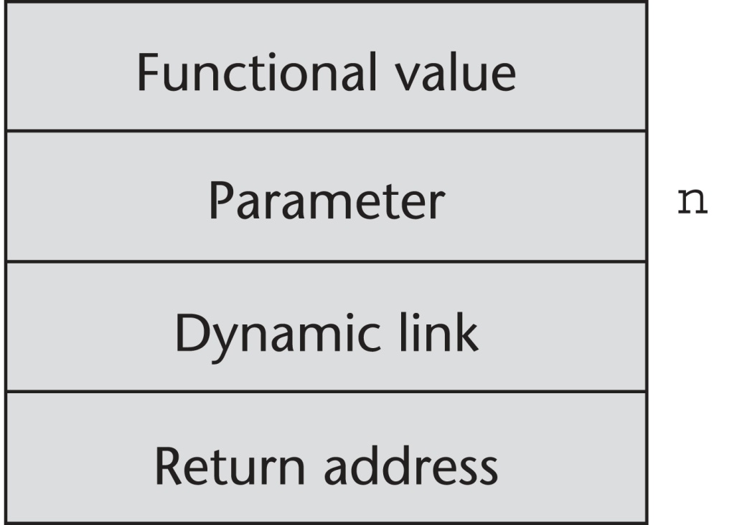
Activation Record for factorial

Slide 22
Subprograms with Stack-Dynamic Variables
Recursion adds possibility of multiple simultaneous activations of a subprogram
  Each activation requires its own copy of formal parameters and dynamically allocated local variables, along with return address

Slide 23
Subprograms with Recursion
int factorial (int n) {
…
if (n <= 1)
return 1;
else
return n*factorial(n-1);
…
}
void main() {
int value;
value = factorial(3);
…
}

Slide 24
Subprograms with Recursion
int factorial (int n) {
…
if (n <= 1)
return 1;
else
return n*factorial(n-1);
…
}
void main() {
int value;
value = factorial(3);
…
}
1
2
3

Slide 25
Subprograms with Recursion
int factorial (int n) {
…
if (n <= 1)
return 1;
else
return n*factorial(n-1);
…
}
void main() {
int value;
value = factorial(3);
…
}
1
2
3

Slide 26
Nested Subprograms
Some non-C-based static-scoped languages (e.g., Pascal, Modula-2, Fortran 95+, Ada, Python, JavaScript, Ruby, and Lua) use stack-dynamic local variables and allow subprograms to be nested
All variables that can be non-locally accessed reside in some activation record instance in the stack
The process of locating a non-local reference:
  Find the correct activation record instance
  Determine the correct offset within that activation record instance

Slide 27
Nested Subprograms
Support for static scoping
  Implemented using static link (also called static scope pointer), which points to the bottom of the activation record instance of its static parent
Notes:
Static scope: scope of variable determined statically (based on
Structure of program)
Dynamic scope:scope of variable depends on calling sequence/execution
Order, so can only be determined at runtime.

Slide 28
Nested Subprograms
Static chain:
  links all static ancestors of executing subprogram
Static_depth
  an integer associated with static scope that indicates how deeply it is nested in outermost scope
Chain offset
  Difference between static_depth of procedure containing reference to variable x and static_depth of procedure containing declaration of x
procedure A is
procedure B is
procedure C is
…
end; -- of C
…
end; -- of B
…
end; -- of A
Static_depths of A, B, and C are 0, 1, and 2, respectively
If procedure C references a variable declared in A, the chain_offset of that reference is 2
Notes:
Static chain: chain of static links that connect certain ARI in stack.

Slide 29
Nested Subprograms
program MAIN_2;
var X : integer;
procedure BIGSUB;
var A, B, C : integer;
procedure SUB1;
var A, D : integer;
begin { SUB1 }
A := B + C; <-----------------1
end; { SUB1 }
procedure SUB2(X : integer);
var B, E : integer;
procedure SUB3;
var C, E : integer;
begin { SUB3 }
SUB1;
E := B + A: <-------------2
end; { SUB3 }
begin { SUB2 }
SUB3;
A := D + E; <----------------3
end; { SUB2 }
begin { BIGSUB }
SUB2(7);
end; { BIGSUB }
begin
BIGSUB;
end. { MAIN_2 }
Calling sequence:
Main_2 calls BIGSUB
BIGSUB calls Sub2
Sub2 calls Sub3
Sub3 calls Sub1

Slide 30
Example
program MAIN_2;
var X : integer;
procedure BIGSUB;
var A, B, C : integer;
procedure SUB1;
var A, D : integer;
begin { SUB1 }
A := B + C; <-----------------1
end; { SUB1 }
procedure SUB2(X : integer);
var B, E : integer;
procedure SUB3;
var C, E : integer;
begin { SUB3 }
SUB1;
E := B + A: <-------------2
end; { SUB3 }
begin { SUB2 }
SUB3;
A := D + E; <----------------3
end; { SUB2 }
begin { BIGSUB }
SUB2(7);
end; { BIGSUB }
begin
BIGSUB;
end. { MAIN_2 }
References to A:
1: (0,3) (local)
2: (2,3) (two levels away)
3: (1,3) (one level away)
Notes:
(chain offset, local_offset)
Chain offset: number of links to correct ARI
Local_offset: offsets from the beginning of the AR of the local scope.

Slide 31
Nested Subprograms
At position 1 in SUB1:
  A - (0, 3) ============> (chain_offset, local_offset)
  B - (1, 4)
  C - (1, 5)
At position 2 in SUB3:
  E - (0, 4)
  B - (1, 4)
  A - (2, 3)
At position 3 in SUB2:
  A - (1, 3)
  D - an error ====➔ ARI for sub1 has been removed
  E - (0, 5)

Slide 32
Nested Subprograms
Drawbacks
  A nonlocal reference is slow if the number of scopes between the reference and the declaration of the referenced variable is large
  Time-critical code is difficult, because the costs of nonlocal references are hard to estimate
Displays
  Alternative to static chains
  Store static links in a single array called display, instead of storing in the activation records
  Accesses to nonlocals require exactly two steps for every access, regardless of the number of scope levels
    Link to correct activation record is found using a statically computed value called the display_offset
    Compute local_offset within activation record instance

Slide 33
Locating a Non-local Reference
Finding the offset is easy
Finding the correct activation record instance
  Static semantic rules guarantee that all non-local variables that can be referenced have been allocated in some activation record instance that is on the stack when the reference is made

Slide 34
Static Scoping
A static chain is a chain of static links that connects certain activation record instances
The static link in an activation record instance for subprogram A points to one of the activation record instances of A's static parent
The static chain from an activation record instance connects it to all of its static ancestors
Static_depth is an integer associated with a static scope whose value is the depth of nesting of that scope

Slide 35
Static Scoping (continued)
The chain_offset or nesting_depth of a nonlocal reference is the difference between the static_depth of the reference and that of the scope when it is declared
A reference to a variable can be represented by the pair:
(chain_offset, local_offset),
where local_offset is the offset in the activation
record of the variable being referenced

Slide 36
Stack Contents
function main(){
function bigsub() {
var a, b, c;
function sub1 {
var a, d;
a = b + c;
...
} // end of sub1
function sub2(x) {
var b, e;
function sub3() {
var c, e;
sub1();
...
e = b + a;
} // end of sub3 ...
sub3();
...
a = d + e;
} // end of sub2
main calls bigsub
bigsub calls sub2
sub2 calls sub3
sub3 calls sub1
...
sub2(7);
...
} // end of bigsub
...
bigsub();
...
} // end of main

Slide 37
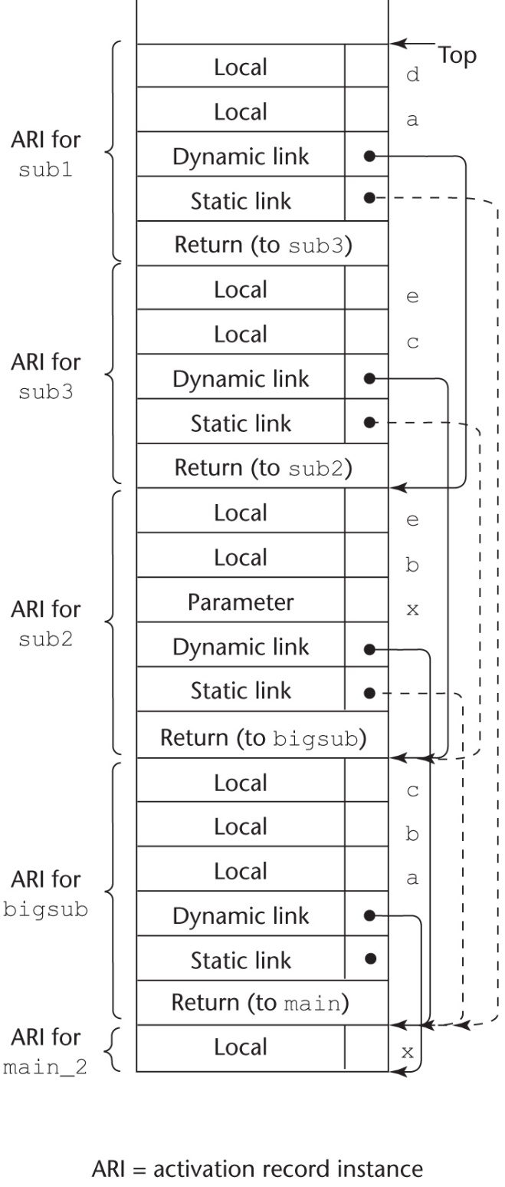
Stack Contents
main calls bigsub
bigsub calls sub2
sub2 calls sub3
sub3 calls sub1
function main(){
function bigsub() {
var a, b, c;
function sub1 {
var a, d;
a = b + c;
...
} // end of sub1
function sub2(x) {
var b, e;
function sub3() {
var c, e;
sub1();
...
e = b + a;
} // end of sub3 ...
sub3();
...
a = d + e;
} // end of sub2
...
sub2(7);
...
} // end of bigsub
...
bigsub();
...
} // end of main

Slide 38
Static Chain Maintenance
At the call,
- The activation record instance must be built
- The dynamic link is just the old stack top pointer
- The static link must point to the most recent ari of the static parent
- Two methods:
1. Search the dynamic chain
2. Treat subprogram calls and
definitions like variable references
and definitions

Slide 39
Evaluation of Static Chains
Problems:
1. A nonlocal areference is slow if the
nesting depth is large
2. Time-critical code is difficult:
a. Costs of nonlocal references are
difficult to determine
b. Code changes can change the
nesting depth, and therefore the cost

Slide 40
Blocks
Blocks are user-specified local scopes for variables
An example in C
{int temp;
temp = list [upper];
list [upper] = list [lower];
list [lower] = temp
}
The lifetime of temp in the above example begins when control enters the block
An advantage of using a local variable like temp is that it cannot interfere with any other variable with the same name

Slide 41
Blocks
void main() {
int x, y, z;
while (…) {
int a, b, c;
…
while (…) {
int d, e;
…
}
}
while (…) {
int f, g;
…
}
…
}
e
d
c
Variables occupy same locations
b and g
a and f
z
y
x
Activation record
instance for Main

Slide 42
Implementing Blocks
Two Methods:
  Treat blocks as parameter-less subprograms that are always called from the same location
    Every block has an activation record; an instance is created every time the block is executed
  2. Since the maximum storage required for a block can be statically determined, this amount of space can be allocated after the local variables in the activation record

Slide 43
Implementing Dynamic Scoping
Deep Access: non-local references are found by searching the activation record instances on the dynamic chain
- Length of the chain cannot be statically
determined
- Every activation record instance must
have variable names
Shallow Access: put locals in a central place
  One stack for each variable name
  Central table with an entry for each variable name

Slide 44
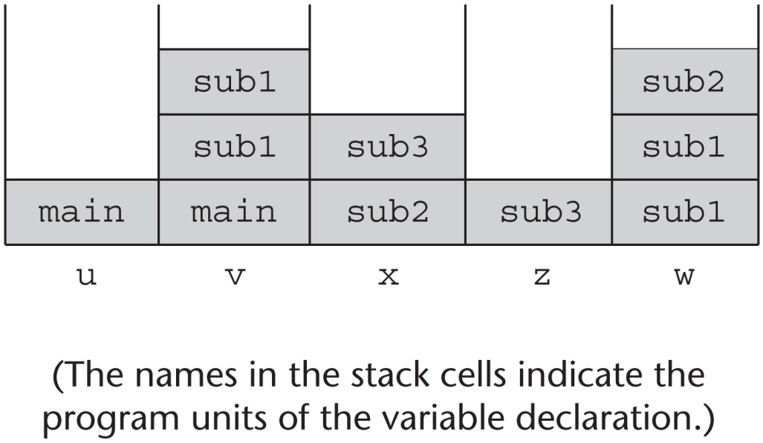
Using Shallow Access to Implement Dynamic Scoping
void sub3() {
int x, z;
x = u + v;
…
}
void sub2() {
int w, x;
…
}
void sub1() {
int v, w;
…
}
void main() {
int v, u;
…
}

Slide 45
Summary
Subprogram linkage semantics requires many action by the implementation
Simple subprograms have relatively basic actions
Stack-dynamic languages are more complex
Subprograms with stack-dynamic local variables and nested subprograms have two components
  actual code
  activation record

Slide 46
Summary (continued)
Activation record instances contain formal parameters and local variables among other things
Static chains are the primary method of implementing accesses to non-local variables in static-scoped languages with nested subprograms
Access to non-local variables in dynamic-scoped languages can be implemented by use of the dynamic chain or thru some central variable table method

