Slide 1
CSE4102 Team Project
Prof. Steven A. Demurjian
Computer Science & Engineering Department
The University of Connecticut
371 Fairfield Way, Box U-255
Storrs, CT 06269-3255
Steven.Demurjian@uconn.edu
http://sdcse.uconn.edu/
(860) 486–4818 (Office)
(860) 486-3719 (CSE Office)

Slide 2
Team semester project
Form teams of 2 to 4 students
Explore in-depth an old, new, or emerging programming language that supports one or more different programming paradigms
Recall that a programming paradigm describes the underlying conceptual and computational model of the PL
Imperative
Procedural
object-oriented etc.
See also
http://cs.lmu.edu/~ray/notes/paradigms/
https://en.m.wikipedia.org/wiki/Programming_paradigm
https://en.m.wikipedia.org/wiki/Software_development#Programming_paradigm

Slide 3
http://cs.lmu.edu/~ray/notes/paradigms/
Imperative: Programming with an explicit sequence of commands that update state.
Declarative: Programming by specifying the result you want, not how to get it.
Structured: Programming with clean, goto-free, nested control structures.
Procedural: Imperative programming with procedure calls.
Functional (Applicative): Programming with function calls that avoid any global state.
Function-Level (Combinator): Programming with no variables at all.

Slide 4
http://cs.lmu.edu/~ray/notes/paradigms/
Object-Oriented: Programming by defining objects that send messages to each other. Objects have their own internal (encapsulated) state and public interfaces. Object orientation can be:
Class-based: Objects get state and behavior based on membership in a class.
Prototype-based: Objects get behavior from a prototype object.
Event-Driven: Programming with emitters and listeners of asynchronous actions.
Flow-Driven: Programming processes communicating with each other over predefined channels.

Slide 5
http://cs.lmu.edu/~ray/notes/paradigms/
Logic (Rule-based): Programming by specifying a set of facts and rules. An engine infers the answers to questions.
Constraint: Programming by specifying a set of constraints. An engine finds the values that meet the constraints.
Aspect-Oriented: Programming cross-cutting concerns applied transparently.
Reflective: Programming by manipulating the program elements themselves.
Array: Programming with powerful array operators that usually make loops unnecessary.
Paradigms are not meant to be mutually exclusive; a single program can feature multiple paradigms!

Slide 6
Four Part Project
Identify the Issues/Questions of chosen PL
Why did you choose your PL?
What types of problems does it solve?
What application domais is it relevant for?
When how and who were the inventors of the programming language?
12/18/24 page final report your chosen PL for 2/3/4 members
One member expands the part A and focuses on paradigm, origin, history, domain, & bios
Other member(s) focus on language, compiler, IDE, grammar, etc.
Demonstrate your chosen programming language through code using perhaps word count or word frequency program.
50/75/100 slide PPT presentation on your chosen programming language using the CSE4102 template on the course web page. Each member does 25 slides on their portion from B. Also prepare a 5-10 slide speed version to present
Class Presentation Integrates Topic, Languages, and Bio PPTs

Slide 7
Team Structure and Responsibilities
A final report with 12 pages for 2 person teams, 18 pages for 3 person teams, in 24 pages for 4 person teams
One team member focuses on the overall introduction of the programming paradigm by:
Expanding the one page discussion in more detail
Discussing the underlying programming paradigm (e.g., concurrent, parallel, functional, etc.)
Explaining motivation /history of PL, bios of founders
Discussing the domain or intended application
Each of the other 1, 2, or 3 team members focuses on the programming language in detail including:
Perspective of technology, compilers, supported platforms, IDE
Grammar in EBNF or yacc/bison format as an appendix
For example, for object-oriented paradigm, Java, Eiffel, and C++, for a 4 person team, one team member do4svoverview and the other three team members assigned to a P

Slide 8
Choosing a Programming Language
Possible Languages to consider are based on categories or application domains or for specific purposes:
Languages for IoT, concurrency/parallelism, machine learning, secure transactions
Categories as in https://en.m.wikipedia.org/wiki/List_of_programming_languages_by_type
Time period organization as in https://en.m.wikipedia.org/wiki/Timeline_of_programming_languages
You cannot choose PLs in class (C, C++, Pascal, Modula-2, Ada, Prolog, Go, Fortran, COBOL), from a CSE class (Python, scheme), or widely in use (Java, JavaScript, C#, Objective-C, Swift, etc.).
Make sure you select a language that has an available compiler to utilize for demonstration and testing purpose
See: https://medium.freecodecamp.org/how-to-visualize-the-programming-language-influence-graph-7f1b765b44d1

Slide 9
Languages For Spring 19
6502 | erlang | php
68000 | F# | R
befunge | functional | Ruby on rails
Bitcoin script | gremlin | rust
Blocky | Haskell | Scala
clojure | juliauh | scratch
dart | kotlin | smalltalk
Django | logo | solodity
elixir | lucid | truebasic
elm | Mathematica

Slide 10
Possible Programming Languages
Dart https://www.dartlang.org Google general purpose/IoT PL
Rust https://www.rust-lang.org/en-US/ Systems programming
Parasail http://parasail-lang.org Parallel Programming
Julia https://julialang.org Numerical Computing
HiveQL SQL-like for Data Warehouses https://cwiki.apache.org/confluence/display/Hive/Home
Others links to Consider
Rosetta Code http://rosettacode.org/wiki/Rosetta_Code
https://techbeacon.com/5-emerging-programming-languages-bright-future
https://techbeacon.com/13-programming-languages-defining-future-coding
https://stackify.com/popular-programming-languages-2018/
http://yoppworks.com/8-predictions-of-future-programming-based-on-2017-trends/

Slide 11
Teams and Due Dates
33% per deliverable – individual and team grade
Important dates
By February 4th at 11:59pm: submit to Steve: a list of team members, your chosen programming language and a one-paragraph description of the language, and which team member is doing which deliverable (B and D)
By April 7 at 11:59pm: submit to Steve the two PPT presentations (speed and long)
Speed Presentation in Class
By May 1 at 11:59pm: submit your final report.

Slide 12
Format/Submission Requirements
All slides must be formatted with http://www.engr.uconn.edu/~steve/Cse4102/cse4102template.pptx
Slide 2 of http://www.engr.uconn.edu/~steve/Cse4102/cse4102template.pptx has organization of final PPT.
For written reports A and B, 1 page is 12pt, 1in margins, single spaced, Times New Roman fonts. You must submit an MS Word Document.
For presentations, use PowerPoint.
Tables, Figures, etc. are not counted in the page requirements of B.

Slide 13
Organization of Final PPT
50/75/100 slide PPT presentation using this template
Biographical PPTs (included in 50/75) for the individuals involved in your PL
See next three slides for an example
Conclusion Slide

Slide 14
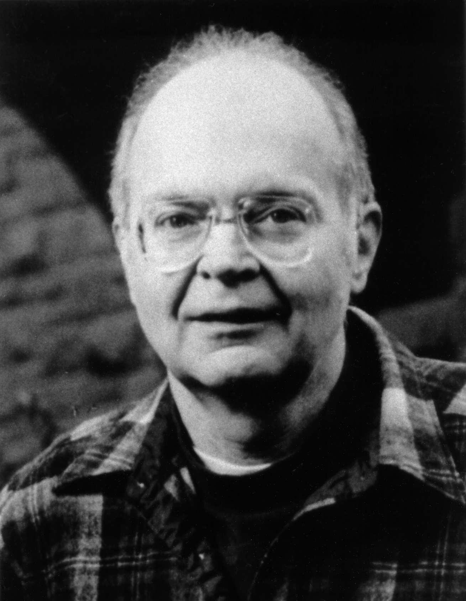
Biography - Donald Knuth
In 8th grade, won competition by finding 4,500 words from “Ziegler’s Giant Bar”
Graduated from high school in 1956 with the highest GPA ever achieved at that school
Graduated in 1960 from Case Institute of Technology with a B.S. in Mathematics, was simultaneously awarded an M.S. for his achievements, an unprecedented move
Received a Ph.D. in Mathematics from California Institute of Technology in 1963
Joined Stanford University as a Professor of Computer Science in 1968
In 1993, became Professor Emeritus of The Art of Computer Programming at Stanford, where he is still currently located

Slide 15
Achievements - Donald Knuth
Authored The Art of Computer Programming, a multi-volume tome on CS
Inventor of TeX and METAFONT
LR(k) parsing
Knuth-Morris-Pratt algorithm
1974 – Turing Award winner
1979 – National Medal of Science
1995 – John von Neumann Medal

Slide 16
Trivia - Donald Knuth
The Art of Computer Programming began as a text about compilers
Loves organ music, mostly 4 and 8-hand music which he plays on an organ in his home, he studied piano as a child
Pays $2.56 (one hexadecimal dollar) for errors found in his books
Quit using email in 1990
Processes all communications in batch-mode

