Slide 1
CSE4102 Final Exam Advice and Hints
Prof. Steven A. Demurjian
Computer Science & Engineering Department
The University of Connecticut
191 Auditorium Road, Box U-155
Storrs, CT 06269-3155
Important note: There’s no easy way for me to answer questions during the exam, since I can’t really respond to easily while you’re using a lockdown browser. When I gave a true false multiple choice exam in spring 2019 I only had one or two questions. My apologies for not being able to figure out a way to do this.
Steven.Demurjian@uconn.edu
http://sdcse.engr.uconn.edu
(860) 486 - 4818

Slide 2
Coverage: Chapters 3,4,5,6,7,8,9,10,11,12
Lexical analysis
Top-down and bottom-up parsing
Names binding and scoping
Typing
Expressions and type systems
Statements
Sub programs and parameter passing
Implementing sub-programs
Abstract data types and encapsulation
Object-oriented programming
Subset of slides
http://sdcse.engr.uconn.edu/Cse4102/PPTsforExam.zip

Slide 3
One Exam in two parts
Total 60pts, 60 minutes
Closed Notes, Book & Web
25 True False Questions Exam – 25 minutes 17 Multiple Choice Questions Exam – 35 minutes
1 of per true false, 2 pts per multiple coice
5 minute gap between the two scheduled exams
Day/time
Thurs 3:29-4:30 April 23
We’ll utilize the Respondus Lockdown browser through husky CT
Questions are randomized within each separate exam
Material for the exam in
http://sdcse.engr.uconn.edu/Cse4102/PPTsforExam.zip

Slide 4
Sample questions
T F In an attribute grammar, a node's inherited
attributes can be based on the values associated
with that node's ancestors and siblings in the
parse tree, but not its descendants.
T F Axiomatic semantics provide a good way of
documenting the design decisions madeimplementing
a program.
Attribute grammars are used to specify
(a) basic syntax of a programming language;
(b) non-finite state machines;
(c) static semantics of a programming language;
(d) dynamic semantics of a programming languag

Slide 5
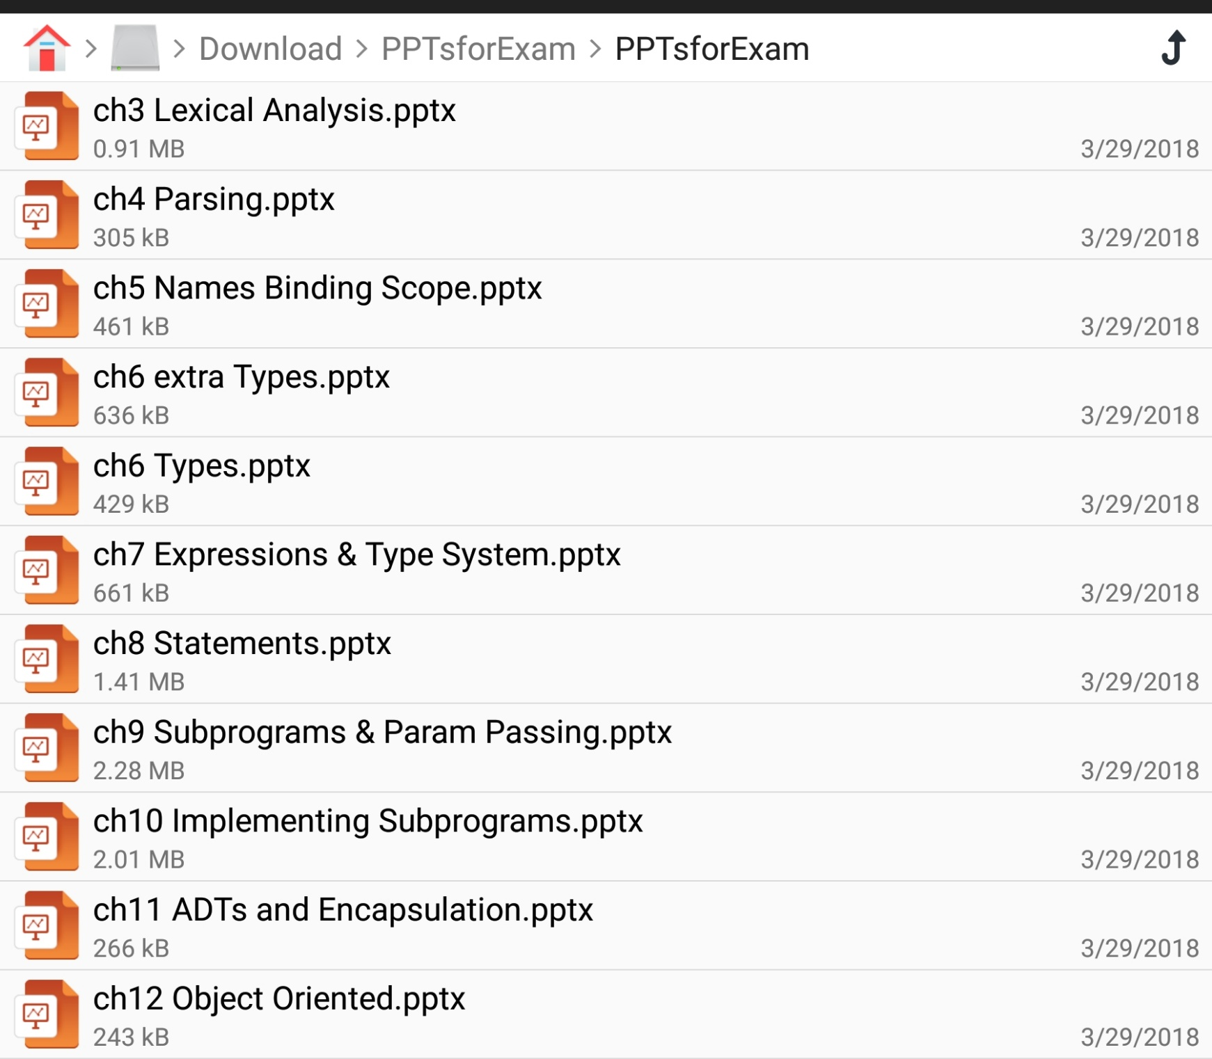
http://sdcse.engr.uconn.edu/Cse4102/PPTsforExam.zip
The zip file contains the followings PowerPoints

Slide 6
How to Study for the Exam
Focus on Chapters 3 to 12 Plus http://sdcse.engr.uconn.edu/Cse4102/stevesoo.pptx
I prepared zip pps for the original open book exam that had 5 to 6 multiple part problems
You might be better off reading the original complete PPTs particularly for Chapters 5 to 12 plus extra OO
Focus on understanding all of the Concepts
Lecical Analysis and Grammars
Parsing
Names, Bindings and Scoping
Typing and Type Checking
All types of statements
Parameter passing and runtime environment
Astract Data Type and Object Oriented

