Slide 1
IDEs and Coding Examples
Prof. Steven A. Demurjian
Computer Science & Engineering Department
The University of Connecticut
371 Fairfield Way, Box U-255
Storrs, CT 06269-3255
Steven.Demurjian@uconn.edu
http://sdcse.engr.uconn.edu
(860) 486–4818 (Office)
(860) 486-3719 (CSE Office)

Slide 2
IDEs and Code
Pascal Slides 3 to 35
Modula 2 Slides 36 to 80
Ada Slides 81 to 129
Prolog Slides 130 to 145
Go Slides 146 to 167
Fortran Slides 168 to 184

Slide 3
Dev-Pascal
http://www.gnu-pascal.de/gpc/h-install.html
Required IDE Dev-Pascal
http://www.bloodshed.net/devpascal.html
http://www.bloodshed.net/dev/devpas192.exe
All of the sample code in this PowerPoint is in
http://sdcse.engr.uconn.edu/Cse4102/PascalModula2Samples.zip

Slide 4
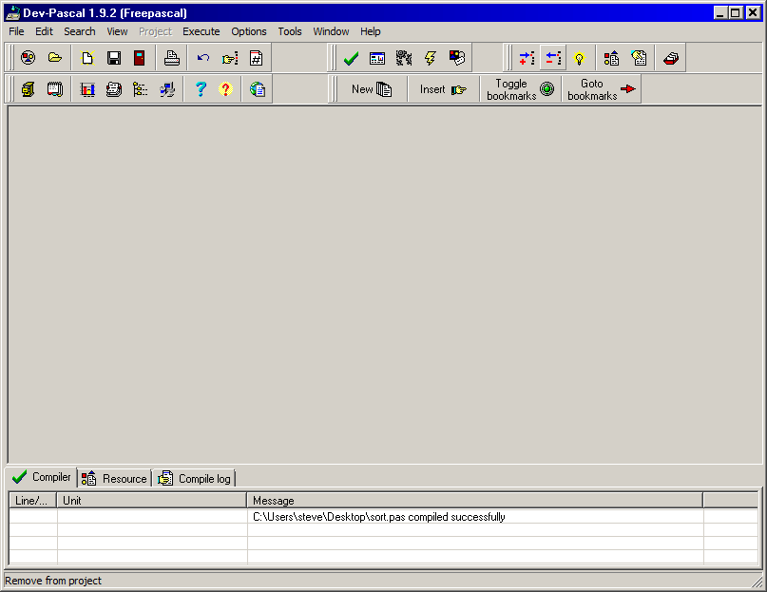
Dev Pascal

Slide 5
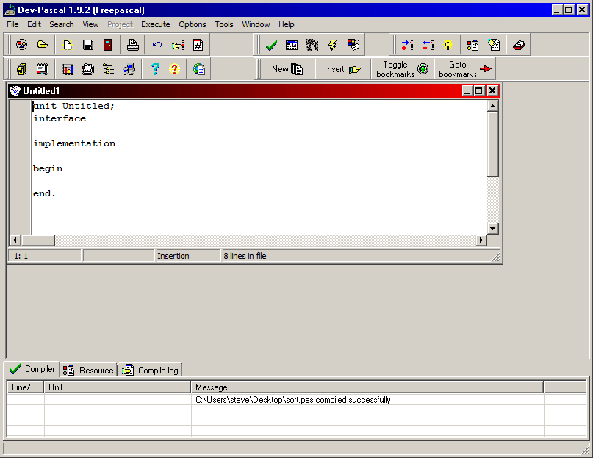
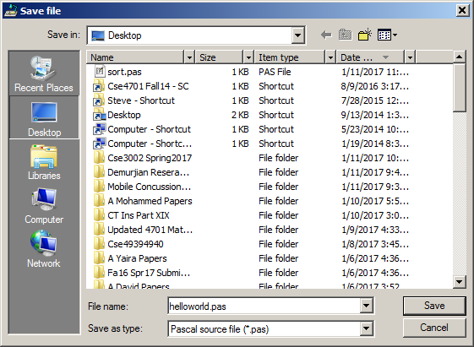
New Source File

Slide 6
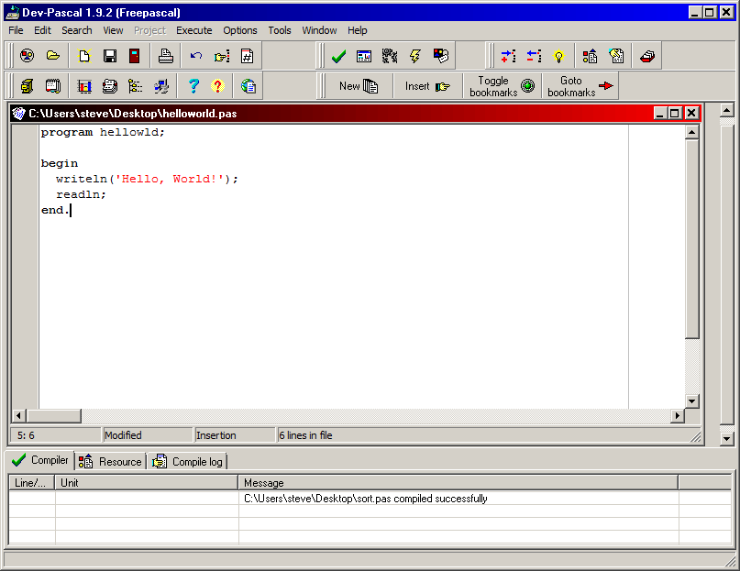
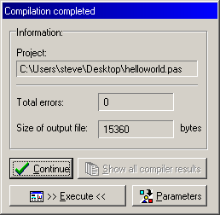
Cut and Paste in Code/Execute Compile

Slide 7
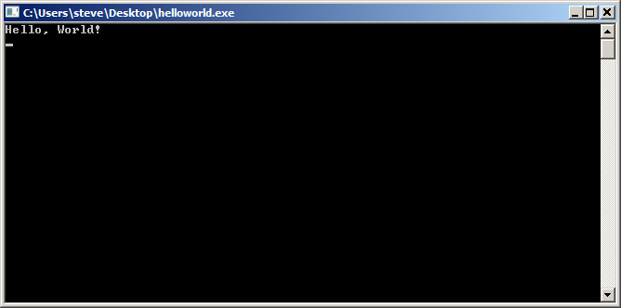
Hit Execute

Slide 8
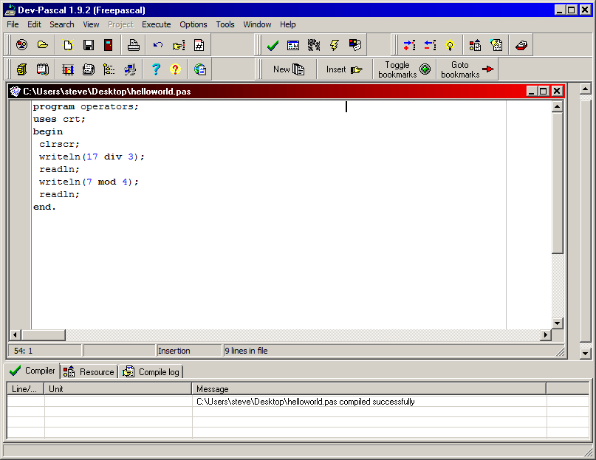
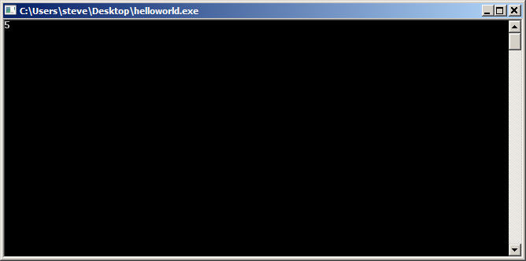
Another Sample
https://www.daniweb.com/programming/software-development/threads/50487/pascal-examples

Slide 9
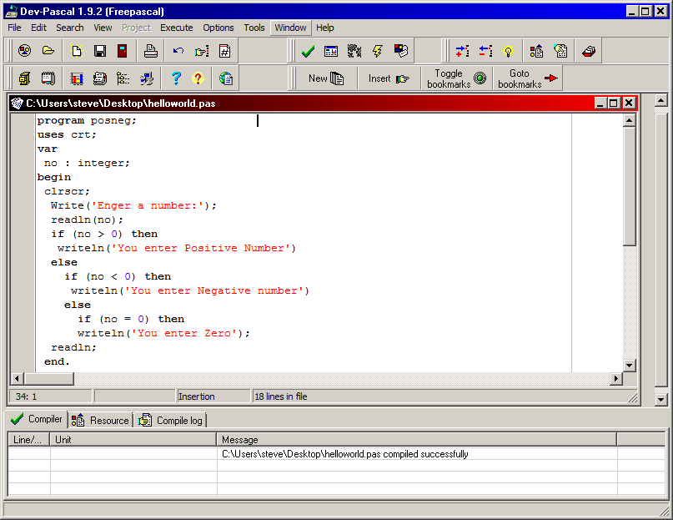
Another Example

Slide 10
Read/Write from files
program readwritetofiles;
var
readfilename : string;
writefilename : string;
myreadfile : text;
mywritefile : text;
c : char;
gpa : integer;
Begin (* put files in c:\Dev-Pas directory *)
readfilename:='letterGrades.txt';
writefilename:='pointGrades.txt';
assign(myreadfile, readfilename);
reset(myreadfile);
assign(mywritefile, writefilename);
rewrite(mywritefile);
while NOT EOF (myreadfile) do
begin
readln(myreadfile, c);
case (c) of
'A' : gpa := 4;
'B' : gpa := 3;
'C' : gpa := 2;
'D' : gpa := 1;
'F' : gpa := 0;
otherwise gpa := -1;
end; (* case *)
writeln(mywritefile, gpa);
end;
writeln(mywritefile,'Completed writing');
close(myreadfile);
close(mywritefile);
end.
letterGrades.txt
A
B
B
A
D
B
pointGrades.txt
4
3
3
4
1
3
Completed writing

Slide 11
Reading and writing lines
program readwritetofiles;
var
readfilename : string;
writefilename : string;
myreadfile : text;
mywritefile : text;
line : packed array [1..100] of char;
begin
(* put files in c:\Dev-Pas directory *)
readfilename:='inputfile.txt';
writefilename:='outputfile.txt';
assign(myreadfile, readfilename);
reset(myreadfile);
assign(mywritefile, writefilename);
rewrite(mywritefile);
while NOT EOF (myreadfile) do
begin
readln(myreadfile, line);
writeln(mywritefile, line);
end;
writeln(mywritefile,'Completed writing');
close(myreadfile);
close(mywritefile);
end.
inputfile.txt
Here is a file
with multiple
words that you also
have to process
outputfile.txt
Here is a file
with multiple
words that you also
have to process
Completed writing
For Pascal Project – read a line at a time and Process the array of char

Slide 12
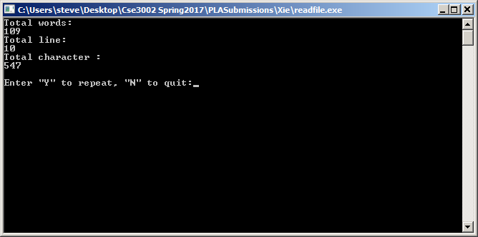
Output of WCF in Pascal for testcase.txt
Please also read the platform specific README and file, if it exists.
News and changes related to this release if are described.
Be sure to uninstall any previous version of Dev-Pascal before installing.
Please also read the platform specific README and file, if it exists.
News and changes related to this release if are described.
Be sure to uninstall any previous version of Dev-Pascal before installing.
News and changes related to this release if are described.
Please also read the platform specific README and file, if it exists.
News and changes related to this release if are described.
News and changes related to this release if are described.

Slide 13
Expanding the Sample Program
program readwritetofiles;
var
readfilename : string;
writefilename : string;
myreadfile : text;
mywritefile : text;
line : packed array [1..100] of char;
i : integer;
num_characters: integer;
begin
(* put files in c:\Dev-Pas directory *)
readfilename:='inputfile.txt';
writefilename:='outputfile.txt';
assign(myreadfile, readfilename);
reset(myreadfile);
assign(mywritefile, writefilename);
rewrite(mywritefile);
while NOT EOF (myreadfile) do
begin
readln(myreadfile, line);
num_characters := 0;
for i:=1 to 100 do
if ord(line[i]) <> 0 then
begin
num_characters := num_characters + 1;
write(mywritefile, line[i])
end;
writeln(mywritefile, num_characters);
end;
writeln(mywritefile,'Completed writing');
close(myreadfile);
close(mywritefile);
end.

Slide 14
Expanding the Sample Program
line : packed array [1..100] of char;
i : integer;
num_characters: integer;
while NOT EOF (myreadfile) do
begin
readln(myreadfile, line);
num_characters := 0;
for i:=1 to 100 do
if ord(line[i]) <> 0 then
begin
num_characters := num_characters + 1;
write(mywritefile, line[i])
end;
writeln(mywritefile, num_characters);
end;

Slide 15
Input
Please also read the platform specific README and file, if it exists.
News and changes related to this release if are described.
Be sure to uninstall any previous version of Dev-Pascal before installing.
Please also read the platform specific README and file, if it exists.
News and changes related to this release if are described.
Be sure to uninstall any previous version of Dev-Pascal before installing.
News and changes related to this release if are described.
Please also read the platform specific README and file, if it exists.
News and changes related to this release if are described.
News and changes related to this release if are described.

Slide 16
Output
Please also read the platform specific README and file, if it exists.69
News and changes related to this release if are described.it exists.68
Be sure to uninstall any previous version of Dev-Pascal before installing.74
Please also read the platform specific README and file, if it exists.ing.73
News and changes related to this release if are described.it exists.ing.72
Be sure to uninstall any previous version of Dev-Pascal before installing.74
News and changes related to this release if are described.ore installing.73
Please also read the platform specific README and file, if it exists.ing.73
News and changes related to this release if are described.it exists.ing.72
News and changes related to this release if are described.it exists.ing.72
Completed writing

Slide 17
readwritetofilesNEW.pas
program readwritetofiles;
var
readfilename : string;
writefilename : string;
myreadfile : text;
mywritefile : text;
line : packed array [1..120] of char;
i, j: integer;
num_characters: integer;
total_chars : integer;
begin
(* put files in c:\Dev-Pas directory *)
readfilename:='inputfile.txt';
writefilename:='outputfile.txt';
assign(myreadfile, readfilename);
reset(myreadfile);
assign(mywritefile, writefilename);
rewrite(mywritefile);

Slide 18
readwritetofilesNEW.pas
total_chars :=0;
while NOT EOF (myreadfile) do
begin
readln(myreadfile, line);
num_characters := 0; (* only chars - no blanks*)
i:=1; (* i will be total chars+blanks per line*)
while (ord(line[i]) <> 0) do i:=i+1;
writeln(mywritefile, i);
for j:=1 to i do
if ((line[j] <> ' ') and (ord(line[j]) <> 0)) then
begin
num_characters := num_characters + 1;
write(mywritefile, line[j])
end;
total_chars :=total_chars+num_characters;
writeln(mywritefile, num_characters);
end;
writeln(mywritefile, total_chars);
writeln(mywritefile,'Completed writing');
close(myreadfile);
close(mywritefile);
end.

Slide 19
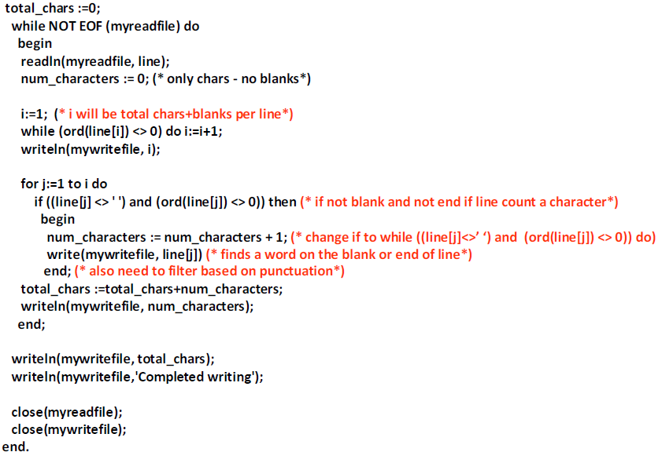
readwritetofilesNEW.pas

Slide 20
Used Ordinal Values of Characters

Slide 21
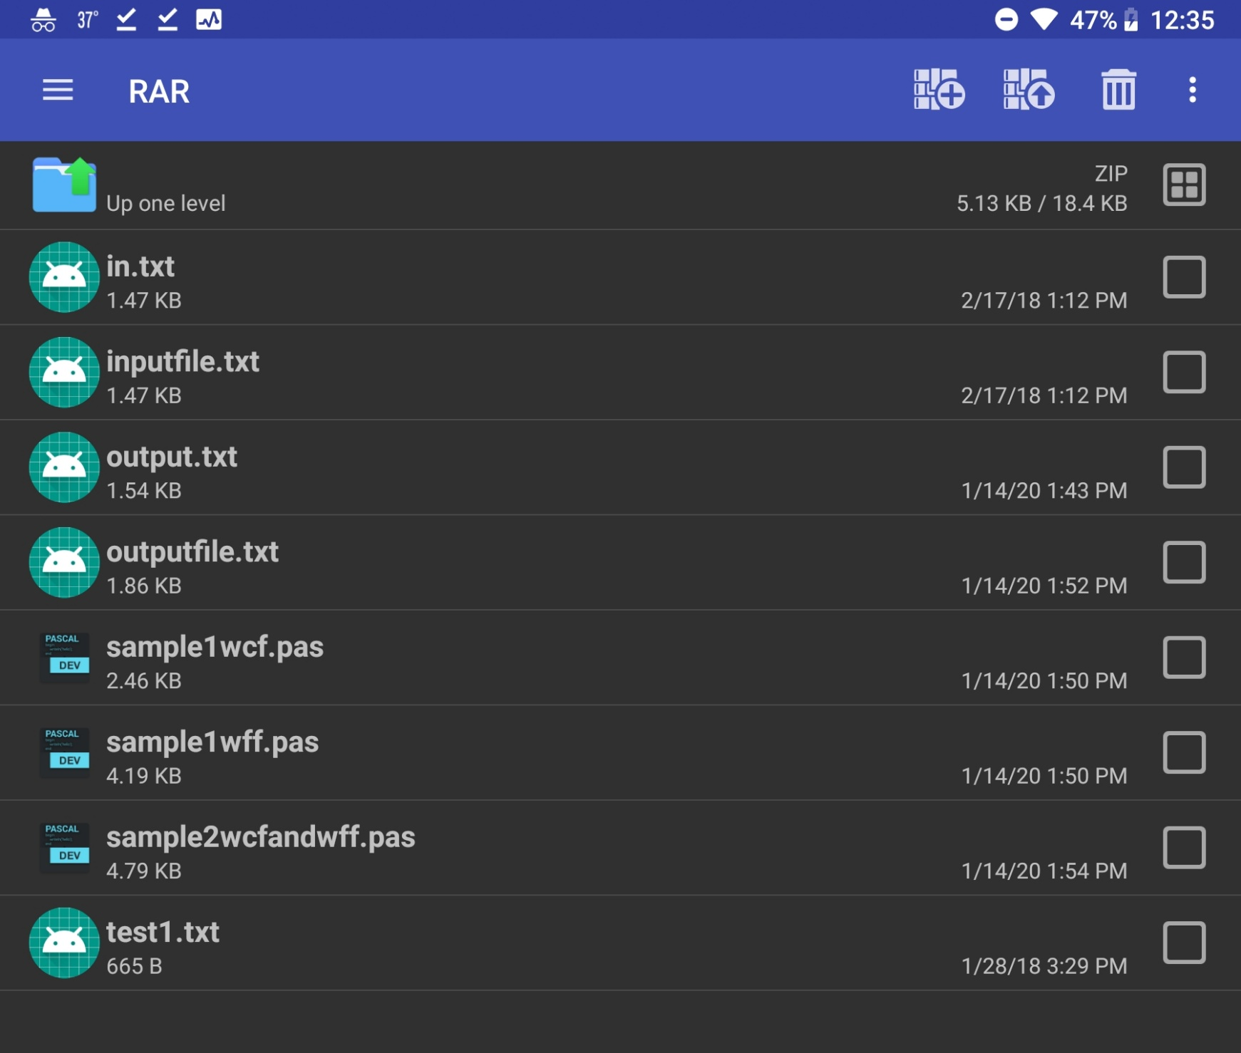
Files in pla1.zip

Slide 22
sample1wcf.pas

Slide 23
sample1wcf.pas

Slide 24
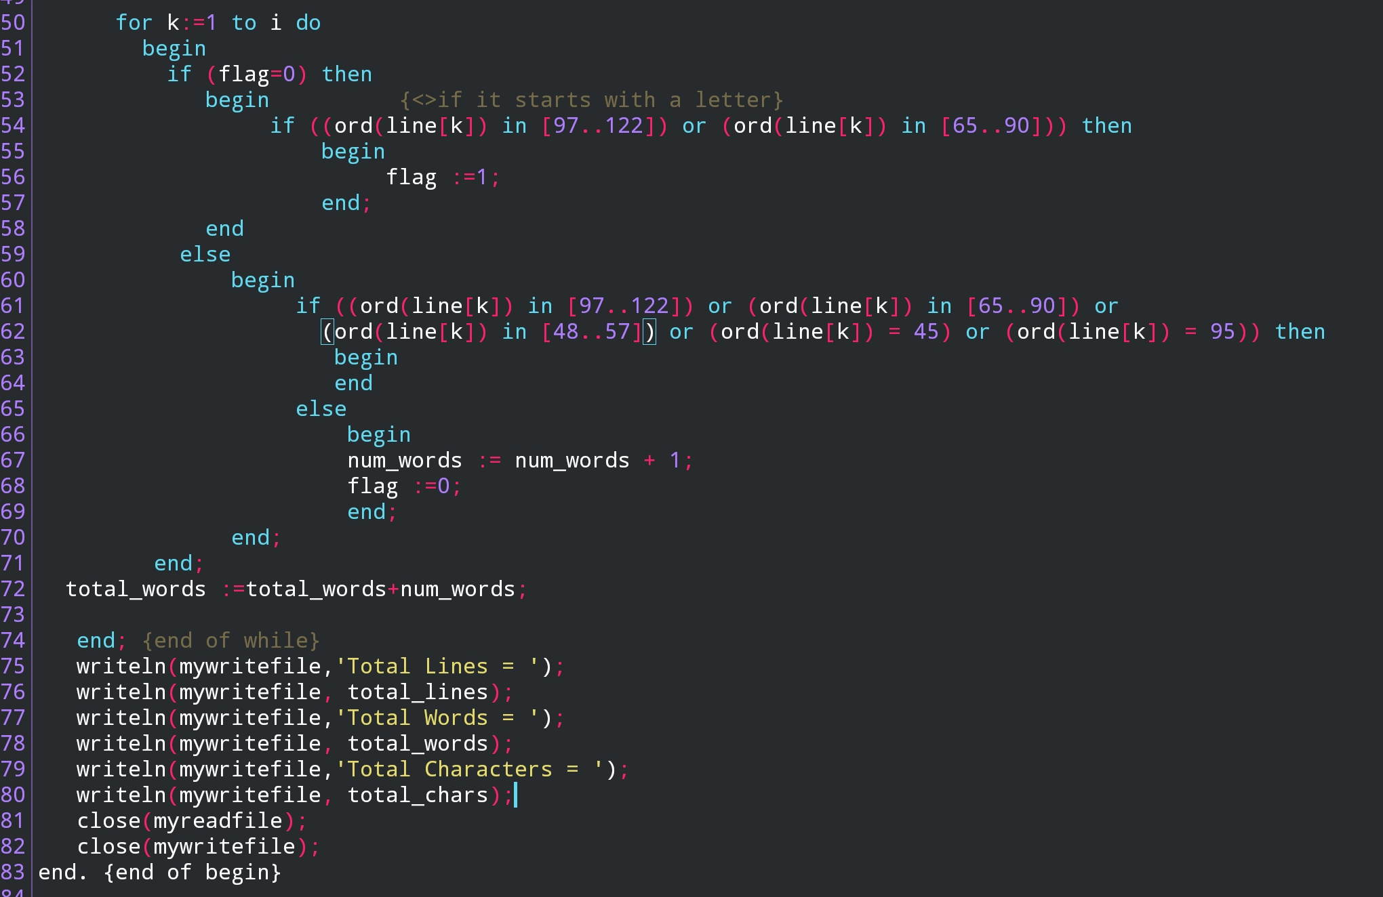
sample1wcf.pas

Slide 25
sample1wff.pas

Slide 26
sample1wff.pas

Slide 27
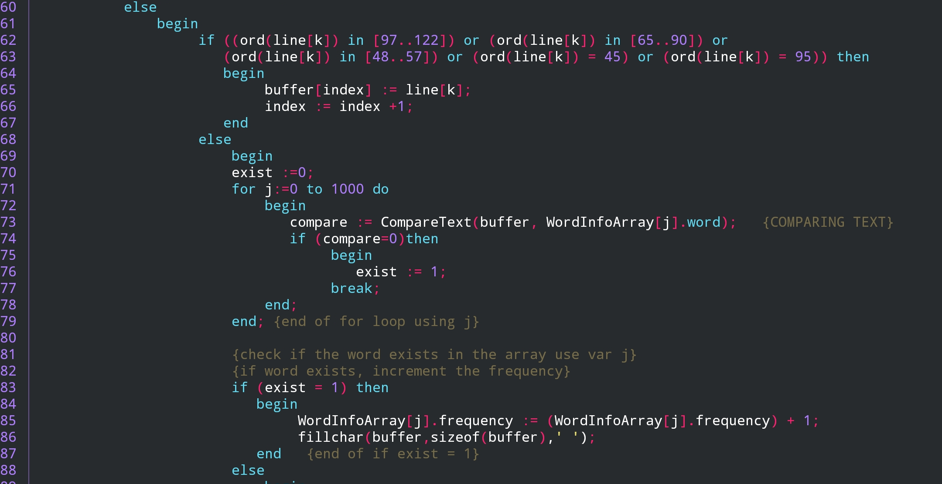
sample1wff.pas

Slide 28
sample1wff.pas

Slide 29
sample1wff.pas

Slide 30
sample2wcfandwff.pas

Slide 31
sample2wcfandwff.pas

Slide 32
sample2wcfandwff.pas

Slide 33
sample2wcfandwff.pas

Slide 34
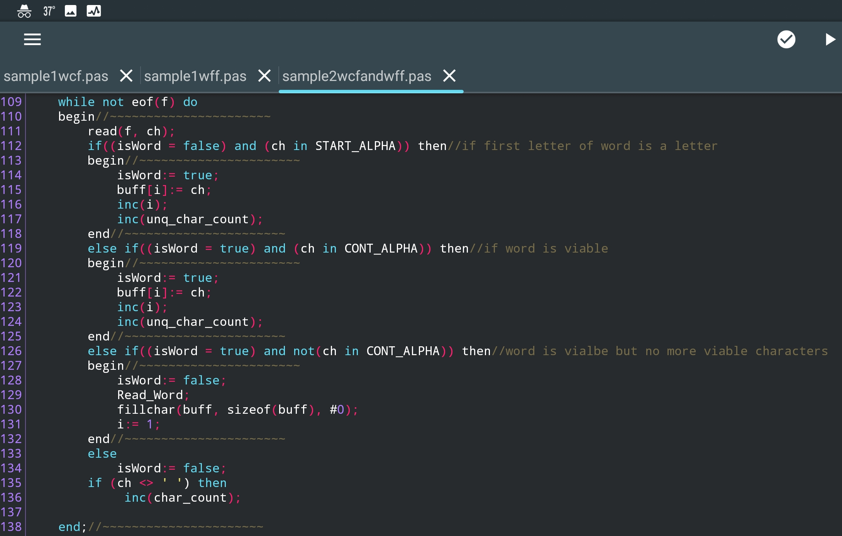
sample2wcfandwff.pas

Slide 35
sample2wcfandwff.pas

Slide 36
Modula-2 Compilers - https://www.modula2.org/
Available at GNU
http://nongnu.org/gm2/homepage.html
http://nongnu.org/gm2/download.html
We are using XDS-IDE:
https://www.excelsior-usa.com/xds.html
https://github.com/excelsior-oss/xds-ide/releases/tag/xds-ide-1.7.0
Just Extract the zip file to a directory on your desktop
Modula-2 Online References
http://www.csc.twu.ca/rsbook/

Slide 37
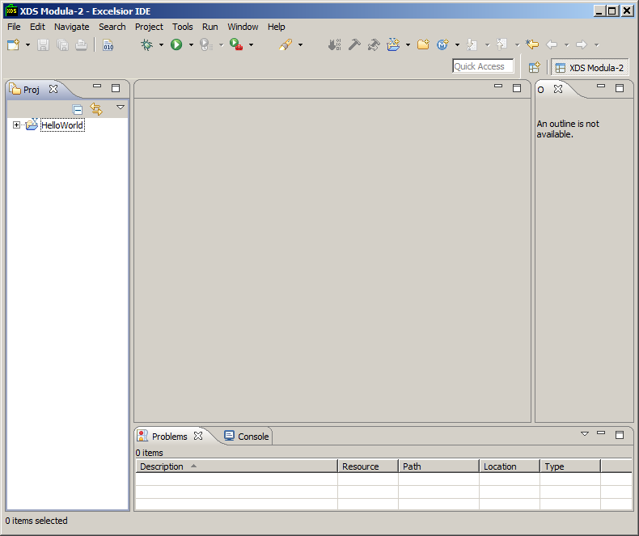
XDS Modula-2– Create New Project

Slide 38
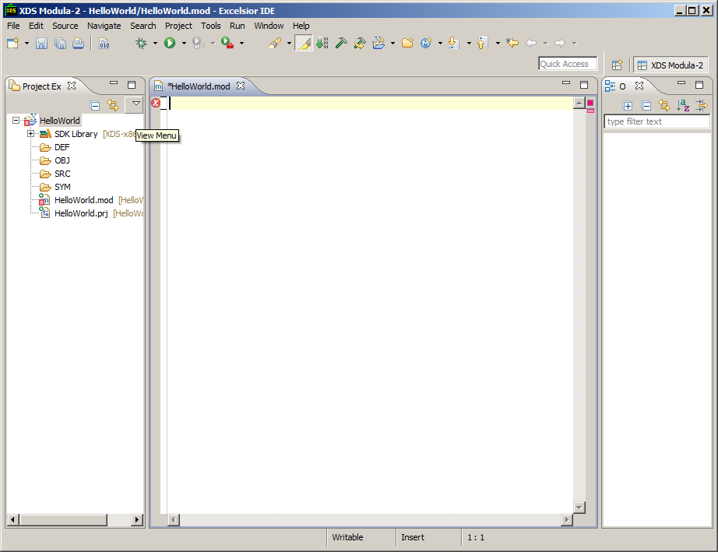
Create New Module – Right Click HelloWorld

Slide 39
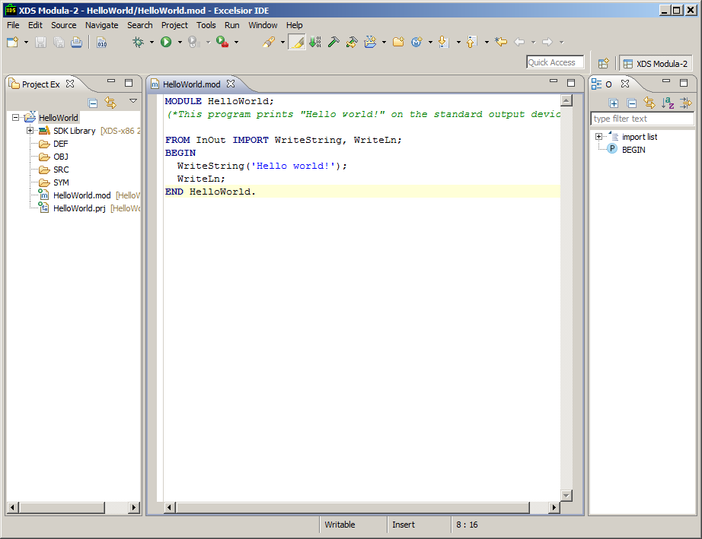
Project-Build Project

Slide 40
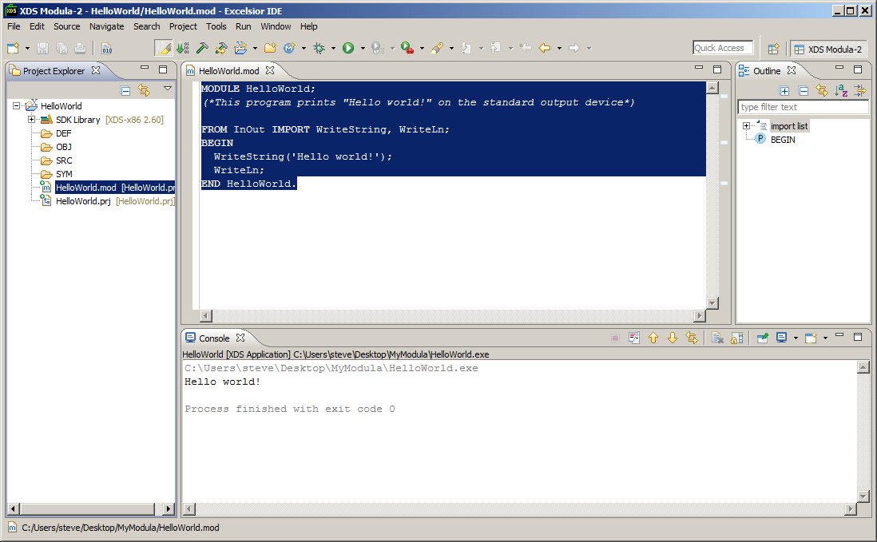
Run/Run As/1 XDS Modula-2 Application

Slide 41
Create Another Project IfDemo
MODULE IfDemo;
FROM InOut IMPORT WriteString, WriteInt, WriteLn;
VAR Index1 : INTEGER;
BEGIN
FOR Index1 := 1 TO 8 DO
IF Index1 < 4 THEN (* Simple IF statement *)
WriteString("Index1 is less than 4.");
WriteInt(Index1,4);
WriteLn;
END; (* end of first IF statement *)
IF Index1 = 5 THEN (* two way IF statement *)
WriteString("Index1 is 5");
ELSE
WriteString("Index1 is not 5");
END; (* end of second IF statement *)
WriteLn;
IF Index1 = 2 THEN (* multiple way IF statement *)
WriteString("Index1 is 2");
ELSIF Index1 = 6 THEN
WriteString("Index1 is 6");
ELSE
WriteString("I really don't care what Index1 is");
END; (* end of third IF statement *)
WriteLn;
END; (* of big FOR loop *)
END IfDemo.

Slide 42
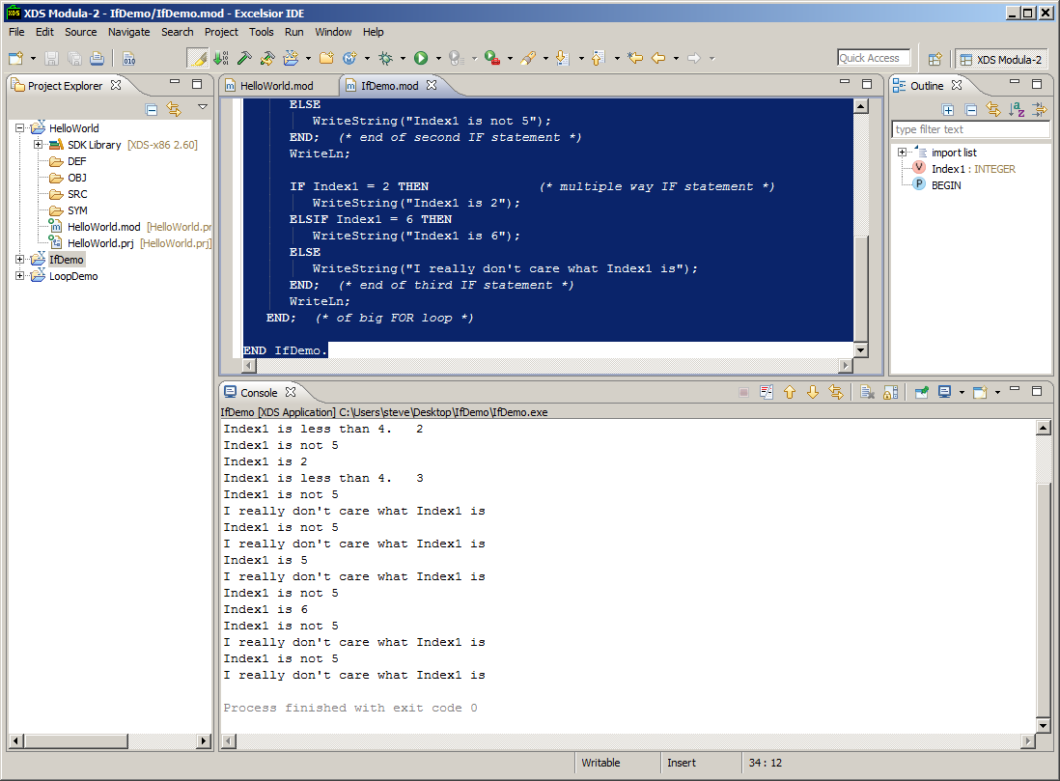
Project Build and Run/Run As

Slide 43
Create Another Project LoopDemo
https://www.modula2.org/tutor/chapter4.php
Had to Change:
FROM Terminal2 IMPORT WriteString, WriteInt, WriteLn, WriteChar;
https://www.modula2.org/reference/isomodules/
MODULE LoopDemo;
FROM STextIO IMPORT WriteString, WriteLn, WriteChar;
FROM SWholeIO IMPORT WriteInt;
CONST Where = 11;
VAR Index : INTEGER;
What : INTEGER;
Letter : CHAR;
BEGIN
WriteString("REPEAT loop = ");
Index := 0;
REPEAT
ETC

Slide 44
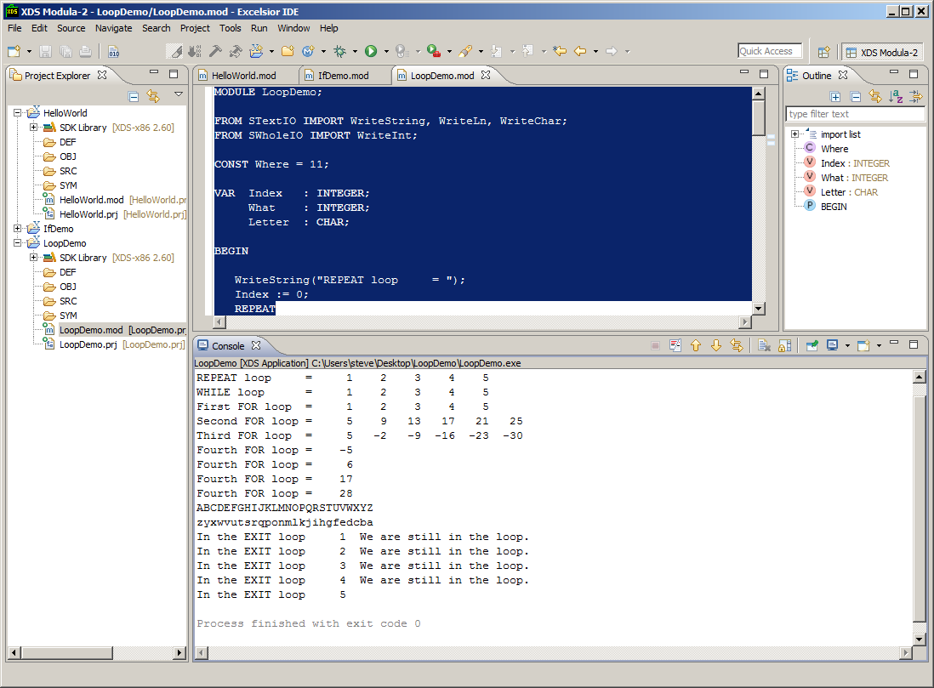
Project Build and Run/Run As

Slide 45
Read File Line-by-Line/Write stdout
MODULE ReadWritestdout;
(* Written by R.J. Sutcliffe *)
(* to illustrate the use of StreamFile *)
(* using ISO standard Modula-2 *)
(* last revision 1994 02 23 *)
FROM StreamFile IMPORT ChanId, Open, read, Close, OpenResults;
FROM TextIO IMPORT ReadString, WriteLn, WriteString, SkipLine;
FROM IOResult IMPORT ReadResult, ReadResults;
FROM StdChans IMPORT StdInChan, StdOutChan;
VAR
infile, stdOut, stdIn : ChanId;
res : OpenResults;
str: ARRAY [1..100] OF CHAR;

Slide 46
Read File Line-by-Line/Write stdout
BEGIN
stdOut := StdOutChan(); (* to force screen output *)
stdIn := StdInChan(); (* to force keyboard input *)
Open (infile, "input.txt", read, res);
IF res = opened
THEN
REPEAT (* Collect the info from the file *)
ReadString (infile, str);
IF ReadResult (infile) = allRight
THEN
SkipLine (infile);
WriteString (stdOut, str);
WriteLn (stdOut);
END; (* if *)
UNTIL ReadResult (infile) # allRight;
Close (infile);
WriteLn (stdOut);
ELSE
WriteString (stdOut,"Sorry, couldn't open the file");
WriteLn (stdOut);
END; (* if *)
close(infile);
close(stdout);
END ReadWritestdout.

Slide 47
input.txt file – Movies with Computing
Desk Set (1957)
Billion Dollar Brain (1967)
2001: A Space Odyssey (1968)
The Computer Wore Tennis Shoes (1969)
Colossus: The Forbin Project (1970)
The Andromeda Strain (1971)
The Aries Computer (1972)
Demon Seed (1977)
Blade Runner (1982)
Tron (1982)
WarGames (1983)
Electric Dreams (1984)
D.A.R.Y.L. (1985)
Prime Risk (1985)
Flight of the Navigator (1986)
Short Circuit (1986)
Defense Play (1989)
Sneakers (1992)
Disclosure (1994)
Hackers (1995)

Slide 48
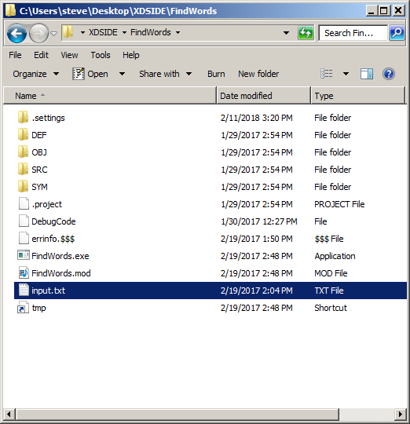
Make Sure input.txt in FindWords Directory

Slide 49
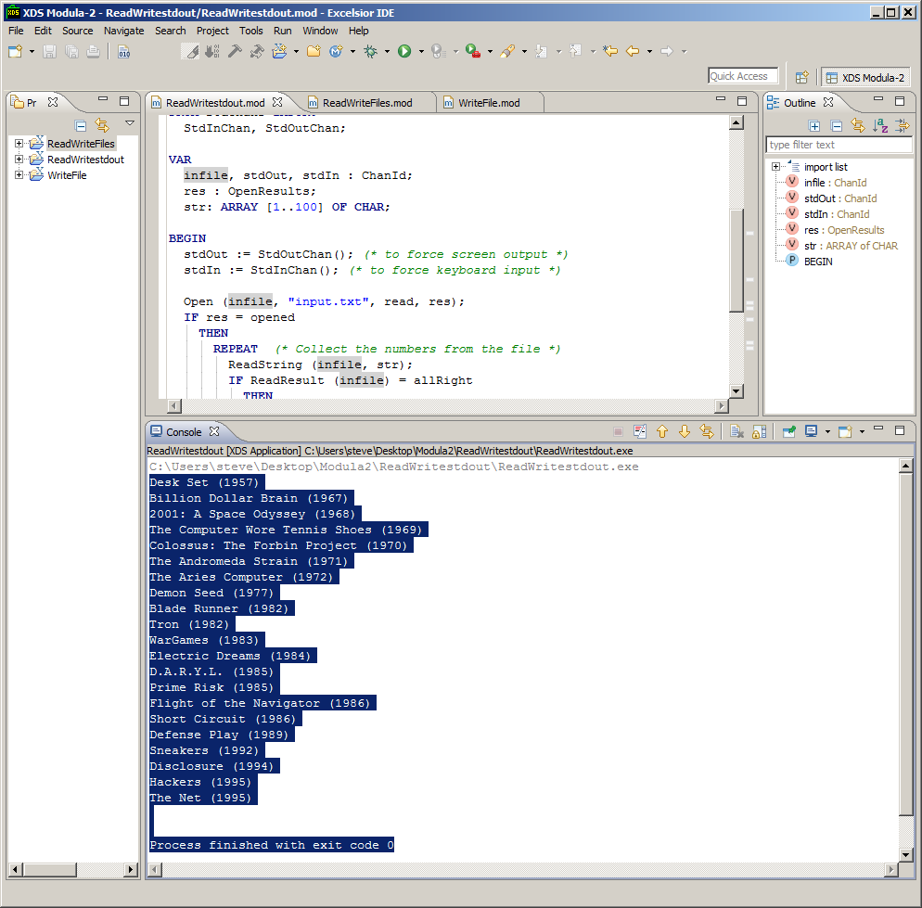
After Execution

Slide 50
Output Cut from Output Window
Desk Set (1957)
Billion Dollar Brain (1967)
2001: A Space Odyssey (1968)
The Computer Wore Tennis Shoes (1969)
Colossus: The Forbin Project (1970)
The Andromeda Strain (1971)
The Aries Computer (1972)
Demon Seed (1977)
Blade Runner (1982)
Tron (1982)
WarGames (1983)
Electric Dreams (1984)
D.A.R.Y.L. (1985)
Prime Risk (1985)
Flight of the Navigator (1986)
Short Circuit (1986)
Defense Play (1989)
Sneakers (1992)
Disclosure (1994)
Hackers (1995)

Slide 51
Write to File
MODULE WriteFile;
FROM StreamFile IMPORT ChanId, Open, read, write, Close, OpenResults;
FROM TextIO IMPORT ReadString, WriteLn, WriteString, SkipLine;
FROM IOResult IMPORT ReadResult, ReadResults;
FROM StdChans IMPORT StdInChan, StdOutChan;
VAR
outfile, stdOut, stdIn : ChanId;
res : OpenResults;
BEGIN
stdOut := StdOutChan(); (* to force screen output *)
stdIn := StdInChan(); (* to force keyboard input *)
Open (outfile, "output.txt", write, res);
WriteString (outfile, "DOES THIS WORK");
WriteLn (outfile);
Close(outfile);
END WriteFile.
Couldn’t get Write to File to Work

Slide 52
Module of Processing Lines from File
MODULE Lines;
FROM StreamFile IMPORT ChanId, Open, read, Close, OpenResults;
FROM TextIO IMPORT ReadString, WriteLn, WriteString, WriteChar, SkipLine;
FROM IOResult IMPORT ReadResult, ReadResults;
FROM StdChans IMPORT StdInChan, StdOutChan;
FROM WholeIO IMPORT WriteInt;
TYPE line = ARRAY[0..100] OF CHAR;
AllLines = ARRAY [1..1000] OF line;
VAR
infile, stdOut, stdIn : ChanId;
res : OpenResults;
inputline: line;
i, j : INTEGER;
numlines : INTEGER;
document: AllLines;

Slide 53
Module of Processing Lines from File
BEGIN
(* Read and Store from input into document *)
stdOut := StdOutChan(); (* to force screen output *)
stdIn := StdInChan(); (* to force keyboard input *)
Open (infile, "input.txt", read, res);
IF res = opened
THEN
i := 1;
REPEAT (* Collect the info from the file *)
ReadString (infile, inputline);
IF ReadResult (infile) = allRight
THEN
SkipLine (infile);
document[i]:=inputline;
WriteString (stdOut, inputline);
WriteString (stdOut, document[i]);
WriteLn (stdOut);
i:=i+1;
END; (* if *)
UNTIL ReadResult (infile) # allRight;
Close (infile);
WriteLn (stdOut);
ELSE
WriteString (stdOut,"Sorry, couldn't open the file");
WriteLn (stdOut);
END; (* if *)

Slide 54
Module of Processing Lines from File
(* output document line by line, char by char *)
numlines :=i-1;
WriteInt(stdOut, numlines, 3);
WriteLn (stdOut);
FOR i:= 1 TO numlines DO
j:=0;
REPEAT
IF ORD(document[i][j]) <> 0
THEN
WriteChar (stdOut, document[i][j]);
j :=j+1;
END;
UNTIL ORD(document[i][j]) = 0 ;
WriteLn (stdOut);
END;
END Lines.

Slide 55
Output of Program
C:\Users\steve\Desktop\Modula2\Lines\Lines.exe
Desk Set (1957)Desk Set (1957)
Billion Dollar Brain (1967)Billion Dollar Brain (1967)
2001: A Space Odyssey (1968)2001: A Space Odyssey (1968)
The Computer Wore Tennis Shoes (1969)The Computer Wore Tennis Shoes (1969)
Colossus: The Forbin Project (1970)Colossus: The Forbin Project (1970)
The Andromeda Strain (1971)The Andromeda Strain (1971)
The Aries Computer (1972)The Aries Computer (1972)
Demon Seed (1977)Demon Seed (1977)
Blade Runner (1982)Blade Runner (1982)
Tron (1982)Tron (1982)
WarGames (1983)WarGames (1983)
Electric Dreams (1984)Electric Dreams (1984)
D.A.R.Y.L. (1985)D.A.R.Y.L. (1985)
Prime Risk (1985)Prime Risk (1985)
Flight of the Navigator (1986)Flight of the Navigator (1986)
Short Circuit (1986)Short Circuit (1986)
Defense Play (1989)Defense Play (1989)
Sneakers (1992)Sneakers (1992)
Disclosure (1994)Disclosure (1994)
Hackers (1995)Hackers (1995)
The Net (1995)The Net (1995)

Slide 56
Output of Program
21
Desk Set (1957)
Billion Dollar Brain (1967)
2001: A Space Odyssey (1968)
The Computer Wore Tennis Shoes (1969)
Colossus: The Forbin Project (1970)
The Andromeda Strain (1971)
The Aries Computer (1972)
Demon Seed (1977)
Blade Runner (1982)
Tron (1982)
WarGames (1983)
Electric Dreams (1984)
D.A.R.Y.L. (1985)
Prime Risk (1985)
Flight of the Navigator (1986)
Short Circuit (1986)
Defense Play (1989)
Sneakers (1992)
Disclosure (1994)
Hackers (1995)
The Net (1995)
Process finished with exit code 0

Slide 57
First Example – Using Records
MODULE Record;
FROM StreamFile IMPORT ChanId, Open, read, Close, OpenResults;
FROM TextIO IMPORT ReadString, WriteLn, WriteString, WriteChar, SkipLine;
FROM IOResult IMPORT ReadResult, ReadResults;
FROM StdChans IMPORT StdInChan, StdOutChan;
FROM WholeIO IMPORT WriteInt;
TYPE line = ARRAY[0..100] OF CHAR;
Word = RECORD
freq : INTEGER;
word : line;
END;
AllWords = ARRAY [1..1000] OF Word;
VAR
infile, stdOut, stdIn : ChanId;
res : OpenResults;
inputline: line;
i, j, k : INTEGER;
numlines : INTEGER;
wordsfound: AllWords;

Slide 58
First Example – Using Records
BEGIN
(* Read and Store from input into document *)
stdOut := StdOutChan(); (* to force screen output *)
stdIn := StdInChan(); (* to force keyboard input *)
Open (infile, "input.txt", read, res);
IF res = opened
THEN
i := 1;
REPEAT (* Collect the numbers from the file *)
ReadString (infile, wordsfound[i].word);
IF ReadResult (infile) = allRight
THEN
SkipLine (infile);
wordsfound[i].word:=wordsfound[i].word;
WriteString (stdOut, wordsfound[i].word);
WriteString (stdOut, wordsfound[i].word);
WriteLn (stdOut);
i:=i+1;
END; (* if *)
UNTIL ReadResult (infile) # allRight;
Close (infile);
WriteLn (stdOut);
ELSE
WriteString (stdOut,"Sorry, couldn't open the file");
WriteLn (stdOut);
END; (* if *)

Slide 59
First Example – Using Records
(* output wordsfound record by record, line by line, char by char *)
numlines :=i-1;
WriteInt(stdOut, numlines, 3);
WriteLn (stdOut);
FOR i:= 1 TO numlines DO
j:=0;
REPEAT
IF ORD(wordsfound[i].word[j]) <> 0
THEN
WriteChar (stdOut, wordsfound[i].word[j]);
j :=j+1;
END;
UNTIL ORD(wordsfound[i].word[j]) = 0 ;
WriteLn (stdOut);
END;
END Record.
Exact Same output as lines.mod

Slide 60
Defining a Procedure (Lazy Way)
MODULE RecordwithProc;
FROM StreamFile IMPORT ChanId, Open, read, Close, OpenResults;
FROM TextIO IMPORT ReadString, WriteLn, WriteString, WriteChar, SkipLine;
FROM IOResult IMPORT ReadResult, ReadResults;
FROM StdChans IMPORT StdInChan, StdOutChan;
FROM WholeIO IMPORT WriteInt;
TYPE line = ARRAY[0..100] OF CHAR;
Word = RECORD
freq : INTEGER;
word : line;
END;
AllWords = ARRAY [1..1000] OF Word;
VAR
infile, stdOut, stdIn : ChanId;
res : OpenResults;
inputline: line;
i, j, k : INTEGER;
numlines : INTEGER;
wordsfound: AllWords;

Slide 61
Defining a Procedure (Lazy Way)
PROCEDURE ReadLines(VAR wdfd:AllWords; VAR nolines: INTEGER);
(* Read and Store from input into document *)
BEGIN
stdOut := StdOutChan(); (* to force screen output *)
stdIn := StdInChan(); (* to force keyboard input *)
Open (infile, "input.txt", read, res);
IF res = opened
THEN
i := 1;
REPEAT (* Collect the numbers from the file *)
ReadString (infile, wordsfound[i].word);
IF ReadResult (infile) = allRight
THEN
SkipLine (infile);
wdfd[i].word:=wdfd[i].word;
WriteString (stdOut, wdfd[i].word);
WriteString (stdOut, wdfd[i].word);
WriteLn (stdOut);
i:=i+1;
END; (* if *)
UNTIL ReadResult (infile) # allRight;
Close (infile);
WriteLn (stdOut);
ELSE
WriteString (stdOut,"Sorry, couldn't open the file");
WriteLn (stdOut);
END; (* if *)
END ReadLines;

Slide 62
Defining a Procedure (Lazy Way)
BEGIN
(* CALL PROCEDURE *)
ReadLines(wordsfound, numlines);
(* output wordsfound record by record, line by line, char by char *)
numlines :=i-1;
WriteInt(stdOut, numlines, 3);
WriteLn (stdOut);
FOR i:= 1 TO numlines DO
j:=0;
REPEAT
IF ORD(wordsfound[i].word[j]) <> 0
THEN
WriteChar (stdOut, wordsfound[i].word[j]);
j :=j+1;
END;
UNTIL ORD(wordsfound[i].word[j]) = 0 ;
WriteLn (stdOut);
END;
END RecordwithProc.
Exact Same output as lines.mod

Slide 63
What is Going on?
Procedure able to access all Global Variables
VAR parameter means
wordsfound → wdfd
numlines → nolines
Both Come out
What a better way to do this?

Slide 64
2nd Example – Using Records/Find Words
MODULE FindWords;
FROM StreamFile IMPORT ChanId, Open, read, Close, OpenResults;
FROM TextIO IMPORT ReadString, WriteLn, WriteString, WriteChar, SkipLine;
FROM IOResult IMPORT ReadResult, ReadResults;
FROM StdChans IMPORT StdInChan, StdOutChan;
FROM WholeIO IMPORT WriteInt;
TYPE line = ARRAY[0..120] OF CHAR;
AllLines = ARRAY [1..1000] OF line;
word = ARRAY[0..20] OF CHAR;
WordFreq = RECORD
freq : INTEGER;
aword : word;
END;
AllWords = ARRAY [1..1000] OF WordFreq;
VAR
infile, stdOut, stdIn : ChanId;
res : OpenResults;
inputline: line;
i, j, k : INTEGER;
charval : INTEGER;
numlines: INTEGER;
wordindex: INTEGER;
numwords: INTEGER;
document: AllLines;
wordsindoc: AllWords;

Slide 65
2nd Example – Using Records/Find Words
BEGIN
stdOut := StdOutChan(); (* to force screen output *)
stdIn := StdInChan(); (* to force keyboard input *)
(* The first part of the code reads all lines from the file *)
(* into inputline and stores them in the document array *)
Open (infile, "input.txt", read, res);
IF res = opened
THEN
i := 1;
REPEAT (* Collect the numbers from the file *)
ReadString (infile, inputline);
WriteString (stdOut, inputline);
IF ReadResult (infile) = allRight
THEN
SkipLine (infile);
(* NOW PROCESS THE LINE TO FIND WORDS *)
document[i]:=inputline;
WriteLn (stdOut);
i:=i+1;
END; (* if *)
UNTIL ReadResult (infile) # allRight;
Close (infile);
WriteLn (stdOut);
ELSE
WriteString (stdOut,"Sorry, couldn't open the file");
WriteLn (stdOut);
END; (* if *)
numlines :=i-1; (* i gets incremented for EOF line*)

Slide 66
Used Ordinal Values of Characters

Slide 67
2nd Example – Using Records/Find Words
(* The code part of the code cycles through document array *)
(* in order to identify words in each line*)
numwords:=0;
wordindex := 1;
FOR i:=1 TO numlines DO
j:=0; k:=0;
WHILE ORD(document[i][j]) <> 0
DO
charval := ORD(document[i][j]);
IF ((charval >= 48) AND (charval < 58)) OR
((charval >= 65) AND (charval < 91)) OR
((charval >= 97) AND (charval < 123)) OR
((charval = 45)) OR ((charval=39))
THEN (* is it a number or upper/lower case char *)
wordsindoc[wordindex].aword[k] := document[i][j];
WriteChar(stdOut, wordsindoc[wordindex].aword[k]);
k:=k+1;
ELSE (* end of word *)
WriteLn (stdOut);
wordindex:=wordindex+1;
numwords:=numwords+1;
k:=0;
END;
j:=j+1;
END;
END;
numwords:=numwords-1; WriteInt(stdOut, numwords, 3); WriteLn(stdOut);
END FindWords.

Slide 68
First Find Words Test
Desk-Set (1957)
Billion Dollar Brain’s (1967)
2001: A Space Odyssey (1968)
The Computer Wore Tennis Shoes (1969)
Colossus: The Forbin Project (1970)
The Andromeda Strain (1971)
The Aries Computer (1972)
Demon Seed (1977)
Blade Runner (1982)
Tron (1982)
WarGames (1983)
Electric Dreams (1984)
D.A.R.Y.L. (1985)
Prime Risk (1985)
Flight of the Navigator (1986)
Short Circuit (1986)
Defense Play (1989)
Sneakers (1992)
Disclosure (1994)
Hackers (1995)
The Net (1995)

Slide 69
Output - First Find Words Test
Desk-Set
1957
Billion
Dollar
Brain’s
1967
2001
A
Space
Odyssey
1968
The
Computer
Wore
Tennis
Shoes
1969
Colossus
The
Forbin
Project
1970
The
Andromeda
Strain
1971
The
Aries
Computer
1972
Demon
Seed
1977
Blade
Runner
1982
Tron
1982
WarGames
1983
Electric
Dreams
1984
D
A
R
Y
L
1985
Prime
Risk
1985
Flight
of
the
Navigator
1986
Short
Circuit
1986
Defense
Play
1989
Sneakers
Desk-Set (1957)
Billion Dollar Brain’s (1967)
2001: A Space Odyssey (1968)
The Computer Wore Tennis Shoes (1969)
Colossus: The Forbin Project (1970)
The Andromeda Strain (1971)
The Aries Computer (1972)
Demon Seed (1977)
Blade Runner (1982)
Tron (1982)
WarGames (1983)
Electric Dreams (1984)
D.A.R.Y.L. (1985)
Prime Risk (1985)
Flight of the Navigator (1986)
Short Circuit (1986)
Defense Play (1989)
Sneakers (1992)
Disclosure (1994)
Hackers (1995)
The Net (1995)
1992
Disclosure
1994
Hackers
1995
The
Net
1995
97
75 Words
96 Counted
Counting Extra CR.
21 Extra Words – 21 lines in input.txt

Slide 70
Program Input - test3.txt
Please also read the platform specific README and file, if it exists.
News and changes related to this release if are described.
Be sure to uninstall any previous version of Dev-Pascal before installing.
Please also read the platform specific README and file, if it exists.
News and changes related to this release if are described.
Be sure to uninstall any previous version of Dev-Pascal before installing.
News and changes related to this release if are described.
Please also read the platform specific README and file, if it exists.
News and changes related to this release if are described.
News and changes related to this release if are described.

Slide 71
Program Output for test3.txt
Please
also
read
the
platform
specific
README
and
file
if
it
exists
News
and
changes
related
to
this
release
if
are
described
Be
sure
to
uninstall
any
previous
version
of
Dev-Pascal
before
installing
Please
also
read
the
platform
specific
README
and
file
if
it
exists
News
and
changes
related
to
this
release
if
are
described
Be
sure
to
uninstall
any
previous
version
of
Dev-Pascal
before
installing
News
and
changes
related
to
this
release
if
are
described
Please
also
read
the
platform
specific
README
README
and
file
if
it
exists
News
and
changes
related
to
this
release
if
are
described
News
and
changes
related
to
this
release
if
are
described
110
Process finished with exit code 0

Slide 72
Program Output for test3.txt

Slide 73
PLA_Ver1.mod WFF
MODULE PLA_Ver1;
FROM StreamFile IMPORT ChanId, Open, read, Close, OpenResults;
FROM TextIO IMPORT ReadString, WriteLn, WriteString, WriteChar, SkipLine;
FROM IOResult IMPORT ReadResult, ReadResults;
FROM StdChans IMPORT StdInChan, StdOutChan;
FROM WholeIO IMPORT WriteInt, WriteCard;
IMPORT Strings;
TYPE line = ARRAY[0..120] OF CHAR;
AllLines = ARRAY [1..1000] OF line;
word = ARRAY[0..50] OF CHAR;
WordFreq = RECORD
freq : INTEGER;
aword : word;
END;
AllWords = ARRAY [1..1000] OF WordFreq;
VAR
infile, stdOut, stdIn : ChanId;
res : OpenResults;
inputline: line;
i, j, k : INTEGER;
charval : INTEGER;
numlines: INTEGER;
wordindex: INTEGER;
numwords: INTEGER;
isWordInList: BOOLEAN;
c: INTEGER;
document: AllLines;
wordsindoc: AllWords;
currWord: word;

Slide 74
PLA_Ver1.mod WFF
BEGIN
stdOut := StdOutChan(); (* to force screen output *)
stdIn := StdInChan(); (* to force keyboard input *)
(* The first part of the code reads all lines from the file *)
(* into inputline and stores them in the document array *)
Open (infile, "test1.txt", read, res);
IF res = opened
THEN
i := 1;
REPEAT (* Collect the numbers from the file *)
ReadString (infile, inputline);
WriteString (stdOut, inputline);
IF ReadResult (infile) = allRight
THEN
SkipLine (infile);
(* NOW PROCESS THE LINE TO FIND WORDS *)
document[i]:=inputline;
WriteLn (stdOut);
i:=i+1;
ELSE
SkipLine (infile);
(* NOW PROCESS THE LINE TO FIND WORDS *)
document[i]:=inputline;
WriteLn (stdOut);
END; (* if *)
UNTIL (ReadResult (infile) # allRight);

Slide 75
PLA_Ver1.mod WFF
Close (infile);
WriteLn (stdOut);
ELSE
WriteString (stdOut,"Sorry, couldn't open the file");
WriteLn (stdOut);
END; (* if *)
numlines :=i-1; (* i gets incremented for EOF line*)
(* The code part of the code cycles through document array *)
(* in order to identify words in each line*)
numwords:=0;
wordindex := 1;
FOR i:=1 TO numlines DO
j:=0; k:=0;
FOR c := 0 TO 50 DO
currWord[c] := '';
END;
WHILE ORD(document[i][j]) <> 0
DO
charval := ORD(document[i][j]);
IF ((charval >= 48) AND (charval < 58)) OR
((charval >= 65) AND (charval < 91)) OR
((charval >= 97) AND (charval < 123)) OR
((charval = 45)) OR ((charval=95))
THEN (* is it a number or upper/lower case char *)
currWord[k] := document[i][j];
(*wordsindoc[wordindex].aword[k] := document[i][j];
WriteChar(stdOut, currWord[k]);*)
k:=k+1;

Slide 76
PLA_Ver1.mod WFF
ELSE (* end of word *)
isWordInList := FALSE;
FOR c := 1 TO wordindex DO
IF (Strings.Equal(wordsindoc[c].aword, currWord) = TRUE)
AND (Strings.Equal(currWord, "") = FALSE)
THEN
wordsindoc[c].freq := wordsindoc[c].freq + 1;
numwords:=numwords+1;
isWordInList := TRUE;
END;
END;
IF (isWordInList = FALSE) AND (Strings.Equal(currWord, "") = FALSE)
THEN
wordsindoc[wordindex].aword := currWord;
wordsindoc[wordindex].freq := 1;
wordindex:=wordindex+1;
numwords:=numwords+1;
END;
k:=0;
FOR c := 0 TO 50 DO
currWord[c] := '';
END;
END;
j:=j+1;
END;

Slide 77
PLA_Ver1.mod WFF
IF (k > 0)
THEN
FOR c := 1 TO wordindex DO
IF (Strings.Equal(wordsindoc[c].aword, currWord) = TRUE)
AND (Strings.Equal(currWord, "") = FALSE)
THEN
WriteLn (stdOut);
wordsindoc[c].freq := wordsindoc[c].freq + 1;
numwords:=numwords+1;
isWordInList := TRUE;
END;
END;
IF (isWordInList = FALSE) AND (Strings.Equal(currWord, "") = FALSE)
THEN
wordsindoc[wordindex].aword := currWord;
wordsindoc[wordindex].freq := 1;
wordindex:=wordindex+1;
numwords:=numwords+1;
END;
END;
END;

Slide 78
PLA_Ver1.mod WFF
(* numwords:=numwords-1; *)
WriteLn(stdOut);
WriteString(stdOut, "Printing Word Frequencies:");
WriteLn(stdOut);
FOR c := 1 TO wordindex - 1 DO
WriteString(stdOut, wordsindoc[c].aword);
WriteString(stdOut, ": ");
WriteInt(stdOut, wordsindoc[c].freq, 3);
WriteLn(stdOut);
END;
WriteString(stdOut, "Num Words: ");
WriteInt(stdOut, numwords, 3);
WriteLn(stdOut);
END PLA_Ver1.

Slide 79
PLA_Ver2.mod WFF with procedures
MODULE PLA_Ver2;
FROM StreamFile IMPORT ChanId, Open, read, Close, OpenResults;
FROM TextIO IMPORT ReadString, WriteLn, WriteString, WriteChar, SkipLine;
FROM IOResult IMPORT ReadResult, ReadResults;
FROM StdChans IMPORT StdInChan, StdOutChan;
FROM WholeIO IMPORT WriteInt, WriteCard;
IMPORT Strings;
TYPE line = ARRAY[0..120] OF CHAR;
AllLines = ARRAY [1..1000] OF line;
word = ARRAY[0..50] OF CHAR;
WordFreq = RECORD
freq : INTEGER;
aword : word;
END;
AllWords = ARRAY [1..1000] OF WordFreq;

Slide 80
PLA_Ver2.mod WFF with procedures
PROCEDURE Read(VAR stdOut: ChanId; VAR document: AllLines; VAR numlines: INTEGER);
VAR
i: INTEGER;
res : OpenResults;
inputline: line;
infile: ChanId;
BEGIN
(* The first part of the code reads all lines from the file *)
(* into inputline and stores them in the document array *)
Open (infile, "test2.txt", read, res);
IF res = opened
THEN
i := 1;
REPEAT (* Collect the numbers from the file *)
ReadString (infile, inputline);
WriteString (stdOut, inputline);
IF ReadResult (infile) = allRight
THEN
SkipLine (infile);
(* NOW PROCESS THE LINE TO FIND WORDS *)
document[i]:=inputline;
WriteLn (stdOut);
i:=i+1;
ELSE
SkipLine (infile);
(* NOW PROCESS THE LINE TO FIND WORDS *)
document[i]:=inputline;
WriteLn (stdOut);
END; (* if *)
UNTIL (ReadResult (infile) # allRight);
Close (infile);
WriteLn (stdOut);
ELSE
WriteString (stdOut,"Sorry, couldn't open the file");
WriteLn (stdOut);
END; (* if *)
numlines :=i-1; (* i gets incremented for EOF line*)
END Read;

Slide 81
PLA_Ver2.mod WFF with procedures
PROCEDURE WFF(VAR wordsindoc: AllWords; VAR document: AllLines;
VAR numwords: INTEGER; VAR numlines: INTEGER; VAR wordindex: INTEGER);
VAR
i, j, k : INTEGER;
c: INTEGER;
charval : INTEGER;
currWord: word;
isWordInList: BOOLEAN;
BEGIN
(* The code part of the code cycles through document array *)
(* in order to identify words in each line*)
numwords:=0;
wordindex := 1;
FOR i:=1 TO numlines DO
j:=0; k:=0;
FOR c := 0 TO 50 DO
currWord[c] := '';
END;
WHILE ORD(document[i][j]) <> 0
DO
charval := ORD(document[i][j]);
IF ((charval >= 48) AND (charval < 58)) OR
((charval >= 65) AND (charval < 91)) OR
((charval >= 97) AND (charval < 123)) OR
((charval = 45)) OR ((charval=95))
THEN (* is it a number or upper/lower case char *)
currWord[k] := document[i][j];
(*wordsindoc[wordindex].aword[k] := document[i][j];*)
k:=k+1;
ELSE (* end of word *)
isWordInList := FALSE;
FOR c := 1 TO wordindex DO
IF (Strings.Equal(wordsindoc[c].aword, currWord) = TRUE)
AND (Strings.Equal(currWord, "") = FALSE)
THEN
wordsindoc[c].freq := wordsindoc[c].freq + 1;
numwords:=numwords+1;
isWordInList := TRUE;
END

Slide 82
PLA_Ver2.mod WFF with procedures
END;
IF (isWordInList = FALSE) AND (Strings.Equal(currWord, "") = FALSE)
THEN
wordsindoc[wordindex].aword := currWord;
wordsindoc[wordindex].freq := 1;
wordindex:=wordindex+1;
numwords:=numwords+1;
END;
k:=0;
FOR c := 0 TO 50 DO
currWord[c] := '';
END;
END;
j:=j+1;
END;
IF (k > 0)
THEN
FOR c := 1 TO wordindex DO
IF (Strings.Equal(wordsindoc[c].aword, currWord) = TRUE)
AND (Strings.Equal(currWord, "") = FALSE)
THEN
wordsindoc[c].freq := wordsindoc[c].freq + 1;
numwords:=numwords+1;
isWordInList := TRUE;
END;
END;
IF (isWordInList = FALSE) AND (Strings.Equal(currWord, "") = FALSE)
THEN
wordsindoc[wordindex].aword := currWord;
wordsindoc[wordindex].freq := 1;
wordindex:=wordindex+1;
numwords:=numwords+1;
END;
END;
END;
(* numwords:=numwords-1;
*)
END WFF;

Slide 83
PLA_Ver2.mod WFF with procedures
PROCEDURE SortAndPrint(VAR stdOut: ChanId; wordsindoc: AllWords; wordindex: INTEGER);
VAR
i: INTEGER;
sortedWordIndex: INTEGER;
addIndex: INTEGER;
temp: WordFreq;
BEGIN
sortedWordIndex := 1;
WHILE wordindex > sortedWordIndex DO
addIndex := sortedWordIndex;
FOR i := sortedWordIndex TO wordindex - 1 DO
IF Strings.Compare(wordsindoc[addIndex].aword, wordsindoc[i].aword) = Strings.greater THEN
addIndex := i;
END;
END;
temp := wordsindoc[sortedWordIndex];
wordsindoc[sortedWordIndex] := wordsindoc[addIndex];
wordsindoc[addIndex] := temp;
sortedWordIndex := sortedWordIndex + 1;
END;
FOR i := 1 TO sortedWordIndex - 1 DO
WriteString(stdOut, wordsindoc[i].aword);
WriteString(stdOut, ": ");
WriteInt(stdOut, wordsindoc[i].freq, 3);
WriteLn(stdOut);
END;
END SortAndPrint;

Slide 84
PLA_Ver2.mod WFF with procedures
VAR
stdOut, stdIn : ChanId;
document: AllLines;
wordsindoc: AllWords;
numwords: INTEGER;
numlines: INTEGER;
wordindex: INTEGER;
BEGIN
stdOut := StdOutChan(); (* to force screen output *)
stdIn := StdInChan(); (* to force keyboard input *)
Read(stdOut, document, numlines);
WFF(wordsindoc, document, numwords, numlines, wordindex);
SortAndPrint(stdOut, wordsindoc, wordindex);
WriteLn(stdOut);
WriteString(stdOut, "Num Words: ");
WriteInt(stdOut, numwords, 3);
WriteLn(stdOut);
END PLA_Ver2.

Slide 85
CRAZY ERROR – DebugCode.mod
MODULE DebugCode;
FROM StreamFile IMPORT ChanId, Open, read, Close, OpenResults;
FROM TextIO IMPORT ReadString, WriteLn, WriteString, WriteChar, SkipLine;
FROM IOResult IMPORT ReadResult, ReadResults;
FROM StdChans IMPORT StdInChan, StdOutChan;
FROM WholeIO IMPORT WriteInt, WriteCard;
TYPE line = ARRAY[0..120] OF CHAR;
AllLines = ARRAY [1..1000] OF line;
word = ARRAY[0..20] OF CHAR;
WordFreq = RECORD
freq : INTEGER;
aword : word;
END;
AllWords = ARRAY [1..1000] OF WordFreq;
VAR
infile, stdOut, stdIn : ChanId;
res : OpenResults;
inputline: line;
i, j, k : INTEGER;
charval : INTEGER;
numlines: INTEGER;
wordindex: INTEGER;
numwords: INTEGER;
document: AllLines;
wordsindoc: AllWords;

Slide 86
CRAZY ERROR – DebugCode.mod
BEGIN
stdOut := StdOutChan(); (* to force screen output *)
stdIn := StdInChan(); (* to force keyboard input *)
(* The first part of the code reads all lines from the file *)
(* into inputline and stores them in the document array *)
Open (infile, "input.txt", read, res);
IF res = opened
THEN
i := 1;
REPEAT (* Collect the numbers from the file *)
ReadString (infile, inputline);
(* WriteString (stdOut, inputline); *)
IF ReadResult (infile) = allRight
THEN
SkipLine (infile);
(* NOW PROCESS THE LINE TO FIND WORDS *)
document[i]:=inputline;
(* WriteLn (stdOut); *)
i:=i+1;
END; (* if *)
UNTIL ReadResult (infile) # allRight;
Close (infile);
WriteLn (stdOut);
ELSE
WriteString (stdOut,"Sorry, couldn't open the file");
WriteLn (stdOut);
END; (* if *)
numlines :=i-1; (* i gets incremented for EOF line*)

Slide 87
CRAZY ERROR – DebugCode.mod
(* The code part of the code cycles through document array *)
(* in order to identify words in each line*)
numwords:=0;
wordindex := 1;
FOR i:=1 TO numlines DO
j:=0; k:=0;
WHILE ORD(document[i][j]) <> 0
DO
charval := ORD(document[i][j]);
IF ((charval >= 48) AND (charval < 58)) OR
((charval >= 65) AND (charval < 91)) OR
((charval >= 97) AND (charval < 123)) OR
((charval = 45)) OR ((charval=39))
THEN (* is it a number or upper/lower case char *)
wordsindoc[wordindex].aword[k] := document[i][j];
WriteChar(stdOut, wordsindoc[wordindex].aword[k]);
WriteCard(stdOut, charval, 4);
k:=k+1;
ELSE (* end of word *)
WriteLn (stdOut);
WriteString(stdOut, "Does this happen more than once for EOL-->");
wordindex:=wordindex+1;
numwords:=numwords+1;
k:=0;
END;
j:=j+1;
END;
END;
numwords:=numwords-1;
WriteInt(stdOut, numwords, 3);
WriteLn(stdOut);
END DebugCode.

Slide 88
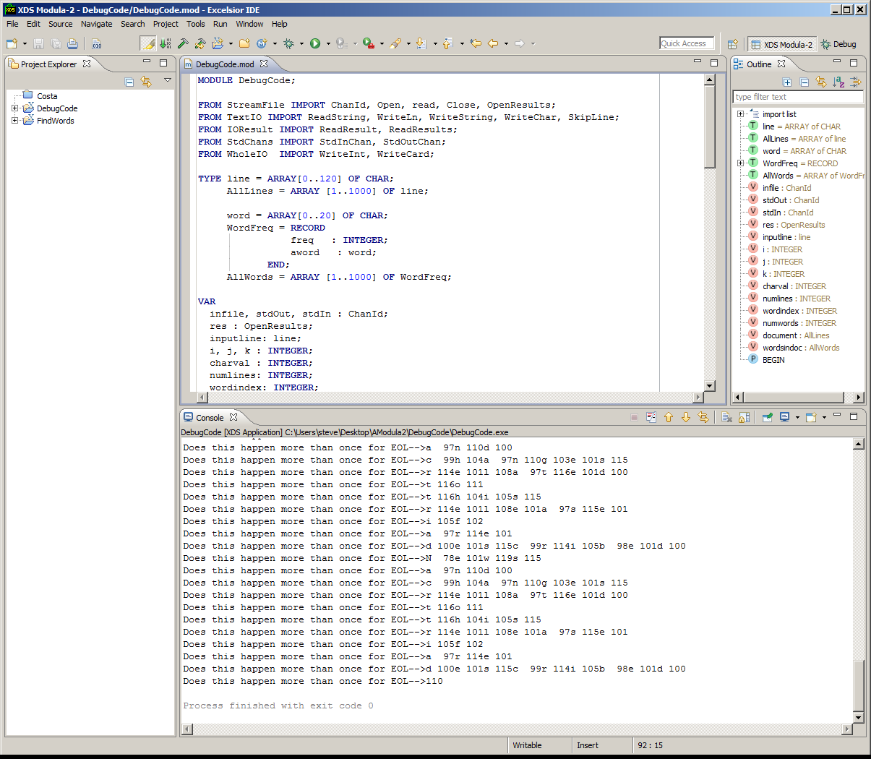
Screen with DebugCode Added

Slide 89
Screen with DebugCode Added

Slide 90
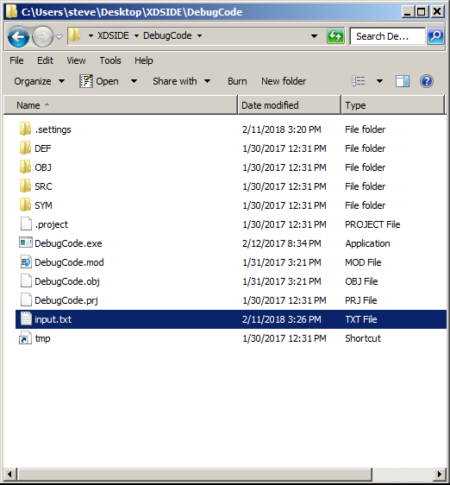
Again input.txt in DebugCode Directory

Slide 91
Results

Slide 92
Results
P 80l 108e 101a 97s 115e 101
Does this happen more than once for EOL-->a 97l 108s 115o 111
Does this happen more than once for EOL-->r 114e 101a 97d 100
Does this happen more than once for EOL-->t 116h 104e 101
Does this happen more than once for EOL-->p 112l 108a 97t 116f 102o 111r 114m 109
Does this happen more than once for EOL-->s 115p 112e 101c 99i 105f 102i 105c 99
Does this happen more than once for EOL-->R 82E 69A 65D 68M 77E 69
Does this happen more than once for EOL-->a 97n 110d 100
Does this happen more than once for EOL-->f 102i 105l 108e 101
Does this happen more than once for EOL-->
Does this happen more than once for EOL-->i 105f 102
Does this happen more than once for EOL-->i 105t 116
Does this happen more than once for EOL-->e 101x 120i 105s 115t 116s 115
Does this happen more than once for EOL-->N 78e 101w 119s 115
Does this happen more than once for EOL-->a 97n 110d 100
Does this happen more than once for EOL-->c 99h 104a 97n 110g 103e 101s 115
Does this happen more than once for EOL-->r 114e 101l 108a 97t 116e 101d 100
Does this happen more than once for EOL-->t 116o 111
Does this happen more than once for EOL-->t 116h 104i 105s 115
Does this happen more than once for EOL-->r 114e 101l 108e 101a 97s 115e 101
Does this happen more than once for EOL-->i 105f 102
Does this happen more than once for EOL-->a 97r 114e 101
Does this happen more than once for EOL-->d 100e 101s 115c 99r 114i 105b 98e 101d 100
Does this happen more than once for EOL-->B 66e 101
Does this happen more than once for EOL-->s 115u 117r 114e 101
Does this happen more than once for EOL-->t 116o 111
Does this happen more than once for EOL-->u 117n 110i 105n 110s 115t 116a 97l 108l 108
Does this happen more than once for EOL-->a 97n 110y 121
Does this happen more than once for EOL-->p 112r 114e 101v 118i 105o 111u 117s 115
Does this happen more than once for EOL-->v 118e 101r 114s 115i 105o 111n 110
Does this happen more than once for EOL-->o 111f 102
Does this happen more than once for EOL-->D 68e 101v 118- 45P 80a 97s 115c 99a 97l 108
Does this happen more than once for EOL-->b 98e 101f 102o 111r 114e 101
Does this happen more than once for EOL-->i 105n 110s 115t 116a 97l 108l 108i 105n 110g 103
Does this happen more than once for EOL-->P 80l 108e 101a 97s 115e 101
Does this happen more than once for EOL-->a 97l 108s 115o 111
Does this happen more than once for EOL-->r 114e 101a 97d 100
Does this happen more than once for EOL-->t 116h 104e 101
Does this happen more than once for EOL-->p 112l 108a 97t 116f 102o 111r 114m 109
Does this happen more than once for EOL-->s 115p 112e 101c 99i 105f 102i 105c 99
Does this happen more than once for EOL-->R 82E 69A 65D 68M 77E 69
Does this happen more than once for EOL-->a 97n 110d 100
Does this happen more than once for EOL-->f 102i 105l 108e 101
Does this happen more than once for EOL-->
Does this happen more than once for EOL-->i 105f 102
Does this happen more than once for EOL-->i 105t 116
Does this happen more than once for EOL-->e 101x 120i 105s 115t 116s 115
Does this happen more than once for EOL-->N 78e 101w 119s 115
Does this happen more than once for EOL-->a 97n 110d 100
Does this happen more than once for EOL-->c 99h 104a 97n 110g 103e 101s 115
Does this happen more than once for EOL-->r 114e 101l 108a 97t 116e 101d 100
Does this happen more than once for EOL-->t 116o 111
Does this happen more than once for EOL-->t 116h 104i 105s 115
Does this happen more than once for EOL-->r 114e 101l 108e 101a 97s 115e 101
Does this happen more than once for EOL-->i 105f 102
Does this happen more than once for EOL-->a 97r 114e 101
Does this happen more than once for EOL-->d 100e 101s 115c 99r 114i 105b 98e 101d 100
Does this happen more than once for EOL-->B 66e 101
Does this happen more than once for EOL-->s 115u 117r 114e 101
Does this happen more than once for EOL-->t 116o 111
Does this happen more than once for EOL-->u 117n 110i 105n 110s 115t 116a 97l 108l 108
Does this happen more than once for EOL-->a 97n 110y 121
Does this happen more than once for EOL-->p 112r 114e 101v 118i 105o 111u 117s 115
Does this happen more than once for EOL-->v 118e 101r 114s 115i 105o 111n 110
Does this happen more than once for EOL-->o 111f 102
Does this happen more than once for EOL-->D 68e 101v 118- 45P 80a 97s 115c 99a 97l 108
Does this happen more than once for EOL-->b 98e 101f 102o 111r 114e 101
Does this happen more than once for EOL-->i 105n 110s 115t 116a 97l 108l 108i 105n 110g 103
Does this happen more than once for EOL-->N 78e 101w 119s 115
Does this happen more than once for EOL-->a 97n 110d 100
Does this happen more than once for EOL-->c 99h 104a 97n 110g 103e 101s 115
Does this happen more than once for EOL-->r 114e 101l 108a 97t 116e 101d 100
Does this happen more than once for EOL-->t 116o 111
Does this happen more than once for EOL-->t 116h 104i 105s 115
Does this happen more than once for EOL-->r 114e 101l 108e 101a 97s 115e 101
Does this happen more than once for EOL-->i 105f 102
Does this happen more than once for EOL-->a 97r 114e 101
Does this happen more than once for EOL-->d 100e 101s 115c 99r 114i 105b 98e 101d 100
Does this happen more than once for EOL-->P 80l 108e 101a 97s 115e 101
Does this happen more than once for EOL-->a 97l 108s 115o 111
Does this happen more than once for EOL-->r 114e 101a 97d 100
Does this happen more than once for EOL-->t 116h 104e 101
Does this happen more than once for EOL-->p 112l 108a 97t 116f 102o 111r 114m 109
Does this happen more than once for EOL-->s 115p 112e 101c 99i 105f 102i 105c 99
Does this happen more than once for EOL-->R 82E 69A 65D 68M 77E 69
Does this happen more than once for EOL-->a 97n 110d 100
Does this happen more than once for EOL-->f 102i 105l 108e 101
Does this happen more than once for EOL-->
Does this happen more than once for EOL-->i 105f 102
Does this happen more than once for EOL-->i 105t 116
Does this happen more than once for EOL-->e 101x 120i 105s 115t 116s 115
Does this happen more than once for EOL-->N 78e 101w 119s 115
Does this happen more than once for EOL-->a 97n 110d 100
Does this happen more than once for EOL-->c 99h 104a 97n 110g 103e 101s 115
Does this happen more than once for EOL-->r 114e 101l 108a 97t 116e 101d 100
Does this happen more than once for EOL-->t 116o 111
Does this happen more than once for EOL-->t 116h 104i 105s 115
Does this happen more than once for EOL-->r 114e 101l 108e 101a 97s 115e 101
Does this happen more than once for EOL-->i 105f 102
Does this happen more than once for EOL-->a 97r 114e 101
Does this happen more than once for EOL-->d 100e 101s 115c 99r 114i 105b 98e 101d 100
Does this happen more than once for EOL-->N 78e 101w 119s 115
Does this happen more than once for EOL-->a 97n 110d 100
Does this happen more than once for EOL-->c 99h 104a 97n 110g 103e 101s 115
Does this happen more than once for EOL-->r 114e 101l 108a 97t 116e 101d 100
Does this happen more than once for EOL-->t 116o 111
Does this happen more than once for EOL-->t 116h 104i 105s 115
Does this happen more than once for EOL-->r 114e 101l 108e 101a 97s 115e 101
Does this happen more than once for EOL-->i 105f 102
Does this happen more than once for EOL-->a 97r 114e 101
Does this happen more than once for EOL-->d 100e 101s 115c 99r 114i 105b 98e 101d 100
Does this happen more than once for EOL-->110
Process finished with exit code 0

Slide 93
Ada Installl
INSTALL BOTH GNAT and AdaGIDE IN ORDER!
GNAT: http://libre.adacore.com/download/
AdaGIDE: https://sourceforge.net/projects/adagide/
Make sure you install the 32-bit version of GNAT
Default to download is 64-bit
Other Links - http://www.radford.edu/~nokie/classes/320/
http://www.radford.edu/~nokie/classes/320/getstarted.html
http://www.radford.edu/~nokie/classes/320/Tour/intro3a.html
http://cs.fit.edu/~ryan/ada/programs/
http://sandbox.mc.edu/~bennet/ada/examples/
https://rosettacode.org/wiki/Category:Ada
AdaGIDE
Easy to Use – Open Files, Build, Run
Save as takes the procedure automatically
Create a single Directory for all of Ada programs
.adb (source), .o, .ali (library), .exe

Slide 94
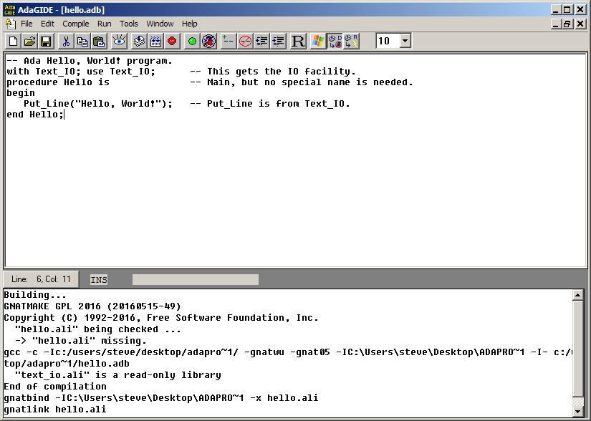
AdaGIDE – Hello World
Build
Run

Slide 95
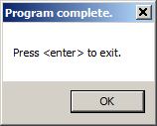
AdaGIDE – Hello World

Slide 96
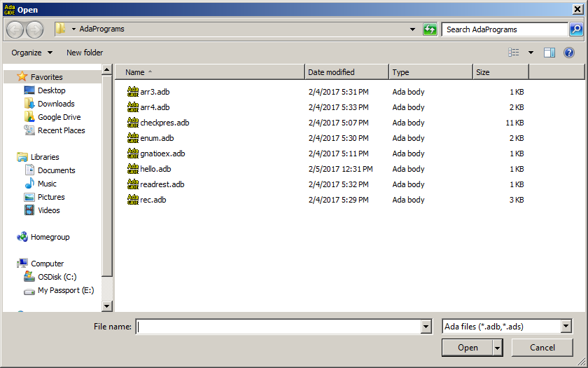
AdaGIDE

Slide 97
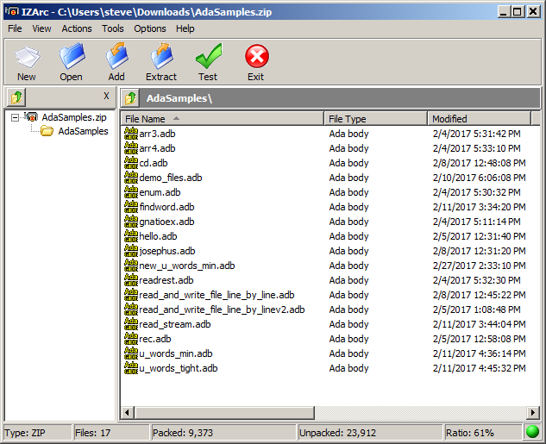
http://sdcse.engr.uconn.edu/Cse4102/AdaSamples.zip

Slide 98
AdaGIDE - Gnatioex
-- This is one of the examples shipped with GNAT.
With Gnat.IO; use Gnat.IO;
procedure Gnatioex is
C : Character;
I : Integer;
S : String (1 .. 100);
begin
Put_Line ("Hello. Welcome to the GNAT IO example" & "!");
New_Line;
Put ("Note: This example uses GNAT.IO which does not raise Data_Error");
Put_Line (" for bad data.");
Put (" ");
Put_Line ("For that you need to use the standard package Ada.Text_IO.");
New_line;
Put ("Please enter a single character now followed by <CR> ");
Get (C);
Put ("Your character is: ");
Put (C);
Get (C); -- read the <CR>

Slide 99
AdaGIDE - Gnatioex
New_Line (2);
Put ("Please enter a String now followed by <CR> :");
Get_Line (S, I);
Put ("Your String is : ");
Put_Line (S (1 .. I));
Put ("Its length is : ");
Put (I);
New_Line (2);
Put ("Please enter an integer now followed by <CR> ");
Get (I);
Put ("Your number is: ");
Put (I);
New_Line (2);
end;

Slide 100
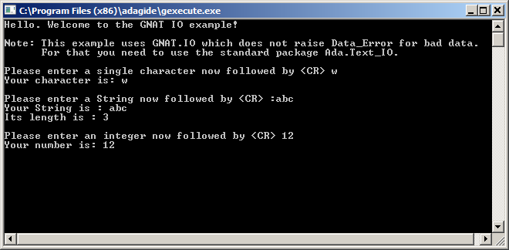
AdaGIDE

Slide 101
Using Enumeration Types
with Gnat.Io; use Gnat.Io;
procedure Enum is
type Day_Type is (Sun, Mon, Tue, Wed, Thu, Fri, Sat);
subtype Week_Days is Day_Type range Mon .. Fri;
Day: Day_Type;
Sdays: array (Day_Type) of String(1..3) :=
("Sun", "Mon", "Tue", "Wed", "Thu", "Fri", "Sat");
-- Notice name conflict on Sat. Ada doesn't mind.
type Declined is (Stood, Sat, Fall);
Declination: Declined;
begin
-- Print out all the days
for Day in Day_Type loop
Put(Sdays(Day) & " ");
end loop;
New_Line;
-- Print out all the days another way.
for Day in Sun .. Sat loop
Put(Sdays(Day) & " ");
end loop;
New_Line;
-- Print out the week days yet another way.
Day := Week_Days'First;
while Day <= Week_Days'Last loop
Put(Sdays(Day) & " ");
Day := Week_Days'Succ(Day);
end loop;
New_Line;
-- Print out the days of a MWF class
for Day in Week_Days loop
if (Week_Days'Pos(Day) - Week_Days'Pos(Mon)) mod 2 = 0 then
Put(Sdays(Day) & " ");
end if;
end loop;
New_Line;
Day := Sat;
Declination := Sat;
Put(Day_Type'Pos(Day));
Put(" ");
Put(Declined'Pos(Declination));
New_Line;
end Enum;

Slide 102
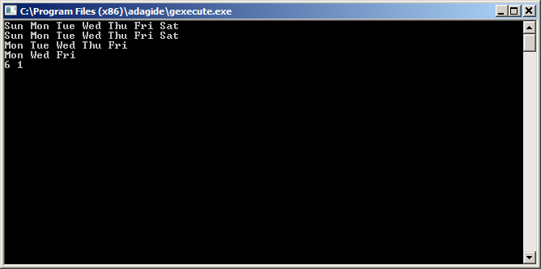
AdaGIDE

Slide 103
-- This reads in a string on a line, but skips leading blanks.
with Gnat.Io; use Gnat.Io;
procedure ReadRest is
Max: constant := 20; -- Max size of string.
Fred: String(1..Max); -- String.
I: Integer; -- Input subscript.
Ch: Character; -- Search for first char.
begin
-- Read to first non-blank character and put it into the first
-- position of the array.
loop
Get(Ch);
exit when Ch /= ' ';
end loop;
Fred(1) := Ch;
-- Read the rest of the line into the part of the array after the
-- first position.
Get_Line(Fred(2..Fred'last), I);
-- Echo the whole string, leading blanks trimmed.
Put_Line(Fred(1..I));
end ReadRest;

Slide 104
A 2-dimensionalbarray
with Gnat.Io; use Gnat.Io;
procedure Arr3 is
type CS is (G_Wiggins, M_Wiggins, Bennet, Woodall);
A: array (1..3, CS) of Integer :=
((4, 8, 17, 34),
(9, 11, 3, -2),
(6, 21, 2, 18));
I: Integer;
P: CS;
begin
-- Print it the usual way.
for I in 1..3 loop
for P in CS loop
Put(A(I,P));
Put(" ");
end loop;
New_Line;
end loop;
New_Line;
-- Print it the inverted way.
for P in CS loop
for I in 1..3 loop
Put(A(I,P));
Put(" ");
end loop;
New_Line;
end loop;
end Arr3;

Slide 105
An Array of Arrays
with Gnat.Io; use Gnat.Io;
procedure Arr4 is
type CS is (G_Wiggins, M_Wiggins, Bennet, Woodall);
type CSMap is array (CS) of Integer;
A: array (1..3) of CSMap :=
((4, 8, 17, 34),
(9, 11, 3, -2),
(6, 21, 2, 18));
I: Integer;
P: CS;
Row: CSMap;
begin
-- Print it the usual way.
for I in 1..3 loop
for P in CS loop
Put(A(I)(P));
Put(" ");
end loop;
New_Line;
end loop;
New_Line;
-- Print it the inverted way.
for P in CS loop
for I in 1..3 loop
Put(A(I)(P));
Put(" ");
end loop;
New_Line;
end loop;
New_Line;
-- Print it once more. Note that you cannot do this with a
-- 2-d array because the assignment Row := A(I) is illegal.
-- (Mostly the reference A(I) is illegal.)
for I in 1..3 loop
Row := A(I); -- Copies one row of A into Row.
for P in CS loop
Put(Row(P));
Put(" ");
end loop;
New_Line;
end loop;
end Arr4;

Slide 106
Record Types
-- Record types are used to represent things having several attributes.
-- They are like classes, have no methods or access controls.
--
-- This program reads in a list of flights, then lists which of the flights
-- leave any particular airport. The input is a list of flights, one
-- per line, number, departs, destination. This is ended by a -1 line,
-- the followed by a list of airports. The flights departing each of
-- these airports are listed. This ends with the word STOP.
--
with Text_IO;
with Gnat.Io; use Gnat.Io;
procedure Rec is
-- Describe flights.
type Airport_Or_Stop is ( ORD, DCA, STL, ATL, LAX, STOP );
subtype Airport is Airport_Or_Stop range ORD .. LAX;
type Flight is record
Number: Integer;
From, Dest: Airport;
end record;
-- I/O on the legitimate airport codes.10
package Airport_IO is new Text_Io.Enumeration_IO(Airport);
use Airport_IO;
-- I/O on the codes or the STOP string. We cannot "use" this new
-- class, because it ambiguates the Airport_IO calls. When we do use
-- it (one place), we say Airport_Or_Stop_IO.Get().
package Airport_Or_Stop_IO is new Text_Io.Enumeration_IO(Airport_Or_Stop);

Slide 107
Record Types
-- List of flights.
N: constant := 25;
Flights: array(1..N) of Flight;
N_Flights: Integer;
I: Integer; -- Loop index.
Flt: Integer; -- Input flight number.
Leave: Airport_Or_Stop; -- Input city.
Found: Boolean; -- Found a flight out.
begin
-- Read in the list.
I := 1;
loop
-- Get a flight number, exit for -1.
Get(Flt);
exit when Flt = -1;
-- Rest of the flight.
Flights(I).Number := Flt;
Get(Flights(I).From);
Get(Flights(I).Dest);
I := I + 1;
end loop;
N_Flights := I - 1;

Slide 108
Record Types
-- Find connections.
loop -- Where are we leaving from?
Airport_Or_Stop_IO.Get(Leave);
exit when Leave = STOP;
Put("From ");
Put(Leave);
Put_Line(":");
-- Can we leave from there?
Found := False;
for I in 1..N_Flights loop
if Flights(I).From = Leave then
-- Print the flight
Put(" Flight "); Put(Flights(I).Number);
Put(“ to “); Put(Flights(I).Dest);
New_Line;
-- Record that we found this.
Found := True;
end if;
end loop;
-- Print a message if no flights out were found.
if not Found then
Put(" No flights depart ");
Put(Leave); Put_Line(".");
end if;
New_Line;
end loop;
end Rec;

Slide 109
Character I/O in Ada – Basic In/Out Read_And_Write_File_Line_By_Line
with Ada.Text_IO; use Ada.Text_IO;
procedure Read_And_Write_File_Line_By_Line is
Input, Output : File_Type;
begin
Open (File => Input,
Mode => In_File,
Name => "input.txt");
Create (File => Output,
Mode => Out_File,
Name => "output.txt");
loop
declare
Line : String := Get_Line (Input);
begin
-- You can process the contents of Line here.
Put_Line (Output, Line);
end;
end loop;
Close (Input);Close (Output);
exception
when End_Error =>
if Is_Open(Input) then
Close (Input);
end if;
if Is_Open(Output) then
Close (Output);
end if;
end Read_And_Write_File_Line_By_Line;
https://rosettacode.org/wiki/Rosetta_Code

Slide 110
Character I/O in Ada – Error Handling Read_And_Write_File_Line_By_Linev2
with Ada.Command_Line, Ada.Text_IO; use Ada.Command_Line, Ada.Text_IO;
procedure Read_And_Write_File_Line_By_Linev2 is
Read_From : constant String := "input.txt";
Write_To : constant String := "output.txt";
Input, Output : File_Type;
begin
begin
Open (File => Input,
Mode => In_File,
Name => Read_From);
exception
when others =>
Put_Line (Standard_Error,
"Can not open the file '" & Read_From & "'. Does it exist?");
Set_Exit_Status (Failure);
return;
end;
begin
Create (File => Output,
Mode => Out_File,
Name => Write_To);
exception
when others =>
Put_Line (Standard_Error,
"Can not create a file named '" & Write_To & "'.");
Set_Exit_Status (Failure);
return;
end;
loop
declare
Line : String := Get_Line (Input);
begin
-- You can process the contents of Line here.
Put_Line (Output, Line);
end;
end loop;
Close (Input);
Close (Output);
exception
when End_Error =>
if Is_Open(Input) then
Close (Input);
end if;
if Is_Open(Output) then
Close (Output);
end if;
end Read_And_Write_File_Line_By_Linev2;

Slide 111
Character I/O in Ada – Char by Char Read_And_Write_File_Character_By_Character
with Ada.Sequential_IO;
procedure Read_And_Write_File_Character_By_Character is
package Char_IO is new Ada.Sequential_IO (Character);
use Char_IO;
Input, Output : File_Type;
Buffer : Character;
begin
Open (File => Input, Mode => In_File, Name => "input.txt");
Create (File => Output, Mode => Out_File, Name => "output.txt");
loop
Read (File => Input, Item => Buffer);
Write (File => Output, Item => Buffer);
end loop;
Close (Input);
Close (Output);
exception
when End_Error =>
if Is_Open(Input) then
Close (Input);
end if;
if Is_Open(Output) then
Close (Output);
end if;
end Read_And_Write_File_Character_By_Character;

Slide 112
Character I/O in Ada – Using Text IO Streams Using_Text_Streams
The following solution uses stream I/O. Any file of Ada.Text_IO can be used to obtain a corresponding stream. Reading and writing streams is more efficient than reading text files directly, because it skips formatting.
with Ada.Text_IO; use Ada.Text_IO;
with Ada.Text_IO.Text_Streams; use Ada.Text_IO.Text_Streams;
procedure Using_Text_Streams is
Input, Output : File_Type;
Buffer : Character;
begin
Open (File => Input, Mode => In_File, Name => "input.txt");
Create (File => Output, Mode => Out_File, Name => "output.txt");
loop
Buffer := Character'Input (Stream (Input));
Character'Write (Stream (Output), Buffer);
end loop;
Close (Input);
Close (Output);
exception
when End_Error =>
if Is_Open(Input) then
Close (Input);
end if;
if Is_Open(Output) then
Close (Output);
end if;
end Using_Text_Streams;

Slide 113
Two of the three samples based on
u_words_min.adb
u_words_tight.adb
http://sdcse.engr.uconn.edu/Cse4102/AdaSamples.zip

Slide 114
u_words_min.adb
-- Read one word per line and print list of unique words and their frequencies
-- Case sensitive
-- This is a minimalist version. No bells or whistles.
with ada.integer_text_io; use ada.integer_text_io;
with ada.text_io; use ada.text_io;
procedure u_words_min is
type Word is record
s: String(1 .. 120); -- The string. Assume 120 characters or less
wlen: Natural; -- Length of the word
count: Natural := 0; -- Total number of occurrences of this word
end record;
type Word_Array is array(1 .. 1000) of Word;
type Word_List is record
words: Word_Array; -- The unique words
num_words: Natural := 0; -- How many unique words seen so far
end record;

Slide 115
u_words_min.adb
procedure get_words(wl: out Word_List) is
begin
wl.num_words := 0; -- only to get rid of a warning
while not End_of_File loop
declare
s: String := Get_Line;
found: Boolean := false;
begin
for i in 1 .. wl.num_words loop
if s = wl.words(i).s(1 .. wl.words(i).wlen) then
wl.words(i).count := wl.words(i).count + 1;
found := true;
end if;
exit when found;
end loop;

Slide 116
u_words_min.adb
if not found then -- Add word to list
wl.num_words := wl.num_words + 1;
wl.words(wl.num_words).s(1 .. s'last) := s;
wl.words(wl.num_words).wlen := s'length;
wl.words(wl.num_words).count := 1;
end if;
end; -- declare
end loop;
end get_words;

Slide 117
u_words_min.adb
procedure put_words(wl: Word_List) is
begin
for i in 1 .. wl.num_words loop
put(wl.words(i).count);
put(" " & wl.words(i).s(1 .. wl.words(i).wlen));
new_line;
end loop;
end put_words;
the_words: Word_List;
begin
get_words(the_words);
put_words(the_words);
end u_words_min;

Slide 118
u_words_tight.adb
-- Read one word per line and print list of unique words and their frequencies
-- Case sensitive.
-- This is a minimalist version.
-- No bells or whistles.
-- This version has a fast inner loop.
-- It has only one comparison.
-- This is done by always putting the word being sought at the end of the list.
-- If the word being sought is found earlier in the list,
--. then the value at the end is ignored.
-- If it is not found earlier, then it has already been added.
-- The final location in the list can’t hold a word that is being counted.
-- It can only be used to hold a sentinal during a search.

Slide 119
u_words_tight.adb
with ada.integer_text_io; use ada.integer_text_io;
with ada.text_io; use ada.text_io;
procedure u_words_tight is
type Word is record
str: String (1 .. 120); -- The string. Assume 120 characters or less
wlen: Natural; -- Length of the word
count: Natural := 1; -- Total number of occurrences of this word
end record;
type Word_Array is array(1 .. 1000) of Word;
type Word_List is record
words: Word_Array; -- The unique words
num_words: Natural; -- How many unique words seen so far
end record;

Slide 120
u_words_tight.adb
procedure get_words (wl: out Word_List) is
i : Natural;
begin
wl.num_words := 0; -- Initialize here to avoid a warning
while not End_of_File loop
declare
s: String := Get_Line;
begin
wl.words (wl.num_words + 1).str (1 .. s'Last) := s;
wl.words (wl.num_words + 1).wlen := s'Length;
i := 1;
while s /= wl.words (i).str (1 .. wl.words (i).wlen) loop
i := i + 1;
end loop;
-- s = wl.words(i)
if i = wl.num_words + 1 then
wl.num_words := wl.num_words + 1;
else
wl.words(i).count := wl.words(i).count + 1;
end if;
end; -- declare
end loop;
end get_words;

Slide 121
u_words_tight.adb
procedure put_words (wl: Word_List) is
begin
for i in 1 .. wl.num_words loop
put (wl.words(i).count);
put (" " & wl.words(i).str(1 .. wl.words(i).wlen));
new_line;
end loop;
end put_words;
the_words: Word_List;
begin
get_words (the_words);
put_words (the_words);
end u_words_tight;

Slide 122
Files in pla2.zip

Slide 123
sample1.adb
with
Ada.Integer_Text_IO,
Ada.Text_IO,
Ada.Text_IO.Unbounded_IO,
Ada.Strings.Unbounded,
Ada.Characters.Handling,
Ada.Text_IO.Text_Streams;
use Ada.Strings.Unbounded;
procedure sample1 is
type Word is record
text: Ada.Strings.Unbounded.Unbounded_String;
count: Natural := 0; -- Total number of occurrences of this word
end record;
type Word_Array is array(1 .. 1000) of Word;
type Word_List is record
words: Word_Array; -- The unique words
num_words: Natural := 0; -- How many unique words seen so far
end record;

Slide 124
sample1.adb
function is_delim(ch: Character) return Boolean is
begin
return
(ch = ' ') or else
(ch = Character'Val(10)) or else
(ch = Character'Val(13)) or else
(ch = Character'Val(9)) or else
(ch = '.') or else
(ch = ',') or else
(ch = ':') or else
(ch = Character'Val(35)) or else
(ch = '(') or else
(ch = ')') or else
(ch = '/') or else
(ch = '?') or else
(ch = '!');
end is_delim;
function is_word_char(ch: Character) return Boolean is
begin
return
Ada.Characters.Handling.Is_Letter(ch) or else
Ada.Characters.Handling.Is_Digit(ch) or else
(ch = '_') or else
(ch = '-');
end is_word_char;

Slide 125
sample1.adb
function is_consisting_of_all_word_char(str: Ada.Strings.Unbounded.Unbounded_string) return Boolean is
begin
for i in 1 .. Ada.Strings.Unbounded.Length(str) loop
if not is_word_char(Ada.Strings.Unbounded.Element(str, i)) then
return false;
end if;
end loop;
return true;
end is_consisting_of_all_word_char;
function is_word(str: Ada.Strings.Unbounded.Unbounded_string) return Boolean is
begin
return
(Ada.Strings.Unbounded.Length(str) > 0) and then
Ada.Characters.Handling.Is_Letter(Ada.Strings.Unbounded.Element(str, 1)) and then
is_consisting_of_all_word_char(str);
end is_word;

Slide 126
sample1.adb
procedure add_word(wl: in out Word_List; str: Ada.Strings.Unbounded.Unbounded_String) is
begin
for i in 1 .. wl.num_words loop
if str = wl.words(i).text then
wl.words(i).count := wl.words(i).count + 1;
return;
end if;
end loop;
wl.num_words := wl.num_words + 1;
wl.words(wl.num_words).text := str;
wl.words(wl.num_words).count := 1;
end add_word;
procedure put_words(output: Ada.Text_IO.File_Type; wl: Word_List) is
begin
for i in 1 .. wl.num_words loop
Ada.Integer_Text_IO.Put(output, wl.words(i).count);
Ada.Text_IO.Unbounded_IO.Put(output, " " & wl.words(i).text);
Ada.Text_IO.New_Line(output);
end loop;
end put_words;

Slide 127
sample1.adb
procedure get_words(input: Ada.Text_IO.File_Type; wl: in out Word_List) is
s: Ada.Strings.Unbounded.Unbounded_String;
begin
while not Ada.Text_IO.End_of_File(input) loop
declare
c: Character;
begin
if Ada.Text_IO.End_of_Line(input) then
c := Character'Val(10);
Ada.Text_IO.Skip_Line(input);
else
Ada.Text_IO.Get(input, c);
end if;
if is_delim(c) then
if is_word(s) then
add_word(wl, s);
end if;
s := Ada.Strings.Unbounded.To_Unbounded_String("");
else
s := s & c;
end if;
exception
when Ada.Text_IO.End_Error =>
return;
end;
end loop;
end get_words;

Slide 128
sample1.adb
procedure sort_words(wl: in out Word_List) is
begin
for i in 1 .. wl.num_words loop
declare
smallest: Natural := i;
temp: Word;
begin
for j in i + 1 .. wl.num_words loop
if wl.words(j).text < wl.words(smallest).text then
smallest := j;
end if;
end loop;
if smallest /= i then
temp := wl.words(i);
wl.words(i) := wl.words(smallest);
wl.words(smallest) := temp;
end if;
end;
end loop;
end sort_words;

Slide 129
sample1.adb
the_words: Word_List;
input, output: Ada.Text_IO.File_Type;
begin
Ada.Text_IO.Open(
File => input,
Mode => Ada.Text_IO.In_File,
Name => "C:\Users\steve\Desktop\pla2\test1.txt"
);
Ada.Text_IO.Create(
File => output,
Mode => Ada.Text_IO.Out_File,
Name => "C:\Users\steve\Desktop\pla2\output.txt"
);
get_words(input, the_words);
sort_words(the_words);
put_words(output, the_words);
Ada.Text_IO.Close(input);
Ada.Text_IO.Close(output);
return;
end sample1;

Slide 130
sample2.adb
-- Read one word per line and print list of unique words and their frequencies
-- Case sensitive
-- This is a minimalist version. No bells or whistles.
with ada.integer_text_io; use ada.integer_text_io;
with ada.text_io; use ada.text_io;
procedure sample2 is
type Word is record
s: String(1 .. 120); -- The string. Assume 120 characters or less
wlen: Natural; -- Length of the word
count: Natural := 0; -- Total number of occurrences of this word
end record;
type Word_Array is array(1 .. 1000) of Word;
type Word_List is record
words: Word_Array; -- The unique words
num_words: Natural := 0; -- How many unique words seen so far
end record;

Slide 131
sample2.adb
procedure split_line(s : String; wl : out Word_List) is
temp : String(1..120);
inWord, found : Boolean;
ascii, word_length : Integer;
begin
word_length := 0;
for i in 1 .. s'length loop
ascii := Character'Pos(s(i));
-- Check if at a possible first character
if (ascii >= 65 and ascii <= 90) or (ascii >= 97 and ascii <= 122) then
inWord := true;
end if;
-- Check if in a word and at a possible character
if inWord and ((ascii >= 65 and ascii <= 90) or (ascii >= 97 and ascii <= 122) or (ascii >= 48 and ascii <= 57) or ascii = 45 or ascii = 95) then
word_length := word_length + 1;
temp(word_length) := s(i);

Slide 132
sample2.adb
-- Clean up at the end of a word
elsif inWord and word_length > 0 then
found := false;
for i in 1 .. wl.num_words loop
if temp = wl.words(i).s then
wl.words(i).count := wl.words(i).count + 1;
found := true;
end if;
exit when found;
end loop;
if not found then -- Add word to list
wl.num_words := wl.num_words + 1;
wl.words(wl.num_words).s(1 .. word_length) := temp(1 .. word_length);
wl.words(wl.num_words).wlen := word_length;
wl.words(wl.num_words).count := 1;
end if;
word_length := 0;
inWord := false;
temp := (others => Character'Val(0));
end if;
end loop;

Slide 133
sample2.adb
-- Final check for last word in line
if inWord and word_length > 0 then
found := false;
for i in 1 .. wl.num_words loop
if temp = wl.words(i).s then
wl.words(i).count := wl.words(i).count + 1;
found := true;
end if;
exit when found;
end loop;
if not found then -- Add word to list
wl.num_words := wl.num_words + 1;
wl.words(wl.num_words).s(1 .. word_length) := temp(1 .. word_length);
wl.words(wl.num_words).wlen := word_length;
wl.words(wl.num_words).count := 1;
end if;
word_length := 0;
end if;
end split_line;

Slide 134
sample2.adb
procedure get_words(wl: out Word_List) is
Input : File_Type;
begin
-- Open the file
Open(File => Input,
Name => "C:\Users\steve\Desktop\pla2\test1.txt",
Mode => In_File);
wl.num_words := 0; -- only to get rid of a warning
while true loop
declare
s : String := Get_Line(Input);
begin
split_line(s, wl);
end; -- declare
end loop;
exception
when End_Error =>
Close(Input);
end get_words;

Slide 135
sample2.adb
-- Sorts words using selection sort for simplicity
-- This got pretty weird to stop it from giving errors
procedure sort_words(wl: out Word_List) is
temp : Word;
begin
for i in 1 .. wl.num_words loop
for j in i + 1 .. wl.num_words loop
if wl.words(j).s < wl.words(i).s then
temp := wl.words(i);
wl.words(i) := wl.words(j);
wl.words(j) := temp;
end if;
end loop;
end loop;
end sort_words;

Slide 136
sample2.adb
procedure put_words(wl: Word_List) is
Output : File_Type;
begin
Create(File => Output, Name => "output.txt");
for i in 1 .. wl.num_words loop
Put_Line(Output,
Integer'Image(wl.words(i).count) & " " & wl.words(i).s(1 .. wl.words(i).wlen));
end loop;
Close(Output);
end put_words;
the_words: Word_List;
begin
get_words(the_words);
sort_words(the_words);
put_words(the_words);
end sample2;

Slide 137
sample3.adb
with Ada.Strings.Unbounded; use Ada.Strings.Unbounded;
with Ada.Text_IO; use Ada.Text_IO;
with Ada.Containers.Generic_Array_Sort;
with Ada.Integer_Text_IO; use Ada.Integer_Text_IO;
with Ada.Text_IO.Unbounded_IO;
with Ada.Long_Float_Text_IO;
procedure sample3 is
type Word is record
wlen: Natural := 45; -- Length of each word
count: Natural := 0; -- Total times that each word occurred
s: Unbounded_String;
value: Unbounded_String;
end record;
type IntArray is array (1 .. 10) of Natural;
type Word_Array is array (Natural range <>) of Word;

Slide 138
sample3.adb
--Sorting--
function "+" (S : String) return Unbounded_String renames To_Unbounded_String;
function "+" (S : Natural) return Unbounded_String renames To_Unbounded_String;
function "<" (L, R : Word) return Boolean is
begin
return L.s < R.s;
end "<";
function "=" (L, R : Word) return Boolean is
begin
return L.s = R.s;
end "=";
procedure Sort is new Ada.Containers.Generic_Array_Sort (Natural, Word, Word_Array);
----
num_words : Integer;

Slide 139
sample3.adb
procedure get_words(wl: out Word_Array) is
Input : File_Type;
begin
num_words := 0;
Open (File => Input,
Mode => In_File,
Name => "C:\Users\steve\Desktop\pla2\test1.txt");
loop
declare
s : String := Get_Line(Input);
found: Boolean := false;
word : Unbounded_String;
index : Integer := 0;
word_len:Integer := 0;
empty : Unbounded_String;
space : Unbounded_String;
begin
-- process the contents of Line below.
index := 1;

Slide 140
sample3.adb
for I in s'Range loop
word_len := word_len + 1;
if (index = s'Length or s(I) = ' ') then
if (s(I) /= ' ') then
word := word & s(I);
end if;
space := space & s(I);
found := false;
for i in 1 .. num_words loop
if word = wl(i).s then
wl(i).count := wl(i).count + 1;
found := true;
end if;
exit when found;
end loop;
if not found and word /= empty then -- Add word to list
num_words := num_words + 1;
wl(num_words).s := word;
wl(num_words).wlen := word_len;
wl(num_words).count := 1;
end if;
word := empty;
word_len := 0;

Slide 141
sample3.adb
else
word := word & s(I);
end if;
index := index + 1;
end loop;
end;
end loop;
exception
when End_Error =>
if Is_Open(Input) then
Close (Input);
end if;
end Get_Words;
Data : Word_Array(1 .. 1000);
Output : File_Type;
begin
get_words(Data);
Sort (Data);
--Create(F, Ada.Text_IO.Out_File, "output.txt");
Create (File => Output,
Mode => Out_File,
Name => "output.txt");
for I in Data'Range loop
if Data(I).wlen /= 45 then
Put_Line(Output, To_String(Data(I).s & Integer'Image(Data(I).count)));
end if;
end loop;
close(Output);
end sample3;

Slide 142
Prolog and Helpful Links
SWI Prolog
http://www.swi-prolog.org/
Download:
http://www.swi-prolog.org/download/stable
Helpful Links
Lots of Examples/Presentations
http://www.cs.toronto.edu/~ajuma/326f08/#lectures
Learn Prolog Now
http://lpn.swi-prolog.org/lpnpage.php?pageid=online
Documentation at SWI
http://www.swi-prolog.org/pldoc/man?section=quickstart
On your Computer After Install
file:///C:/Program%20Files%20(x86)/swipl/doc/windows.html
Prolog Naming
Variables – capital letters
Constants – start with letter or number

Slide 143
Strongly Suggest you Review
http://www.cs.toronto.edu/~ajuma/326f08/16Prolog.pdf
http://www.cs.toronto.edu/~ajuma/326f08/17Prolog2.pdf
http://www.cs.toronto.edu/~ajuma/326f08/20Prolog5.pdf

Slide 144
Supp/Part/Proj DB Facts/Rules – pla6.pl
supp(s1,smith,20,london).
supp(s2,jones,10,paris).
supp(s3,blake,30,paris).
supp(s4,clark,20,london).
supp(s5,adams,30,athens).
part(p1, nut, red, 12, london).
part(p2, bolt, green, 17, paris).
part(p3, screw, blue, 17, oslo).
part(p4, screw, red, 14, london).
part(p5, cam, blue, 12, paris).
part(p6, cog, red, 19, london).
proj(j1, sorter, paris).
proj(j2, display, rome).
proj(j3, ocr, athens).
proj(j4, console, athens).
proj(j5, raid, london).
proj(j6, eds, oslo).
proj(j7, tape, london).
sppj(s1, p1, j1, 200).
sppj(s1, p1, j4, 700).
sppj(s2, p2, j1, 400).
sppj(s2, p2, j2, 200).
sppj(s2, p2, j3, 200).
sppj(s2, p2, j4, 500).
sppj(s2, p2, j5, 600).
sppj(s2, p2, j6, 400).
sppj(s2, p2, j7, 800).
sppj(s2, p5, j2, 100).
sppj(s3, p2, j1, 200).
sppj(s3, p4, j2, 500).
sppj(s4, p6, j3, 300).
sppj(s4, p6, j7, 300).
sppj(s5, p2, j2, 200).
sppj(s5, p2, j4, 100).
sppj(s5, p5, j5, 500).
sppj(s5, p5, j7, 100).
sppj(s5, p6, j2, 200).
sppj(s5, p1, j4, 100).
sppj(s5, p2, j4, 200).
sppj(s5, p4, j4, 800).
sppj(s5, p5, j4, 400).
sppj(s5, p6, j4, 500).
suppliesparts(S,P,N,T,C,J,A):-supp(S,N,T,C),sppj(S,P,J,A).
usedbyproject(P,N,C,A,L,S,J,D):-part(P,N,C,A,L),sppj(S,P,J,D).
usesparts(J,A,B,P,N,S,J,X,G,H):-proj(J,A,B),sppj(S,P,J,X),part(P,N,G,H).
notinlocation(S,N,T,C,J,A,B):-supp(S,N,T,C),proj(J,A,B), not(C=B).

Slide 145
Closer Look at Rules
supp(s# sname status city)
part(p# pname color weight city)
proj(j# jname city)
sppj(s# p# j# qty)
suppliesparts(S,P,N,T,C,J,A):-supp(S,N,T,C),sppj(S,P,J,A).
usedbyproject(P,N,C,A,L,S,J,D):-part(P,N,C,A,L),sppj(S,P,J,D).
usesparts(J,A,B,P,N,S,J,X,G,H):- proj(J,A,B), sppj(S,P,J,X),
part(P,N,G,H).
notinlocation(S,N,T,C,J,A,B):-supp(S,N,T,C),proj(J,A,B), not(C=B).

Slide 146
Load in SWI Prolog - Consult

Slide 147
Run Queries –all tuples per table – use space bar –CR to exit early

Slide 148
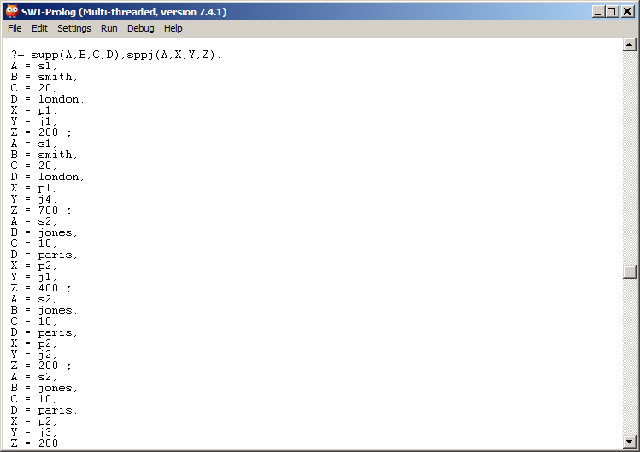
This Example Links on A (supplier ID)

Slide 149
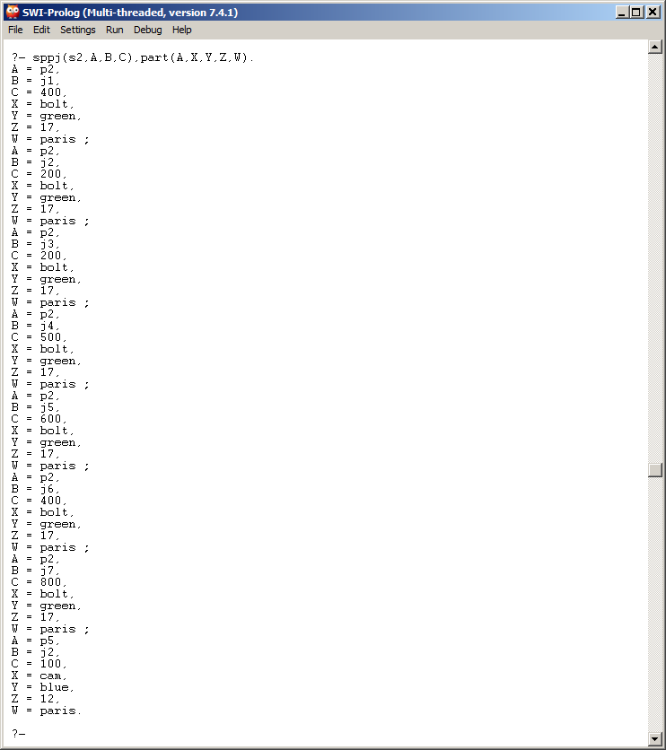
All parts for s2 for all projects it supplies

Slide 150
findall (Object, Goal, List)
Find all suppliers in London
Final all Supplier Names in London
Find all Status in London

Slide 151
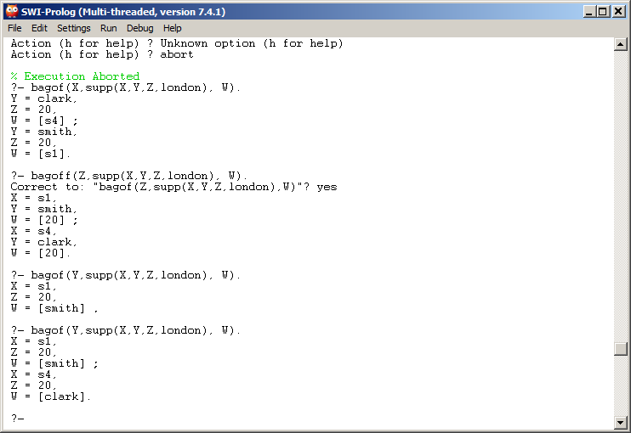
bagof (Object, Goal, List)
Returns sets of all values (not just W)

Slide 152
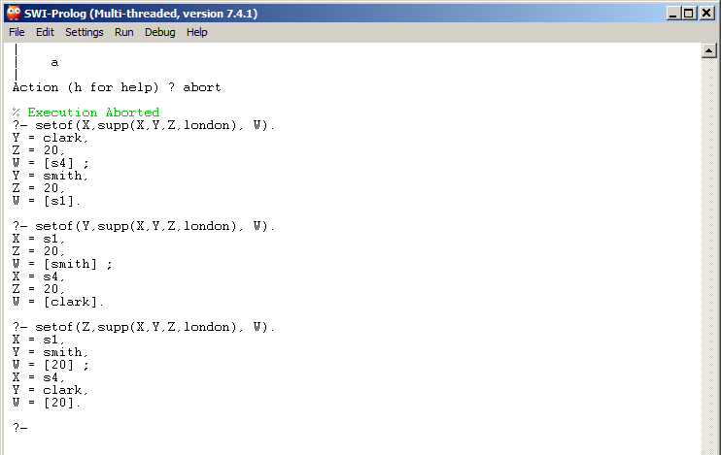
Set (Object, Goal, List)
Returns collection of all values (no duplicates)

Slide 153
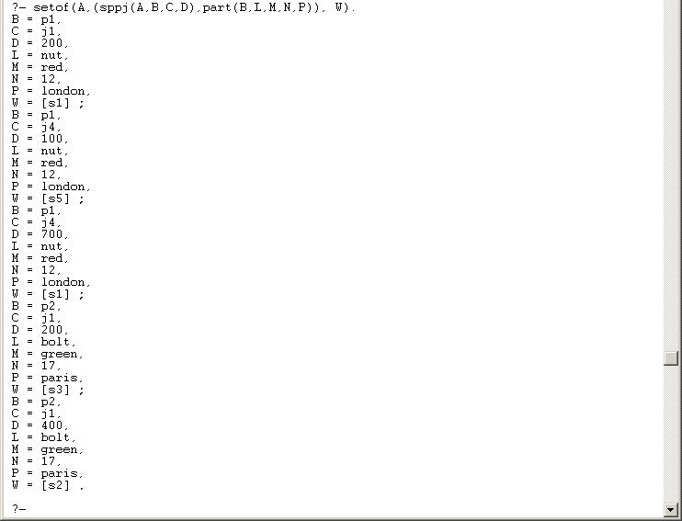
Multiple clauses in a setof

Slide 154
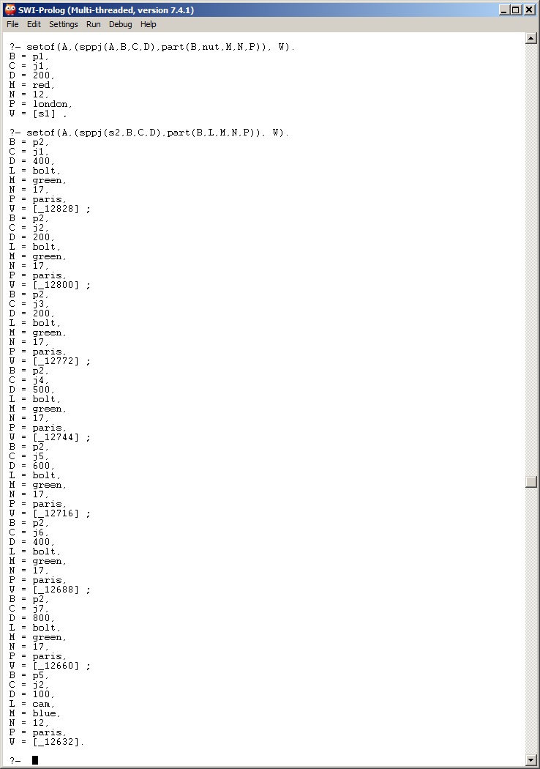
Other Examples

Slide 155
Closer Look at Rules
supp(s# sname status city)
part(p# pname color weight city)
proj(j# jname city)
sppj(s# p# j# qty)
suppliesparts(S,P,N,T,C,J,A):-supp(S,N,T,C),sppj(S,P,J,A).
usedbyproject(P,N,C,A,L,S,J,D):-part(P,N,C,A,L),sppj(S,P,J,D).
usesparts(J,A,B,P,N,S,J,X,G,H):- proj(J,A,B), sppj(S,P,J,X),
part(P,N,G,H).
notinlocation(S,N,T,C,J,A,B):-supp(S,N,T,C),proj(J,A,B), not(C=B).

Slide 156
Using the Rules

Slide 157
Negation – supplies not in london

Slide 158
Go and Helpful Links
Main Option
Suggest: https://www.tutorialspoint.com/codingground.htm
Three Options for setting up Golang
Windows - See
http://www.wadewegner.com/2014/12/easy-go-programming-setup-for-windows/
Mac OS X – See
https://www.goinggo.net/2013/06/installing-go-gocode-gdb-and-liteide.html
Linux - see
https://golang.org/doc/install
http://www.tecmint.com/install-go-in-linux/
https://www.digitalocean.com/community/tutorials/how-to-install-go-1-6-on-ubuntu-14-04

Slide 159
Go and Helpful Links
Helpful Links
https://gobyexample.com/
https://blog.golang.org/examples
http://dlintw.github.io/gobyexample/public/index.html

Slide 160
Rosetta code - strings
https://rosettacode.org/wiki/String_append#Go
https://rosettacode.org/wiki/String_case#Go
https://rosettacode.org/wiki/String_comparison#Go
https://rosettacode.org/wiki/String_concatenation#Go
https://rosettacode.org/wiki/String_length#Character_Length_30
https://rosettacode.org/wiki/String_matching#Go
https://rosettacode.org/wiki/String_prepend#Go
https://rosettacode.org/wiki/Strip_a_set_of_characters_from_a_string#Go

Slide 161
Sample Go from Rosetta
https://rosettacode.org/wiki/String_append#Go
s := "foo" s += "bar"
https://rosettacode.org/wiki/String_concatenation#Go
package main
import "fmt"
func main() {
// text assigned to a string variable
s := "hello"
// output string variable
fmt.Println(s)
// this output requested by original task descrption, although
// not really required by current wording of task description.
fmt.Println(s + " literal")
// concatenate variable and literal, assign result to another string variable
s2 := s + " literal"
// output second string variable
fmt.Println(s2)
}

Slide 162
Sample Go from Rosetta
https://rosettacode.org/wiki/String_case#Go
package main
import (
"fmt"
"strings"
"unicode"
"unicode/utf8"
)
func main() {
show("alphaBETA")
show("alpha BETA")
// Three digraphs that should render similar to DZ, Lj, and nj.
show("Ǆǈǌ")
// Unicode apostrophe in third word.
show("o'hare O'HARE o’hare don't")
}
func show(s string) {
fmt.Println("\nstring: ",
s, " len:", utf8.RuneCountInString(s), "runes") // DZLjnj
fmt.Println("All upper case: ", strings.ToUpper(s)) // DZLJNJ
fmt.Println("All lower case: ", strings.ToLower(s)) // dzljnj
fmt.Println("All title case: ", strings.ToTitle(s)) // DzLjNj
fmt.Println("Title words: ", strings.Title(s)) // Dzljnj
fmt.Println("Swapping case: ", // DzLjNJ
strings.Map(unicode.SimpleFold, s))
}

Slide 163
Sample Go from Rosetta
https://rosettacode.org/wiki/String_comparison#Go
package main
import (
"fmt"
"strings"
)
func main() {
// Go language string comparison operators:
c := "cat"
d := "dog"
if c == d {
fmt.Println(c, "is bytewise identical to", d)
}
if c != d {
fmt.Println(c, "is bytewise different from", d)
}
if c > d {
fmt.Println(c, "is lexically bytewise greater than", d)
}
if c < d {
fmt.Println(c, "is lexically bytewise less than", d)
}
if c >= d {
fmt.Println(c, "is lexically bytewise greater than or equal to", d)
}
if c <= d {
fmt.Println(c, "is lexically bytewise less than or equal to", d)
}
eqf := `when interpreted as UTF-8 and compared under Unicode
simple case folding rules.`
if strings.EqualFold(c, d) {
fmt.Println(c, "equal to", d, eqf)
} else {
fmt.Println(c, "not equal to", d, eqf)
}

Slide 164
Sample Go from Rosetta
https://rosettacode.org/wiki/String_length#Character_Length_30
package main
import (
"fmt"
"unicode/utf8"
)
func main() {
m := "møøse"
u := "𝔘𝔫𝔦𝔠𝔬𝔡𝔢"
j := "J̲o̲s̲é̲"
fmt.Printf("%d %s %x\n", utf8.RuneCountInString(m), m, []rune(m))
fmt.Printf("%d %s %x\n", utf8.RuneCountInString(u), u, []rune(u))
fmt.Printf("%d %s %x\n", utf8.RuneCountInString(j), j, []rune(j))
}
https://rosettacode.org/wiki/String_prepend#Go
s := "world!" s = "Hello, " + s

Slide 165
Sample Go from Rosetta
https://rosettacode.org/wiki/String_matching#Go
package main
import (
"fmt"
"strings"
)
func match(first, second string) {
fmt.Printf("1. %s starts with %s: %t\n",
first, second, strings.HasPrefix(first, second))
i := strings.Index(first, second)
fmt.Printf("2. %s contains %s: %t,\n", first, second, i >= 0)
if i >= 0 {
fmt.Printf("2.1. at location %d,\n", i)
for start := i+1;; {
if i = strings.Index(first[start:], second); i < 0 {
break
}
fmt.Printf("2.2. at location %d,\n", start+i)
start += i+1
}
fmt.Println("2.2. and that's all")
}
fmt.Printf("3. %s ends with %s: %t\n",
first, second, strings.HasSuffix(first, second))
}
func main() {
match("abracadabra", "abr")
}

Slide 166
Sample Go from Rosetta
https://rosettacode.org/wiki/Strip_a_set_of_characters_from_a_string#Go
package main
import (
"fmt"
"strings"
)
func stripchars(str, chr string) string {
return strings.Map(func(r rune) rune {
if strings.IndexRune(chr, r) < 0 {
return r
}
return -1
}, str)
}
func main() {
fmt.Println(stripchars("She was a soul stripper. She took my heart!",
"aei"))
}

Slide 167
https://github.com/ae6rt/golang-examples/blob/master/goeg/src/wordfrequency/wordfrequency.go
//
// Copyright © 2011-12 Qtrac Ltd.
//
// This program or package and any associated files are licensed under the
// Apache License, Version 2.0 (the "License"); you may not use these files
// except in compliance with the License. You can get a copy of the License
// at: http://www.apache.org/licenses/LICENSE-2.0.
//
// Unless required by applicable law or agreed to in writing, software
// distributed under the License is distributed on an "AS IS" BASIS,
// WITHOUT WARRANTIES OR CONDITIONS OF ANY KIND, either express or implied.
// See the License for the specific language governing permissions and
// limitations under the License.
package main
import (
"bufio"
"fmt"
"io"
"log"
"os"
"path/filepath"
"runtime"
"sort"
"strings"
"unicode"
"unicode/utf8"
)

Slide 168
https://github.com/ae6rt/golang-examples/blob/master/goeg/src/wordfrequency/wordfrequency.go
func main() {
if len(os.Args) == 1 || os.Args[1] == "-h" || os.Args[1] == "--help" {
fmt.Printf("usage: %s <file1> [<file2> [... <fileN>]]\n",
filepath.Base(os.Args[0]))
os.Exit(1)
}
frequencyForWord := map[string]int{} // Same as: make(map[string]int)
for _, filename := range commandLineFiles(os.Args[1:]) {
updateFrequencies(filename, frequencyForWord)
}
reportByWords(frequencyForWord)
wordsForFrequency := invertStringIntMap(frequencyForWord)
reportByFrequency(wordsForFrequency)
}
func commandLineFiles(files []string) []string {
if runtime.GOOS == "windows" {
args := make([]string, 0, len(files))
for _, name := range files {
if matches, err := filepath.Glob(name); err != nil {
args = append(args, name) // Invalid pattern
} else if matches != nil { // At least one match
args = append(args, matches...)
}
}
return args
}
return files
}

Slide 169
https://github.com/ae6rt/golang-examples/blob/master/goeg/src/wordfrequency/wordfrequency.go
func updateFrequencies(filename string, frequencyForWord map[string]int) {
var file *os.File
var err error
if file, err = os.Open(filename); err != nil {
log.Println("failed to open the file: ", err)
return
}
defer file.Close()
readAndUpdateFrequencies(bufio.NewReader(file), frequencyForWord)
}
func readAndUpdateFrequencies(reader *bufio.Reader,
frequencyForWord map[string]int) {
for {
line, err := reader.ReadString('\n')
for _, word := range SplitOnNonLetters(strings.TrimSpace(line)) {
if len(word) > utf8.UTFMax ||
utf8.RuneCountInString(word) > 1 {
frequencyForWord[strings.ToLower(word)] += 1
}
}
if err != nil {
if err != io.EOF {
log.Println("failed to finish reading the file: ", err)
}
break
}
}
}

Slide 170
https://github.com/ae6rt/golang-examples/blob/master/goeg/src/wordfrequency/wordfrequency.go
func SplitOnNonLetters(s string) []string {
notALetter := func(char rune) bool { return !unicode.IsLetter(char) }
return strings.FieldsFunc(s, notALetter)
}
func invertStringIntMap(intForString map[string]int) map[int][]string {
stringsForInt := make(map[int][]string, len(intForString))
for key, value := range intForString {
stringsForInt[value] = append(stringsForInt[value], key)
}
return stringsForInt
}
func reportByWords(frequencyForWord map[string]int) {
words := make([]string, 0, len(frequencyForWord))
wordWidth, frequencyWidth := 0, 0
for word, frequency := range frequencyForWord {
words = append(words, word)
if width := utf8.RuneCountInString(word); width > wordWidth {
wordWidth = width
}
if width := len(fmt.Sprint(frequency)); width > frequencyWidth {
frequencyWidth = width
}
}
sort.Strings(words)
gap := wordWidth + frequencyWidth - len("Word") - len("Frequency")
fmt.Printf("Word %*s%s\n", gap, " ", "Frequency")
for _, word := range words {
fmt.Printf("%-*s %*d\n", wordWidth, word, frequencyWidth,
frequencyForWord[word])
}
}

Slide 171
https://github.com/ae6rt/golang-examples/blob/master/goeg/src/wordfrequency/wordfrequency.go
// We only want to count words of 2 or more letters. The cheapest way is to
// see if the word has enough bytes to represent at least one UTF-8
// character that uses the most possible bytes (i.e., 4); but if it is less
// than 4 bytes it could still be a 2, 3, or 4 letter word if they're 7-bit
// ASCII so for this case we actually count the runes (which will be cheap
// because there are at most 4 to count)
func reportByFrequency(wordsForFrequency map[int][]string) {
frequencies := make([]int, 0, len(wordsForFrequency))
for frequency := range wordsForFrequency {
frequencies = append(frequencies, frequency)
}
sort.Ints(frequencies)
width := len(fmt.Sprint(frequencies[len(frequencies)-1]))
fmt.Println("Frequency → Words")
for _, frequency := range frequencies {
words := wordsForFrequency[frequency]
sort.Strings(words)
fmt.Printf("%*d %s\n", width, frequency, strings.Join(words, ", "))
}
}

Slide 172
https://github.com/BluntSporks/word-counter/blob/master/word-counter.go
// word-counter counts the words in a text file.
//
package main
import (
"bufio"
"flag"
"fmt"
"github.com/BluntSporks/mapsort"
"log"
"os"
"regexp"
"strconv"
"strings"
)
var wordRegExp = regexp.MustCompile(`\pL+('\pL+)*`)
var wordCnts = make(map[string]int)
func main() {
lookup := flag.String("lookup", "", "Existing word count file to use for lookup")
flag.Parse()
if len(flag.Args()) < 1 {
log.Fatal("Missing filename argument")
}
file := flag.Arg(0)

Slide 173
https://github.com/BluntSporks/word-counter/blob/master/word-counter.go
// Choose program function.
if *lookup != "" {
lookUpCnts(file, *lookup)
} else {
cntWords(file)
}
// Print the word counts.
pairs := mapsort.ByVal(wordCnts, false)
for _, pair := range pairs {
fmt.Printf("%s,%d\n", pair.Key, pair.Val)
}
}
// cntWords counts the words in a file.
func cntWords(file string) {
hdl, err := os.Open(file)
if err != nil {
log.Fatal(err)
}
defer hdl.Close()
scanner := bufio.NewScanner(hdl)
for scanner.Scan() {
if err := scanner.Err(); err != nil {
log.Fatal(err)
}

Slide 174
https://github.com/BluntSporks/word-counter/blob/master/word-counter.go
line := strings.ToLower(scanner.Text())
words := wordRegExp.FindAllString(line, -1)
for _, word := range words {
wordCnts[word]++
}
}
}
// lookUpCnts looks up the word counts for a file in an existing word count file.
func lookUpCnts(file string, lookup string) {
hdl, err := os.Open(file)
if err != nil {
log.Fatal(err)
}
defer hdl.Close()
scanner := bufio.NewScanner(hdl)
wordsToLookUp := make(map[string]bool)
for scanner.Scan() {
if err := scanner.Err(); err != nil {
log.Fatal(err)
}
line := strings.ToLower(scanner.Text())
words := wordRegExp.FindAllString(line, -1)
for _, word := range words {
wordsToLookUp[word] = true
}
}

Slide 175
https://github.com/BluntSporks/word-counter/blob/master/word-counter.go
lookupHdl, err := os.Open(lookup)
if err != nil {
log.Fatal(err)
}
defer lookupHdl.Close()
scanner = bufio.NewScanner(lookupHdl)
for scanner.Scan() {
if err := scanner.Err(); err != nil {
log.Fatal(err)
}
line := strings.ToLower(scanner.Text())
fields := strings.Split(line, ",")
if len(fields) != 2 {
continue
}
word := fields[0]
if wordsToLookUp[word] {
cnt, err := strconv.Atoi(fields[1])
if err == nil {
wordCnts[word] = cnt
}
}
}
}

Slide 176
https://github.com/habib-rangoonwala/golang/blob/master/WordCountSequential/WordCountSequential.go
// Author: Habib Rangoonwala
// Created: 03-May-2016
// Updated: 01-July-2016
package main
import (
"bufio"
"fmt"
"path/filepath"
"regexp"
"log"
"os"
"strings"
"strconv"
"time"
)
var fileList []string
func main() {
if len(os.Args) == 1 || os.Args[1] == "-h" || os.Args[1] == "--help" {
fmt.Printf("Usage: %s <file/directory 1> [file/directory 2/3/4 . . .] \n", filepath.Base(os.Args[0]))
os.Exit(1)
}

Slide 177
https://github.com/habib-rangoonwala/golang/blob/master/WordCountSequential/WordCountSequential.go
starttime := time.Now()
fmt.Println("Processing . . .")
vWordArr := map[string]int{}
//fileList := []string{}
//identify all the files and/or files from directory
for _, filename := range os.Args[1:]{
myListFiles(filename)
}
// process all the files
for _, file := range fileList {
myReadFile(file, vWordArr)
//fmt.Println(file)
}
myPrintORWrite(vWordArr,os.Args[1])
elapsedtime := time.Since(starttime)
fmt.Println("Complete!!")
fmt.Println("Time taken:",elapsedtime)
}

Slide 178
https://github.com/habib-rangoonwala/golang/blob/master/WordCountSequential/WordCountSequential.go
func myListFiles( searchDir string) {
filepath.Walk(searchDir, func(path string, f os.FileInfo, err error) error {
if !f.IsDir() {
fileList = append(fileList, path)
}
return nil
})
}
func myReadFile(filename string, vWordArr map[string]int) {
file, err := os.Open(filename)
if err != nil {
log.Println("Error: ", err)
return
}
fmt.Println(". . . " + filename)
scanner := bufio.NewScanner(file)
//regex to remove all special characters
reg, err := regexp.Compile("[^A-Za-z0-9]+")
if err != nil {
log.Fatal(err)
}

Slide 179
https://github.com/habib-rangoonwala/golang/blob/master/WordCountSequential/WordCountSequential.go
// Setting Split method to ScanWords.
scanner.Split(bufio.ScanWords)
// Scan all words from the file.
for scanner.Scan() {
//remove all spaces and special chars
word := strings.TrimSpace(reg.ReplaceAllString(scanner.Text(),""))
if len(word) > 0 {
vWordArr[strings.ToLower(word)] += 1
}}
file.Close()
}
func myPrintORWrite(vWordArr map[string]int, filename string) {
filehandle, err := os.Create(filepath.Dir(filename)+"/processed.csv")
if err != nil {
log.Println("Error writing to file: ", err)
return
}
fmt.Println("Writing to file:" , filehandle.Name())
writer := bufio.NewWriter(filehandle)
for word, frequency := range vWordArr {
//fmt.Printf("%s %d\n",word,frequency)
fmt.Fprintln(writer, word+","+strconv.Itoa(frequency))
}
writer.Flush()
filehandle.Close()
}

Slide 180
Rosetta Code Links – I/O
https://rosettacode.org/wiki/File_input/output#Go
https://rosettacode.org/wiki/Input/Output_for_Lines_of_Text#Go
https://rosettacode.org/wiki/Strip_a_set_of_characters_from_a_string#Gok
https://rosettacode.org/wiki/Text_processing/1#Go
https://rosettacode.org/wiki/Text_processing/2#Go
https://rosettacode.org/wiki/User_input/Text#Go
https://rosettacode.org/wiki/Read_entire_file#Go
https://rosettacode.org/wiki/Write_entire_file#Go
https://rosettacode.org/wiki/Read_a_file_line_by_line#Go

Slide 181
Sample Go from Rosetta
https://rosettacode.org/wiki/File_input/output#Go
package main
import (
"fmt"
"io/ioutil"
)
func main() {
b, err := ioutil.ReadFile("input.txt")
if err != nil {
fmt.Println(err)
return
}
if err = ioutil.WriteFile("output.txt", b, 0666); err != nil {
fmt.Println(err)
}
}

Slide 182
Sample Go from Rosetta
package main
import (
"io"
"log"
"os"
)
func CopyFile(out, in string) (err error) {
var inf, outf *os.File
inf, err = os.Open(in)
if err != nil {
return
}
defer func() {
cErr := inf.Close()
if err == nil {
err = cErr
}
}()
outf, err = os.Create(out)
if err != nil {
return
}
_, err = io.Copy(outf, inf)
cErr := outf.Close()
if err == nil {
err = cErr
}
return
}
func main() {
if err := CopyFile("output.txt", "input.txt"); err != nil {
log.Fatal(err)
}
}

Slide 183
Sample Go from Rosetta
https://rosettacode.org/wiki/Input/Output_for_Lines_of_Text#Go
package main
import (
"bufio"
"fmt"
"io"
"log"
"os"
)
func main() {
// Often we'd already have wrapped os.Stdin (or some other
// io.Reader, like an *os.File) in a bufio.Reader by this point
// and we'd use fmt.Fscanln() on that reader instead.
var lines int
n, err := fmt.Scanln(&lines)
if n != 1 || err != nil {
log.Fatal(err)
}
// Use a bufio.Scanner. This uses a SplitFunc which we can choose
// or provide our own that splits or otherwise pre-processes the
// input into tokens however we like.
//
// Could also just use bufio.ReadString('\n') but a Scanner
// with ScanLines matches (and removes) `\r?\n$` and is more
// general purpose.
//
// Normally the loop would be just:
// for scanner.Scan() {
// // use scanner.Text() or scanner.Bytes()
// }
// and we'd loop until the scan indicated EOF. But for this task
// we've got an explictly specified number of lines to read.
scanner := bufio.NewScanner(os.Stdin)
scanner.Split(bufio.ScanLines) // not needed, this is the default
for ; scanner.Scan() && lines > 0; lines-- {
doStuff(scanner.Text())
}
if err := scanner.Err(); err != nil {
log.Fatal(err)
}
// Check for too few lines, normally not needed
if lines > 0 {
log.Fatalln("early", io.EOF)
}
}
func doStuff(line string) {
fmt.Println(line)
}

Slide 184
Sample Go from Rosetta
https://rosettacode.org/wiki/Strip_a_set_of_characters_from_a_string#Go
package main
import (
"fmt"
"strings"
)
func stripchars(str, chr string) string {
return strings.Map(func(r rune) rune {
if strings.IndexRune(chr, r) < 0 {
return r
}
return -1
}, str)
}
func main() {
fmt.Println(stripchars("She was a soul stripper. She took my heart!",
"aei"))
}

Slide 185
Sample Go from Rosetta
https://rosettacode.org/wiki/Text_processing/1#Go
package main
import (
"bufio"
"fmt"
"log"
"os"
"strconv"
"strings"
)
const (
filename = "readings.txt"
readings = 24 // per line
fields = readings*2 + 1 // per line
)
func main() {
file, err := os.Open(filename)
if err != nil {
log.Fatal(err)
}
defer file.Close()
var (
badRun, maxRun int
badDate, maxDate string
fileSum float64
fileAccept int
)
endBadRun := func() {
if badRun > maxRun {
maxRun = badRun
maxDate = badDate
}
badRun = 0
}
s := bufio.NewScanner(file)
for s.Scan() {
f := strings.Fields(s.Text())
if len(f) != fields {
log.Fatal("unexpected format,", len(f), "fields.")
}
var accept int
var sum float64
for i := 1; i < fields; i += 2 {
flag, err := strconv.Atoi(f[i+1])
if err != nil {
log.Fatal(err)
}
if flag <= 0 { // value is bad
if badRun++; badRun == 1 {
badDate = f[0]
}
} else { // value is good
endBadRun()
value, err := strconv.ParseFloat(f[i], 64)
if err != nil {
log.Fatal(err)
}
sum += value
accept++
}
}
fmt.Printf("Line: %s Reject %2d Accept: %2d Line_tot:%9.3f",
f[0], readings-accept, accept, sum)
if accept > 0 {
fmt.Printf(" Line_avg:%8.3f\n", sum/float64(accept))
} else {
fmt.Println()
}
fileSum += sum
fileAccept += accept
}
if err := s.Err(); err != nil {
log.Fatal(err)
}
endBadRun()
fmt.Println("\nFile =", filename)
fmt.Printf("Total = %.3f\n", fileSum)
fmt.Println("Readings = ", fileAccept)
if fileAccept > 0 {
fmt.Printf("Average = %.3f\n", fileSum/float64(fileAccept))
}
if maxRun == 0 {
fmt.Println("\nAll data valid.")
} else {
fmt.Printf("\nMax data gap = %d, beginning on line %s.\n",
maxRun, maxDate)
}
}

Slide 186
Sample Go from Rosetta
https://rosettacode.org/wiki/User_input/Text#Go
package main
import "fmt"
func main() {
var s string
var i int
if _, err := fmt.Scan(&s, &i); err == nil && i == 75000 {
fmt.Println("good")
} else {
fmt.Println("wrong")
}
}

Slide 187
Sample Go from Rosetta
https://rosettacode.org/wiki/User_input/Text#Go
package main
import (
"bufio"
"fmt"
"os"
"strconv"
"strings"
)
func main() {
in := bufio.NewReader(os.Stdin)
fmt.Print("Enter string: ")
s, err := in.ReadString('\n')
if err != nil {
fmt.Println(err)
return
}
s = strings.TrimSpace(s)
fmt.Print("Enter 75000: ")
s, err = in.ReadString('\n')
if err != nil {
fmt.Println(err)
return
}
n, err := strconv.Atoi(strings.TrimSpace(s))
if err != nil {
fmt.Println(err)
return
}
if n != 75000 {
fmt.Println("fail: not 75000")
return
}
fmt.Println("Good")
}

Slide 188
Sample Go from Rosetta
https://rosettacode.org/wiki/Read_entire_file#Go
// +build !windows,!plan9,!nacl // These lack syscall.Mmap
package main
import (
"fmt"
"log"
"os"
"syscall"
)
func main() {
f, err := os.Open("file")
if err != nil {
log.Fatal(err)
}
fi, err := f.Stat()
if err != nil {
log.Fatal(err)
}
data, err := syscall.Mmap(int(f.Fd()), 0, int(fi.Size()),
syscall.PROT_READ, syscall.MAP_PRIVATE)
if err != nil {
log.Fatal(err)
}
fmt.Println(string(data))
}

Slide 189
Sample Go from Rosetta
https://rosettacode.org/wiki/Write_entire_file#Go
import "io/ioutil"
func main() {
ioutil.WriteFile("path/to/your.file", []byte("data"), 0644)
}

Slide 190
Sample Go from Rosetta
https://rosettacode.org/wiki/Read_a_file_line_by_line#Go
package main
import (
"bufio"
"fmt"
"log"
"os"
)
func init() {
log.SetFlags(log.Lshortfile)
}
func main() {
// Open an input file, exit on error.
inputFile, err := os.Open("byline.go")
if err != nil {
log.Fatal("Error opening input file:", err)
}
// Closes the file when we leave the scope of the current function,
// this makes sure we never forget to close the file if the
// function can exit in multiple places.
defer inputFile.Close()
scanner := bufio.NewScanner(inputFile)
// scanner.Scan() advances to the next token returning false if an error was encountered
for scanner.Scan() {
fmt.Println(scanner.Text())
}
// When finished scanning if any error other than io.EOF occured
// it will be returned by scanner.Err().
if err := scanner.Err(); err != nil {
log.Fatal(scanner.Err())
}
}

Slide 191
Sample Go from Rosetta
https://rosettacode.org/wiki/Read_a_file_line_by_line#Go
package main
import (
"bufio"
"fmt"
"io"
"log"
"os"
)
func main() {
f, err := os.Open("file")
if err != nil {
log.Fatal(err)
}
bf := bufio.NewReader(f)
for {
switch line, err := bf.ReadString('\n'); err {
case nil:
// valid line, echo it. note that line contains trailing \n.
fmt.Print(line)
case io.EOF:
if line > "" {
// last line of file missing \n, but still valid
fmt.Println(line)
}
return
default:
log.Fatal(err)
}
}
}

Slide 192
Sample Go from Rosetta
https://rosettacode.org/wiki/Read_a_file_line_by_line#Go
package main
import (
"bufio"
"fmt"
"log"
"os"
)
func init() {
log.SetFlags(log.Lshortfile)
}
func main() {
// Open an input file, exit on error.
inputFile, err := os.Open("byline.go")
if err != nil {
log.Fatal("Error opening input file:", err)
}
// Closes the file when we leave the scope of the current function,
// this makes sure we never forget to close the file if the
// function can exit in multiple places.
defer inputFile.Close()
scanner := bufio.NewScanner(inputFile)
// scanner.Scan() advances to the next token returning false if an error was encountered
for scanner.Scan() {
fmt.Println(scanner.Text())
}
// When finished scanning if any error other than io.EOF occured
// it will be returned by scanner.Err().
if err := scanner.Err(); err != nil {
log.Fatal(scanner.Err())
}
}

Slide 193
Fortran Install – Won’t Work
Multi-Step Process of GCC and CBFortran
TDM-GCC and MinGW Compiler
http://www.eclipse.org/downloads/packages/eclipse-parallel-application-developers/junosr2
I Installed TDM32 Bundle (tdm-gcc-5.1.0-3.exe)
Code::Blocks IDE for Fortran – CBFortran
http://cbfortran.sourceforge.net/downloads.html
http://cbfortran.sourceforge.net/notes.html
http://cbfortran.sourceforge.net/news.html
Other Links
https://sites.esm.psu.edu/~ajm138/fortranexamples.html
http://people.sc.fsu.edu/~jburkardt/f_src/f90/f90.html
http://fortranwiki.org/fortran/show/Code

Slide 194
Fortran Install
Multi-Step Process of GCC and CBFortran
TDM-GCC and MinGW Compiler
http://tdm-gcc.tdragon.net/
I Installed TDM32 Bundle (tdm-gcc-5.1.0-3.exe)
Code::Blocks IDE for Fortran – CBFortran
http://cbfortran.sourceforge.net/downloads.html
http://cbfortran.sourceforge.net/notes.html
http://cbfortran.sourceforge.net/news.html
Other Links
https://sites.esm.psu.edu/~ajm138/fortranexamples.html
http://people.sc.fsu.edu/~jburkardt/f_src/f90/f90.html
http://fortranwiki.org/fortran/show/Code

Slide 195
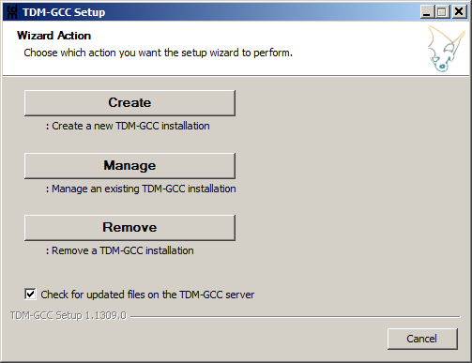
TDM-GCC Install
Select Create

Slide 196
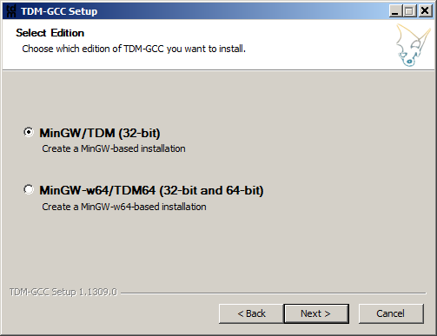
TDM-GCC Install
Installed 32 Bit version

Slide 197
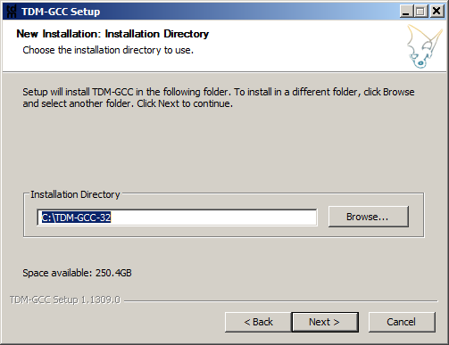
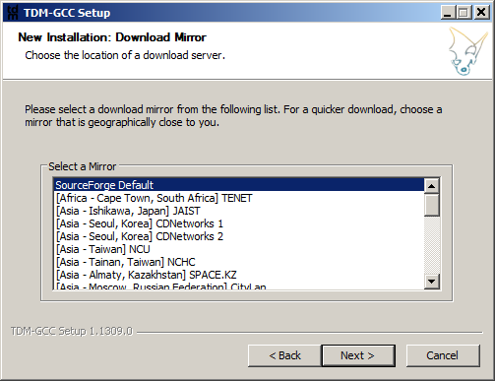
TDM-GCC Install
Use Default Directory and Download Mirror

Slide 198
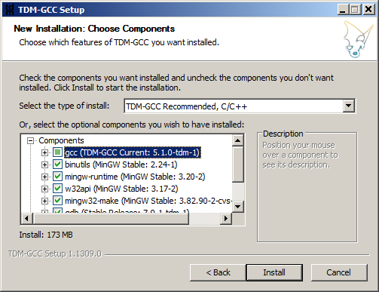
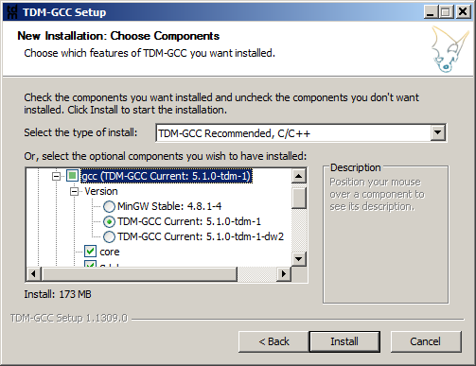
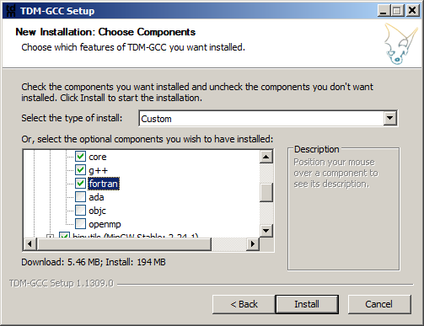
TDM-GCC Install
Open gcc scroll and select fortran and Install

Slide 199
CBFortran Next
http://cbfortran.sourceforge.net/
http://cbfortran.sourceforge.net/downloads.html
Downloaded zip for Windows Version
Extract to c:\
Go to Directory and execute codeblocks.exe
Follow Instructions on:
http://cbfortran.sourceforge.net/notes.html
To set up the install on Windows (or Linux)
Use First YouTube Video
http://cbfortran.sourceforge.net/news.html

Slide 200
CBFortran Next
Set Compiler Install Directory
Setup of compiler's installation directory (gfortran users)
In Code::Blocks open "Settings -> Compiler..." dialog. Find "GNU GCC Compiler". Open "Toolchain executables" tab. Fill "Compiller's installation directory" text-box (in my case it is C:\MinGW32). USE AUTODETECT
For gfortran compiler. Find "GNU Fortran Compiler". Open "Toolchain executables" tab. Fill "Compiller's installation directory" text-box (in my case it is C:\MinGW32) and "Program Files" text-boxes. Just remember, that programs on Windows end with ".exe". So your compiler name should end with ".exe" too.
C:\TDM-GCC-32\bin\gfortran.exe

Slide 201
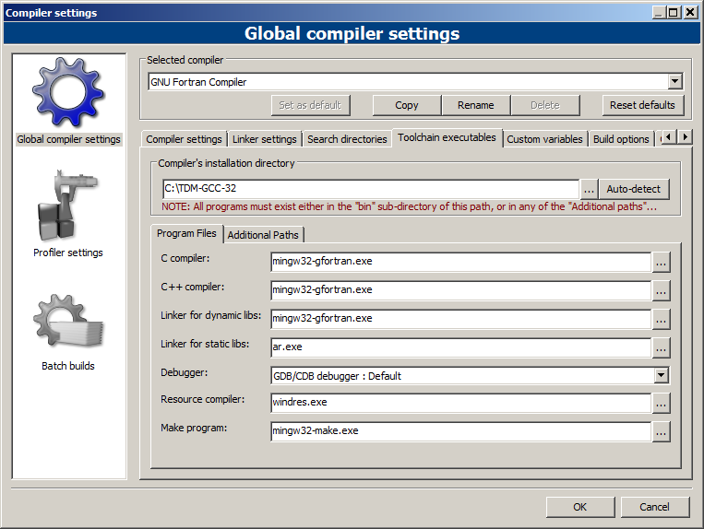
CBFortran
Make Sure Settings set as follows (defaults gcc):

Slide 202
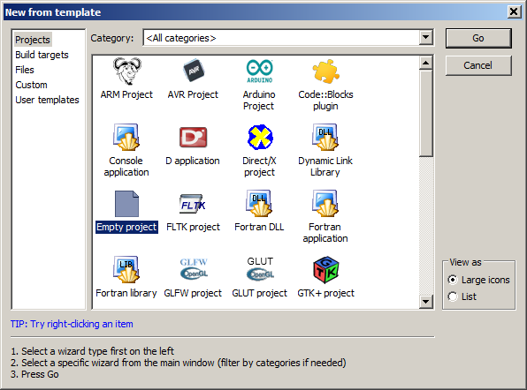
CBFortran
Create a New Project

Slide 203
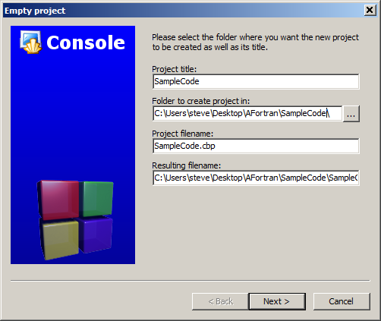
CBFortran
Name the Project

Slide 204
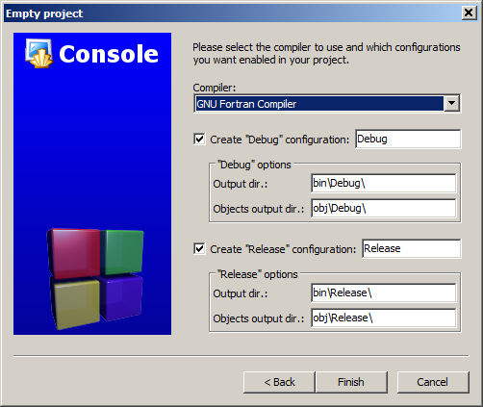
CBFortran
Compiler Option

Slide 205
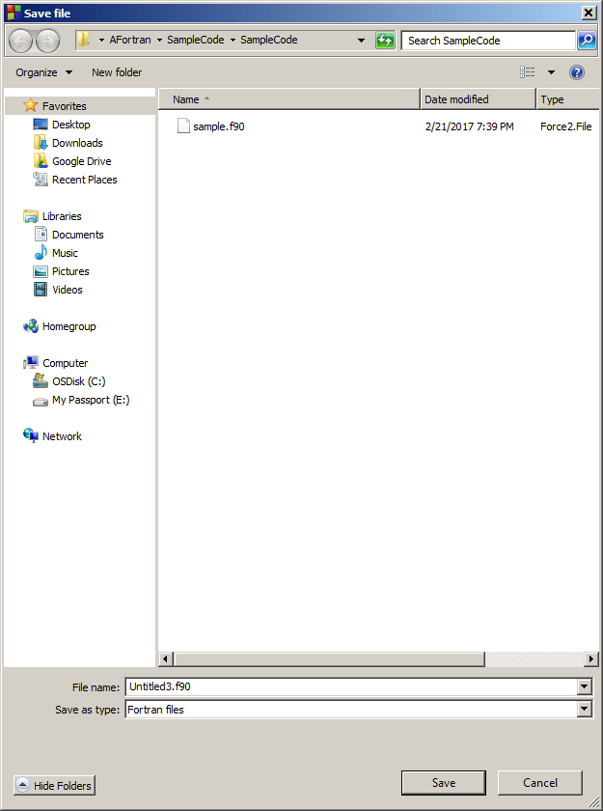
CBFortran
File - New - Empty File

Slide 206
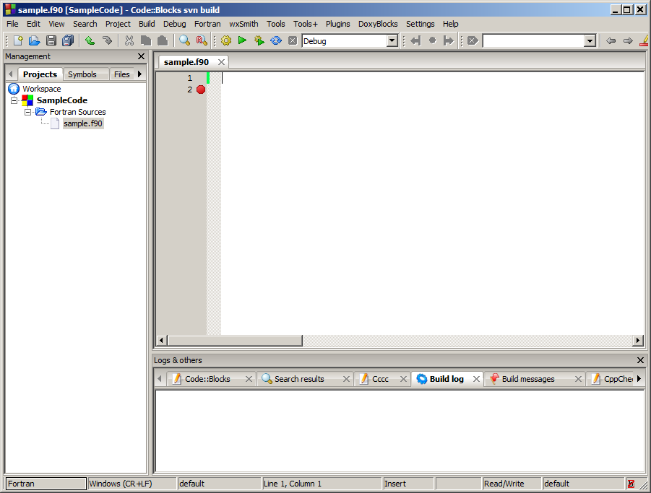
CBFortran – Cut and Paste Code

Slide 207
Build & Run

Slide 208
Output

Slide 209
Other Fortran Examples: Code
-- This is one of the examples shipped with GNAT.
With Gnat.IO; use Gnat.IO;
procedure Gnatioex is
C : Character;
I : Integer;
S : String (1 .. 100);
begin
Put_Line ("Hello. Welcome to the GNAT IO example" & "!");
New_Line;
Put ("Note: This example uses GNAT.IO which does not raise Data_Error");
Put_Line (" for bad data.");
Put (" ");
Put_Line ("For that you need to use the standard package Ada.Text_IO.");
New_line;
Put ("Please enter a single character now followed by <CR> ");
Get (C);
Put ("Your character is: ");
Put (C);
Get (C); -- read the <CR>
New_Line (2);
Put ("Please enter a String now followed by <CR> :");
Get_Line (S, I);
Put ("Your String is : ");
Put_Line (S (1 .. I));
Put ("Its length is : ");
Put (I);
New_Line (2);
Put ("Please enter an integer now followed by <CR> ");
Get (I);
Put ("Your number is: ");
Put (I);
New_Line (2);
end;

