Slide 1



Ada Seminar
An Introduction
Copyright © 1997-2004 Lexical Integration (M) Sdn Bhd Copyright © 2003-2008 AdrianHoe.com,AdaStar Informatics

Slide 2







The History of Ada
What?
Who?
When?
Why?
How?
Copyright © 1997-2004 Lexical Integration (M) Sdn Bhd Copyright © 2003-2008 AdrianHoe.com,AdaStar Informatics

Slide 3









The World Software Crisis
US DoD, world largest computer user
Complexity - Tri-forces
  Embedded systems
  Databases
  Processing
  Real-time
  Scientific
Copyright © 1997-2004 Lexical Integration (M) Sdn Bhd Copyright © 2003-2008 AdrianHoe.com,AdaStar Informatics

Slide 4





Variety of programming languages and variant used:
  TACPOL, CMS-2Y, CMS-2M, SPL-1, Jovial J3, Jovial J73, FORTRAN, COBOL, CORAL 66, Pascal, PL/I, PL/M,ALGOL 60,ALGOL 68, Simula, Modula, CHILL, Mesa, CSP, PEARL,APL, Linda, and etc...
Transportability
Copyright © 1997-2004 Lexical Integration (M) Sdn Bhd Copyright © 2003-2008 AdrianHoe.com,AdaStar Informatics

Slide 5



Complexity - led to
  escalating costs both development and maintenance
Reliability - Mission / Safety Critical
Other part of the world having same experience
Copyright © 1997-2004 Lexical Integration (M) Sdn Bhd Copyright © 2003-20087 AdrianHoe.com,AdaStar Informatics

Slide 6








•
Identified software crisis symptoms:
Responsiveness
Reliability
Cost
Modifiability
Timeliness
Transportability
Maintainability
Efficiency
Copyright © 1997-2004 Lexical Integration (M) Sdn Bhd Copyright © 2003-2008 AdrianHoe.com,AdaStar Informatics

Slide 7




Solutions?
Single standard is needed
  General computing
  Embedded and Real-Time applications
  Scientific engineering
Copyright © 1997-2004 Lexical Integration (M) Sdn Bhd Copyright © 2003-2008 AdrianHoe.com,AdaStar Informatics

Slide 8










Solution!
1975 - HOLWG
  Straw man
  Wooden man
1976 - Tin man
  Iron man
    17 proposals, 4 selected
•
•
•
•
Green (CII Honeywell Bull) Red (Intermetrics)
Blue (Softech)
Yellow (SRI International)
Copyright © 1997-2004 Lexical Integration (M) Sdn Bhd Copyright © 2003-2008 AdrianHoe.com,AdaStar Informatics

Slide 9







Solution!
1978 - Steel man
  Red
  Green
May 2, 1979 - GREEN team won! CII Honeywell Bull led by French engineer, Jean Ichbiah
Copyright © 1997-2004 Lexical Integration (M) Sdn Bhd Copyright © 2003-20087 AdrianHoe.com,AdaStar Informatics

Slide 10





Ada was born!
Pascal-like syntax
Concurrency
Object-based
Named after Augusta Ada Byron (1815 - 1852), Countess of Lovelace, daughter of Lord Byron
Copyright © 1997-2004 Lexical Integration (M) Sdn Bhd Copyright © 2003-20087 AdrianHoe.com,AdaStar Informatics

Slide 11


Ada, not ADA!
Copyright © 1997-2004 Lexical Integration (M) Sdn Bhd Copyright © 2003-2008 AdrianHoe.com,AdaStar Informatics

Slide 12





Ada and Standardization
July 1980 - Definitive version proposed to ANSI
December 12, 1980 - MIL-STD-1815
January 1983 - Awarded ANSI standard - Ada 83
1987 - ISO Standard 8652
1988 - Ada 9X revision
1995 - Ada 95 (Object-Oriented) - ISO/IEC 8652:1995
2000 - Ada 200X revision
2007 - Ada 2005 - ISO/IEC 8652:2007 (E) Ed. 3 - March 9,
2007
Copyright © 1997-2004 Lexical Integration (M) Sdn Bhd Copyright © 2003-20087 AdrianHoe.com,AdaStar Informatics

Slide 13













Ada 2005 New Features
Language features
  Character set - Support new 32-bit character type,Wide_Wide_Character in source code, e.g. identifiers and comments
    π : constant := Pi;
  Interface
    Abstract interfaces to provide multiple inheritance
    Protected and task interfaces
  Union
    Unchecked unions using variant records with no run-time discriminant
    Annex B.3.3 Pragma Unchecked_Union
  With
    Limited With Clauses
    Access to private units in private part
  Access types
    Not null access
    Anonymous access
Copyright © 1997-2004 Lexical Integration (M) Sdn Bhd Copyright © 2003-20087 AdrianHoe.com,AdaStar Informatics

Slide 14











Ada 2005 New Features
Language library
  Containers
  Scan Filesystem Directories and Environment Variables
    Directory Operations
  •Environment variables
Numerics
    Add Greek pi (π) to Ada.Numerics
    Vector and matrix operations
  •Non-Preemptive Dispatching
Dynamic priorities for protected objects
    Dynamic ceiling priorities
Copyright © 1997-2004 Lexical Integration (M) Sdn Bhd Copyright © 2003-2008 AdrianHoe.com,AdaStar Informatics

Slide 15












Ada 2005 New Features
Real-Time and High Integrity Systems
  Timing events
  Execution-Time Clocks
  Group execution-time budgets
  Task termination procedure
  Further functions returning Time_Span values
  Ravenscar profile
    Ravenscar profile for high-integrity systems
    New pragma and additional restriction identifiers for real-time systems
    Annex H
    Partition Elaboration Policy for High-Integrity Systems
  New scheduling policies
    Priority Specific Dispatching including Round Robin
    Support for Deadlines and Earliest Deadlines First Scheduling
    Non-Preemptive Dispatching
  Dynamic priorities for protected objects
    Dynamic ceiling priorities
Copyright © 1997-2004 Lexical Integration (M) Sdn Bhd Copyright © 2003-20087 AdrianHoe.com,AdaStar Informatics

Slide 16


Why Ada?
When failure is not an option!
Copyright © 1997-2004 Lexical Integration (M) Sdn Bhd Copyright © 2003-20087 AdrianHoe.com,AdaStar Informatics

Slide 17







Ada Characteristics
Expressive - Primitive objects and operations and must be extensible
Reliability - Strong typing, enumerated data, capture errors during compilation
Language implementation of tasking
Language extension by annexes
Portability, readability and maintainability
Built on top of software engineering philosophy
Validated
Time-to-market
Copyright © 1997-2004 Lexical Integration (M) Sdn Bhd Copyright © 2003-20087 AdrianHoe.com,AdaStar Informatics

Slide 18



Expressive
Structured definitions of objects and operations using Package
package Class_Stack is
type Stack is tagged private;
procedure procedure procedure
reset (the : in out Stack);
push (the : in out Stack; item : in Integer); pop (the : in out Stack; item : out Integer);
private
type type
Stack_Index is new Integer range 0 .. 10;
Stack_Array is array (1 .. Stack_Index’Last) of Integer;
type Stack is Element : Position :
end record;
tagged record Stack_Array; Stack_Index := 0;
end Class_Stack;
Copyright © 1997-2004 Lexical Integration (M) Sdn Bhd Copyright © 2003-20087 AdrianHoe.com,AdaStar Informatics

Slide 19




Expressive
Structured definitions of objects and operations using Package
Package must be extensible using Genericity
generic
type T is private;
Max_Stack : in Positive := 10; package Class_Stack is
type Stack is tagged private;
procedure procedure procedure
reset (the : in out Stack);
push (the : in out Stack; item : in T); pop (the : in out Stack; item : out T);
private
type type
Stack_Index is new Integer range 0 .. Max_Stack; Stack_Array is array (1 .. Max_Stack) of T;
type Stack is Element : Position :
end record;
tagged record Stack_Array; Stack_Index := 0;
end Class_Stack;
Copyright © 1997-2004 Lexical Integration (M) Sdn Bhd Copyright © 2003-2008 AdrianHoe.com,AdaStar Informatics

Slide 20
generic
type T is private;
Max_Stack : in Positive := 10; package Class_Stack is
type Stack is tagged private;
procedure procedure procedure
reset (the : in out Stack);
push (the : in out Stack; item : in T); pop (the : in out Stack; item : out T);
private
type | Stack_Index is new Integer | range 0 .. | Max_Stack;
type | Stack_Array is array (1 .. | Max_Stack) | of T;
type Stack is Element : Position :
end record;
tagged record Stack_Array; Stack_Index := 0;
end Class_Stack;
with Class_Stack;
...
package Integer_Stack is new
...
Class_Stack
(Integer);
package Float_Stack is new Class_Stack (Float, 50);
Copyright © 1997-2004 Lexical Integration (M) Sdn Bhd Copyright © 2003-20087 AdrianHoe.com,AdaStar Informatics

Slide 21












Reliability
Strong typing
Range constraints
Enumerated data types
Arrays begin at 1
Array aggregates
  A : array (1 .. 6) of Float :=
(1 .. 5 =>
0.0, 6 => 1.0);
Safe variables passing
  procedure Set (A : in Integer; B : out Integer; C : in out Integer);
Capture errors during compilation
Copyright © 1997-2004 Lexical Integration (M) Sdn Bhd Copyright © 2003-2008 AdrianHoe.com,AdaStar Informatics

Slide 22




Tasking
Language implementation of tasking (process) rather than system primitive threads
Rendezvous instead of semaphores
Copyright © 1997-2004 Lexical Integration (M) Sdn Bhd Copyright © 2003-20087 AdrianHoe.com,AdaStar Informatics

Slide 23








Language Extension
Annex A - Predefined Language Environment
Annex B - Interface to Other Languages
Annex C - Systems Programming
Annex D - Real-Time Systems
Annex E - Distributed Systems
Annex F - Information Systems
Annex G - Numerics
Annex H - High Integrity Systems
Copyright © 1997-2004 Lexical Integration (M) Sdn Bhd Copyright © 2003-20087 AdrianHoe.com,AdaStar Informatics

Slide 24







Readability
Pascal-like syntax
  Natural
  Top-down
  Clean
No cryptic symbols
Clear definitions
Easy maintenance
Copyright © 1997-2004 Lexical Integration (M) Sdn Bhd Copyright © 2003-20087 AdrianHoe.com,AdaStar Informatics

Slide 25







Time-To-Market
Definition of Time-To-Market
  Timely delivery of reliable software vs. deliver first, patch later
  Force programmers/software engineers spend more time on design
    10% time spent on coding
  Also allow rapid prototyping
Copyright © 1997-2004 Lexical Integration (M) Sdn Bhd Copyright © 2003-2008 AdrianHoe.com,AdaStar Informatics

Slide 26






Software Engineering Philosophy
Built on top of strong software philosophy
  Enforce strong disciplines in software engineering
    On-The-Fly programming is also allowed (rapid prototyping)
  Language for both implementation and design
• Directly reflects structure of the problem space
Efforts of software engineers around the world
  Not a design of one or two individuals
• Technology NOT proprietary to one organization
Matured
  MIL-STD
  Full ANSI and ISO
Copyright © 1997-2004 Lexical Integration (M) Sdn Bhd Copyright © 2003-2008 AdrianHoe.com,AdaStar Informatics

Slide 27



Validation
Fully validated
  Validation suite
Copyright © 1997-2004 Lexical Integration (M) Sdn Bhd Copyright © 2003-2008 AdrianHoe.com,AdaStar Informatics

Slide 28

Examples ...
Copyright © 1997-2004 Lexical Integration (M) Sdn Bhd Copyright © 2003-2008 AdrianHoe.com,AdaStar Informatics

Slide 29



Example 1 - Readability
Calculate
{
int c, d;
(int
*a, *b)
c=*a++; d=c*a/*b; a=d+(*a)-b;
}
procedure
c, d : begin
Calculate Integer;
(a : in out Integer;
b : in Integer) is
c := a;
a | := | a | + | 1;
d | := | c | * | a | / | b;
a | := | d | + | a | - | b;
end Calculate;
Copyright © 1997-2004 Lexical Integration (M) Sdn Bhd Copyright © 2003-20087 AdrianHoe.com,AdaStar Informatics

Slide 30

Example 2 - Reliability
int Matrix[10];
...
Max = 15;
...
do_something_dangerous (int *matrix,
{
for (i=0;i++;i<=Max)
{
safety_value=Matrix[i];
...
}
}
int max)
Matrix : array (1..10) of Integer;
...
Max : Integer := 15;
...
for I in 1 .. Max loop begin
Safety_Value := Matrix (I);
...
-- Constraint
error raised
by compiler
end;
Copyright © 1997-2004 Lexical Integration (M) Sdn Bhd Copyright © 2003-20087 AdrianHoe.com,AdaStar Informatics

Slide 31

Example 3 - Reliability
enum Color {green=1, red=2}
...
color traffic_light = green;
...
do_something();
...
if (traffic_light==green) start_train();
else
wait();
...
do_someting()
{ /* Somehow enum color {green, red} somewhere => green=0,
red=1 */
traffic_light=1; /* Red */
type Color is
...
Traffic_Light
...
Traffic_Light
...
enum (Green, Red);
: Color := Red;
:= 1; -- Compiler
gives error
if Traffic_Light Start_Train;
else
Wait; end if;
= Green then
Copyright © 1997-2004 Lexical Integration (M) Sdn Bhd Copyright © 2003-2008 AdrianHoe.com,AdaStar Informatics

Slide 32

Example 4 - Tasking
process_1() {...}
procedure Do_Some_Process is task Process_1;
process_2() {...}
task body Process_1 is begin
...
end Process_1;
void do_some_process()
{
Tid1 = Create_Thread Tid2 = Create_Thread
...
(&process_1); (&process_2);
task Process_2;
Start_Thread Start_Thread
...
(Tid1);
(Tid2);
task body Process_2 is begin
...
end Process_2;
Kill_Thread (Tid2);
}
begin
Do_Whatever_Here; end Do_Some_Process;
Copyright © 1997-2004 Lexical Integration (M) Sdn Bhd Copyright © 2003-2008 AdrianHoe.com,AdaStar Informatics

Slide 33

Who use Ada?
Copyright © 1997-2004 Lexical Integration (M) Sdn Bhd Copyright © 2003-2008 AdrianHoe.com,AdaStar Informatics

Slide 34

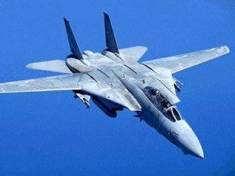


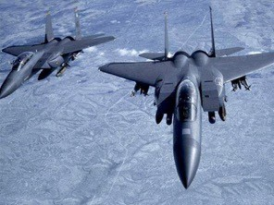



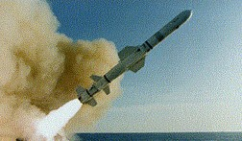



Military
C4I
Battle Theater Management System
Mission Planning
Weapon Control
Missiles
Warships
Satellites
Simulations / War Games
more...
Copyright © 1997-2004 Lexical Integration (M) Sdn Bhd Copyright © 2003-2008 AdrianHoe.com,AdaStar Informatics

Slide 35

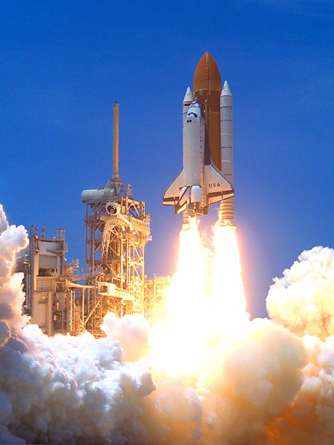
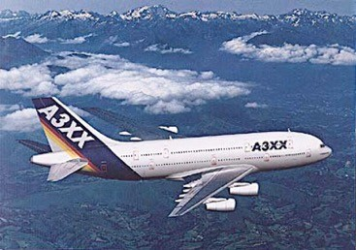







Aerospace Industries
NASA
Boeing
Lockheed Martin
British Aerospace
Airbus
Air Traffic Control
GPS
Copyright © 1997-2004 Lexical Integration (M) Sdn Bhd Copyright © 2003-2008 AdrianHoe.com,AdaStar Informatics

Slide 36


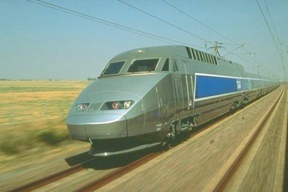



Transports
TGV Bullet Trains
Railway Traffic Control (European Train Control)
Paris Subway
Cairo & Calcutta Metros
Copyright © 1997-2004 Lexical Integration (M) Sdn Bhd Copyright © 2003-20087 AdrianHoe.com,AdaStar Informatics

Slide 37





Financial
NASDAQ, Dow Jones, DAX, etc...
Swiss Bank (International Fund Transfer, SWIFT)
Well Fargo Bank
Copyright © 1997-2004 Lexical Integration (M) Sdn Bhd Copyright © 2003-2008 AdrianHoe.com,AdaStar Informatics

Slide 38
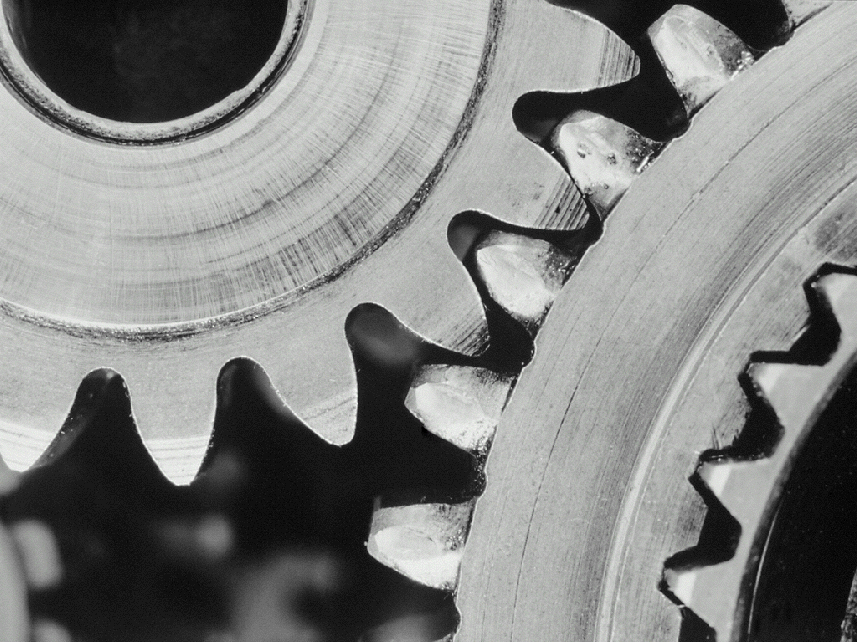



Industries
Steel Mill (Production Monitoring and Control)
Furniture (MRP)
ERP
Copyright © 1997-2004 Lexical Integration (M) Sdn Bhd Copyright © 2003-20087 AdrianHoe.com,AdaStar Informatics

Slide 39



Safety and Testing
Nuclear Power Plants
Pratt & Whitney
Copyright © 1997-2004 Lexical Integration (M) Sdn Bhd Copyright © 2003-2008 AdrianHoe.com,AdaStar Informatics

Slide 40



Medical
X-ray, CT scan, MRI
Heart pacer
Copyright © 1997-2004 Lexical Integration (M) Sdn Bhd Copyright © 2003-20087 AdrianHoe.com,AdaStar Informatics

Slide 41








Others
Pollution Monitoring
Video Security
Radio Telescope
Video Editing
Fault-Tolerant System
Sharp Zaurus-Mac OS X Sync Software
Network Cooperative Software Development Daemon (CVS)
Web Applications
Copyright © 1997-2004 Lexical Integration (M) Sdn Bhd Copyright © 2003-2008 AdrianHoe.com,AdaStar Informatics

Slide 42




Countries that use Ada
US, Canada, Mexico, Brazil
UK, France, Germany,Austria, Poland, Italy, Norway, Russia, Spain, Sweden, Switzerland, Belgium, Portugal, Finland
Japan, China, India, Pakistan, South Korea, Taiwan, Hong Kong,Vietnam, Singapore, Australia, Malaysia(?)
Copyright © 1997-2004 Lexical Integration (M) Sdn Bhd Copyright © 2003-2008 AdrianHoe.com,AdaStar Informatics

Slide 43







References
•
•
•
•
Steelman - Requirements for High Order Computer Languages, Department of Defense (http://www.xgc.com/manuals/steelman/t1.html)
Ada - DoD HOLWG, Col WM Whitaker, 1993 (http://archive.adaic.com/pol- hist/history/holwg-93/2.html)
A Review of Non-Ada to Ada Conversion (http://www.dacs.dtic.mil/techs/ada/ NONADA2ADA1.html)
Software Development Reengineering - An Experience Report,Adrian Hoe, 7th International Conference on Reliable Software Technologies,Ada-Europe 2002,Vienna,Austria (http://adrianhoe.com)
Copyright © 1997-2004 Lexical Integration (M) Sdn Bhd Copyright © 2003-2008 AdrianHoe.com,AdaStar Informatics

Slide 44





Q & A
Thank you!
Adrian Hoe adrianhoe.com adastarinformatics.com

